Slide 1
Quantum Technician Training
Brian Rashap, IoT and Quantum Educator
CNM Ingenuity
brashap@cnm.edu

Slide 2
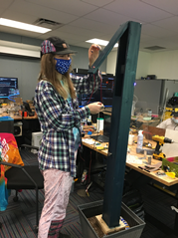
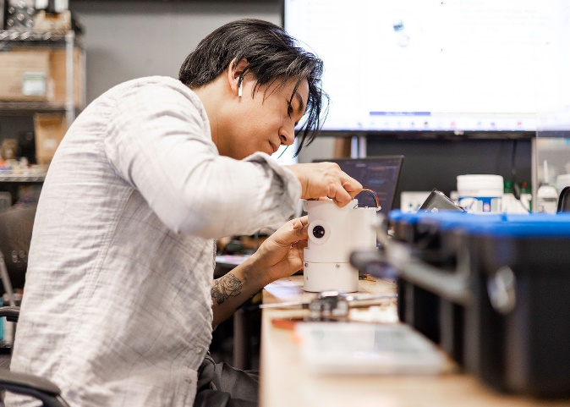
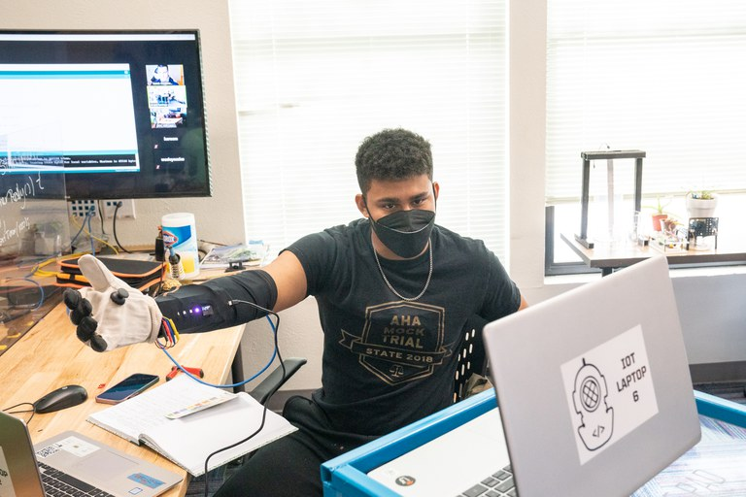
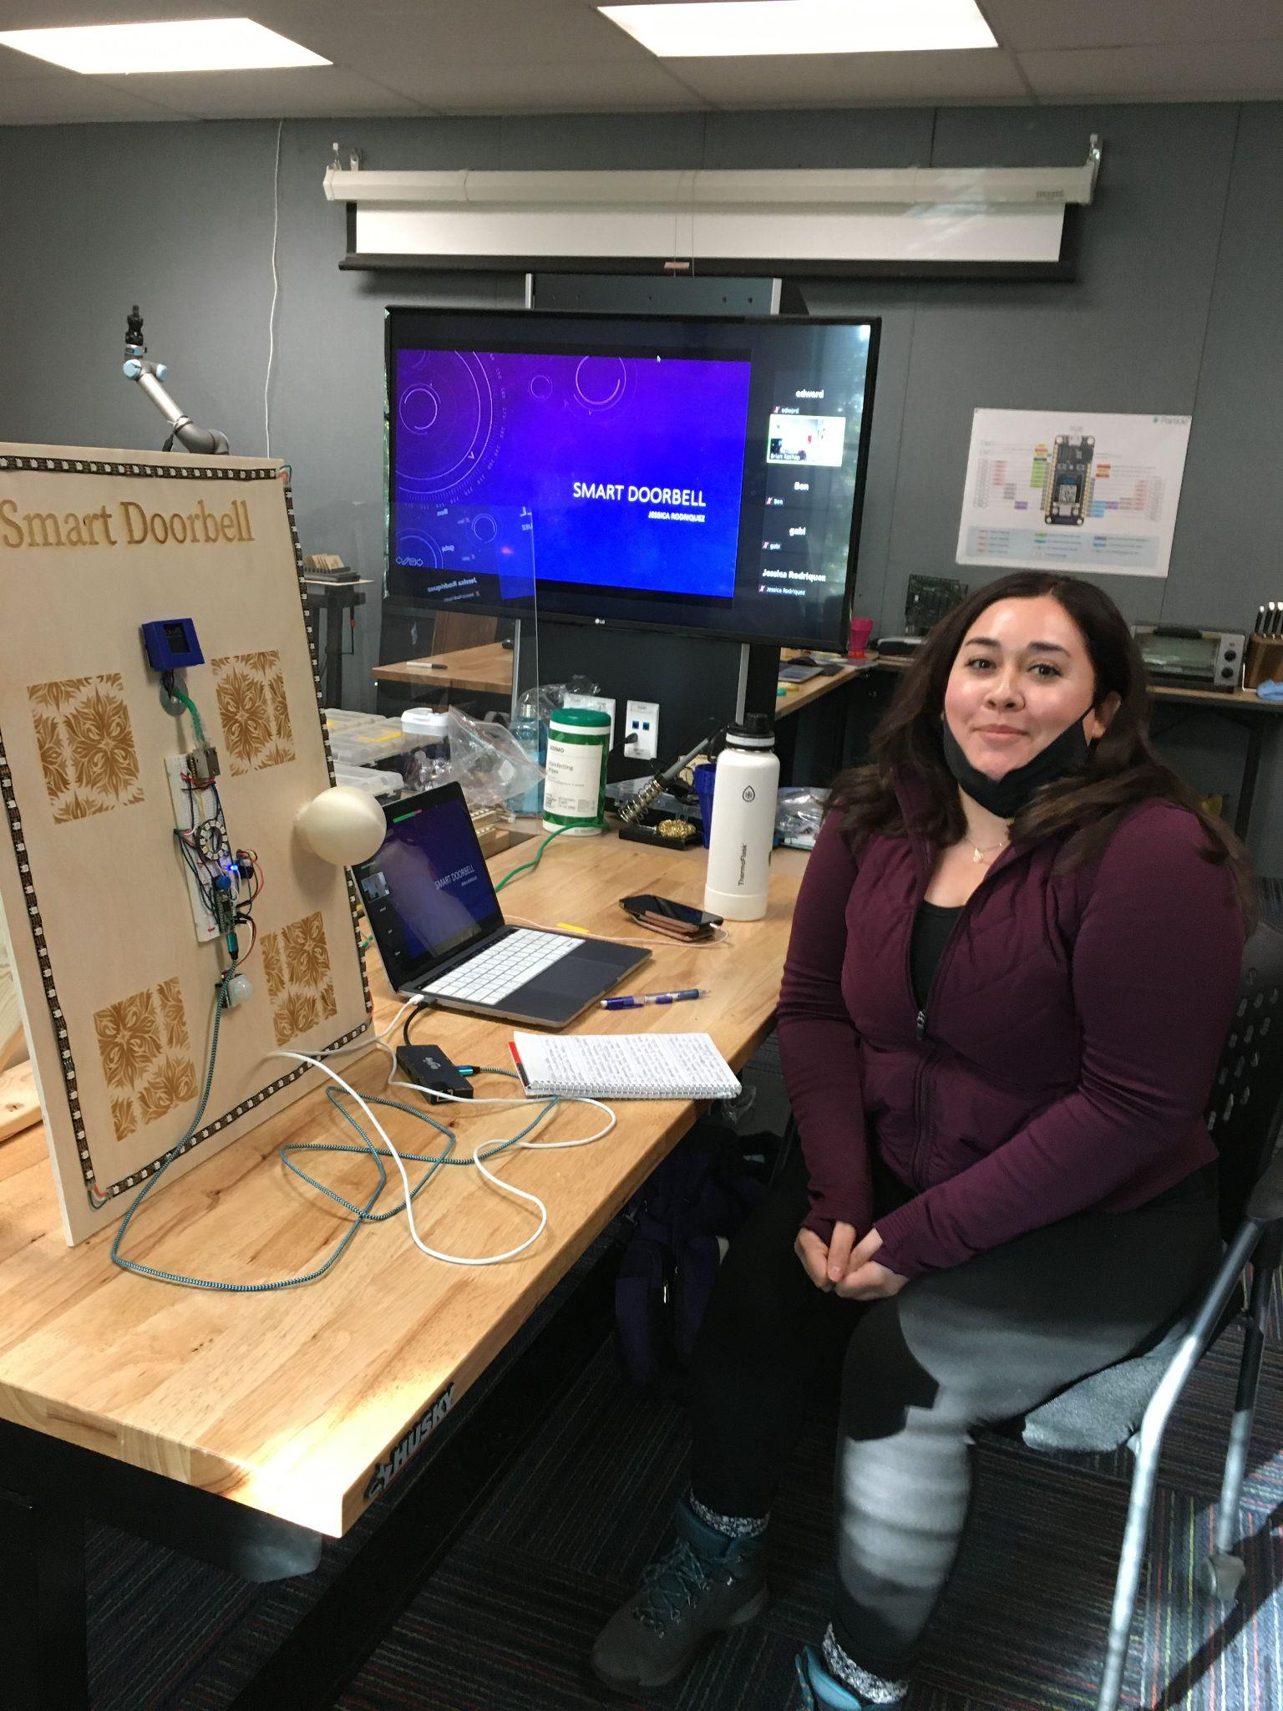
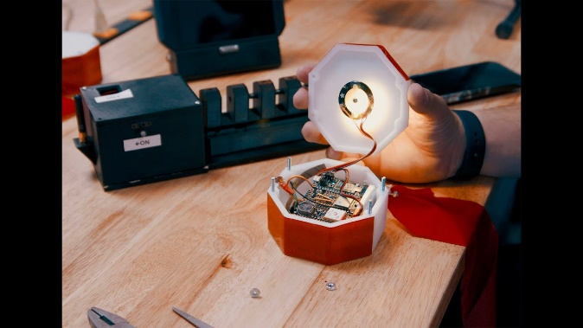
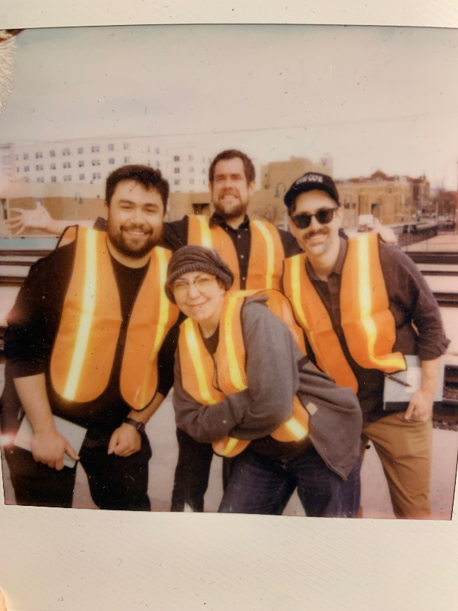
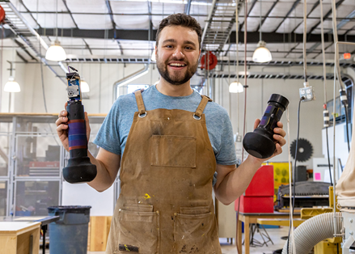
A bit about me and Ingenuity bootcamps
Former Intel General Manager
25+ years experience in semiconductor manufacturing
Teach Internet of Things bootcamp
10-week, full time, immersive training
Focus on career pivoters and those re-entering the workforce.
No prior technical experience needed
Placed graduates in entry (and more advanced) technical jobs in several dozen companies
Learn to prototype smart devices
C/C++ programming
Electrical circuit design
Computer Aid Design
Much more

Slide 3
Quantum Technician Training Bootcamp
Designing a workforce development program for Quantum Technicians with support from partners SNL and LANL.
Training will take place in the Quantum Learning Lab (QuLL) at CNM’s FUSE Makerspace.
In the process of developing curriculum for a 10-week bootcamp
Starting with Neutral Atom system
Course will contain technician skills around
Lasers and Optics
Vacuum Systems
Quantum Systems
Target to first offer in Spring semester 2025
Students will also get Credit for Prior Learning towards a CNM Engineering Technician certificate.
Future: make the QuLL available to others in the community for hands-on experience with Quantum systems.

