Slide 1
Veracity Forecasting Group Data Science Interview Problem Asset Utilization & Status Analysis
Brashon Ford

Slide 2
Business Problem & Objective
Objective: Understanding how assets are used, their status changes, facility efficiency.
Datasets Used:
Status Codes (Asset status updates)
Cycles (Utilization records)
Schedule (Facility activities)
Notes:
In this analysis, I examined asset usage in terms of cycles and hours. I also calculated the average daily utilization to identify which assets are being overused or underused. The goal is to determine how we can balance workloads to prevent excessive wear and improve productivity.

Slide 3
Data Overview
Number of Records: Cycle (37,514 entries) ; Status (1,146 entries) ; Schedule (594 entries).
Key Variables:
Facility
Serial No.
Activity Status
Usage Hours
Date

Slide 4
Data Overview
Data Cleaning & Preprocessing
Data cleaning and standardization
Joined datasets using SerialNo. and Facility.
Assuming the status persists until next record.

Slide 5
Key Metrics
Total:
Assets | 48
Facilities | 49
Activities | 24
Notes:
In this analysis, we examined asset usage in terms of cycles and hours. We also calculated the average daily utilization to identify which assets are being overused or underused. Our goal is to determine how we can balance workloads to prevent excessive wear and improve productivity.

Slide 6
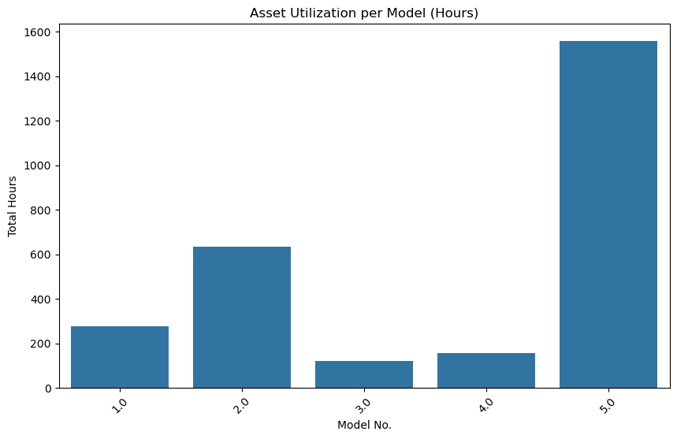
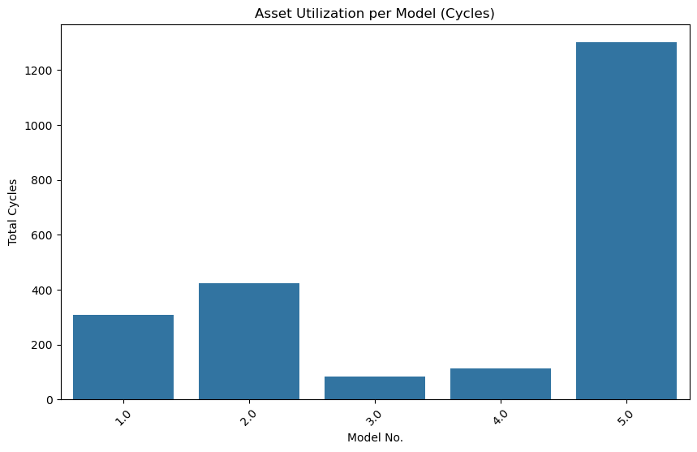
Utilization Analysis (Cycles & Hours)
Notes:
This is how I calculated the utilization:
# Identifying overutilized and underutilized assets
model_avg_usage = merged2_df.groupby('modelno')[['cycles', 'hours']].mean().reset_index()
overutilized_assets = asset_avg_usage[asset_avg_usage['cycles'] > 1.5 * model_avg_usage['cycles'].mean()]
underutilized_assets = asset_avg_usage[asset_avg_usage['cycles'] < 0.5 * model_avg_usage['cycles'].mean()]

Slide 7
Overutilized Assets By Serial No.
serialno | cycles | hours | avg_cycles_per_day | avg_hours_per_day
1 | 7.0 | 7.9 | 0.009421 | 0.010633
263 | 24.0 | 20.3 | 0.032301 | 0.027322
734 | 8.0 | 9.1 | 0.010767 | 0.012248
745 | 29.0 | 32.9 | 0.039031 | 0.044280
758 | 43.0 | 41.1 | 0.057873 | 0.055316
1155 | 117.0 | 131.3 | 0.157470 | 0.176716
1163 | 51.0 | 29.0 | 0.068641 | 0.039031
1169 | 3.0 | 9.6 | 0.004038 | 0.012921
1188 | 50.0 | 86.5 | 0.067295 | 0.116420
1244 | 133.0 | 108.3 | 0.179004 | 0.145760
1375 | 10.0 | 34.0 | 0.013459 | 0.045760
1387 | 35.0 | 42.0 | 0.047106 | 0.056528
1456 | 23.0 | 70.6 | 0.030956 | 0.095020
1712 | 12.0 | 23.0 | 0.016151 | 0.030956
1914 | 72.0 | 103.2 | 0.096904 | 0.138896
2034 | 3.0 | 3.9 | 0.004038 | 0.005249
2189 | 112.0 | 163.2 | 0.150740 | 0.219650
2402 | 6.0 | 9.8 | 0.008075 | 0.013190
2935 | 5.0 | 4.4 | 0.006729 | 0.005922
Notes:
Here I have displayed a table with the most overutilized assets, These assets have high cycle counts and operational hours, indicating that they are being used more than expected.
As we can see, serial numbers such as 1155, 1244, and 4756 stand out due to their significant usage. For instance, asset 4756 has recorded 342 cycles and over 383 operational hours, averaging approximately 0.46 cycles and 0.52 hours per day. Such high utilization rates may lead to faster wear and tear, potential breakdowns, and increased maintenance costs.

Slide 8
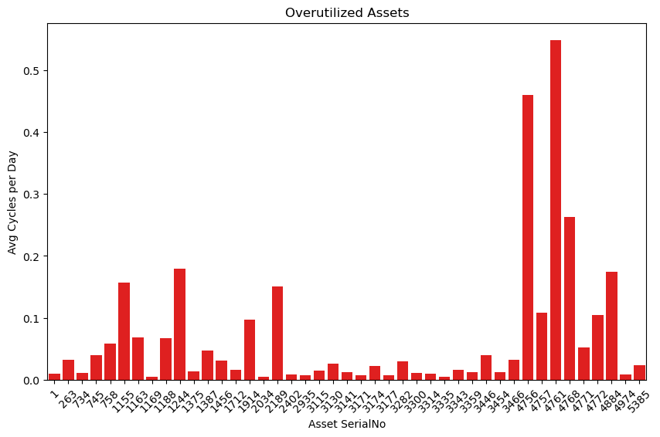
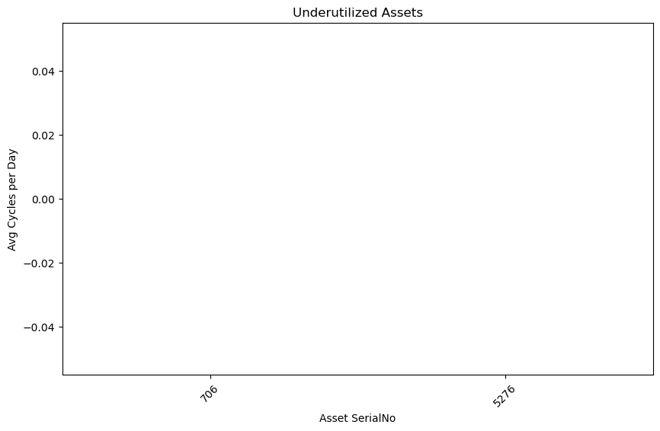
Overutilized & Underutilized Assets
Notes:
On the other hand, we also identified assets that are significantly underutilized. The table here shows assets that have either zero usage or very low cycle and hour counts. For example, assets 706 and 5276 show zero recorded usage, which suggests they might be sitting idle. This could indicate a potential opportunity to redistribute workload from overutilized assets or repurpose these underused assets for other tasks.

Slide 9
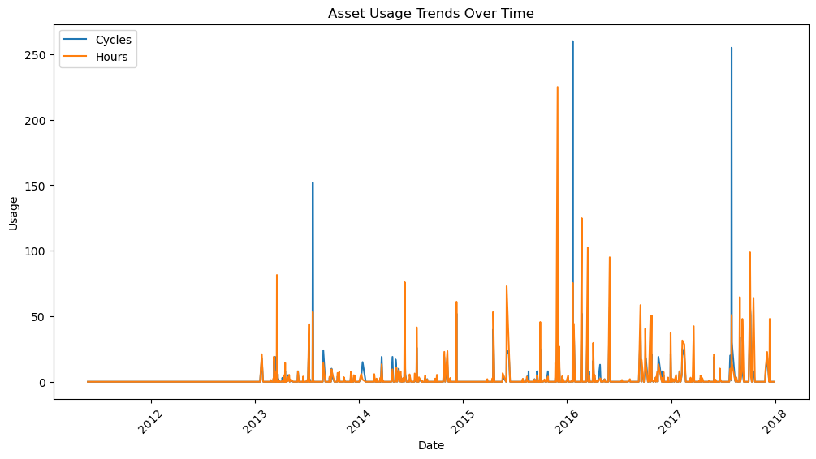
Time Based Trends – How asset usage changed over time.
Notes:
How I calculated average asste price :
# Average usage per asset
asset_avg_usage = merged2_df.groupby('serialno')[['cycles', 'hours']].sum().reset_index()
asset_avg_usage['avg_cycles_per_day'] = asset_avg_usage['cycles'] / merged2_df['date'].nunique()
asset_avg_usage['avg_hours_per_day'] = asset_avg_usage['hours'] / merged2_df['date'].nunique()
print("\nAverage Usage per Asset:")
print(asset_avg_usage.head())

Slide 10
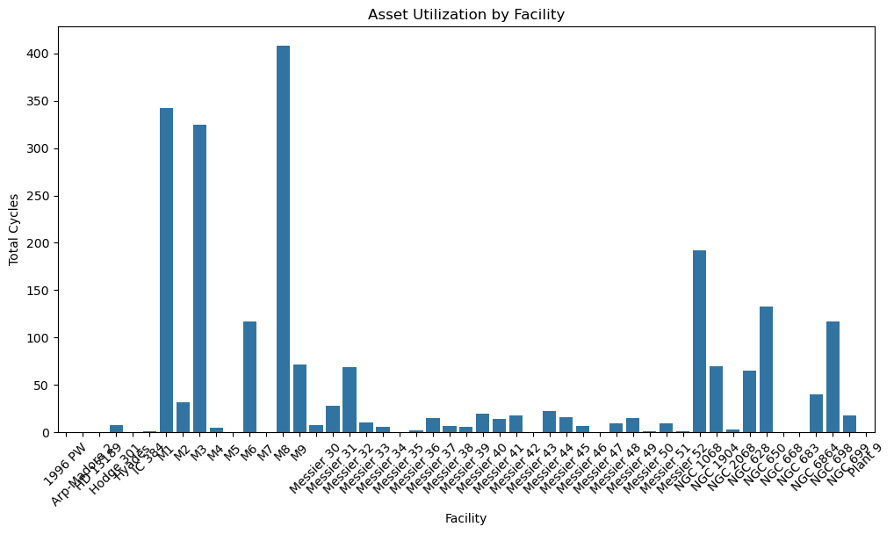
Facility Level Insights - Asset utilization per facility
Notes:
Facility M8 had the highest amount of total cycles

Slide 11
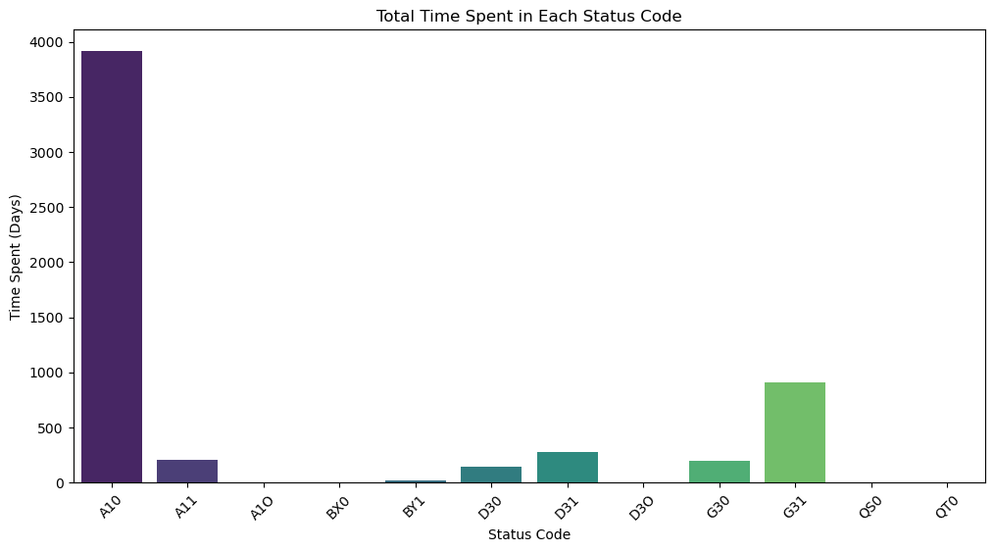
Lifecycle Analysis: Time spent in each status
Status Code | Days in Status
A10 | 3914
A11 | 209
A1O | 2
BX0 | 6
BY1 | 16
D30 | 142
D31 | 277
D3O | 2
G30 | 199
G31 | 908
QS0 | 1
QT0 | 1

Slide 12
Key Takeaways
From this analysis, I can conclude a few important points:
Certain assets are overworked and may require workload redistribution to avoid breakdowns.
Underutilized assets present an opportunity to optimize usage and improve efficiency.

Slide 13
Next Steps
Conduct a deeper analysis to determine why certain assets are overutilized or underutilized.
Implement workload balancing to ensure even distribution of asset usage.
Develop a thorough maintenance plan for high usage assets to reduce risk of failure.

