Slide 1
CS 455 - Computer Graphics
Ray Tracing Part I - The Basics

Slide 2
Ray Tracing
What is ray tracing?
  Follow (trace) the path of a ray of light and model how it interacts with the scene
  When a ray intersects an object, send off secondary rays (reflection, shadow, transmission) and determine how they interact with the scene
  Basic algorithm allows for:
    Hidden surface removal - Reflections
    Multiple light sources - Transparent refractions
    Hard shadows
  Extensions can achieve:
    Soft shadows - Motion blur
    Blurred reflections (glossiness) - Depth of field (finite apertures)
    Translucent refractions - and more

Slide 3
Ray Tracing
Produces Highly realistic scenes
Strengths:
  Specular reflections
  Transparency
Weaknesses:
  Color bleeding (diffuse reflections)
  Time consuming
References:
  “An Improved Illumination Model for Shaded Display,” Turner Whitted, CACM, June 1980.
  “Distributed Ray Tracing,” Cook, Porter, and Carpenter, Computer Graphics, July 1984, pp. 137-145.

Slide 4
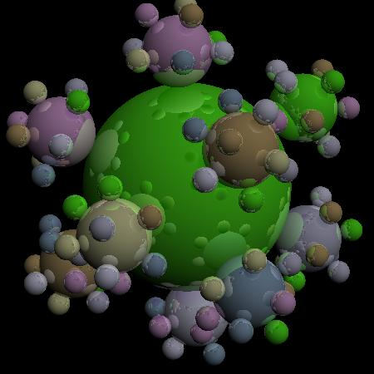
Ray traced images

Slide 5
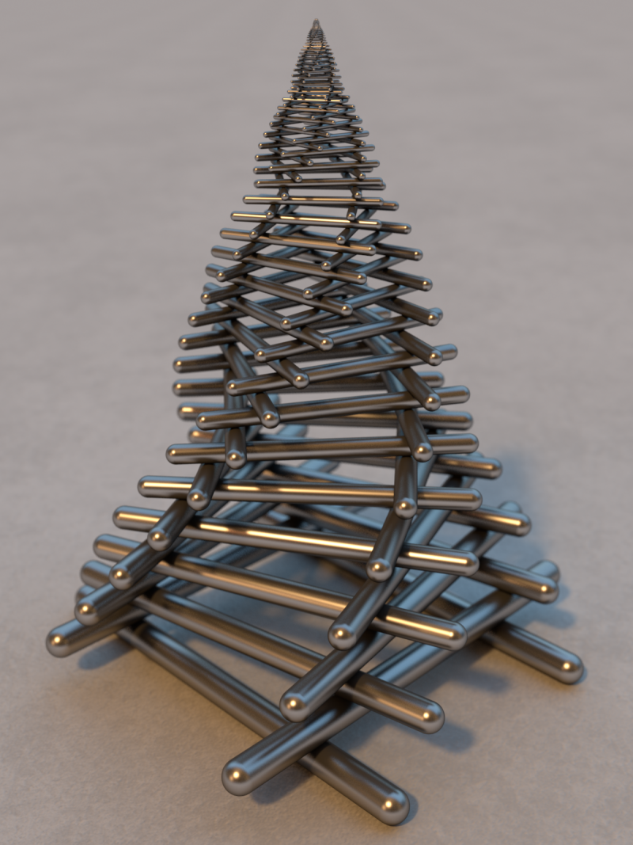

Slide 6
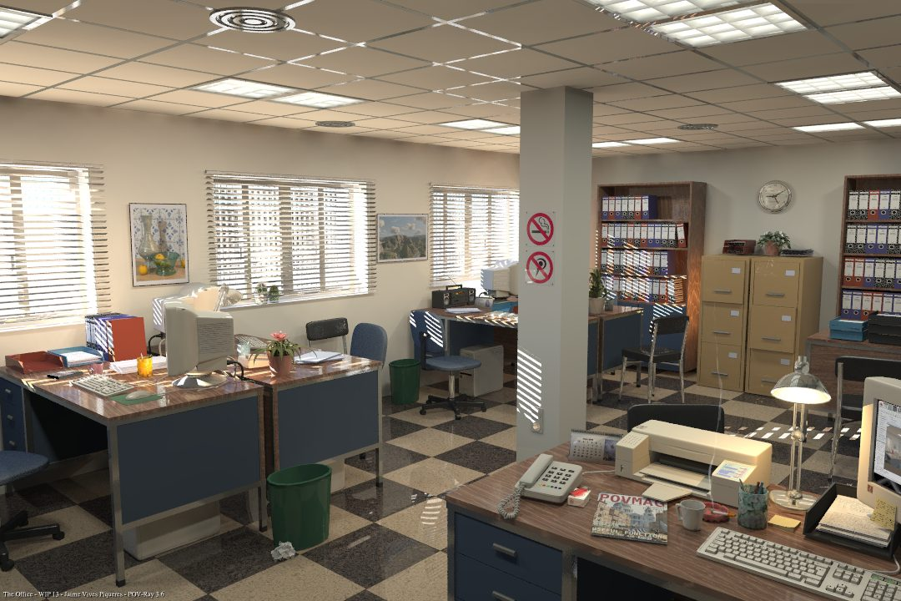

Slide 7
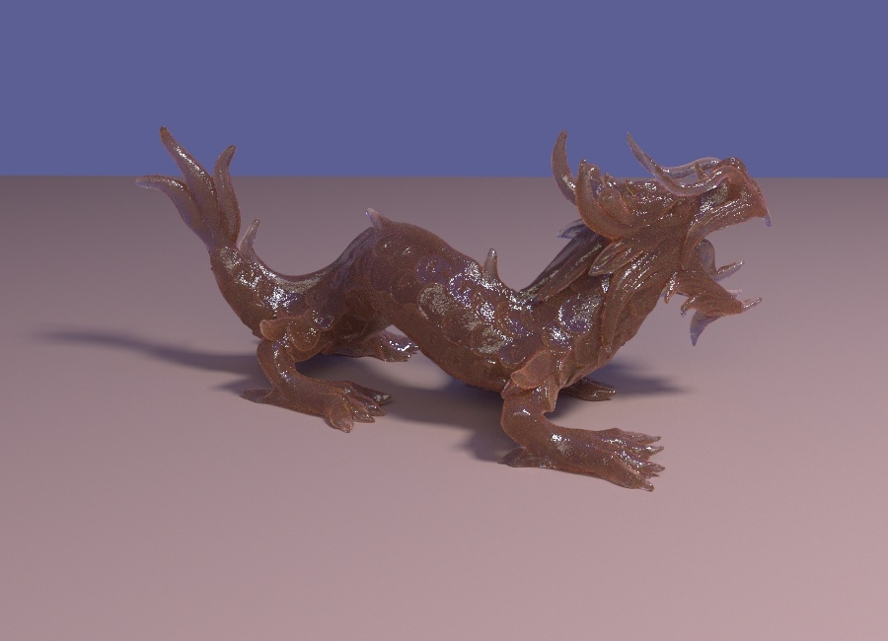

Slide 8
Ray Tracing
“Backward” ray tracing:
  Traces the ray forward (in time) from the light source through potentially many scene interactions
  Physically based
  Global illumination model:
    Color bleeding
    Caustics
    Etc.
  Problem: most rays will never
  even get close to the eye
  Very inefficient since it computes
  many rays that are never seen
Light
Eye
Image plane

Slide 9
Ray Tracing
“Forward” ray tracing:
  Traces the ray backward (in time) from the eye, through a point on the screen
  Not physically based
  Doesn’t properly model:
    Color bleeding
    Caustics
    Other changes in light intensity and
    color due to refractions and
    non-specular reflections
  More efficient: computes only
  visible rays (since we start at eye)
  Generally, ray tracing refers to forward ray tracing
Light
Eye
Image plane

Slide 10

Ray Tracing
Ray tracing is an image-precision algorithm: Visibility determined on a per-pixel basis
  Trace one (or more) rays per pixel
  Compute closest object (triangle,
  sphere, etc.) for each ray
Produces realistic results
Computationally expensive
6000x8000
“couple of days”

Slide 11
Minimal Ray Tracer
A basic (minimal) ray tracer is simple to implement:
  The code can even fit on a 3×5 card (code courtesy of Paul Heckbert with a small change to output as a PPM file):
typedef struct{double x,y,z}vec;vec U,black,amb={.02,.02,.02};struct sphere{
vec cen,color;double rad,kd,ks,kt,kl,ir}*s,*best,sph[]={0.,6.,.5,1.,1.,1.,.9,
.05,.2,.85,0.,1.7,-1.,8.,-.5,1.,.5,.2,1.,.7,.3,0.,.05,1.2,1.,8.,-.5,.1,.8,.8,
1.,.3,.7,0.,0.,1.2,3.,-6.,15.,1.,.8,1.,7.,0.,0.,0.,.6,1.5,-3.,-3.,12.,.8,1.,
1.,5.,0.,0.,0.,.5,1.5,};yx;double u,b,tmin,sqrt(),tan();double vdot(A,B)vec A
,B;{return A.x*B.x+A.y*B.y+A.z*B.z;}vec vcomb(a,A,B)double a;vec A,B;{B.x+=a*
A.x;B.y+=a*A.y;B.z+=a*A.z;return B;}vec vunit(A)vec A;{return vcomb(1./sqrt(
vdot(A,A)),A,black);}struct sphere*intersect(P,D)vec P,D;{best=0;tmin=1e30;s=
sph+5;while(s-->sph)b=vdot(D,U=vcomb(-1.,P,s->cen)),u=b*b-vdot(U,U)+s->rad*s
->rad,u=u>0?sqrt(u):1e31,u=b-u>1e-7?b-u:b+u,tmin=u>=1e-7&&u<tmin?best=s,u:
tmin;return best;}vec trace(level,P,D)vec P,D;{double d,eta,e;vec N,color;
struct sphere*s,*l;if(!level--)return black;if(s=intersect(P,D));else return
amb;color=amb;eta=s->ir;d= -vdot(D,N=vunit(vcomb(-1.,P=vcomb(tmin,D,P),s->cen
)));if(d<0)N=vcomb(-1.,N,black),eta=1/eta,d= -d;l=sph+5;while(l-->sph)if((e=l
->kl*vdot(N,U=vunit(vcomb(-1.,P,l->cen))))>0&&intersect(P,U)==l)color=vcomb(e
,l->color,color);U=s->color;color.x*=U.x;color.y*=U.y;color.z*=U.z;e=1-eta*
eta*(1-d*d);return vcomb(s->kt,e>0?trace(level,P,vcomb(eta,D,vcomb(eta*d-sqrt
(e),N,black))):black,vcomb(s->ks,trace(level,P,vcomb(2*d,N,D)),vcomb(s->kd,
color,vcomb(s->kl,U,black))));}main(){puts(“P3\n32 32\n255”);while(yx<32*32)
U.x=yx%32-32/2,U.z=32/2-yx++/32,U.y=32/2/tan(25/114.5915590261),U=vcomb(255.,
trace(3,black,vunit(U)),black),printf("%.0f %.0f %.0f\n",U);}/*minray!*/

Slide 12
Minimal Ray Tracer
This code implements:
  Multiple spheres (with
  different properties)
  Multiple levels of
  recursion:
    Reflections
  Transparency:
    Refraction
  One point light source:
    Hard shadows
  Hidden surface removal
  Phong illumination model
  It even has a comment
typedef struct{double x,y,z}vec;vec U,black,amb={.02,.02,.02};struct sphere{
vec cen,color;double rad,kd,ks,kt,kl,ir}*s,*best,sph[]={0.,6.,.5,1.,1.,1.,.9,
.05,.2,.85,0.,1.7,-1.,8.,-.5,1.,.5,.2,1.,.7,.3,0.,.05,1.2,1.,8.,-.5,.1,.8,.8,
1.,.3,.7,0.,0.,1.2,3.,-6.,15.,1.,.8,1.,7.,0.,0.,0.,.6,1.5,-3.,-3.,12.,.8,1.,
1.,5.,0.,0.,0.,.5,1.5,};yx;double u,b,tmin,sqrt(),tan();double vdot(A,B)vec A
,B;{return A.x*B.x+A.y*B.y+A.z*B.z;}vec vcomb(a,A,B)double a;vec A,B;{B.x+=a*
A.x;B.y+=a*A.y;B.z+=a*A.z;return B;}vec vunit(A)vec A;{return vcomb(1./sqrt(
vdot(A,A)),A,black);}struct sphere*intersect(P,D)vec P,D;{best=0;tmin=1e30;s=
sph+5;while(s-->sph)b=vdot(D,U=vcomb(-1.,P,s->cen)),u=b*b-vdot(U,U)+s->rad*s
->rad,u=u>0?sqrt(u):1e31,u=b-u>1e-7?b-u:b+u,tmin=u>=1e-7&&u<tmin?best=s,u:
tmin;return best;}vec trace(level,P,D)vec P,D;{double d,eta,e;vec N,color;
struct sphere*s,*l;if(!level--)return black;if(s=intersect(P,D));else return
amb;color=amb;eta=s->ir;d= -vdot(D,N=vunit(vcomb(-1.,P=vcomb(tmin,D,P),s->cen
)));if(d<0)N=vcomb(-1.,N,black),eta=1/eta,d= -d;l=sph+5;while(l-->sph)if((e=l
->kl*vdot(N,U=vunit(vcomb(-1.,P,l->cen))))>0&&intersect(P,U)==l)color=vcomb(e
,l->color,color);U=s->color;color.x*=U.x;color.y*=U.y;color.z*=U.z;e=1-eta*
eta*(1-d*d);return vcomb(s->kt,e>0?trace(level,P,vcomb(eta,D,vcomb(eta*d-sqrt
(e),N,black))):black,vcomb(s->ks,trace(level,P,vcomb(2*d,N,D)),vcomb(s->kd,
color,vcomb(s->kl,U,black))));}main(){puts(“P3\n32 32\n255”);while(yx<32*32)
U.x=yx%32-32/2,U.z=32/2-yx++/32,U.y=32/2/tan(25/114.5915590261),U=vcomb(255.,
trace(3,black,vunit(U)),black),printf("%.0f %.0f %.0f\n",U);}/*minray!*/

Slide 13
Ray Tracing: Types of Rays
Primary rays:
  Sent from the eye, through the image plane, and into the scene
  May or may not intersect an object in the scene:
    No intersection → set pixel color to
    background color
    Intersects object → send out
    secondary rays and compute
    lighting model
Light
Opaque object
P₁
Transparent object
P₂
Eye

Slide 14
Ray Tracing: Types of Rays
Secondary Rays:
  Sent from the point at which the
  ray intersects an object
Multiple types:
Light
Transmission (T): sent in the direction of refraction
S₂
S₃
Reflection (R): sent in the direction of reflection, and used in the Phong illumination model
R₂
T₂
S₁
T₁
R₁
R₃
Opaque object
Shadow (S): sent toward a light source to determine if point is in shadow or not.
Transparent object
P
Eye

Slide 15
Ray Tracing: Types of Rays
Light
P → Primary rays
R → Reflected rays
T → Transmitted rays
S → Shadow rays
S₂
S₃
R₂
T₂
S₁
T₁
R₁
R₃
Opaque object
Transparent object
P
Eye

Slide 16
Ray Tracing: Ray Tree
Each intersection may spawn secondary rays:
  Rays form a ray tree
  Nodes → Intersection points
  Edges → Reflected/transmitted ray
Rays are recursively spawned until:
  Ray does not intersect any object
  Tree reaches a maximum depth
  Light reaches some minimum value
Shadow rays are sent from every intersection point (to determine if point is in shadow), but they do not recursively spawn secondary rays

Slide 17
Ray Tracing: Ray Tree Example
Eye
Light
P
S₂
S₃
O₁
R₂
O₃
T₂
R₁
T₁
S₁
T₁
O₂
R₁
O₁
R₃
O₂
O₁
Opaque object
Transparent object
R₂
R₃
T₂
P
BG
O₁
BG
Eye
Ray tree is evaluated from bottom up:
  Depth-first traversal
  Each node’s color is calculated as a function of its children’s colors

Slide 18
Basic Ray Tracing Algorithm
Generate one ray for each pixel
For each ray:
  Determine the nearest object intersected by the ray
  Compute intensity information for the intersection point using the illumination model
  Calculate and trace reflection ray (if surface is reflective)
  Calculate and trace transmission ray (if surface is transparent)
  Calculate and trace shadow ray
  Combine results of the intensity computation, reflection ray intensity, transmission ray intensity, and shadow ray information
  If the ray misses all objects, set the pixel color to the background color

Slide 19
2D Ray Tracing Demo

Slide 20
Tracing Rays
Basic (non-recursive) ray tracing algorithm:
  1. Send a ray from the eye through the screen
  2. Determine which object that ray first intersects
  3. Compute pixel color
Most (approx. 75%) of the time in step 2:
  Simple method:
    Compare every ray against every object and remember the closest object hit by each ray
  Very time consuming:
    Several optimizations possible

Slide 21
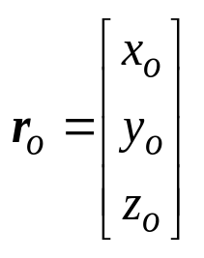
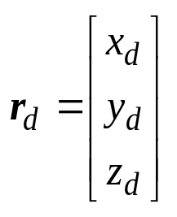
Ray Representation
A ray can be represented explicitly (in parametric form) as an origin (point) and a direction (vector):
  Origin:
  Direction:
The ray consists of all points:
  r(t) = r_{o} + r_{d}t
r(3)
r(2)
r_{o} + r_{d} = r(1)
r_{o} = r(0)
r(–1)

Slide 22
Viewing Ray
The primary ray (or viewing ray) for a point s on the view plane (i.e., screen) is computed as:
  Origin: r_{o} = eye
  Direction: r_{d} = s – eye
Which coordinate space?
  Want to define rays in terms of world-space coods (x, y, z)
  Eye is already specified in terms of (x, y, z) position
  Screen point s is easiest to define in terms of where it is on the window in viewing-space coordinates (u, v, w)
s
r_{d} = s – eye
r_{o} = eye
Window

Slide 23
Viewing Ray: Screen Point
Given:
  Our scene in world-coordinates
  A camera (eye) position in world-coordinates (x, y, z)
  A pixel (i, j) in the viewport
We need to:
  Compute the point on the view plane window that corresponds to the (i, j) point in the viewport
  Transform that point into world-coordinates

Slide 24
View-reference coordinates
v
y
LookAt point
LookFrom point
w
x
u
z
World coordinates
View reference coordinates

Slide 25
View-reference Window
v
Window
(u_{max}, v_{max})
LookAt point
LookFrom point
u
(u_{min}, v_{min})
w
View reference coordinates

Slide 26
Viewport
(i_{max}, j_{max})
(i, j)
(i_{min}, j_{min})

Slide 27
Computing Window Point
Step 1: Reverse the Window-to-Viewport transformation
v
(i, j)
(u, v, 0)
u
w
Viewport
View Reference coordinates

Slide 28
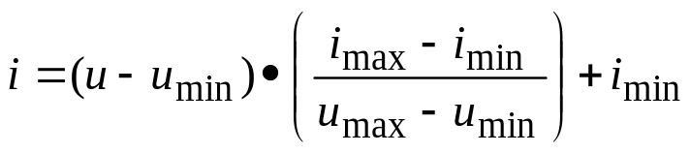
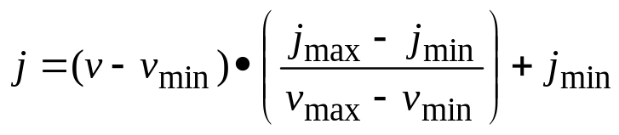
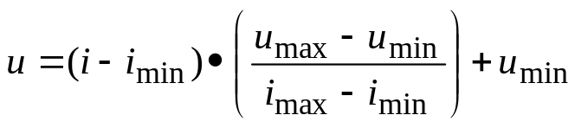
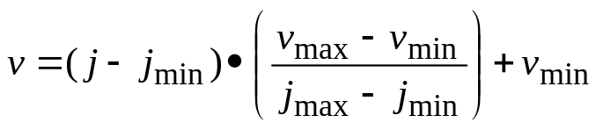

Viewport-Window transform
Window-viewport:
Inverse transform (viewport-window)

Slide 29
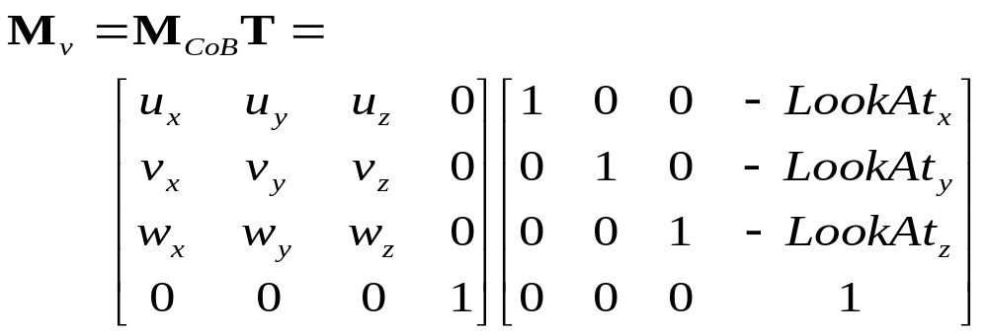
View-reference to World transform
Given the screen point in terms of viewing-space coordinates (u, v, w), transform to world-space (x, y, z):
  The viewing transform takes a point from world space to view space:
y
v
s
w
Window
u
x
z

Slide 30
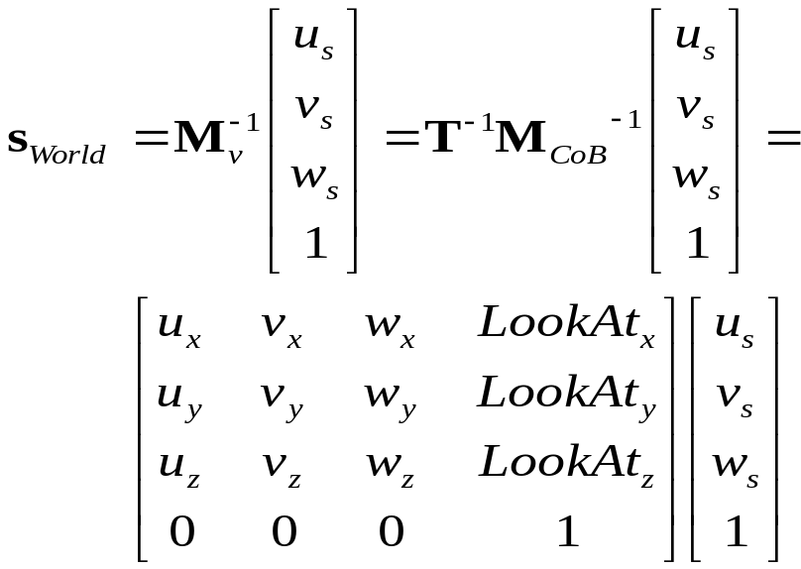
View-reference to World transform
Given the screen point in terms of viewing-space coordinates (u, v, w), transform to world-space (x, y, z):
  We want to reverse this:
  or
  s_{World} = LookAt + u_{s}u + v_{s}v + w_{s}w
y
v
s
w
Window
u
x
z

