Slide 1
CS 455 – Computer Graphics
Ray-Object Intersections

Slide 2
Curve and Surface Types
Implicit
  f(x, y) = 0
  plug in an (x, y) point
    if f = 0, the point is on the surface
    if f < 0, the point is inside the object
    if f > 0, the point is outside the object
  easy to determine if a specific point is on the surface
  difficult to find all surface points, for example
parametric
  (x, y) = f(t) - for a 2D curve
  (x, y, z) = f(t) - for a 3D surface
  easy to get all points on the curve (or surface)
  difficult to determine if a specific point is on the curve (or surface)

Slide 3
Ray-Object Intersections
Many objects can be represented as implicit surfaces:
  Sphere (with center at c and radius R): f_{sphere}(p) = ||p – c||² - R² = 0
  Plane (with normal n and distance to origin d): f_{plane}(p) = p · n + D = 0
To determine where a ray intersects an object:
  Need to find the intersection point p of the ray and the object
  The ray is represented explicitly in parametric form:
  r(t) = r_{o} + r_{d}t
  Plug the ray equation into the surface equation and solve for t:
  f(r(t)) = 0
  Substitute t back into ray equation to find intersection point p:
  p = r(t) = r_{o} + r_{d}t

Slide 4
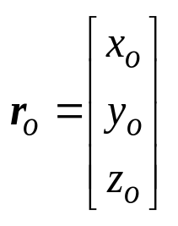
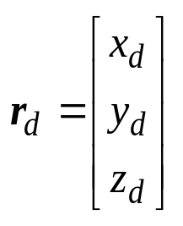
Recall: Ray Representation
A ray can be represented explicitly (in parametric form) as an origin (point) and a direction (vector):
  Origin:
  Direction:
The ray consists of all points:
  r(t) = r_{o} + r_{d}t
r(3)
r(2)
r_{o} + r_{d} = r(1)
r_{o} = r(0)
r(–1)

Slide 5
Ray-Sphere Intersections
To find the intersection points of a ray with a sphere:
  Sphere is represented as:
    center (point): S_{c} = (x_{c}, y_{c}, z_{c})
    and a radius (float): r
  The surface of the sphere is the set of all points (x, y, z) such that:
    (x-x_{c})² + (y - y_{c})² + (z - z_{c})² = r²
  In this form (implicit form), it is difficult to directly generate surface points
  However, given a point, it is easy to see if the point lies on the surface
  To solve the ray-surface intersection, substitute the ray equation into the sphere equation.

Slide 6
Ray-Sphere Intersections
First, split the ray into its component equations:
  x = x_{o} + x_{d}t
  y = y_{o} + y_{d}t
  z = z_{o} + z_{d}t
Next substitute the ray equation into the sphere equation:
    (x-x_{c})² + (y - y_{c})² + (z - z_{c})² = r²
Giving:
    (x_{o} + x_{d}t - x_{c})² + (y_{o} + y_{d}t - y_{c})² + (z_{o} + z_{d}t - z_{c})² = r²

Slide 7
Ray-Sphere Intersections
Next, simplify the equation:
    (x₀ + x_{d}t - x_{c})² + (y₀ + y_{d}t - y_{c})² + (z₀ + z_{d}t - z_{c})² = r²
⇒(x_{d}² + y_{d}² + z_{d}²)t² +
2(x_{d}x_{o} - x_{d}x_{c}+ y_{d}y_{o} - y_{d}y_{c}+ z_{d}z_{o} - z_{d}z_{c})t +
(x_{o}²- 2x_{o}x_{c}+ x_{c}²+ y_{o}²- 2y_{o}y_{c}+ y_{c}²+ z_{o}²-2z_{o}z_{c}+ z_{c}²)
= r²

Slide 8
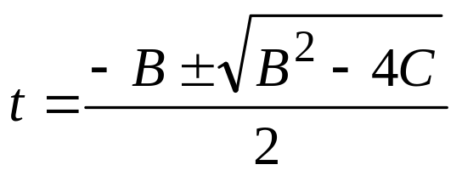
Ray-Sphere Intersections
Let
A = x_{d}² + y_{d}² + z_{d}² = 1
B = 2(x_{d}x_{o} - x_{d}x_{c}+ y_{d}y_{o} - y_{d}y_{c}+ z_{d}z_{o} - z_{d}z_{c})
C = x_{o}²- 2x_{o}x_{c}+ x_{c}²+ y_{o}²- 2y_{o}y_{c}+ y_{c}²+ z_{o}²-2z_{o}z_{c}+ z_{c}² - r²
Then
At² + Bt + C = 0
Then solve using the quadratic equation:

Slide 9
Ray-Sphere Intersections
3 possibilities:
  Case 1: Discriminant = 0
    One real root
      t₀ = t₁ = -B/2
  Case 2: Discriminant < 0
    Zero real roots
  Case 3: Discriminant > 0
    Two real roots
    Subcase a: t₀ < 0, t₁ > 0
      t₁ is the correct answer
    Subcase b: t₀ > 0, t₁ > 0
      t₀ is the correct answer
case 1
case 2
case 3a
case 3b

Slide 10
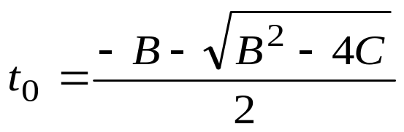
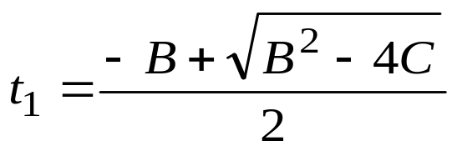
Ray-Sphere Intersections
If the discriminant is negative, the ray misses the sphere
The smaller positive root (if one exists) is the closer intersection point
We can save some computation time by computing the smaller root first, then only computing the second root if necessary

Slide 11
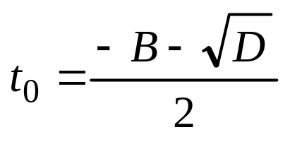
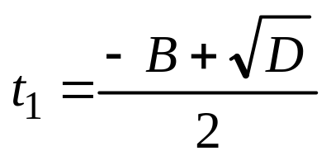
Ray-Sphere Intersections: Algorithm
Algorithm for ray-sphere intersection:
  1. Calculate B and C of the quadratic
  2. Calculate the discriminant: D = B² – 4C
  3. If D < 0 return false (no intersection point)
  4. Calculate smaller intersection parameter t₀:
  5. If t₀ ≤ 0 then calculate larger t-value t₁:
  6. If t₁ ≤ 0 return false (intersection point behind ray)
  7. else set t = t₁
  8. else set t = t₀
  9. Return intersection point: p = r(t) = r_{o} + r_{d}t

Slide 12
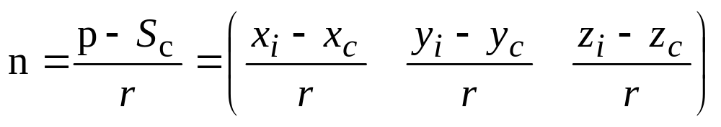
Ray-Sphere Intersections: Normal
The normal n at an intersection point p on a sphere is:
n
p
r
c

Slide 13
Ray-Sphere Intersections
Computation time:
  17 adds/subtracts
  17 multiplies
  1 square root
for each ray/sphere test
Can we reduce the number of intersection calculations?
  use a geometric approach

Slide 14
Ray-Sphere Intersections - Geometric
t_{ca}
t_{hc}
d
S_{c}
OC
r₀

Slide 15
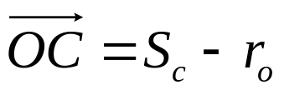
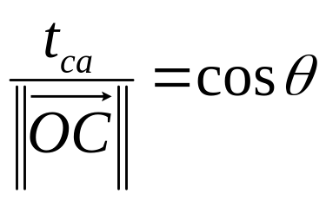
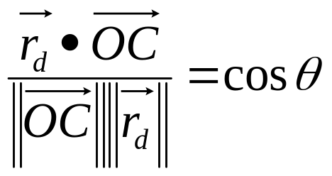
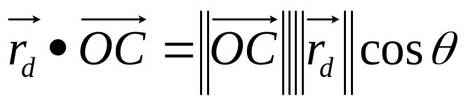
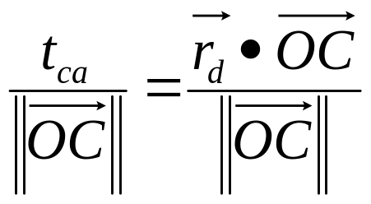
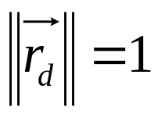
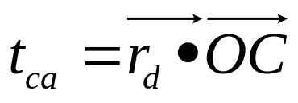
Ray-Sphere Intersections - Geometric
What is OC?
What is t_{ca}?
t_{ca}
t_{hc}
d
OC
S_{c}
r₀
by the Law of Cosines, and
so:
with:
so:
hence:

Slide 16
Ray-Sphere Intersections - Geometric
Determine whether the ray’s origin is outside the sphere
  if ║ S_{c} - r₀ ║ < r, then the point is inside the sphere
  Call the vector between r₀ and S_{c} OC
Find the closest approach of the ray to the sphere’s center.
  let d = distance from S_{c} to the ray
  let t_{ca} = distance from r₀ to closest approach of ray to S_{c}
  t_{ca} = r_{d} • OC
t_{ca}
t_{hc}
d
OC
S_{c}
r₀

Slide 17
Ray-Sphere Intersections - Geometric
If t_{ca} < 0 and r₀ lies outside the sphere, the ray does not intersect the sphere
Otherwise, compute t_{hc}, the distance from the closest approach to the sphere’s surface
  t_{hc}² = r² - d²
  d² = ||OC||² - t_{ca}², so
  t_{hc}² = r² - ||OC||² + t_{ca}²
t_{ca}
t_{hc}
d
OC
S_{c}
r₀

Slide 18
Ray-Sphere Intersections - Geometric
If t_{hc}² < 0 the ray does not intersect the sphere
Otherwise, calculate the intersection distance
  If r₀ is outside the sphere:
  t = t_{ca} - t_{hc}
  If r₀ is inside the sphere:
  t = t_{ca} + t_{hc}
t_{ca}
t_{hc}
d
OC
S_{c}
r₀

Slide 19
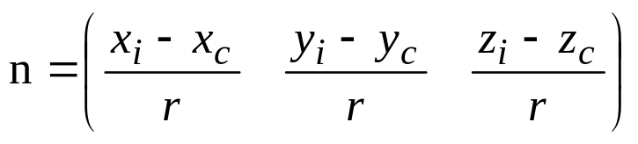
Ray-Sphere Intersections - Geometric
Calculate the intersection point:
  (x_{i}, y_{i}, z_{i}) =
  (x_{o} + x_{d}t, y_{o} + y_{d}t, z_{o} + z_{d}t)
Calculate the normal at the intersection point:
This reduces the computation (worst case) by 4 multiplies and 1 add
Even fewer computations if the ray misses the sphere
t_{ca}
t_{hc}
d
OC
S_{c}
r₀

Slide 20
Ray-Plane Intersections
To find the intersection points of a ray with an infinite plane:
  Ray equation:
    Origin: r_{o} = (x_{o}, y_{o}, z_{o})
    Direction: r_{d} = (x_{d}, y_{d}, z_{d})
  Plane equation:
    ax +by +cz +d = 0
    with a² + b² +c² = 1
    normal vector p_{n} = (a, b, c)
    distance from (0, 0, 0) to plane is d
Substitute the ray equation into the plane equation:
  a(x₀ + x_{d}t) + b(y₀ + y_{d}t) + c(z₀ + z_{d}t) + d = 0
  ⇒ ax₀ + ax_{d}t + by₀ + by_{d}t + cz₀ + cz_{d}t + d = 0
  Solving for t we get:
t = -(ax₀ + by₀ + cz₀ + d) / (ax_{d} + by_{d} + cz_{d})

Slide 21
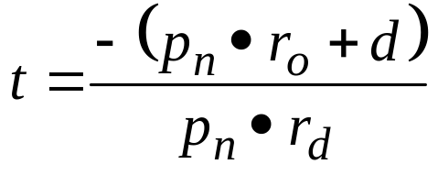


Ray-Plane Intersections
In vector form we have:
If the ray is parallel to the plane and does not intersect
If the normal of the plane is pointing away from the ray, and thus the plane is culled
If t ≤ 0 then intersection point is behind the ray, so no real intersection occurs
Otherwise, compute intersection point: p = r_{o} + r_{d}t

Slide 22
Ray/Plane Intersection
Basic Algorithm:
compute v_{d} = p_{n} · r_{d}
if v_{d} ≥ 0 and 1 sided plane then return
if v_{d} = 0 then return (ray parallel to plane)
compute v_{o} = -(p_{n} · r_{o} + d)
compute t = v_{o} / v_{d}
if t < 0 return
if v_{d} > 0 reverse the plane’s normal
return r = (x_{o} + x_{d}t, y_{o} + y_{d}t, z_{o} + z_{d}t)

Slide 23
Ray/Polygon Intersection
Assume planar polygons
First perform the ray/plane intersection with the plane in which the polygon lies
Next, determine whether the intersection point lies within the polygon
How do we quickly tell whether the point lies within the polygon?

Slide 24
Ray/Polygon Intersection
Idea: shoot a ray from the intersection point in an arbitrary direction
  if the ray crosses an even number of polygon edges, the point is outside the polygon
  if the ray crosses an odd number of polygon edges, the point is inside the polygon
11 crossings -
point inside
polygon
4 crossings -
point outside
polygon

Slide 25
Ray/Polygon Intersection
Polygon:
  a set of N points G_{n} = (x_{n}, y_{n}, z_{n}), n = 0, 1, … N-1
Plane:
  Ax + By + Cz + D = 0, with normal P_{n} = (A, B, C)
Intersection point:
  R_{i} = (x_{i}, y_{i}, z_{i}), R_{i} on the plane

Slide 26
Ray/Polygon Intersection Algorithm
Step 1:
  Project the polygon onto a 2D plane
    one of the coordinate planes
    simply discard one of the coordinates
    this will project the polygon onto the plane defined by the other two coordinates
    topology preserving but not area preserving
    throw away the coordinate whose magnitude in the plane normal is greatest
    e.g., if P_{n} = (3, -1, -5) we would throw away all z coordinates

Slide 27
Ray/Polygon Intersection Algorithm
Step 2:
  Translate the polygon so that the intersection point is at the origin
    apply this translation to all points in the polygon
Step 3:
  Send a ray down one of the coordinate axes and count the number of intersections of that ray with the polygon
    This is done in practice by looking at each polygon edge, one at a time, to see if it crosses the coordinate axis

Slide 28
Ray/Polygon Intersection Algorithm
Problems:
  Vertices that lie exactly on the ray
  Edges that lie exactly on the ray

Slide 29
Ray/Polygon Intersection Algorithm
How do we handle these cases?
  In essence, shift the vertex or edge up by ε so that it will lie in the plane just above the axis
  This is done by checking for a y value > 0
What about if the intersection point is exactly a vertex?
  Perform a similar ε shift
What if the intersection point lies exactly on an edge?
  Specify it as either in or out - as long as we do the specification consistently, it will work okay
  If the edge is shared by two polygons, the point will be “in” one polygon and “out” of the other.

Slide 30
Ray/Polygon Intersection Algorithm
The effect of doing this ε shift is:
These cases all work correctly now.

Slide 31
The Actual Algorithm - part 1
  Determine the dominant coordinate as the largest magnitude component of P_{n}
  For each vertex (x_{n}, y_{n}, z_{n}), n = 0, 1, …, N-1 of the polygon, project the vertex onto the dominant coordinate axis, giving (u_{n}, v_{n}) vertices.
  Project the intersection point (x_{int}, y_{int}, z_{int}) onto the same coordinate plane as the vertices.
  Translate all polygon vertices by (-u_{int}, -v_{int}), giving (u_{n}’, v_{n}’) vertices.
  Set numCrossings = 0

Slide 32
The Actual Algorithm - part 2
  If v₀’ < 0, set signHolder = -1, otherwise set signHolder = 1
  For i = 0 to N-1 (note - when i = N-1, i+1 should be 0)
    if v_{i+1}’ < 0 set nextSignHolder = -1 else set nextSignHolder = 1
    if (signHolder <> nextSignHolder)
      if (u_{i}’ > 0 and u_{i+1}’ > 0) this edge crosses +u’ so increment numCrossings
      else if (u_{i}’ > 0 or u_{i+1}’>0) the edge might cross +u’, so compute the intersection with the u’ axis
      u_{cross}= u_{i}’ -v_{i}’ * (u_{i+1}’ -u_{i}’)/(v_{i+1}’ -v_{i}’)
      if u_{cross} > 0 the edge crosses +u so increment numCrossings
    set signHolder = nextSignHolder
  If numCrossings is odd, the point is inside the polygon

Slide 33
Example
Given a polygon:
  G₀ = (-3, -3, 7)
  G₁ = (3, -4, 3)
  G₂ = (4, -5, 4)
and intersection point
  R_{i} = (-2, -2, 4)
Does the intersection point lie within the polygon?
G₀
G₁
G₂

Slide 34
Example
  G0 = (-3, -3, 7)
  G1 = (3, -4, 3)
  G2 = (4, -5, 4)
  Ri = (-2, -2, 4)
Step 1: Get the plane normal, determine dominant coordinate
P_{n} can be computed from the cross product of two vectors in the plane
The vertices of the polygon can be used to compute vectors in the plane
G₀
G₁
G₂

Slide 35
Example
  G0 = (-3, -3, 7)
  G1 = (3, -4, 3)
  G2 = (4, -5, 4)
  Ri = (-2, -2, 4)
Compute the Normal:
  First, compute edge vectors from the vertices
G₀
G₁
v₁ = G₀ - G₁ = (-3, -3, 7) - (3, -4, 3)
= (-6, 1, 4)
G₂
v₂ = G₂ - G₁ = (4, -5, 4) - (3, -4, 3)
= (1, -1, 1)

Slide 36
Example
  G0 = (-3, -3, 7)
  G1 = (3, -4, 3)
  G2 = (4, -5, 4)
  Ri = (-2, -2, 4)
The plane normal is then v₂ x v₁
P_{n} = (-6, 1, 4) x (1, -1, 1)
= (5, 10, 5)
G₀
G₁
G₂
So the dominant coordinate is y

Slide 37
Example
Step 2: Project the vertices
Step 3: Project the intersection point
  G₀ = proj of (-3, -3, 7) ⇒ (−3, 7)
  G₁ = proj of (3, -4, 3) ⇒ (3, 3)
  G₂ = proj of (4, -5, 4) ⇒ (4, 4)
x=u
R_{i}
G₁
G₂
G₀
z=v
  R_{i} = proj of (-2, -2, 4) ⇒ (−2, 4)

Slide 38
Example
Step 4: Translate the vertices by -R_{i}
  G₀’ = (-3, 7) - (-2, 4) ⇒ (−1, 3)
  G₁’ = (3, 3) - (-2, 4) ⇒ (5, −1)
  G₂’ = (4, 4) - (-2, 4) ⇒ (6, 0)
  R_{i}’ = (-2, 4) - (-2, 4) ⇒ (0, 0)
G₁’
R_{i}’
u
G₂’
G₀’
v

Slide 39
Example
Step 5: Set numCrossings = 0
Step 6: v₀’= 3, so
signHolder = 1
G₁’ = (5, -1)
R_{i}’
G₂’ = (6, 0)
G₀’ = (-1, 3)

Slide 40
Example
G₁’ = (5, -1)
Step 7:
i signHolder nextSignHolder numCrossings intersection point
R_{i}’
  For i = 0 to N-1 (note - when i = N-1, i+1 should be 0)
    if v_{i+1}’ < 0 set nextSignHolder = -1 else set nextSignHolder = 1
    if (signHolder <> nextSignHolder)
      if (u_{i}’ > 0 and u_{i+1}’ > 0) this edge crosses +u’
      so increment numCrossings
      else if (u_{i}’ > 0 or u_{i+1}’>0) the edge might cross +u’,
      so compute the intersection with the u’ axis
      ucross= u_{i}’ -v_{i}’ * (u_{i+1}’ -u_{i}’)/(v_{i+1}’ -v_{i}’)
      if ucross > 0 the edge crosses +u so increment numCrossings
    set signHolder = nextSignHolder
u
G₂’ = (6, 0)
G₀’ = (-1, 3)
v
+1
0

Slide 41
Example
G₁’ = (5, -1)
Step 7:
i signHolder nextSignHolder numCrossings intersection point
R_{i}’
  For i = 0 to N-1 (note - when i = N-1, i+1 should be 0)
    if v_{i+1}’ < 0 set nextSignHolder = -1 else set nextSignHolder = 1
    if (signHolder <> nextSignHolder)
      if (u_{i}’ > 0 and u_{i+1}’ > 0) this edge crosses +u’
      so increment numCrossings
      else if (u_{i}’ > 0 or u_{i+1}’>0) the edge might cross +u’,
      so compute the intersection with the u’ axis
      ucross= u_{i}’ -v_{i}’ * (u_{i+1}’ -u_{i}’)/(v_{i+1}’ -v_{i}’)
      if ucross > 0 the edge crosses +u so increment numCrossings
    set signHolder = nextSignHolder
u
G₂’ = (6, 0)
G₀’ = (-1, 3)
v
+1
0
0

Slide 42
Example
G₁’ = (5, -1)
Step 7:
i signHolder nextSignHolder numCrossings intersection point
R_{i}’
  For i = 0 to N-1 (note - when i = N-1, i+1 should be 0)
    if v_{i+1}’ < 0 set nextSignHolder = -1 else set nextSignHolder = 1
    if (signHolder <> nextSignHolder)
      if (u_{i}’ > 0 and u_{i+1}’ > 0) this edge crosses +u’
      so increment numCrossings
      else if (u_{i}’ > 0 or u_{i+1}’>0) the edge might cross +u’,
      so compute the intersection with the u’ axis
      ucross= u_{i}’ -v_{i}’ * (u_{i+1}’ -u_{i}’)/(v_{i+1}’ -v_{i}’)
      if ucross > 0 the edge crosses +u so increment numCrossings
    set signHolder = nextSignHolder
u
G₂’ = (6, 0)
G₀’ = (-1, 3)
v
+1
0
0
-1

Slide 43
Example
G₁’ = (5, -1)
Step 7:
i signHolder nextSignHolder numCrossings intersection point
R_{i}’
  For i = 0 to N-1 (note - when i = N-1, i+1 should be 0)
    if v_{i+1}’ < 0 set nextSignHolder = -1 else set nextSignHolder = 1
    if (signHolder <> nextSignHolder)
      if (u_{i}’ > 0 and u_{i+1}’ > 0) this edge crosses +u’
      so increment numCrossings
      else if (u_{i}’ > 0 or u_{i+1}’>0) the edge might cross +u’,
      so compute the intersection with the u’ axis
      ucross= u_{i}’ -v_{i}’ * (u_{i+1}’ -u_{i}’)/(v_{i+1}’ -v_{i}’)
      if ucross > 0 the edge crosses +u so increment numCrossings
    set signHolder = nextSignHolder
u
G₂’ = (6, 0)
G₀’ = (-1, 3)
v
+1
0
0
-1

Slide 44
Example
G₁’ = (5, -1)
Step 7:
i signHolder nextSignHolder numCrossings intersection point
R_{i}’
  For i = 0 to N-1 (note - when i = N-1, i+1 should be 0)
    if v_{i+1}’ < 0 set nextSignHolder = -1 else set nextSignHolder = 1
    if (signHolder <> nextSignHolder)
      if (u_{i}’ > 0 and u_{i+1}’ > 0) this edge crosses +u’
      so increment numCrossings
      else if (u_{i}’ > 0 or u_{i+1}’>0) the edge might cross +u’,
      so compute the intersection with the u’ axis
      ucross= u_{i}’ -v_{i}’ * (u_{i+1}’ -u_{i}’)/(v_{i+1}’ -v_{i}’)
      if ucross > 0 the edge crosses +u so increment numCrossings
    set signHolder = nextSignHolder
u
G₂’ = (6, 0)
G₀’ = (-1, 3)
v
+1
0
0
-1

Slide 45
Example
G₁’ = (5, -1)
Step 7:
i signHolder nextSignHolder numCrossings intersection point
R_{i}’
  For i = 0 to N-1 (note - when i = N-1, i+1 should be 0)
    if v_{i+1}’ < 0 set nextSignHolder = -1 else set nextSignHolder = 1
    if (signHolder <> nextSignHolder)
      if (u_{i}’ > 0 and u_{i+1}’ > 0) this edge crosses +u’
      so increment numCrossings
      else if (u_{i}’ > 0 or u_{i+1}’>0) the edge might cross +u’,
      so compute the intersection with the u’ axis
      ucross= u_{i}’ -v_{i}’ * (u_{i+1}’ -u_{i}’)/(v_{i+1}’ -v_{i}’)
      if ucross > 0 the edge crosses +u so increment numCrossings
    set signHolder = nextSignHolder
u
G₂’ = (6, 0)
G₀’ = (-1, 3)
v
+1
0
0
-1

Slide 46
Example
G₁’ = (5, -1)
Step 7:
i signHolder nextSignHolder numCrossings intersection point
R_{i}’
  For i = 0 to N-1 (note - when i = N-1, i+1 should be 0)
    if v_{i+1}’ < 0 set nextSignHolder = -1 else set nextSignHolder = 1
    if (signHolder <> nextSignHolder)
      if (u_{i}’ > 0 and u_{i+1}’ > 0) this edge crosses +u’
      so increment numCrossings
      else if (u_{i}’ > 0 or u_{i+1}’>0) the edge might cross +u’,
      so compute the intersection with the u’ axis
      ucross= u_{i}’ -v_{i}’ * (u_{i+1}’ -u_{i}’)/(v_{i+1}’ -v_{i}’)
      if ucross > 0 the edge crosses +u so increment numCrossings
    set signHolder = nextSignHolder
u
G₂’ = (6, 0)
G₀’ = (-1, 3)
v
+1
0
0
-1
-1-3*(5-(-1))/(-1-3) = 3.5

Slide 47
Example
G₁’ = (5, -1)
Step 7:
i signHolder nextSignHolder numCrossings intersection point
R_{i}’
  For i = 0 to N-1 (note - when i = N-1, i+1 should be 0)
    if v_{i+1}’ < 0 set nextSignHolder = -1 else set nextSignHolder = 1
    if (signHolder <> nextSignHolder)
      if (u_{i}’ > 0 and u_{i+1}’ > 0) this edge crosses +u’
      so increment numCrossings
      else if (u_{i}’ > 0 or u_{i+1}’>0) the edge might cross +u’,
      so compute the intersection with the u’ axis
      ucross= u_{i}’ -v_{i}’ * (u_{i+1}’ -u_{i}’)/(v_{i+1}’ -v_{i}’)
      if ucross > 0 the edge crosses +u so increment numCrossings
    set signHolder = nextSignHolder
u
G₂’ = (6, 0)
G₀’ = (-1, 3)
v
+1
0
0
-1
1
3.5

Slide 48
Example
G₁’ = (5, -1)
Step 7:
i signHolder nextSignHolder numCrossings intersection point
R_{i}’
  For i = 0 to N-1 (note - when i = N-1, i+1 should be 0)
    if v_{i+1}’ < 0 set nextSignHolder = -1 else set nextSignHolder = 1
    if (signHolder <> nextSignHolder)
      if (u_{i}’ > 0 and u_{i+1}’ > 0) this edge crosses +u’
      so increment numCrossings
      else if (u_{i}’ > 0 or u_{i+1}’>0) the edge might cross +u’,
      so compute the intersection with the u’ axis
      ucross= u_{i}’ -v_{i}’ * (u_{i+1}’ -u_{i}’)/(v_{i+1}’ -v_{i}’)
      if ucross > 0 the edge crosses +u so increment numCrossings
    set signHolder = nextSignHolder
u
G₂’ = (6, 0)
G₀’ = (-1, 3)
v
+1
0
0
-1
-1
1
3.5

Slide 49
Example
G₁’ = (5, -1)
Step 7:
i signHolder nextSignHolder numCrossings intersection point
R_{i}’
  For i = 0 to N-1 (note - when i = N-1, i+1 should be 0)
    if v_{i+1}’ < 0 set nextSignHolder = -1 else set nextSignHolder = 1
    if (signHolder <> nextSignHolder)
      if (u_{i}’ > 0 and u_{i+1}’ > 0) this edge crosses +u’
      so increment numCrossings
      else if (u_{i}’ > 0 or u_{i+1}’>0) the edge might cross +u’,
      so compute the intersection with the u’ axis
      ucross= u_{i}’ -v_{i}’ * (u_{i+1}’ -u_{i}’)/(v_{i+1}’ -v_{i}’)
      if ucross > 0 the edge crosses +u so increment numCrossings
    set signHolder = nextSignHolder
u
G₂’ = (6, 0)
G₀’ = (-1, 3)
v
+1
0
0
-1
-1
1
3.5
1

Slide 50
Example
G₁’ = (5, -1)
Step 7:
i signHolder nextSignHolder numCrossings intersection point
R_{i}’
  For i = 0 to N-1 (note - when i = N-1, i+1 should be 0)
    if v_{i+1}’ < 0 set nextSignHolder = -1 else set nextSignHolder = 1
    if (signHolder <> nextSignHolder)
      if (u_{i}’ > 0 and u_{i+1}’ > 0) this edge crosses +u’
      so increment numCrossings
      else if (u_{i}’ > 0 or u_{i+1}’>0) the edge might cross +u’,
      so compute the intersection with the u’ axis
      ucross= u_{i}’ -v_{i}’ * (u_{i+1}’ -u_{i}’)/(v_{i+1}’ -v_{i}’)
      if ucross > 0 the edge crosses +u so increment numCrossings
    set signHolder = nextSignHolder
u
G₂’ = (6, 0)
G₀’ = (-1, 3)
v
+1
0
0
-1
-1
1
3.5
1
+1

Slide 51
Example
G₁’ = (5, -1)
Step 7:
i signHolder nextSignHolder numCrossings intersection point
R_{i}’
  For i = 0 to N-1 (note - when i = N-1, i+1 should be 0)
    if v_{i+1}’ < 0 set nextSignHolder = -1 else set nextSignHolder = 1
    if (signHolder <> nextSignHolder)
      if (u_{i}’ > 0 and u_{i+1}’ > 0) this edge crosses +u’
      so increment numCrossings
      else if (u_{i}’ > 0 or u_{i+1}’>0) the edge might cross +u’,
      so compute the intersection with the u’ axis
      ucross= u_{i}’ -v_{i}’ * (u_{i+1}’ -u_{i}’)/(v_{i+1}’ -v_{i}’)
      if ucross > 0 the edge crosses +u so increment numCrossings
    set signHolder = nextSignHolder
u
G₂’ = (6, 0)
G₀’ = (-1, 3)
v
+1
0
0
-1
-1
1
3.5
1
+1

Slide 52
Example
G₁’ = (5, -1)
Step 7:
i signHolder nextSignHolder numCrossings intersection point
R_{i}’
  For i = 0 to N-1 (note - when i = N-1, i+1 should be 0)
    if v_{i+1}’ < 0 set nextSignHolder = -1 else set nextSignHolder = 1
    if (signHolder <> nextSignHolder)
      if (u_{i}’ > 0 and u_{i+1}’ > 0) this edge crosses +u’
      so increment numCrossings
      else if (u_{i}’ > 0 or u_{i+1}’>0) the edge might cross +u’,
      so compute the intersection with the u’ axis
      ucross= u_{i}’ -v_{i}’ * (u_{i+1}’ -u_{i}’)/(v_{i+1}’ -v_{i}’)
      if ucross > 0 the edge crosses +u so increment numCrossings
    set signHolder = nextSignHolder
u
G₂’ = (6, 0)
G₀’ = (-1, 3)
v
+1
0
0
-1
-1
1
3.5
1
+1
2

Slide 53
Example
G₁’ = (5, -1)
Step 7:
i signHolder nextSignHolder numCrossings intersection point
R_{i}’
  For i = 0 to N-1 (note - when i = N-1, i+1 should be 0)
    if v_{i+1}’ < 0 set nextSignHolder = -1 else set nextSignHolder = 1
    if (signHolder <> nextSignHolder)
      if (u_{i}’ > 0 and u_{i+1}’ > 0) this edge crosses +u’
      so increment numCrossings
      else if (u_{i}’ > 0 or u_{i+1}’>0) the edge might cross +u’,
      so compute the intersection with the u’ axis
      ucross= u_{i}’ -v_{i}’ * (u_{i+1}’ -u_{i}’)/(v_{i+1}’ -v_{i}’)
      if ucross > 0 the edge crosses +u so increment numCrossings
    set signHolder = nextSignHolder
u
G₂’ = (6, 0)
G₀’ = (-1, 3)
v
+1
0
0
-1
-1
1
3.5
1
+1
+1
2

Slide 54
Example
G₁’ = (5, -1)
Step 7:
i signHolder nextSignHolder numCrossings intersection point
R_{i}’
  For i = 0 to N-1 (note - when i = N-1, i+1 should be 0)
    if v_{i+1}’ < 0 set nextSignHolder = -1 else set nextSignHolder = 1
    if (signHolder <> nextSignHolder)
      if (u_{i}’ > 0 and u_{i+1}’ > 0) this edge crosses +u’
      so increment numCrossings
      else if (u_{i}’ > 0 or u_{i+1}’>0) the edge might cross +u’,
      so compute the intersection with the u’ axis
      ucross= u_{i}’ -v_{i}’ * (u_{i+1}’ -u_{i}’)/(v_{i+1}’ -v_{i}’)
      if ucross > 0 the edge crosses +u so increment numCrossings
    set signHolder = nextSignHolder
u
G₂’ = (6, 0)
G₀’ = (-1, 3)
v
+1
0
0
-1
-1
1
3.5
1
+1
+1
2
2

Slide 55
Example
G₁’ = (5, -1)
Step 7:
i signHolder nextSignHolder numCrossings intersection point
R_{i}’
  For i = 0 to N-1 (note - when i = N-1, i+1 should be 0)
    if v_{i+1}’ < 0 set nextSignHolder = -1 else set nextSignHolder = 1
    if (signHolder <> nextSignHolder)
      if (u_{i}’ > 0 and u_{i+1}’ > 0) this edge crosses +u’
      so increment numCrossings
      else if (u_{i}’ > 0 or u_{i+1}’>0) the edge might cross +u’,
      so compute the intersection with the u’ axis
      ucross= u_{i}’ -v_{i}’ * (u_{i+1}’ -u_{i}’)/(v_{i+1}’ -v_{i}’)
      if ucross > 0 the edge crosses +u so increment numCrossings
    set signHolder = nextSignHolder
u
G₂’ = (6, 0)
G₀’ = (-1, 3)
v
+1
0
0
-1
-1
1
3.5
1
+1
+1
2
2
+1

Slide 56
Example
G₁’ = (5, -1)
Step 7:
i signHolder nextSignHolder numCrossings intersection point
R_{i}’
  For i = 0 to N-1 (note - when i = N-1, i+1 should be 0)
    if v_{i+1}’ < 0 set nextSignHolder = -1 else set nextSignHolder = 1
    if (signHolder <> nextSignHolder)
      if (u_{i}’ > 0 and u_{i+1}’ > 0) this edge crosses +u’
      so increment numCrossings
      else if (u_{i}’ > 0 or u_{i+1}’>0) the edge might cross +u’,
      so compute the intersection with the u’ axis
      ucross= u_{i}’ -v_{i}’ * (u_{i+1}’ -u_{i}’)/(v_{i+1}’ -v_{i}’)
      if ucross > 0 the edge crosses +u so increment numCrossings
    set signHolder = nextSignHolder
u
G₂’ = (6, 0)
G₀’ = (-1, 3)
v
+1
0
0
-1
-1
1
3.5
1
+1
+1
2
2
+1

Slide 57
Example
G₁’ = (5, -1)
Step 7:
i signHolder nextSignHolder numCrossings intersection point
R_{i}’
  For i = 0 to N-1 (note - when i = N-1, i+1 should be 0)
    if v_{i+1}’ < 0 set nextSignHolder = -1 else set nextSignHolder = 1
    if (signHolder <> nextSignHolder)
      if (u_{i}’ > 0 and u_{i+1}’ > 0) this edge crosses +u’
      so increment numCrossings
      else if (u_{i}’ > 0 or u_{i+1}’>0) the edge might cross +u’,
      so compute the intersection with the u’ axis
      ucross= u_{i}’ -v_{i}’ * (u_{i+1}’ -u_{i}’)/(v_{i+1}’ -v_{i}’)
      if ucross > 0 the edge crosses +u so increment numCrossings
    set signHolder = nextSignHolder
u
G₂’ = (6, 0)
G₀’ = (-1, 3)
v
+1
0
0
-1
-1
1
3.5
1
+1
+1
2
2
+1
+1
Since numCrossings is even, the point is outside the polygon

Slide 58
Shadows
Send a shadow ray from intersection point to the light:
  Compute the following shadow ray properties:
    Shadow ray direction: s_{d} = (l – p) / ||l – p||
    Distance to the light from the intersection point: t_{l} = ||l – p||
  Test if shadow ray intersects an object before reaching the light:
    In theory, the possible range of t-values is t ∈ [0, t_{l}]
    Due to numerical (floating-point) error, test in the range t ∈ [ε, t₁] where ε is some small value (such as 2^{–16})

Slide 59
Recursive Ray Tracing
Basic ray tracing results in basic Phong illumination plus hidden surfaces
Shadows require only one extra ray per light source
  Shadow rays do not reflect or refract
  No need to find the closest object, only need to hit once before reaching the light
We can add more realism (and some really cool effects!) by sending reflection and refraction (transmission) rays.
Reflection and refraction can spawn many new rays since light can keep bouncing!

Slide 60
Specular Reflection
Perfect reflection: angle of reflection = angle of incidence
Light continues to bounce:
Typically, some energy is lost on each bounce
n
d
r
r = d – 2n(d · n)

Slide 61
Specular Reflection
Implement specular reflection with a recursive call:
  color = ambient + diffuse_{obj} + specular_{obj} +
  k_{s} reflectedColor
  where k_{s} represents how “perfect” the mirror is and reflected color is the recursive call
Limit recursion: max depth or when the contribution of a ray is negligible
For efficiency, generate a reflection ray ONLY if this point is not in shadow.

Slide 62
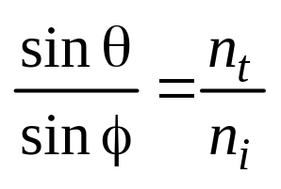


Refraction (transparency)
When an object is transparent, it transmits light
Light bends when moving from one medium to another according to Snell’s law:
  n_{i} sin θ = n_{t} sin φ
d
n
air
glass

Slide 63
Refraction Indices
Index of refraction for various materials:
Material Index
Vacuum 1.0
Air 1.0003
Water 1.33
Alcohol 1.36
Fused quartz 1.46
Crown glass 1.52
Flint glass 1.65
Sapphire 1.77
Heavy flint glass 1.89
Diamond 2.42

Slide 64
Refraction
Total internal reflection
  When going from a dense to less dense medium, the angle of refraction becomes more shallow
  If the angle of incidence is too shallow, it can get trapped in the dense material
    Optical cable
    Diamonds
Calculating the transmitted vector requires:
  Incident ray direction
  Normal
  Indices of refraction
  Some trigonometry
air
glass
d
n

Slide 65
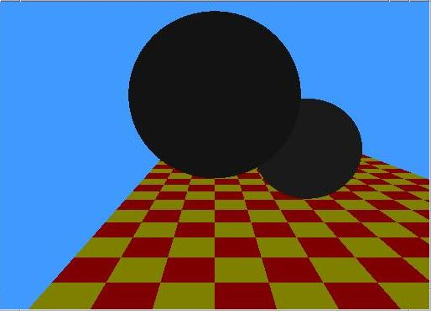
Ray Tracing (images by Nan Schaller)
Ambient Light only

Slide 66
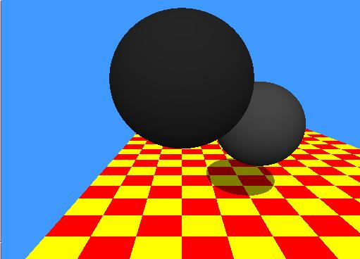
Ray Tracing
With shadows

Slide 67
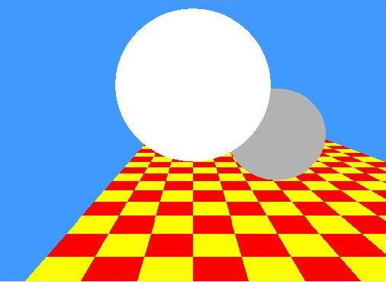
Ray Tracing
Primary rays only

Slide 68
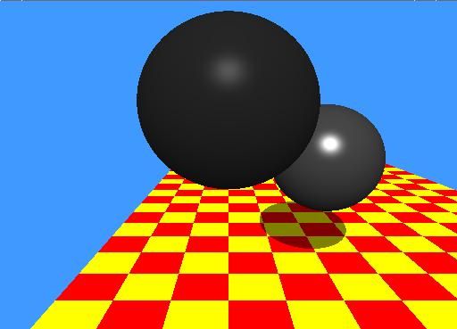
Ray Tracing
With Phong shading

Slide 69
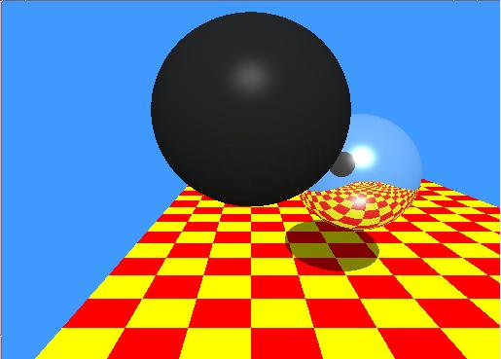
Ray Tracing
With reflections

Slide 70
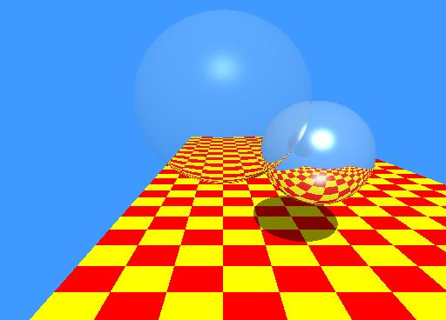
Ray Tracing
With transmissions

Slide 71
Ray Tracing
Movies

Slide 72
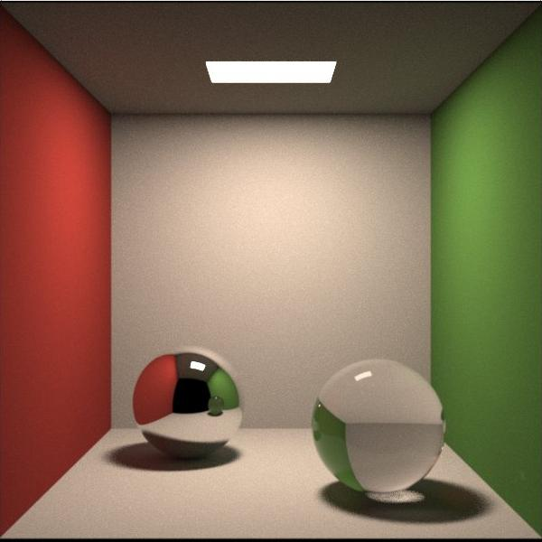
Other Ray Traced Images (courtesy the web)

Slide 73
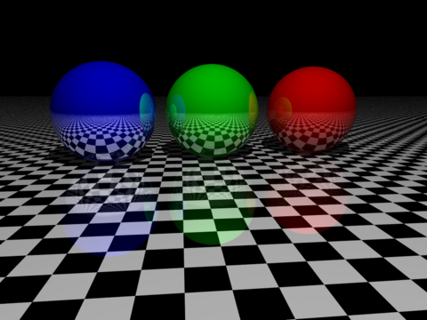
Other Ray Traced Images (courtesy the web)

Slide 74
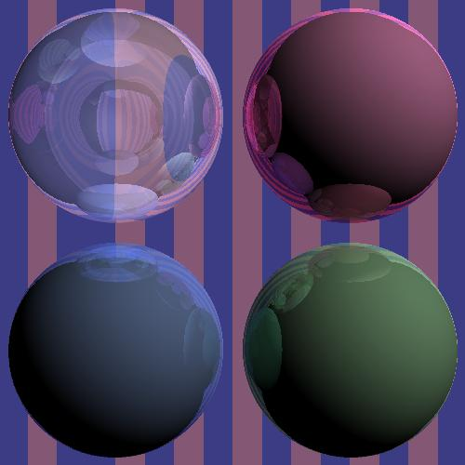
Other Ray Traced Images (courtesy the web)

Slide 75
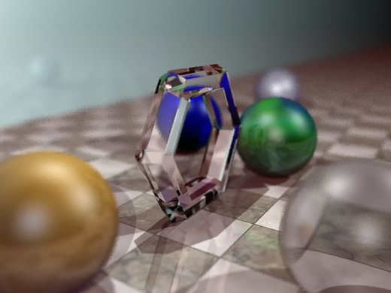
Other Ray Traced Images (courtesy the web)

Slide 76

Other Ray Traced Images (courtesy the web)

Slide 77

Other Ray Traced Images (courtesy the web)

Slide 78
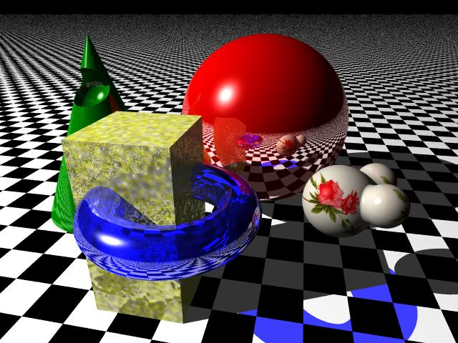
Other Ray Traced Images (courtesy the web)

Slide 79

Other Ray Traced Images (courtesy the web)

