Slide 1
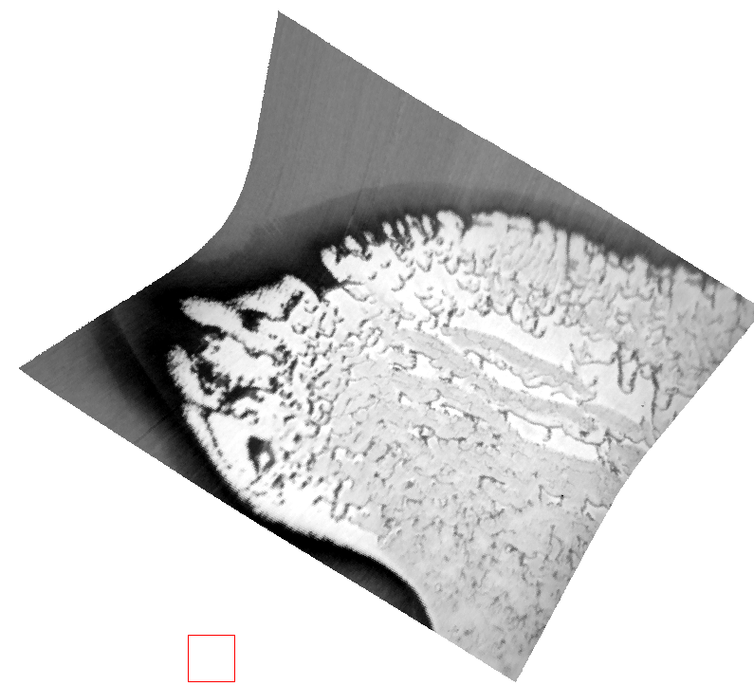
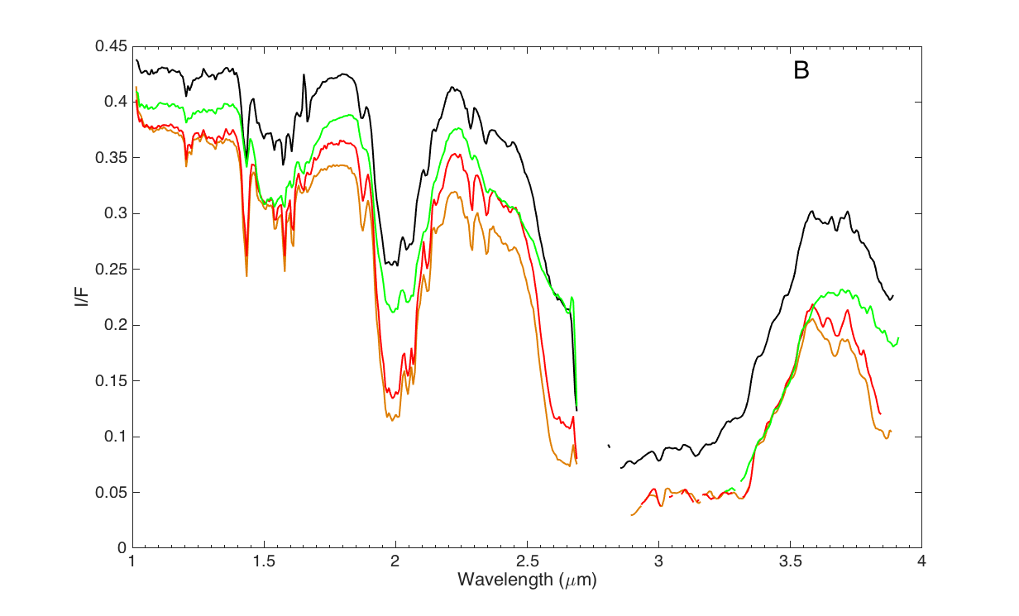
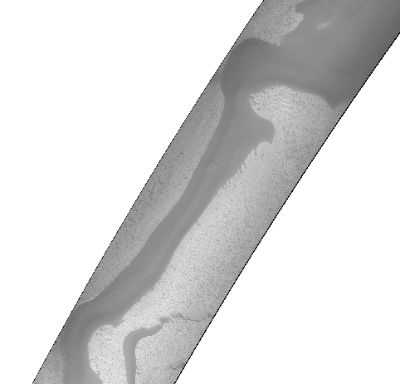
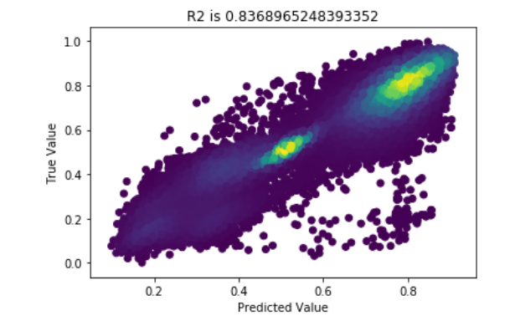
05/21 Project Update
“Ground Truth” Generation
Training
Next Steps:
Include terrain and illumination geometry and increase data set size across multiple images.
Modify DenseNet to multiple branches, concatenate results before linear layers.
Initial condensed DenseNet Results

