Slide 1
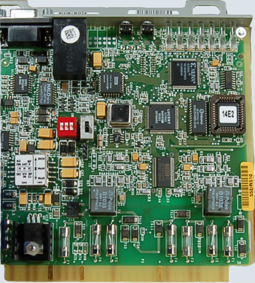
Welcome to
Electronics
Phys 310
Spring 2022
Brian Rasnow
brian.rasnow@csuci.edu

Slide 2
Covid 19 bright side
Covid caused me to radically rethink how to teach this course, and the results were better than the past!
We used to rely on equipment from the stock room – now instead you have everything you need in kits …
  Everything except space and time (and a computer …)
  Even if there was no online component to this course, you would still need space and time outside of class to explore and learn the material (but you wouldn’t have access to the equipment outside of class …)
Electronics requires a lot of time and struggle because you’re applying a lot of advanced physics and math to an unintuitive domain
Courses are (always) a work in progress, and I always welcome your feedback
THIS semester I’m planning to be in person in Sierra 2141 (and on Zoom) on Wed and remotely on Mon (you’re encouraged to Zoom with me in Sierra 2141)

Slide 3
Introductions
What’s your name, major?
Your prior experience with electronics
What do you most hope to get out of this class?
Share something cool about yourself …

Slide 4
Learning objectives
Learn (and appreciate) electronics language
  Schematics are a formal language with unique and powerful grammar, syntax, and semantics + context (structure, symbols, and meaning)
    A good language helps us discover, explore, and communicate ideas
    Fluency involves thinking in the language, not just translating
    How many of you can speak more than 1 language?
  Abstractions/representations avoid solving Maxwell’s equations
    Just as computers obey binary instructions, we generally seek more abstract, “higher level”, representations of their states
Appreciate the art of electronic engineering
  Find synergy in imagining, visualizing, and creating new devices
Notes:
The constraints of a language need not be handcuffs on our creative expression – consider what poets can express within the tighter constraints of poetry vs ordinary language. The constraints of electronics are about as limiting as a 2-d canvas is to a painter or photoshop to a digital artist. My learning objective for each of you is to create some nice electronics art – make some novel paths for electrons to flow.

Slide 5
The big challenge
In any language, you need to master a lot of words and rules before you can communicate anything meaningful
  Many books spend hundreds of pages on DC circuits, resistors, capacitors – you’ll be bored to death before getting to fun and interesting stuff
Complexity makes it hard to separate and understand the forest for the trees or the trees because of the forest
  Whichever concept we start with requires you to understand 20 other concepts that you don’t understand yet …

Slide 6
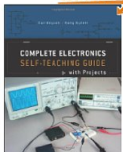
Complete Electronics
Claims to be a “self-teaching guide” –
let’s see if it is!
Part of your homework is to read/work through 1 chapter per week in parallel with the lecture activities
I’m not delegating all my teaching to the book, just some of it … in particular ”grill and drill” homework exercises are important

Slide 7
Tools and Toolbox
You’re being provided with a toolbox and soldering kit that contains everything you’ll need to pass the class
You can’t pass the class without this kit, so please be careful not to lose or destroy it
  If any part, or voltmeter, Arduino, soldering iron ... fails, we can get you another ...
  Try to set up a well-lit lab space, away from food, where your pet or roommate won‘t mess with it ...
You need to download Matlab (free through the school) – if you don‘t have a suitable computer, ask us, and we‘ll try to get you one.
  Mathworks has tutorials and you can find others searching youtube and google
  https://www.mathworks.com/learn/tutorials/matlab-onramp.html
You‘ll need to download the Arduino IDE (www.arduino.cc)

Slide 8
The Art of Poetry
It is true
I’ve always loved
the daring ones
like the black young man
who tried to crash
all barriers
at once,
wanted to swim
at a white beach (in Alabama)
Nude.
- Howard Zinn

Slide 9
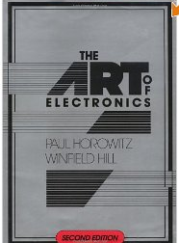
The Art of Electronics was a previous text for this class
It’s a cult classic among analog EEs
Offers broad, deep, and practical insights into
using, building, understanding, and fixing electronics
Quite complete and powerful for one book, useful long after class
I used it twice, and the students generally hated it …
  Its old … but I still recommend it as a great reference
  The newer edition is enormously expanded
So we’re trying another text …
  Much cheaper (don’t buy used – it’s a workbook)
  Easier to follow – all answers are included (you must try the problems first to learn!!)
  Much less content – so I’ll have to supplement more

Slide 10
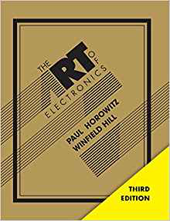
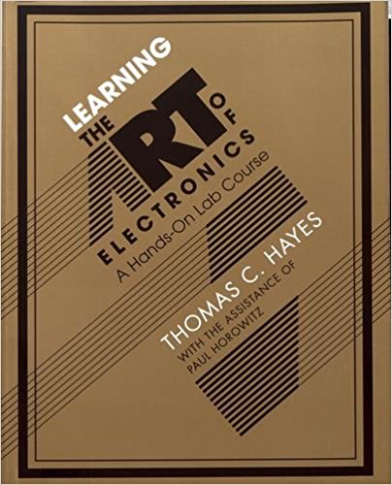
Other references
Other books, websites, etc:
  Library, reference – these books are on reserve
  Wikipedia, hyperphysics, etc. are great for applets and explanations of particular concepts
  MIT open courseware
  "Foundations of analog and digital electronic circuits” by Agarwal and Lang is brilliant theory, but advanced
  “Electronics Fundamentals” by Floyd takes 700 pages to get to transistors
  Several “for dummies” and the like books may fit your level and style
  On-line texts with various specializations are becoming more available – please let me know if you find good ones
5 lbs, 1220 pgs

Slide 11
Building complex stuff
Is an art that takes infinite practice
  Reductionism and creativity are essential
We’ll need to work hard
Most of what we try won’t work the first time (or the second time, or the third …)
Persevere as well as seek alternative solutions
  There are many possible paths
  Reduce the biggest uncertainties
  To a hammer, everything is a nail
The journey can be a big part of the reward
Make reasonable expectations
Notes:
Those slides do reveal a lot about me. We’re going to be building stuff in this class.

Slide 12
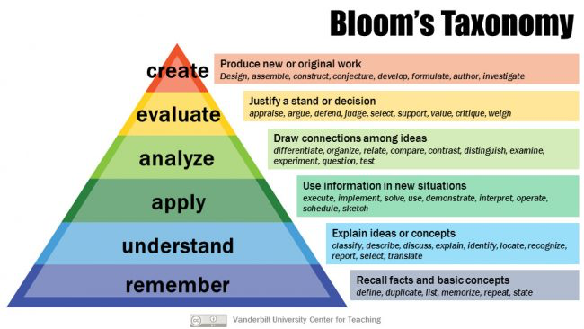
Education theory:
Reductionism of the cognitive domain
http://thesecondprinciple.com/teaching-essentials/beyond-bloom-cognitive-taxonomy-revised/
http://www.utar.edu.my/fegt/file/Revised_Blooms_Info.pdf
Notes:
Metacognition

Slide 13
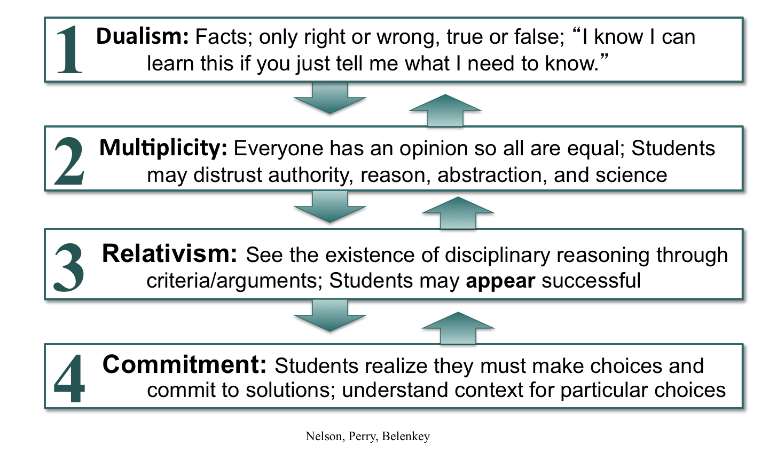
Stages of of cognitive development
https://prezi.com/1cmm76suwcb1/perrys-stages-of-cognitive-development/

Slide 14
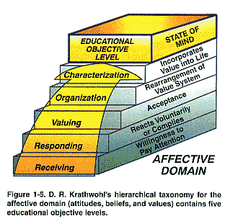
Reductionism of the affective domain
Studying electronics can teach you an awful lot about yourself
How do you learn?
How do you deal with uncertainty?
How do you use abstraction?
The more you struggle here, the less you’ll struggle elsewhere to achieve higher intellectual growth

Slide 15
Matching Perry's cognitive taxonomy with Bloom’s affective taxonomy connects feelings with each intellectual level
(cognitive)

Slide 16
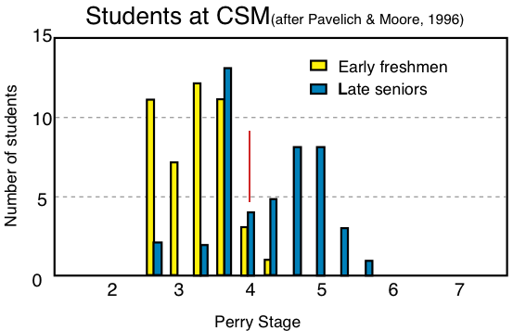
Change in Levels of Thinking
This intellectual development doesn’t happen quickly …

Slide 17
Class rules
Do the assigned readings before class
  At least familiarize yourself with the material
  Post to a Canvas Discussion
Actively seek additional sources & explanations
Actively test your understanding and creativity
Don’t be complacent about not understanding
Be inquisitive and (almost) fearless in labs
Memorize some things, understand others, appreciate lots more
Keep trying to fit new ideas into a bigger, more general picture

Slide 18
Class philosophy
Electronics is hard to learn
  No innate sense of weak electricity
    Must rely on machines to detect it (and they can lie)
  Abstract and unintuitive
    Different physics than our other senses
  Daunting complexity
    Technology provides us with a smorgasbord of devices with various behaviors
But learning how to learn about electronics will help you learn about other complex, unintuitive systems in life
  e.g., your spouse, kids, malfunctioning body, …

Slide 19
Topics
There are many organizational ways to break up electronics
Electronic components
Circuit building blocks
The art(s) of construction, debugging, & design
Sensors, transducers, & actuators
DC, AC, frequency responses
Analog and Digital regimes
Instrumentation, noise, measurement theory, metrology
Digital signal processing
… (any requests now?)
A challenge is most of these aren’t independent …
  you need to know a many of them to learn any of them
  analogous to any language – there’s a minimum useful vocabulary)

Slide 20
How to approach it?
Conventional approach
  Simple circuits are boring
  Useful circuits are confusing
We’ll try to steer a path in between
  Expect to be confused sometimes, hopefully never bored
Key to understanding advanced topics are
  Understanding basic concepts
  Art of measurement; DMM, oscilloscope, computer
    What to do when something doesn’t work?
  Built a lot, visualize, and verbalize in the new language

Slide 21
Specifically …
You’re going to build your own test equipment and apparatus: starting with a regulated DC power supply
Because these are essential generic tools
  You’ll learn a lot as you build, debug, and use your own tools and test circuits
You’ll use an Arduino Nano microcontroller and MATLAB instead of an oscilloscope
  This will teach you many useful lessons about automation, programming, interfacing, signal processing, and managing complexity
  We’ll do more with this $5 microcontroller than possible with a $500 oscilloscope
  You still may wish to pick up a used oscilloscope on Craigslist, ebay, or a ham radio swapmeet …

Slide 22
Is this approach a good idea?
To try to teach a too-big topic in a loosely structured style from a foreign perspective?
  I don’t think you’d prefer the conventional approach
    Hardly covers any ground in a semester
    Strives to build a strong foundation (so you can have a nice slab of cement in a few years)
  I think you can learn much more much faster
    Study things that you know and care more about
    I will try not to hold any of you back, and I challenge you to push yourself and the rest of us forward
  What do you think or recommend?
I’m relying on your frequent & honest feedback
  If you’re bored or lost, chances are that others are too
  If the book isn’t helping you, please let me know!

Slide 23
Format of a lab report
Objective – concise description of the goal
Methods – how you achieved the above goal
  Past tense, you did it. Note, this isn’t a blog. Don’t mention mistakes or misteps (unless they teach a valuable lesson, and then try to frame those as deliberate and positive … we never make mistakes ;-)
Results – what happened from following your methods as stated above (attach voluminous raw data as appendicies)
Discussion – analysis of how the results relate to the objectives as stated above
Conclusions, or more typically higher meta-reflections of lessons learned, new questions you wish to answer next, etc.
Note: it is usually a lie that we work linearly and our discoveries are deliberate. Iteration and mistakes are important steps that we tend not to publicize

Slide 24
Portfolio or class project

Slide 25
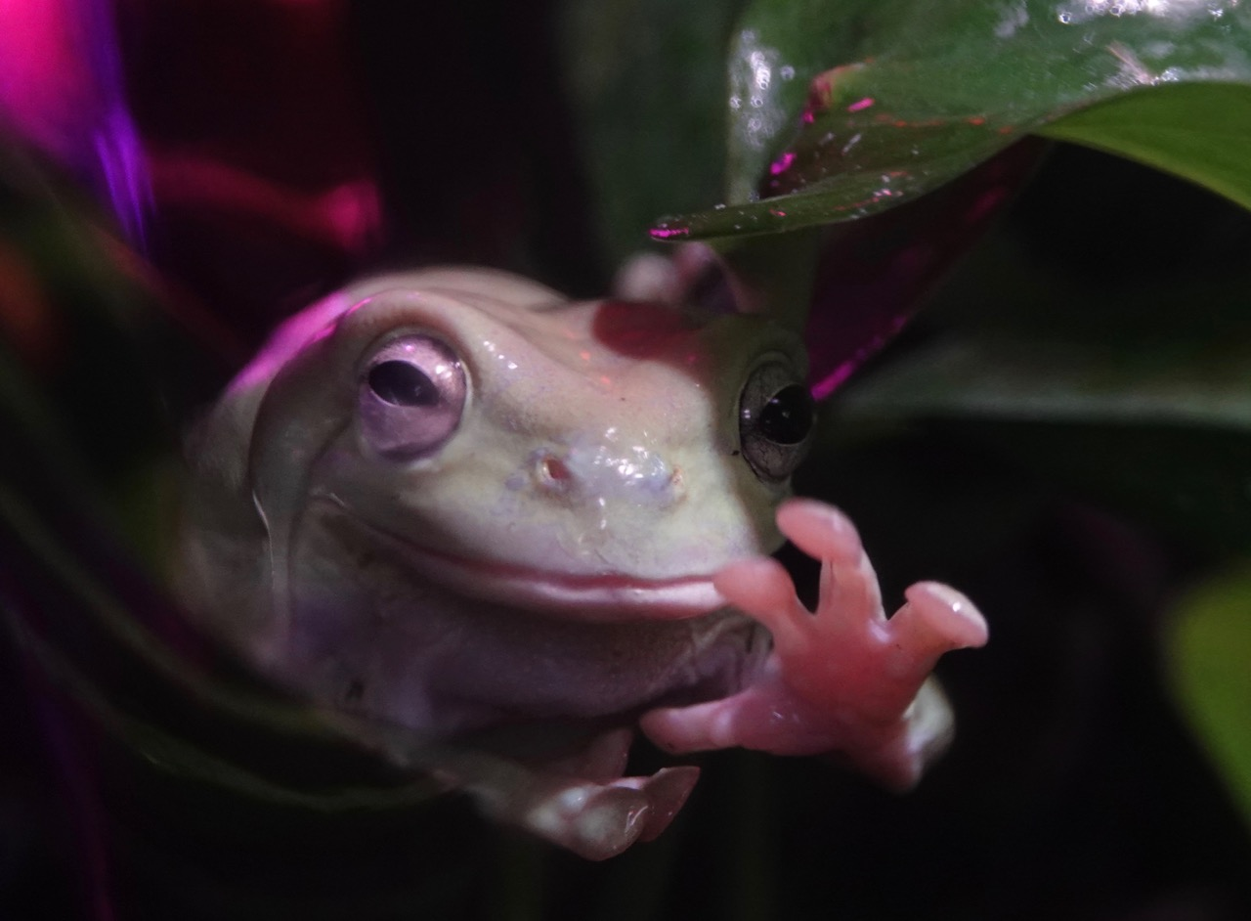
Questions?

