Slide 1
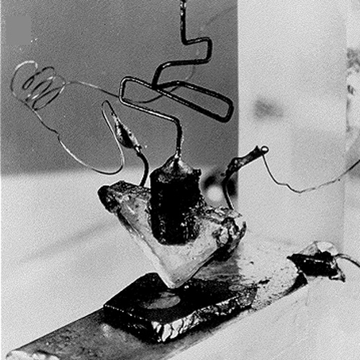
Transistors
Week 5
First transistor, 1947, Bell Labs
5-2

Slide 2
Why is this class so hard?
Are you putting enough time into this class?
A “typical” student spends 3-4 hours/week per unit in college (I googled it)
  This 4-unit class requires 12-16 hours/week, thus 7-11 hours per week outside of class for the typical student (and many of us have to work harder)
  Living in earth’s gravity gives us some intuition about kinematics, but we have nothing to base intuition about feeble electric fields in semiconductors
  If you’re putting in ½ the time, getting <½ the grade is expected
Another reason this class is harder is it’s 300 level …
  We’re not applying one formula at a time to “problems” (odd answers in the back)
    Our “problems” are like: “Why doesn’t the *%&$ circuit work???” (answers maybe on the back of the circuit board ;-)
  You’re applying all the undergraduate math, principles and reasoning you learned in 201, and experimental methods (that’s what your kit is for) to answer questions in this foreign domain – and test and verify those answers
  This is much harder … and afterwards you’ll have achieved much greater and powerful intellectual milestones …

Slide 3
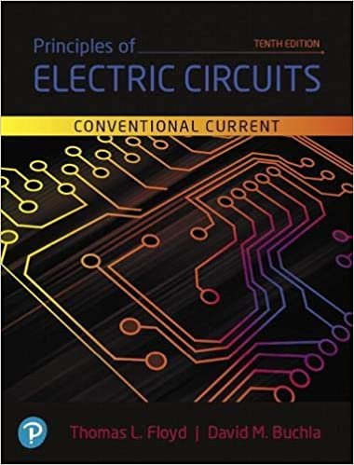
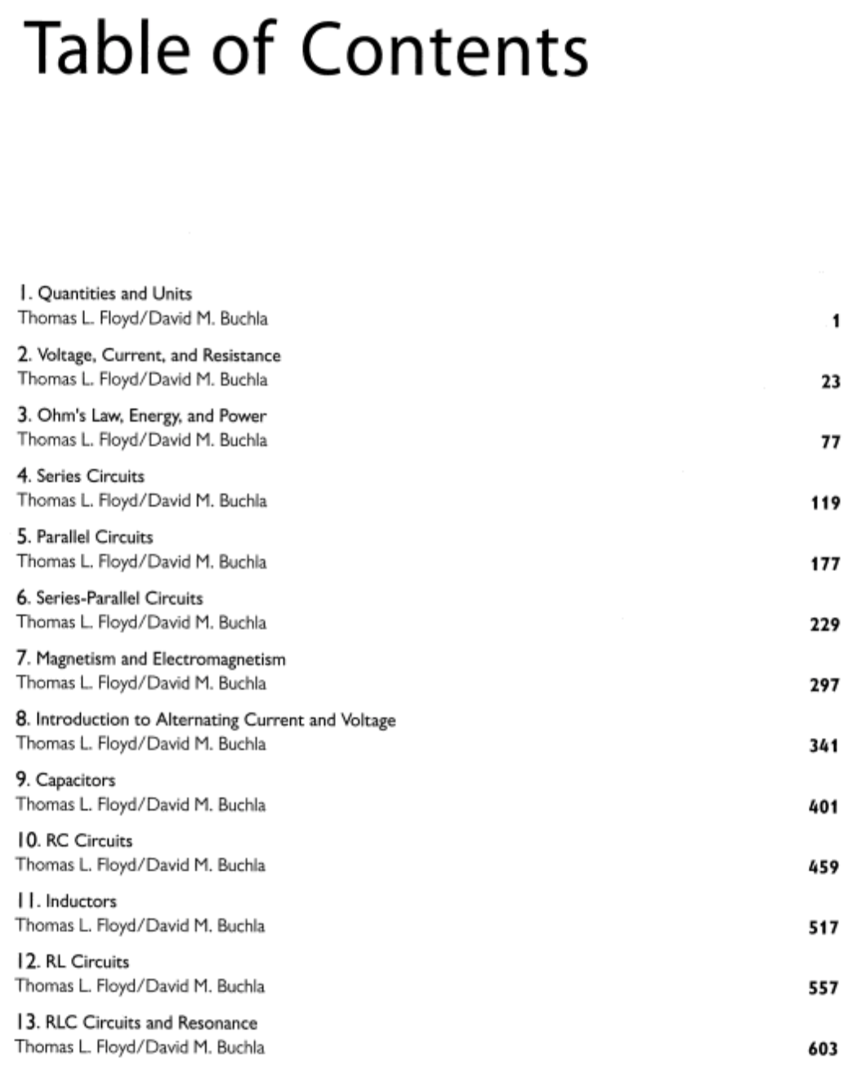
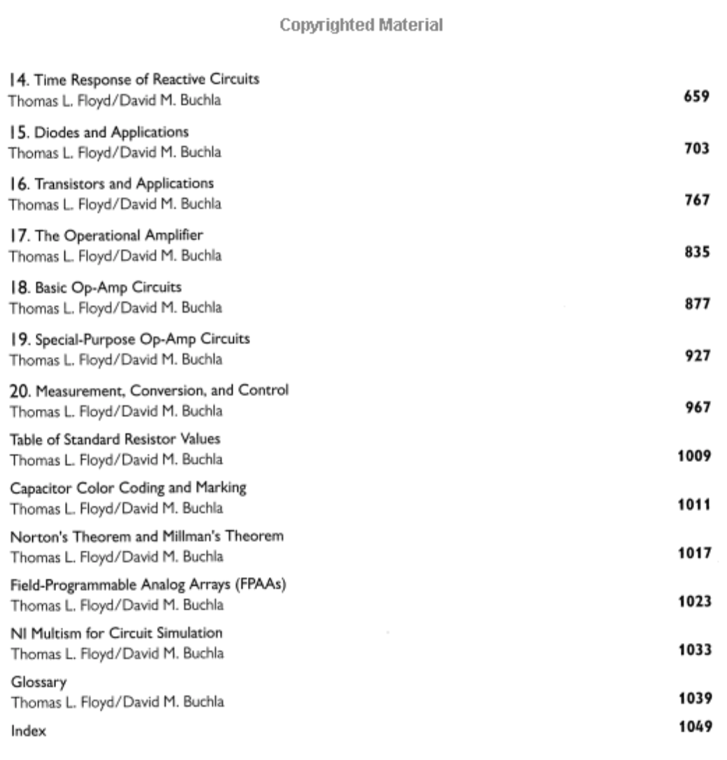
Floyd’s textbook
We’re skipping a lot … to get into more interesting and useful contents …

Slide 4
http://en.wikipedia.org/wiki/Transistor
What is a transistor? What is a car?
A semiconductor device commonly used to amplify or switch electronic signals.
Made of a solid piece of a semiconductor material, with at least three terminals for connection to an external circuit.
A voltage or current applied to one pair of the transistor's terminals changes the current flowing through another pair of terminals.
Because the controlled (output) power can be much larger than the controlling (input) power, the transistor can amplify (increase) a signal
  Voltage dividers can only decrease signals
The transistor is the fundamental building block of modern electronic devices, and is used in radio, telephone, computer and other electronic systems.
Some transistors are packaged individually but most are found in integrated circuits.

Slide 5
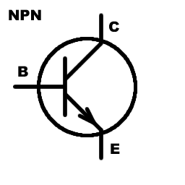
Key points
3 terminals = 2 circuits
  B-E current controls C-E current
NPN and PNP flavors (and variants)
  Facilitate normally-on or normally-off, NOT, …
Many behaviors and functions are possible
  Behavior is typically highly nonlinear
Several mathematical models apply
  Use the simplest model you can get away with
ICs are generally more useful than individual transistors (and about as cheap)
  E.g., op-amps generally beat discrete transistor amps
  TTL (74xx) or CMOS (40xx, 45xx) families of logic Ics
  So your use of discrete transistors will be limited – but nevertheless very powerful!!

Slide 6
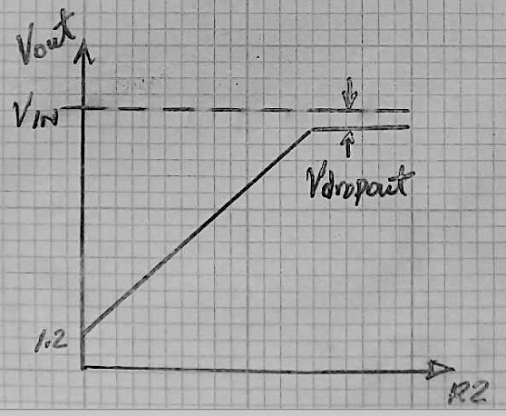
Multiple regimes of operation
The LM317 is described by different equations:
  Vout = 1.25V*(1+R2/R1), or …
  Vout = Vin - Vdropout, or …
  Vout = 0 (i.e., when the power is off)
  …
All of those equations can’t be true at the same time – so how do you choose which applies?
Likewise, transistors have 3 main
regimes: cutoff, active, & saturation
We’ll study active first, then
saturation (Ch. 4, the switch)

Slide 7
Recommended strategy
If you’re at all like me, it will take lots of effort (i.e., years) to wrap your brain around these things
  Memorize the basic nomenclature (base/emitter/collector) – can’t avoid it, the sooner you grok it, the easier
  Try to understand intuitively the most basic model by reading and rereading descriptions from many sources
The voltages that matter are relative, measured between the pins. The transistor doesn’t know or care what its voltage is relative to ground or your favorite reference
  The big challenge is figuring out what those relative voltages are in dynamic circuits

Slide 8
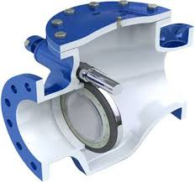
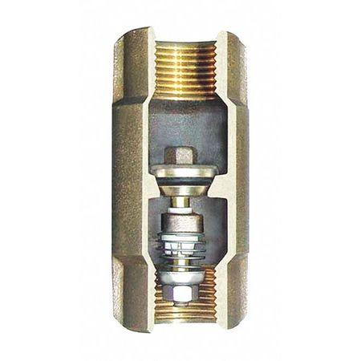

Water analogies
Diodes are like “check valves”
  There’s a minimal pressure difference to open (~0.7V for Si, ~0.4 for Ge, 1.5-2.5V for LEDs)
  Allows for flow in only one direction
    If P1>P2, flow is to the right
    If V1 > V2, current is to the right
    No flow if P1<P2, no current if V1 < V2
  Analogy is only as good as it is …
    E.g., diodes have no moving
    parts larger than electrons
P1
P2
V1
V2

Slide 9
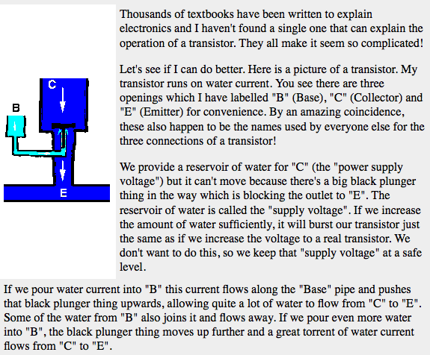
Transistor as a valve
A small base-emitter current controls a much larger collector-emitter current
http://www.satcure-focus.com/tutor/page4.htm (google “transistor tutorial” for many other explanations)

Slide 10
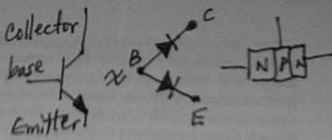
Some (minor) issues with the book
I find Fig 3.11-16 confusing … how is thinking of a transistor as 2 back-to-back diodes useful?
Fig. 3.15-16 confuses me because I’m accustomed to + voltages drawn at the top and – voltages at the bottom – so current tends to flow down → why draw this figure upside down? (I think they’re trying to make PNPs look more like upside down NPN’s …)
You can postpone reading about JFETs for now, we’ll come back to them later.
We will also just focus on NPN transistor circuits

Slide 11

BJT Golden Rules
There are no golden rules … there are many
configurations and possibilities with BJTs…
The base-emitter often acts like a diode
  If V_{be} < ~0.6V then i_{c} ~ 0 and the transistor is “off”
  If V_{be}~0.6-0.7V (forward biased diode), the collector-emitter conducts
  Making V_{be}>0.7V will likely destroy the device quickly
If not saturated, i_{c} = β * i_{b}
The transistor will lower its collector-emitter voltage in order to satisfy (3.) But it can’t go below V_{ce}~ 0.01-0.3V
Like diodes (e.g., LEDs), external components are generally needed to keep base and collector currents at safe (for the device) values
…

Slide 12
Matlab transistor gain activity

Slide 13
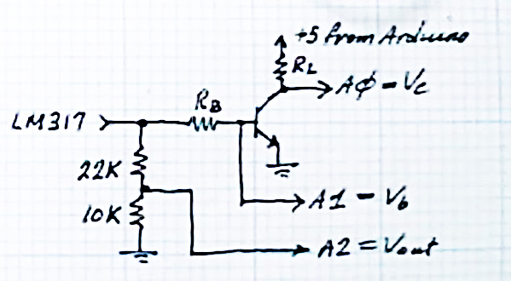
Saturation
What happens if we change R_{L} to 2kΩ, 10ΚΩ?
  Swap the component and repeat the experiment …
  The second time is much faster …
  Did you forget to change Rc in the Matlab code?
=1kΩ
22kΩ
1MΩ
20K

Slide 14
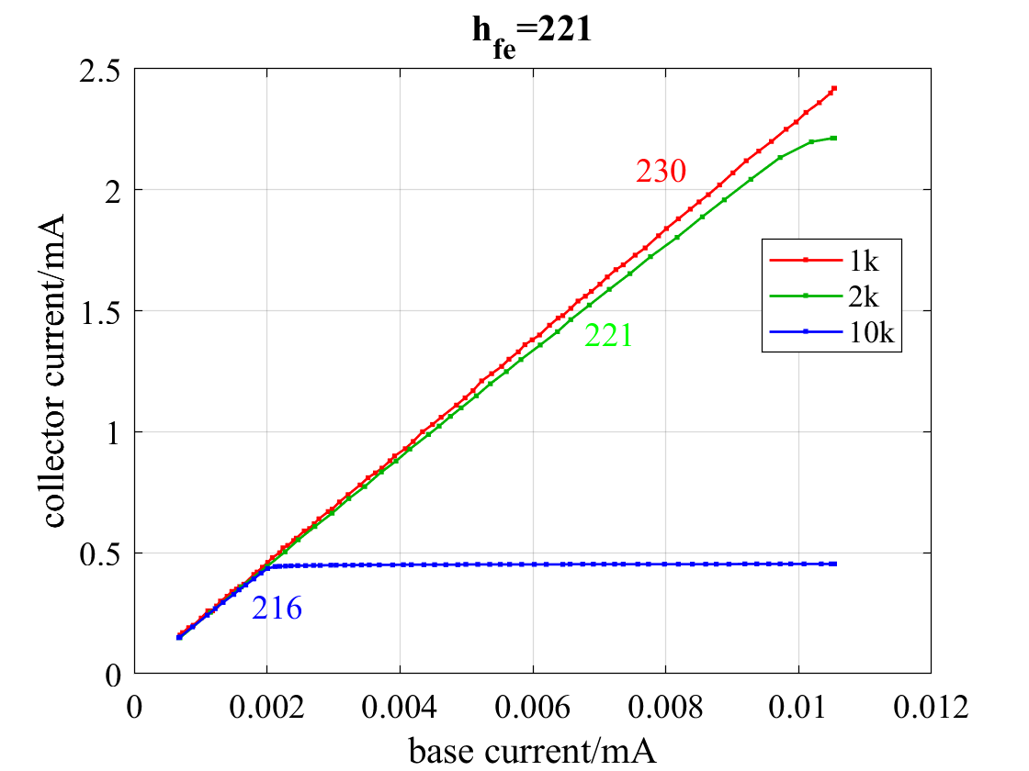
Saturation
>> indx = ib < .006;
>> p = polyfit(ib(indx), ic(indx), 1)
ans =
331.0971 0.0037
>> mean(ic(~indx))
ans =
2.2285
>> (Vref-min(data1(:,3)))/2
ans =
2.2550
R_{c} = 2kΩ saturated i_{c} at 2.23mA,
with V_{CE} = 0.23V – the transistor
couldn’t go lower

Slide 15

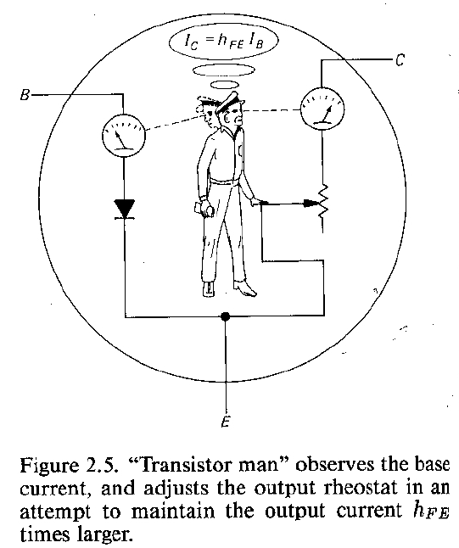
What happens in saturation?
V_{cc}
R_{c}
“Transistor man” adjusts a variable resistor that’s a voltage divider with R_{c}. Once set to its minimum value (R=V_{ce}/i_{c}), it can’t go any lower
i_{c} is now saturated at (V_{cc}-V_{ce})/R_{c}, additional increase in i_{b} cannot increase i_{c}
In saturation, the external collector circuitry (R_{c}) determines i_{c}, not h_{fe}i_{b}.
How do you feel about this model?

Slide 16
What do you think?
How did your second automated lab feel?
  >700 voltages were recorded in this dataset
  Fewer data would suffice, but its just as easy to deal with more complete data when the acquisition and analyses are automated
  Setting up the system is where the (1-time, “NRE”) effort is, repeating experiments is easy
The complexity of hardware, μC software, and Matlab SW is higher than your typical Phys 200 lab
But when the pieces fit together, the puzzle picture comes out pretty cool!!
What strategies can you use to help manage the complexity?

Slide 17
Automating labs …
Right now, the process I’ve shown you involves
  Design and build a test circuit
  Create a hardware interface between the circuit and Arduino
  Write a software interface (Arduino code) to measure and send data to the Serial Monitor
  Copy/paste data into Matlab
  Write a data interface (Matlab code) to process the data into results and figures
  Copy/paste results and figures into Word (or Latex, …)
  Write a lab report
What did we leave out?
What additional steps can we automate?
  What criteria should we use to decide what’s worth automating?
  https://www.youtube.com/watch?v=FN2RM-CHkuI
Notes:
Left out was how we collected the data by turning the knob on the power supply. If we want to automate data acquisition, then Arduino needs to control the PS. Current mirror maybe the way to do that … but that’s for another lab.

Slide 18
Matlab LiveScripts – automating lab reports
TransistorGain.mlx generates (export to Word) a word doc that you should edit and proofread

