Slide 1

Week 1
More Intro …

Slide 2
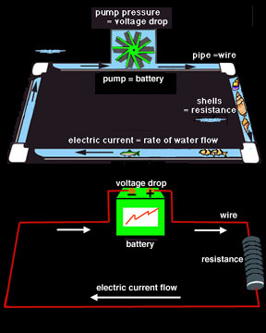
Electronics analogy to hydrodynamics
Charge <=> Mass , 1 coulomb ~ -6e18 electrons of charge
Voltage <=> Pressure , 1 volt = 1 J/C
  Only defined differentially
  “The ability to move charge through a resistance”
Current <=> Flow , 1 ampere = 1 C/sec
Power = voltage * current , 1 watt = 1 J/sec
  Rate of energy flow
Hydrodynamics is controlled by pumps, valves, pipes, reservoirs, etc. Electronics has analogous components: power supplies, switches, resistors and wires, capacitors, inductors, batteries, etc. "Active" devices require an external power source -- like pumps and power supplies, and "passive" devices don't require anything other than voltage and current to operate.

Slide 3
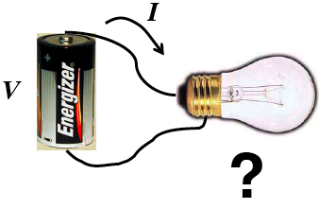
How do we describe what happens?
What is the current in the bulb?

Slide 4
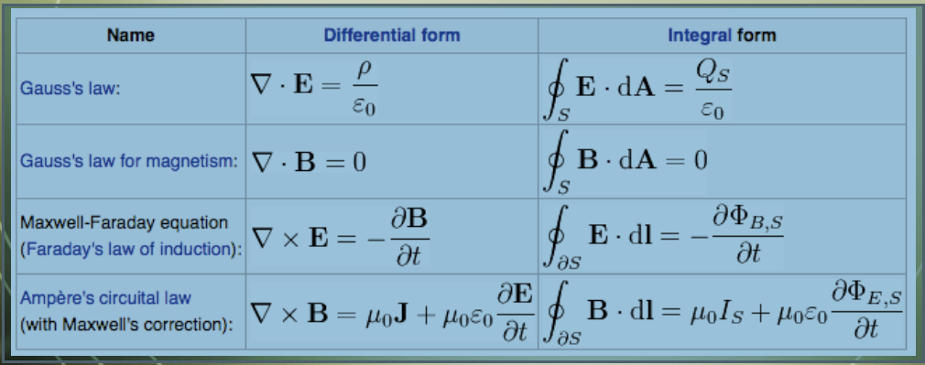
From first principles…
Just solve Maxwell’s equations …
Everywhere? Where’s an axis of symmetry ….?

Slide 5
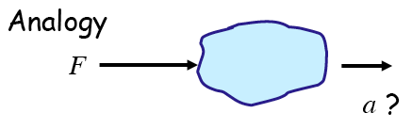
Consider this analogous problem
What is the acceleration?

Slide 6

What matters?
If you know just the mass of the blob, you can answer:
You can ignore the object’s shape, color, temperature, point of force, etc.

Slide 7
What matters?
If you know just the mass of the blob, you can answer:
You can ignore the object’s shape, color, temperature, point of force, etc. … assuming the object doesn’t break up, burn, ... (the model is only as good as it is)

Slide 8

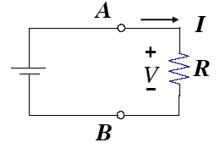
The easy way …
If we don’t care how the current flows in the bulb, nor its temperature, shape, orientation, etc.
Then we can model the bulb as a discrete resistor to calculate its current
Like mass in the prior force problem, R is the only relevant property

Slide 9
Do you really want to know the details?
https://www.youtube.com/watch?v=oI_X2cMHNe0
It really is that complicated … as you might imagine a microscopic (or quantum mechanical) description of momentum exchange is … but F = ma is an adequate (accurate enough, simple enough) alternative model

Slide 10
Algebraic Rules and Laws*
Key rules
  Ohm’s Law: V = IR
  Watt’s Law: P = VI = V²/R = I²R
  Kirchhoff’s Voltage Law (KVL): ΣV=0 around any loop
  Kirchhoff’s Current Law (KCL): ΣI=0 into or out of any node
I-V curves are a useful way to characterize devices
    Thus are often called “characteristic curves”
  Diodes are electrical “check-valves” – allow current flow in one direction
  Resistors turn current into voltage and turn voltage sources into current sources … (please read that sentence again …)
BJTs have 3 terminals → 2 circuits, i_{B} controls I_{C}, in the linear range, i_{C} = h_{fe}I_{B} , but often we use BJTs as switches in saturation
…
* Empirical rules work under many common circumstances. But when they don’t, deal with it, or seek more accurate (and complicated) rules

Slide 11
Memorize this!!
What’s V_{b}? (I.e., V_{b}-V_{c})
This is the common “voltage divider” equation, which you’ll be using over and over …
Note: there’s a lot of implicit information in this game …
Writing (and rewriting) notes will help you identify what you don’t know, …

