Slide 1
This is not the NaN you are looking for
A discussion of the wretched hive of scum and villainy that is NaN
Dan Shernicoff
dan@brassnet.biz https://brassnet.biz https://masto.bnet.boo/@brass75
PyOhio 2026
https://github.com/brass75/nan-talk

Slide 2
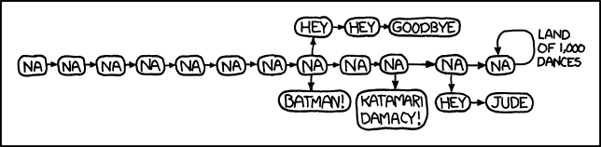
https://xkcd.com/851_make_it_better/
https://github.com/brass75/nan-talk
Notes:
Hi. I'm Dan Shernicoff and I've been programming computers for over 40 years, ever since my sister taught me BASIC on our Commodore-64. For the last 20 years I've been paid to do it, working on embedded systems, DevOps, security, and automation. Today we're going to take a little bit of time to look at floats that aren't actually numbers, specifically NaN.

Slide 3
Agenda
Introduction
IEEE-754 and the history of NaN
NaN in Python
What can we do with NaN
Cool Stuff
Conclusion
https://github.com/brass75/nan-talk
Notes:
It has been suggested to me that starting a talk with an agenda is a generally good idea so here goes.
We'll start with an introduction - that's where we are now.
Next is some background on IEEE-754 and NaN.
Then we'll talk about NaN in Python.
After that I'll show you some things we can do with NaN.
NaNth we'll take a look at some cool stuff
And, finally, a short conclusion and recap.

Slide 4
PyDis - How I started down this rabbit hole
https://discord.gg/python
https://brassnet.biz/blog/nan-is-weird.html
https://github.com/brass75/nan-talk
https://github.com/brass75/nan-talk
Notes:
Many programmers have never given NaN much thought. I know I hadn't. It was always this really weird thing that existed but I had never actually encountered it.
That was until earlier this year when I was hanging out in the Python Discord and there was a discussion going on about NaN and how it could be used as a dictionary key but you couldn't get the value back unless you used that same NaN instance.
That led me down a rabbit hole, starting with a blog post.
I was then nerd sniped by the wonderful people in the Python Discord to write a talk proposal, and here we are.

Slide 5
>>>> print(f"That's ba{1e234567 - 1e765432}as!")
That's bananas!
https://github.com/brass75/nan-talk
Notes:
When I started down this rabbit hole I kept thinking to myself, "That's bananas!" So I kept on looking and seeing what else I could find.

Slide 6
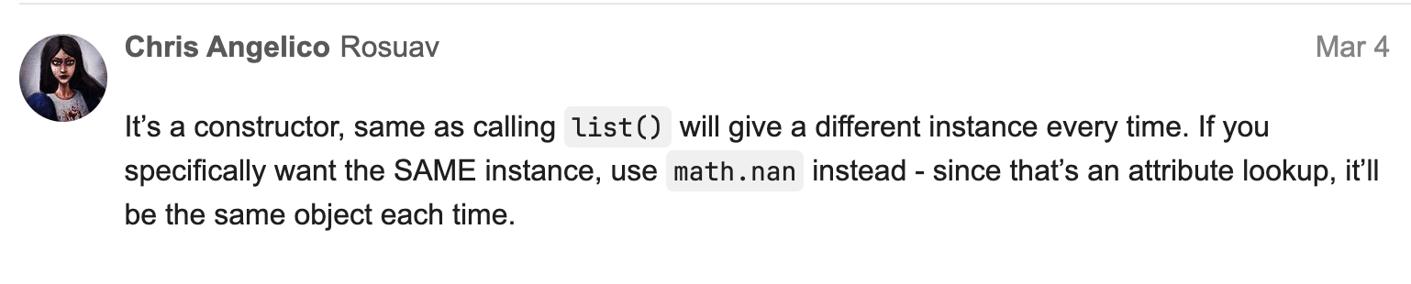
https://discuss.python.org/t/question-about-float-nan/106378
https://github.com/brass75/nan-talk
Notes:
I spoke to people in the Python community. I opened a thread on the Python Discourse and asked, "I was wondering if anyone knows why each call to float(‘nan’) returns a different instance?"
While there's a lot of interesting discussion there about NaN, the basic answer is, "the reason they’re different is because it’s a constructor, and by default, that’s what constructors do."

Slide 7
"NaN is a lot like infinity in that people want to treat it as a number but It's Not and trying to do that will only lead to surprise and disappointment."
– Luna Celeste
https://github.com/brass75/nan-talk
Notes:
I spoke to people I work with. My teammate, Luna, said that people want to treat NaN like a number but doing that will lead to surprise and disappointment. This resonated with me and I've tried to keep it in mind as I've worked on this talk.

Slide 8

History of IEEE-754
In the 1960s and 70s there were multiple methods of storing floating point data.
IEEE-754-1985 standardized the encoding of floating point numbers and defines:
  Arithmetic formats
  Interchange formats
  Rounding Rules
  Operations
  Exception handling
https://en.wikipedia.org/wiki/IEEE_754
https://github.com/brass75/nan-talk
Notes:
Before we talk about NaN we should get a better understanding of where it came from. NaN came out of the IEEE-754 specification for a single floating point number system. But why did that come about?
In the 1960s and 70s there were multiple, competing, formats for working with floating point data. IBM used a hex based format, while CDC and Cray used a ones' complement format. Exception handling for divide-by-zero was different on different computers. These issues made having a standard necessary to increase reliability and portability.
IEEE established a standard that defines:
Arithmetic formats consisting of finite numbers, infinities, and NaN.
Interchange formats defining how the numbers are encoded in bits.
Rounding rules stating how numbers should be rounded during arithmetic and conversions.
Arithmetic and other operations, such as trigonometric functions.
Exception handling such as divide-by-zero and overflow.

Slide 9
Floating Point is not Decimal
0.1 + 0.2
0.30000000000000004
https://github.com/brass75/nan-talk
Notes:
Since we're talking about floating point numbers, I want to make sure that everyone understands that floating point is not decimal. So we're going to do a quick check.
Can anyone tell me what 0.1 + 0.2 is?
If you said 0.3_000_000_000_000_000_4 you're correct.
That's not the math I remember learning in elementary school. This comes from the simple fact that IEEE 754 can't properly encode certain numbers.

Slide 10
inf, nan and IEEE 754
Double precision float is 64 bits:
  1 sign bit
  11 exponent bits
  52 significand bits
If we overflow a float we get inf
Subtracting inf from inf gives us a nan
Dividing inf by inf gives us a nan
https://github.com/brass75/nan-talk
Notes:
Before we get into what makes NaN fun let's talk a bit more about IEEE 754, specifically how it defines infinity and NaN.
A double precision, 64 bit float has 1 sign bit, 11 exponent bits, and 52 significand bits.
Infinity is used to represent floating point numbers that are too big. If you overflow a float, you get inf. Most operations involving inf will give you inf back (unless NaN is also an operand, in which case you get back a NaN.)
The 2 exceptions are inf - inf and inf / inf each of which gives you a NaN.

Slide 11
Encoding inf and nan in IEEE 754
For both inf and nan the sign bit does not matter
inf has all of the exponent bits set to 1 and all of the significand bits set to 0
  There are 2 possible inf values (+/- inf)
nan has all of the exponent bits set to 1 and one or more of the significand bits set to 1
  There are 2*(2^52 - 1) possible nan values (a total of 2^53-2)
https://github.com/brass75/nan-talk
Notes:
The sign bit doesn't matter for encoding either inf or NaN - you can have positive and negative of both.
For inf all of the exponent bits are set to 1 and the significand bits are 0. This gives us 2 possible inf values - positive and negative infinity.
For NaN all of the exponent bits are 1 and one or more of the significand bits is set to 1. This gives is 2^53 - 2 possible NaN values. This is important because part of the spec defines 2 types of NaN - quiet and signaling. Signaling NaNs are used to indicate why the NaN was returned.

Slide 12
Numerical Encoding
b'\x01\x00\x00\x00'
struct.unpack('i', b'\x01\x00\x00\x00')[0] # 1
struct.unpack('f', b'\x01\x00\x00\x00')[0] # 1.401298464324817e-45
b'\xff\xff\xff\xff'
struct.unpack('i', b'\xff\xff\xff\xff')[0] # -1
struct.unpack('f', b'\xff\xff\xff\xff')[0] # nan
https://github.com/brass75/nan-talk
Notes:
As I mentioned, one of the things that IEEE-754 specifies is interchange formats for encoding floating point numbers as bits. So let's take a quick look at that.
Can anyone tell me what 0x01000000 is as an int?
It's 1.
How about as a float?
It's a really small number - much less than 1.
OK. Now how about 0xFFFFFFFF?
It's -1.
But it's also NaN.
When we read bits we need to know what those bits represent to properly interpret them.

Slide 13
Fast Inverse Square Root
float Q_rsqrt( float number )
{
long i;
float x2, y;
const float threehalfs = 1.5F;
x2 = number * 0.5F;
y = number;
i = * ( long * ) &y; // evil floating point bit level hacking
i = 0x5f3759df - ( i >> 1 ); // what the fuck?
y = * ( float * ) &i;
y = y * ( threehalfs - ( x2 * y * y ) ); // 1st iteration
// y = y * ( threehalfs - ( x2 * y * y ) ); // 2nd iteration, this can be removed
return y;
}
https://github.com/id-Software/Quake-III-Arena/blob/master/code/game/q_math.c#L552
https://github.com/brass75/nan-talk
Notes:
Switching formats like we just saw can be a useful thing. One of the use cases that has been found has been quickly finding the inverse square root, something that many game engines use for graphic manipulations such as lighting, clipping, and shading.
An unpublished paper from 1986 suggested that bit fiddling techniques could be used, along with a magic number, to approximate that inverse square root. The code you see here is from its first known use in an actual application - Quake III Arena.
You can find the full source code, published by id Software, at the GitHub link.

Slide 14
nan in Python
float('nan') will give a new variable every time. With a different id and hash.
There are sentinel nans - numpy.nan and math.nan are both singletons.
In general, any operation with nan with nan will return nan
nan is equal to nothing - not even itself
https://github.com/brass75/nan-talk
Notes:
Now that we have that done, let's talk about NaN in Python.
Every call to float('nan') will give you a new variable with a different hash (remember I mentioned at the beginning about using NaN as a dictionary key was what got me started here?) but they will all contain the same value.
Both numpy and the standard library math module define singleton NaNs that can be used as sentinels.
In general, operations with nan return NaN.
There is nothing in Python - or any programming language! - that is equal to NaN; not even NaN itself.

Slide 15
Why the unique hash?
NaN in Python originally had a hardcoded hash.
There was discussion about making it a singleton
The decision was made to use the object hash
https://github.com/python/cpython/issues/87641
https://github.com/brass75/nan-talk
Notes:
But why the unique hash?
In 2021 an issue was raised in CPython about hash collisions with NaN because hash(NaN) was hardcoded to 0.
Some of the discussion on that issue raised the idea of a singleton NaN but that was dismissed because there are actually different types of NaNs and people might have been using them.
The final decision was made to use object's hash method to hash NaN.

Slide 16
NaN is Required in Python
Since Python 3.11 CPython has required support for IEEE-754
In Python 3.11 the Py_NO_NAN macro was removed from the CPython source code.
https://docs.python.org/3/whatsnew/3.11.html#build-changes
https://github.com/brass75/nan-talk
Notes:
Prior to Python 3.11, CPython did not require IEEE-754 support. Because of this there had been a Py_NO_NAN macro that surrounded any place where NaN might be in the C code - #ifndef Py_NO_NAN - but there were places where it was missing. With 3.11 and the decision to require IEEE-754 support, that macro was removed.

Slide 17
How can we get a NaN to play with?
float('nan')
float('inf') - float('inf')
float('inf') / float('inf')
import struct
float_bytes = b"\xaa\xbb\xcc\xdd\xff\xff\xff\xff"
val = struct.unpack("d", float_bytes)[0]
print(val) # nan
https://github.com/brass75/nan-talk
Notes:
So how do we get a NaN to play with? There are a few simple ways.
We can call `float('nan')`
We can subtract infinity from infinity
We can divide infinity by infinity
We can build one ourselves. For this we'll need to import `struct`.
Then we create a byte sequence containing the bytes we want
Finally, we unpack it.
When we print it out, we can see that we have made our very own NaN.

Slide 18
Operations with NaN
math.nan == math.nan # False
[math.nan] == [math.nan] # True
float('nan') == 1 # False
float('nan') != 1 # True
https://github.com/brass75/nan-talk
Notes:
OK, now that we know how we can get a NaN let's take a look at what happens when we perform some operations with it. Let's start with some comparisons.
We already said it doesn't equal itself.
But if we put it in a pair of lists, will they equal themselves? Yes, they will because Python does an identity check before an equality check and since they have the same id - they are the same object - it asserts that they are equal. The same holds true for sets, dictionaries, and other collections.
But is it equal to 1? No. NaN isn't equal to anything.
In fact, any comparison other than not equal will give us False.

Slide 19
Operations with NaN, continued
nan > 4 # False
nan < 4 # False
min(nan, 4) # nan
min(4, nan) # 4
min(nan, 4, 3) # nan
min(4, nan, 3) # 3
https://github.com/brass75/nan-talk
Notes:
We looked at equality, but what about other comparisons?
Is NaN greater than 4? No.
So it must be less than 4, right? Still no.
I wonder what happens when we plug it into `min`. Looks like we get NaN.
Or do we? In this case we get a 4 back.
If we look at a longer list will we get back 3? No. It's NaN.
But if we change the order we do get that 3.
What's happening is that Python sees the NaN in the first spot and declines to compare, returning the NaN. If it's anywhere else the comparison happens as expected with the NaN removed from the equation.

Slide 20
Operations with NaN, continued
float('nan') + 1 # nan
float('nan') - 1 # nan
float('nan') * 0 # nan
float('nan') / 0 # ZeroDivisionError
float('nan') ** 0 # 1
https://github.com/brass75/nan-talk
Notes:
But what if we add 1 to it? NaN
Subtract 1 from it? NaN
What about multiplying it by 0? Still NaN.
Divide nan by 0? That gives us a ZeroDivisionError. Per IEEE-754 this can either give a NaN or an error. Python has chosen the error and I think that's the right call.
And raising it to the zeroth power? That gives us 1.

Slide 21
>>>> print(f"That's ba{1e234567 - 1e765432}as!")
That's bananas!
https://github.com/brass75/nan-talk
Notes:
OK. That is bananas. But it's actually part of the IEEE 754 spec that anything to the zeroth power, including NaN, will return 1. Why it doesn't return 0 for multiplying by 0 seems odd to me, but I didn't write the spec.

Slide 22
How can we use nan?
We can populate a set with multiple instances of nan
We can have a dictionary with multiple nan keys
  There is no way to retrieve the values at those keys without saving the original nan that was used for each one.
If you create a Counter from an iterable with multiple nan instances they will each appear with a count of 1.
https://github.com/brass75/nan-talk
Notes:
Now that we know a bit more about NaN - let's talk a bit about how we can use it.
We can populate a set with multiple instances (remember that these are not singletons and each will have its own hash.)
We can have a dictionary with multiple values of NaN as keys. But we can't look them up unless we preserve the instance of NaN that was used for each one.
If we create a Counter from an Iterable with multiple NaN instances, each will appear with a count of 1.

Slide 23
Other things we can do with NaN
Because NaN can have a payload we can use NaNs to hide unicode characters.
import struct
def nan_with_payload(p):
return struct.unpack("f", struct.pack("i", 0x7fc0_0000 | p))[0]
def nan_payload(n):
return struct.unpack("i", struct.pack("f", n))[0] & ~0x7fc0_0000
def nancode(s):
return [nan_with_payload(ord(c)) for c in s]
def nandecode(l):
return "".join(chr(nan_payload(i)) for i in l)
https://github.com/brass75/nan-talk
Notes:
Since the significand portion of the NaN just has to be non-zero we can use it to hold a payload. This is actually part of the IEEE-754 spec that defines both quiet and signaling NaNs.
If we look at nan_with_payload we are building a NaN as we saw earlier but using a specific value for the significand - the payload.
We can then extract that payload with the nan_payload function by doing a bitwise and.

Slide 24
NaN Cipher Continued
encoded = nancode("I 💩 IEEE-754")
assert all(math.isnan(x) for x in encoded)
print("The cyphertext is", encoded) The cyphertext is [nan, nan, nan, nan, nan, nan, nan, nan, nan, nan, nan, nan]
print("The plaintext is ", nandecode(encoded)) The plaintext is I 💩 IEEE-754
Credit to Jeff Epler for NaN Cypher
https://codeberg.org/jepler/junkdrawer/src/branch/main/na869m0v/nancode.py
https://github.com/brass75/nan-talk
Notes:
Now let's check that out. We can encode a string with nancode. We'll verify that we got back a list of NaN objects. Printing it out shows that that's we have. Finally, we decode it and get back our original string.
I will point out that this cipher wouldn't be that great for transmitting data because the receiving system probably won't give you back the same NaN values that you put in.
Thanks to Jeff Epler for putting this together.

Slide 25
One more thing...
JSON's number type does not support NaN.
Python's JSON parser does.
import math
import json
print(json.dumps({"Bananas!": math.nan})){"Bananas!": NaN}
json.loads('{"Bananas!": NaN}') {'Bananas!': nan}
JSON.parse('{"Bananas!": NaN}')
"Unexpected token 'N', "{"Bananas!": NaN}" is not valid JSON"
https://github.com/brass75/nan-talk
Notes:
Up till now I've dealt with things you're not likely to encounter unless you're actively looking for them, but this is something you might actually come across.
JSON does not support NaN.
Python's JSON parser does.
You can make a dictionary with NaN in it - key or value - and export it as JSON and Python's JSON module will happily do it for you. You can then parse that JSON back and get an equivalent dictionary. Obviously the input won't be equal to the output because NaNs aren't equal to anything, but they are equivalent.
Try parsing that in Javascript - a language notorious for loving NaN - and you get an error.
If you do need to move NaNs from one system to another, YAML does support NaN so you can safely use that.

Slide 26
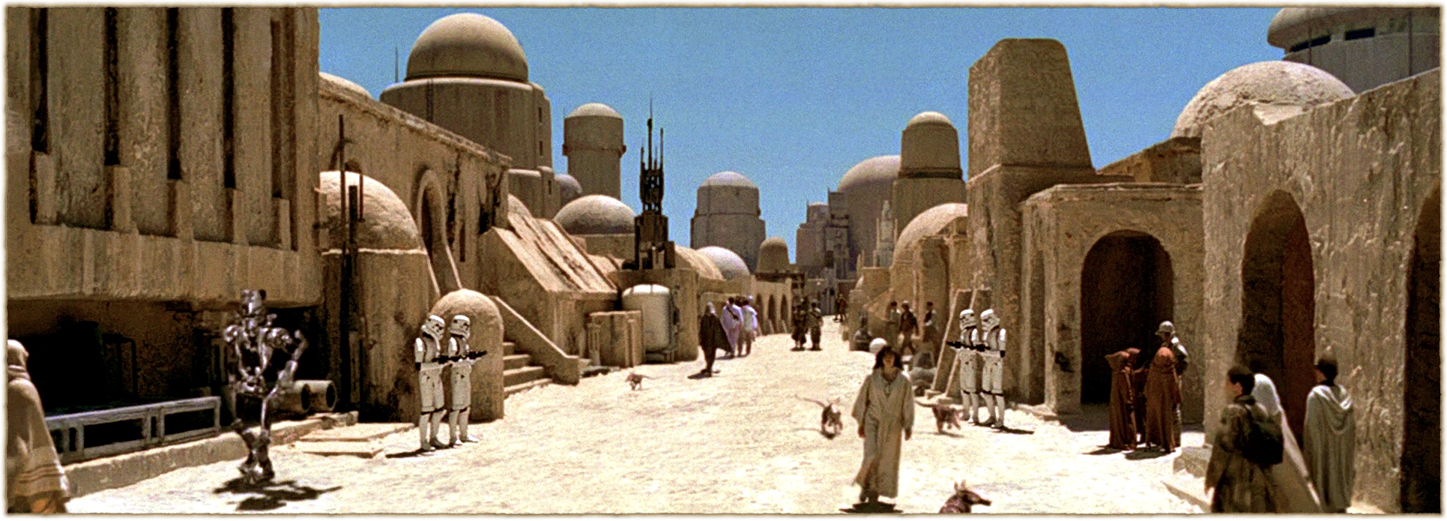
"NaN is a wild land governed by laws both alien and arcane."
- Luna Celeste
https://starwars.fandom.com/wiki/Mos_Eisley/Legends?file=Mos_Eisley.png
https://github.com/brass75/nan-talk
Notes:
As we have seen, NaN is a wild land, governed by laws both alien and arcane. But what can we do about it?

Slide 27
Introducing NanDict
A subclass of Python's dict class that allows for a single nan key
  A singleton value of nan is used.
  Any access will look at the key and if it is a nan it will be replaced by the sentinel nan
https://github.com/brass75/nan-talk
Notes:
Introducing NanDict - a subclass of Python's dict class that allows for 1, single NaN key. It detects that the key is a NaN and uses a predefined singleton for any access - both adding or retrieving a value.

Slide 28
How it works
from math import nan
class NaNDict(dict):
"""A Python Dictionary that can only accept a single NaN as a key"""
def __init__(
self, init: Mapping | Iterable | None = None, **kwargs
):
super().__init__()
self.update(init, **kwargs)
def __setitem__(self, key, value):
key = nan if key != key else key
super().__setitem__(key, value)
def __getitem__(self, key):
key = nan if key != key else key
return super().__getitem__(key)
https://github.com/brass75/nan-talk
Notes:
Before we see it in action, let's take a quick look at the code.
The first thing is subclassing `dict`.
We do want to call `super().__init__()` to initialize the dictionary but we don't want to pass it the initialization variables. We'll handle that ourselves by calling `self.update`.
The magic happens when we try do something with `NaN` as a key. We simply check to see if it is a NaN and if it is we use a singleton value. In this case, I imported `nan` from `math` but I could have, just as easily, created my own and held on to it.

Slide 29
Live Demo
https://github.com/brass75/nan-talk
Notes:
Create a set of 10 NaN objects
Create a dict using from_keys
Create a NaNDict using the dict

Slide 30
Introducing NanCounter
Extends NanDict
Replaces the __init__ with the counting
https://github.com/brass75/nan-talk
Notes:
Introducing NanCounter - a Counter class that will tell you how many instances of NaN are in your iterable.

Slide 31
Another Live Demo
https://github.com/brass75/nan-talk
Notes:
Create a Counter from the set we did in the previous demo
Create a NaNCounter from that set

Slide 32
But wait! There's more!
Support for handling different NaNs has been added!
class NaNDict:
_mappings = {as_int(nan): nan}
def _get_key_mapping(self, key: Any) -> Hashable:
match key:
case float():
return self._mappings.setdefault(as_int(key), key) if key != key else key
case _:
if not isinstance(key, Hashable):
raise ValueError(f'Provided key is not Hashable. {repr(key)}')
return key
https://github.com/brass75/nan-talk
Notes:
You thought we were done, didn't you? No. There's one more thing.
There are different NaNs - we talked about that already. So we should support them all.
In order to add that support we add a bytes --> key mapping. This is a dictionary where we take the bytes for the NaN, stored as an int, and map that to the specific NaN object. Then when something tries to access the dictionary with a NaN we check to see if it's one that's recognized. If it is, we give that back and if it's not we map it. Everything else works the same.

Slide 33
One More Live Demo
https://github.com/brass75/nan-talk
Notes:
Introduce Bruce Wayne
Create a NaNCounter from Bruce
Show what decoded Bruce looks like
Show the Zen
Pick a line from the Zen
Encode the line
Show a NaNCounter from the Zen
Create a dict with the decoded values and counts from the NaNCounter
Show the decoded line

Slide 34
Using NanDict, NanCounter, and NaNCipher
NanDict, NanCounter, and NaNCipher are available on PyPI!
To install:
uv add nandict
pip install nandict
To use:
from nandict import NaNDict, NanCounter, NaNCipher
https://github.com/brass75/nan-talk
Notes:
You can find NanDict, NanCounter, and NanCipher on PyPI and install them for yourselves! The package name is nandict so feel free to install them with uv, pip, or your package manager of choice!

Slide 35
Roadmap!
While NaNDict and NaNCounter have a basic test suite I would like to see it be more extensive and include some level of performance testing.
At the moment the key mapping is just for NaN values, but we could expand it to other types. Maybe by adding a convenient way to override the `_get_key_mapping()` method.
PRs are welcome!
https://github.com/brass75/nan-talk
Notes:
What kind of open source project would NaNDict be if we didn't have a roadmap for future development?
I did add some basic testing while working on NaNDict for this demo but it could be more extensive. I would love to add some performance testing to it.
But what if someone wanted to have their own method for mapping keys, and not just the one I implemented. We could add a way for the caller to specify the method for handling the key mapping.
PRs are welcome!

Slide 36
Recap and Conclusion
https://github.com/brass75/nan-talk
Notes:
I would like to take a quick moment to thank the Electrical and Electronics engineers for giving us NaN. With IEEE-754, they gave us a standard for floating point notation including ways to represent both infinity and things that are not numbers. NaN has a lot of interesting properties and, if you write code that ends up producing them, can be a real PITA and give you some weird results if you're not careful.

Slide 37
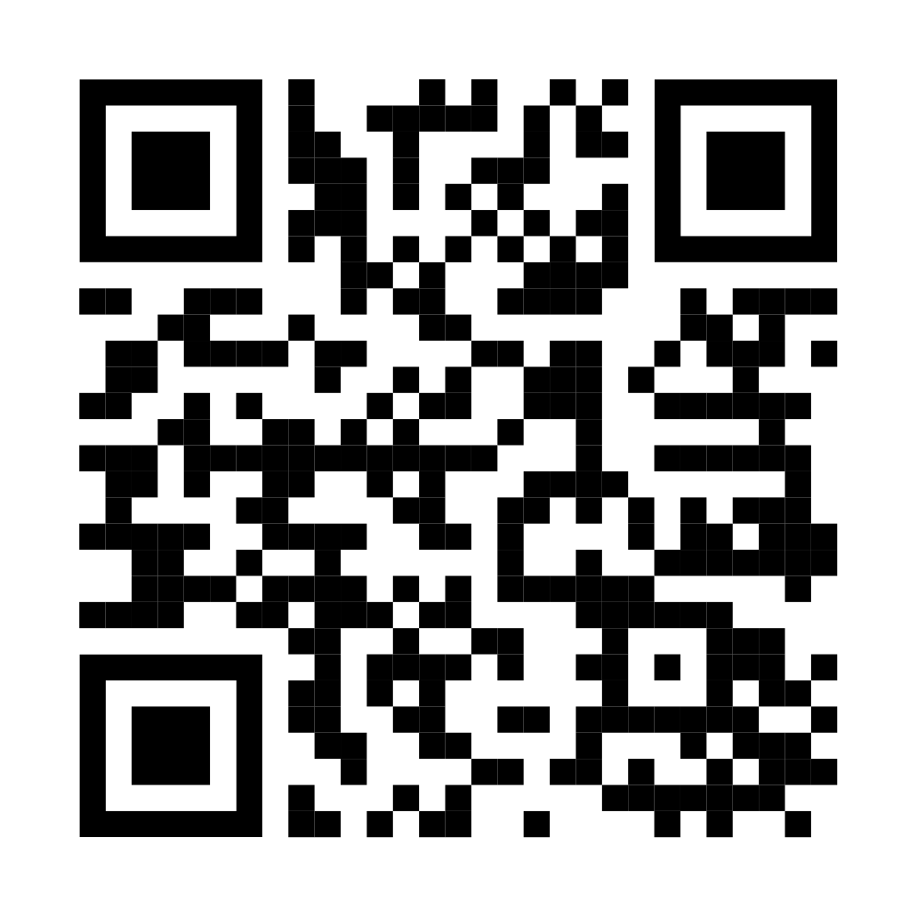
Dan Shernicoff
dan@brassnet.biz
https://brassnet.biz
https://masto.bnet.boo/@brass75
https://github.com/brass75/nan-talk
Notes:
Again, I'm Dan Shernicoff. Here are the links to where you can find me on the interwebs. The bottom link (and the QR code) will take you to the GitHub repo where you can find this presentation, the code I've used, and my notes. If you're interested in submitting your own talk to a CFP you can also see the description and outline that I submitted in that repo.

