Slide 1
Android Layout and Widgets
Intro to Android Programming

Slide 2
Course Outline
Android Layouts and Widgets
XML based layout creation
Views - Button, Checkbox, Label, Edit Text, Radio Group, Radio Button
Linear and Relative Layouts
Lab – Widget Interaction

Slide 3
XML based layout creation
As seen in the earlier sections, the Eclipse IDE provides a graphical based layout editor, but the UI layouts are actually defined using XML
Using XML to define the screen layouts helps to separate the layout code from the implementation code
The XML file contains the layout of all the XML elements, both widgets and containers
Specifies the relationships of widgets with each other and their containers
Very similar to laying out a webpage
Located in res/layout – aka main.xml
Your layout file will be a tree of XML elements
The attributes or properties of each element then define how the element should look and behave
The properties can be accessed via the Java code too

Slide 4
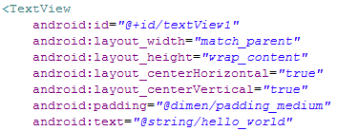
XML layout widget properties
Each element that can be used supported a variety of XML properties that can be set.
Layout properties - Each item in the layout file as a minimum must define the layout_height and layout_width properties
MATCH_PARENT - the view will be as big as its parent (minus padding)
WRAP_CONTENT - the view will be just big enough to enclose its content (plus padding)
An exact number of pixels – not recommended if supporting multiple screen sizes.
ID properties – To interact with an item it must be assigned an ID
The “@” symbol indicates to the XML parser that this is an ID resource
The “+” symbol indicates that it is a new resource. Do not include the “+” if this is meant to be a reference to another widget
Access this widget later with View.findViewById() or Activity.findViewById()
The Text property shown above is optional and could have the string defined locally

Slide 5
Common XML widgets
TextView
Can do all the things you would expect, set bold, italic, set color
Can set the text in code, XML, or via a resource defined elsewhere res/values/strings.xml (@string/hello)
Button
Derives from TextView
Can set the associated “click” method an additional way to the OnClickListener
Best method. Set from the IDE properties page.
Image
ImageView, ImageButton
In main.xml need to include android:src attribute
supports common still-image formats PNG, JPG, and GIF
EditText
Derives from TextView
Typical Edit box properties and also items like autoText, digits, singleLine

Slide 6
Common XML widgets
CheckBox
Derives from CompoundButton which derives from TextView
Typical checkbox properties, isChecked, setChecked, toggle
Can wire up a handler right from the XML just like the button or set up the OnCheckedChangeListener
RadioButton, RadioGroup
Derives from CompoundButton which derives from TextView
Place inside a RadioGroup
Typical properties, check, clearcheck, getCheckedRadioButtonId
Useful methods - http://developer.android.com/resources/tutorials/views/hello-formstuff.html
setEnabled, isEnabled, requestFocus, isFocused, getParent, findViewById
android:autoText - control if the field should provide automatic spelling assistance
android:capitalize - control if the field should automatically capitalize the first letter of entered text (e.g., first name, city)
android:digits - configure the field to accept only certain digits
android:singleLine - control if the field is for single-line input or multiple-line input

Slide 7
Lab – Widget 101
Upon completion of this lab the student should be able to understand the following
How to create the basic widgets commonly used
How to interact with these widgets

Slide 8
Lab – Widget 101
We will update the existing HelloWorld lab project
Add a TextView
Add a Button
Add an ImageView
Add an EditText
Add a CheckBox
Add a RadioGroup
Use the Graphical Layout editor to add the new widgets
ImageView is located in Images & Media
When adding an ImageView a Resource Chooser dialog will be displayed Select ic_launcher and then OK
EditText in TextFields, choose the Plain Text version
CheckBox and RadioGroup are in Form Widgets

Slide 9
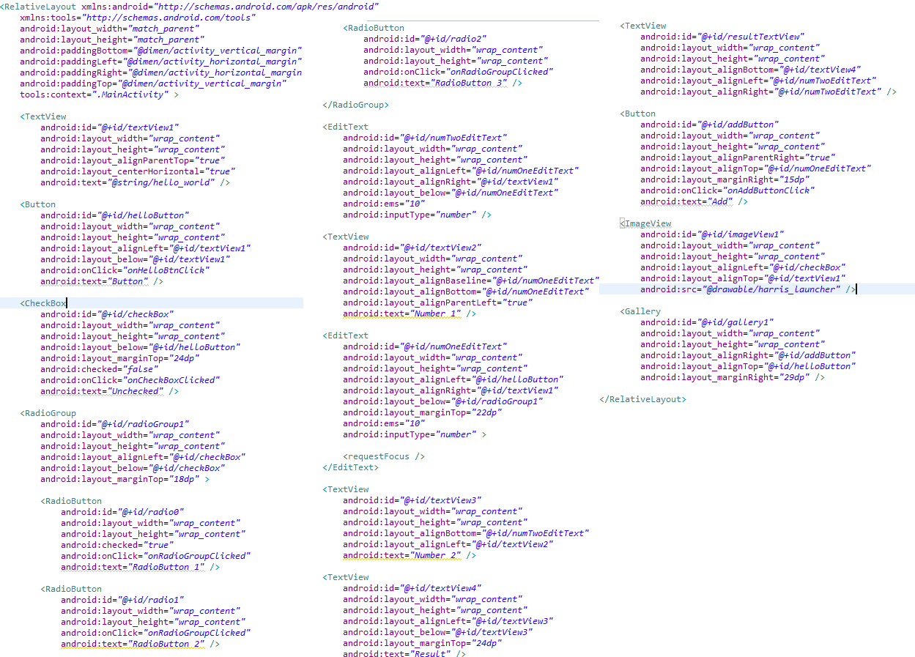
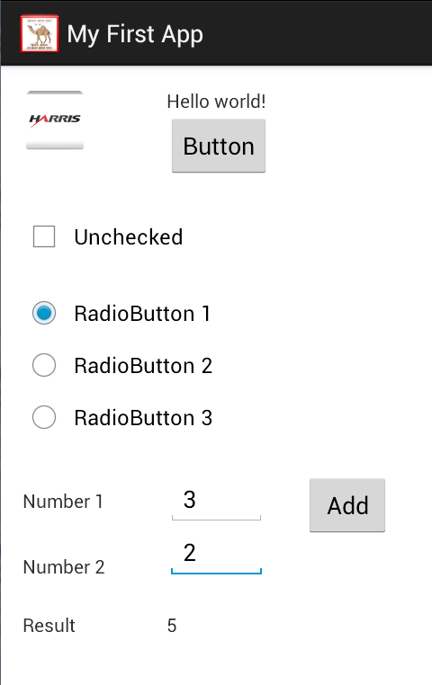
Lab – Widget 101
These settings should be updated in the graphical Editor. They can be updated in the XML and later at runtime using the Java class that will be associated with the layout, However that can be risky and mistakes can happen very easily.

Slide 10
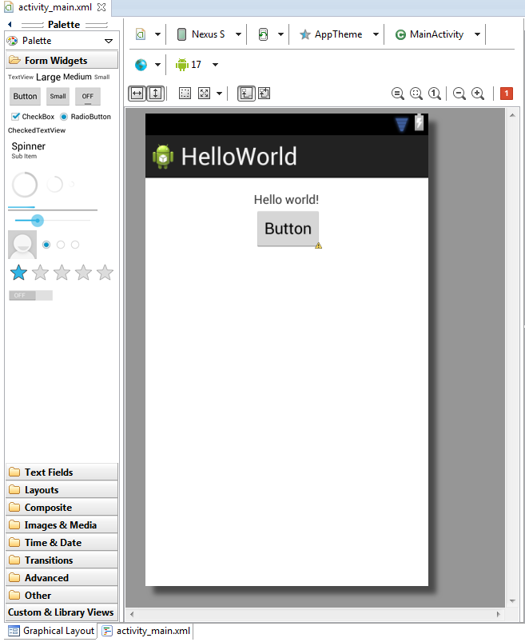
Lab – Simple Activity
Add the button via the Graphical Layout Editor
This is the preferred method.

Slide 11
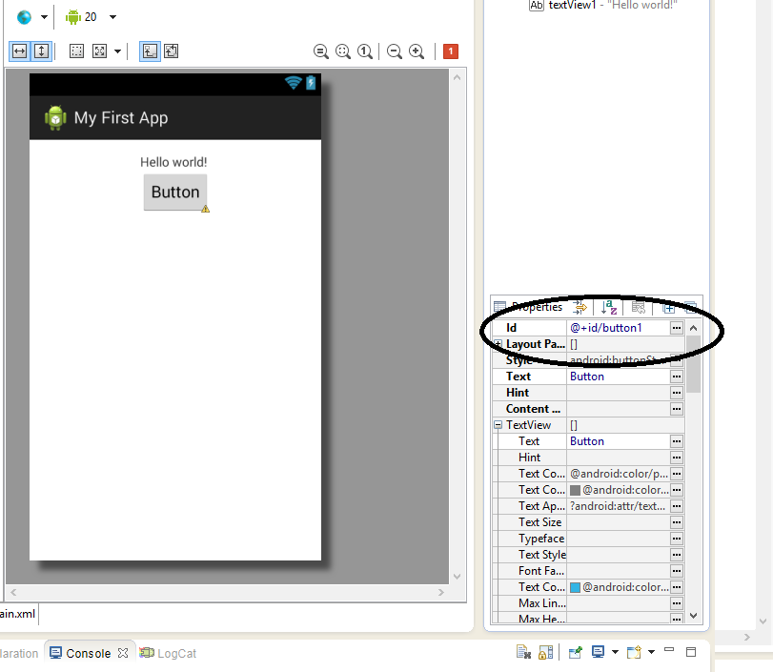
Lab – Simple Activity
Select the button
In the Id field of the properties tab change the name of the button from button1 to myButton
Do not remove the @+id/
Should be @+id/myButton
All names MUST start with lower case.

Slide 12
Lab – Simple Activity
Now we need to wire the button member variable to the screen object it needs to be associated with.
Use the method findViewById to create this binding.
The result must be cast to match the type (in this case Button).
The parameter is the ID that was set in the Layout file, addressable via R.id.<your ID>.
The button also needs to have it’s onClick method defined so that the class knows what to do when the button is clicked. This is the function that will be called upon a action on the button.
In graphical editor, click the button then scroll down in the Properties window to you see “On Click”. Type in “onHelloBtnClick”.
Next we need to add code to the MainActivity.java file to
Create a Button
Associate the Button variable to our button on the activity.
Import the Button type. This is pretty simple
Create the button callback function with
Specific format
Same name as you put in the onClick section before.
Then we will add some code to do something when you push the button.
Change the text back and forth each time we push the button

Slide 13
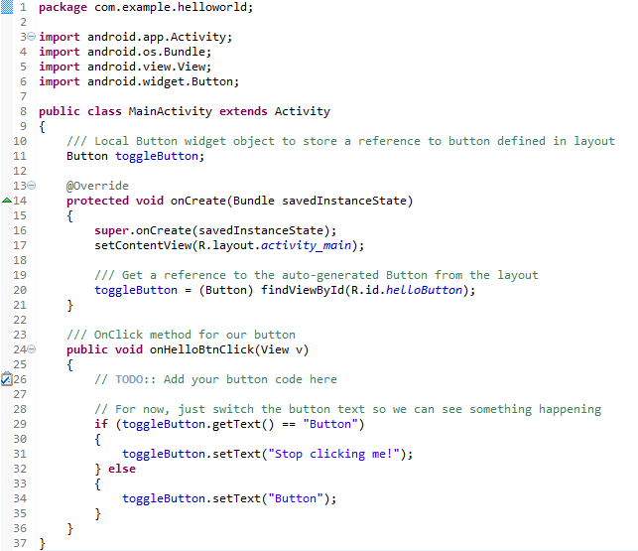
Lab – Simple Activity
Here we associate a class member variable with a reference to the Button object defined in the layout.
Create Button
Hit Ctrl-Shift-O to automatically organize the imports.
Or left click the Light that comes up next to the button and select Import Button.
NEVER select create class.
Here we associate a class member variable with a reference to the Button object defined in the layout.
Connect to Activity via button ID.
The OnClickListener is automatically wired up by the layout since we defined a method for the “On Click” property.
NOTE: You need to define the “onHelloBtnClick” with the prototype shown here and name needs to exactly match the one you put in the “On Click” property for the Button in the layout.

Slide 14
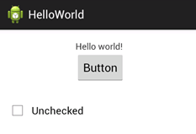
Lab – Widget 101
Now start adding functionality to the other widgets.
Drag a CheckBox onto the layout
Click on the CheckBox and change its id to “checkBox”
Change the CheckBox’s Text field to “Checked”
Update the CheckBox’s “Checked” property to “false”
You should now see a an empty checkbox
Set the On Click property to “onCheckBoxClicked”
Now go into the Activity Java code
Add a class member variable for the CheckBox
Hit Ctrl-Shift-O to automatically organize the imports
Create you callback funtion with “yourName(View v) OR
Copy-and-paste the existing “onHelloBtnClick”
Rename the copy to “onCheckBoxClicked” or what ever you named your callback function.
Change all of the code in your checkbox handler to use your CheckBox class variable instead of the one for your Button
If the CheckBox is checked set its text field to “Checked”
If the CheckBox is not checked, set its text field to “Unchecked”
Build the project and run it in your AVD

Slide 15
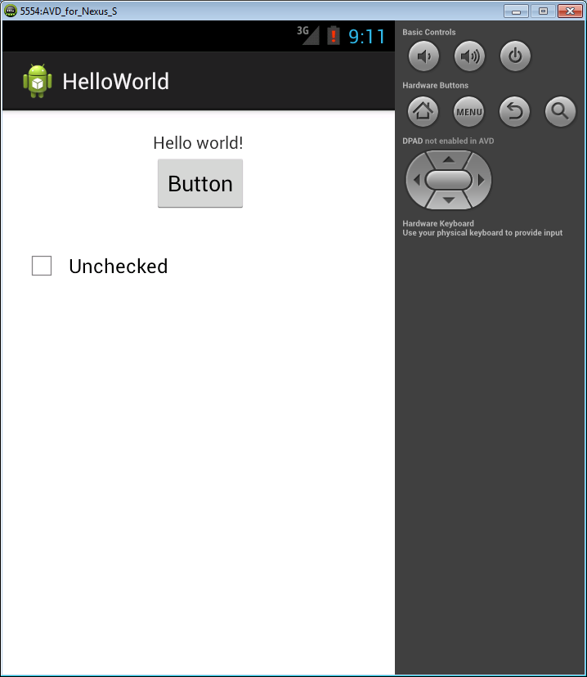
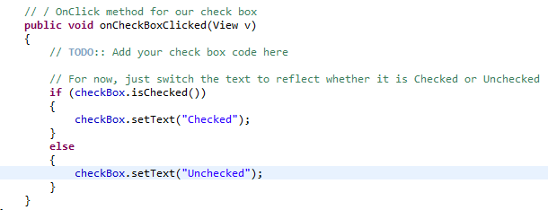
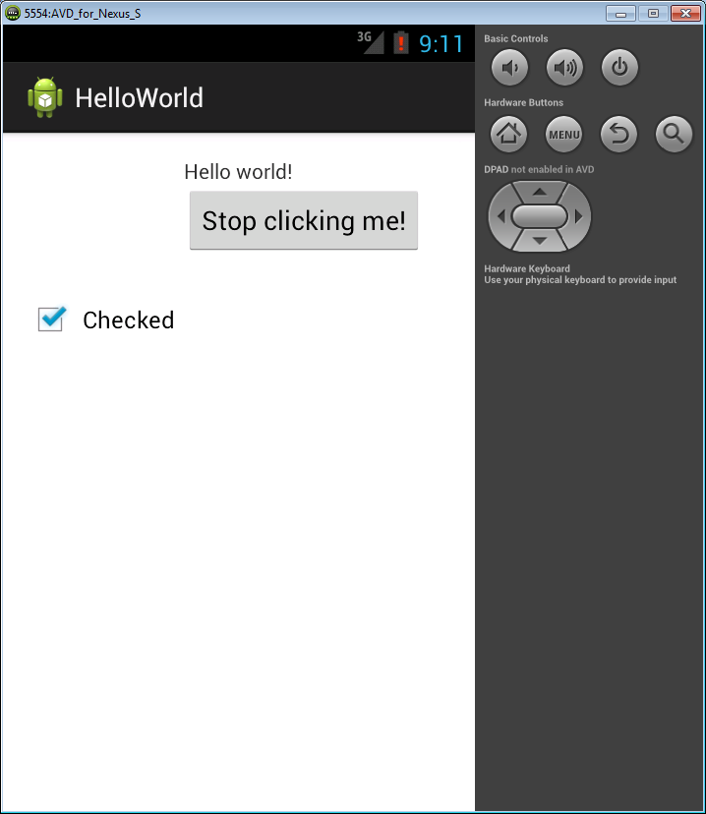
Lab – Widget 101
Note that the listener passes in the base class of View which then could be cast to a CheckBox – or we can access our defined variable directly

Slide 16
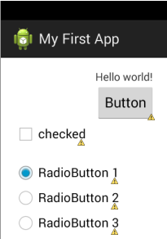
Lab – Widget 101
Drag a RadioGroup onto the layout
This looks like 3 circles in a horizontal row with the left-most one filled in and blue
A RadioGroup is a grouping of radio buttons that allows only one radio button to ever be checked. If you check a different one, the previous one becomes unchecked. So it is a way to present multiple mutually-exclusive options.
Change the Text field of each radio button to end in a number
Note: There are 3 by default
By default they have id’s “radio0”, “radio1”, and “radio2”.
The radio group itself has id “radioGroup1”
The RadioGroup itself is “invisible” on the layout.
It can be selected by clicking on “radioGroup1” in the “Outline” window in Eclipse
And then its properties can be changed graphically in the Properties editor

Slide 17
Lab – Widget 101
Add an On Click method for each Radio Button (but not the Radio Group)
Call it “onRadioGroupClicked”
Make sure each Radio Button uses the same function callback.
This will have each click go to the same function where we will determine who called it.
In the Java Code
Create class member variable for the RadioGroup and wire to layout
Create class member variable for the TextView and wire to layout
This is your very first “Hello world!” text.
Implement the onRadioGroupClicked() method
challenge :: figure out which radio button was clicked then update the text value of the radio button to the TextView at the top of the activity.
See next slide to learn how to figure out which radio button was clicked.
Build the project and run it in your AVD

Slide 18
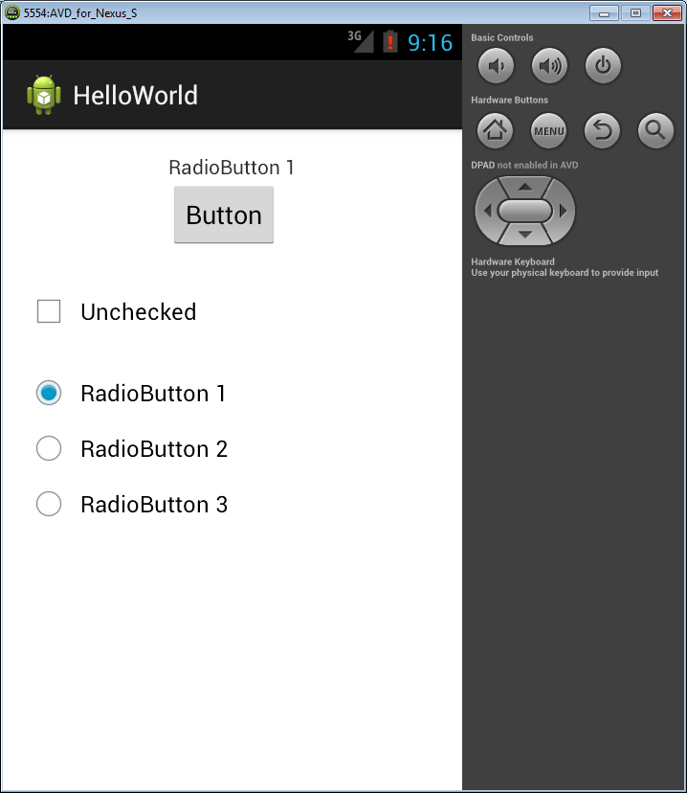
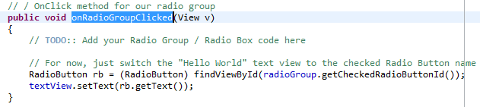
Lab – Widget 101
In this example, use the ID to get the actual button that was selected, then get it’s text value and set to the EditText object.

Slide 19
Debugging tools
Now lets add some simple debugging tools that will help the developer by
Giving textual output during specific points of execution in your code.
Use Logging to output information to the debugger
Give Textual output to the user that has limited life
Use a “Toast”. This is a simple textbox that will display to the user for a short period of time.

Slide 20
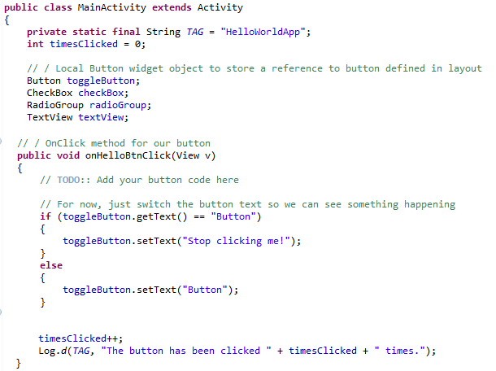
LogCat Log Debugging
High-performance debug logging while connected to device via USB or while using AVD
Add integer to class.
Add String “TAG”. This is useful to identify where you put the debug statement
In Button click callback “onHelloBtnClick” increment the integer each time you click the button.
Add Log.d function to log the information

Slide 21
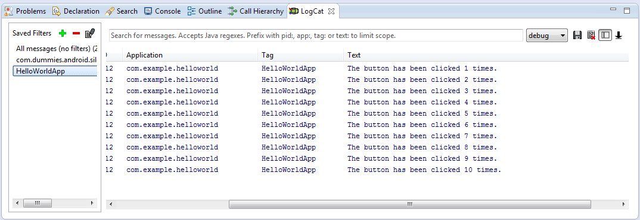
LogCat Log Debugging
You can create filters to only see data based on the “TAG” that you set in your Class.
Useful to filter the information you wish to see. This will switch the minimum log level viewed

Slide 22
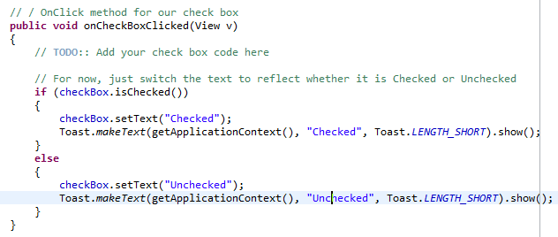
Toast Debugging
Low-performance debug logging that is viewable within your App during runtime
Use sparingly for an actual deployable app
Add two Toasts to the onCheckBoxClicked() method
One for the “if” case and the other for the “else”.
Have toast say “Checked” or “Unchecked”

Slide 23
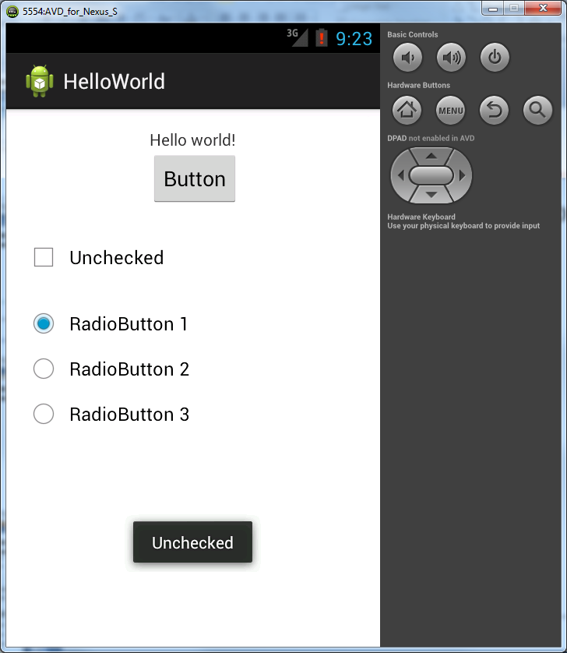
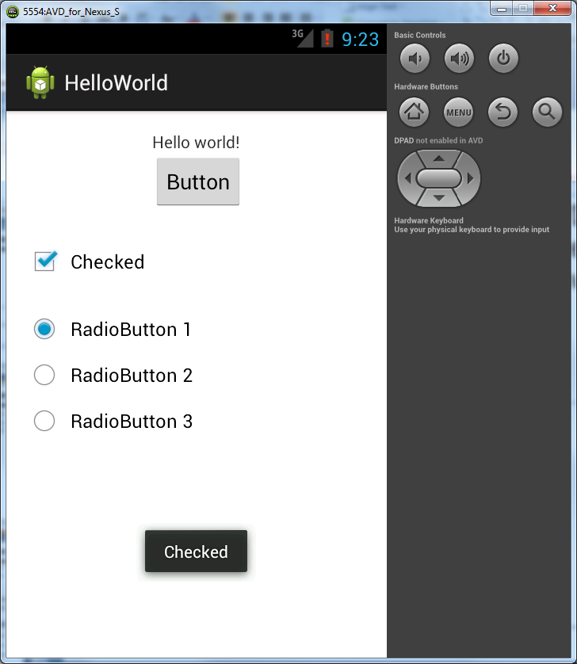
Toast Debugging
The AVD may run a bit slower than your phone would in real time

Slide 24
Saving Data in Preferences
SharedPreferences
Interface for accessing and modifying preference data returned by Context.getSharedPreferences. For any particular set of preferences, there is a single instance of this class that all clients share. Modifications to the preferences must go through an Editor object to ensure the preference values remain in a consistent state and control when they are committed to storage. Objects that are returned from the various get methods must be treated as immutable by the application
getSharedPreferences(String name, int mode)
Retrieve and hold the contents of the preferences file 'name', returning a SharedPreferences through which you can retrieve and modify its values. Only one instance of the SharedPreferences object is returned to any callers for the same name, meaning they will see each other's edits as soon as they are made.
Overrides: getSharedPreferences(...) in Context
Parameters:
name Desired preferences file. If a preferences file by this name does not exist, it will be created when you retrieve an editor (SharedPreferences.edit()) and then commit changes (Editor.commit()).
mode Operating mode. Use 0 or MODE_PRIVATE for the default operation, MODE_WORLD_READABLE and MODE_WORLD_WRITEABLE to control permissions. The bit MODE_MULTI_PROCESS can also be used if multiple processes are mutating the same SharedPreferences file. MODE_MULTI_PROCESS is always on in apps targetting Gingerbread (Android 2.3) and below, and off by default in later versions.
Returns:
Returns the single SharedPreferences instance that can be used to retrieve and modify the preference values.
In Essense :: You can store all your data in a preference. You can then reload the data either on startup or access it in other activities

Slide 25
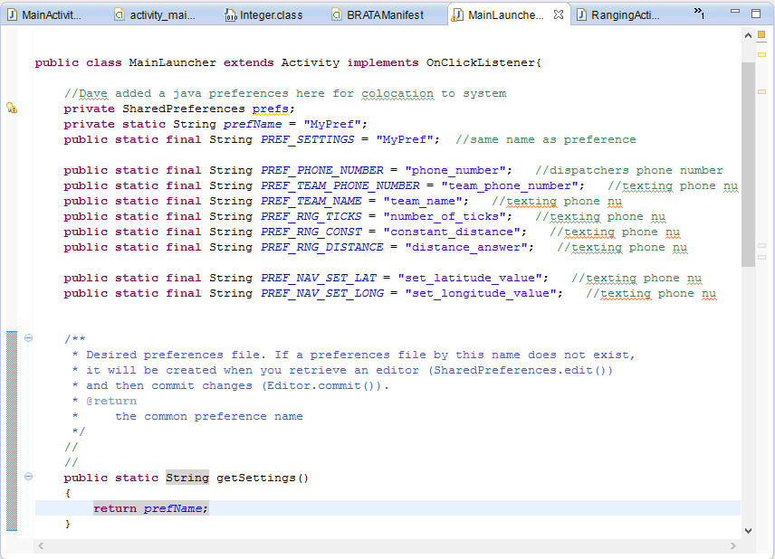
Saving Data in Preferences
Preference object accessed via common “name”.
All data stored must also have a common “name”
Data stored as a STRING

Slide 26
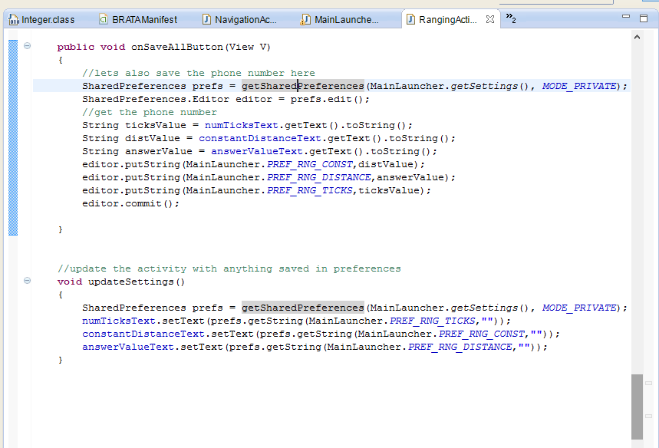
Saving Data in Preferences
All data stored must also have a common “name”
Data stored as a STRING
Preference object accessed via common “name”.
If this is the first time saving then “commit” will create the preference file.
Function to update this activities values. I call this in the onCreate() function .

Slide 27
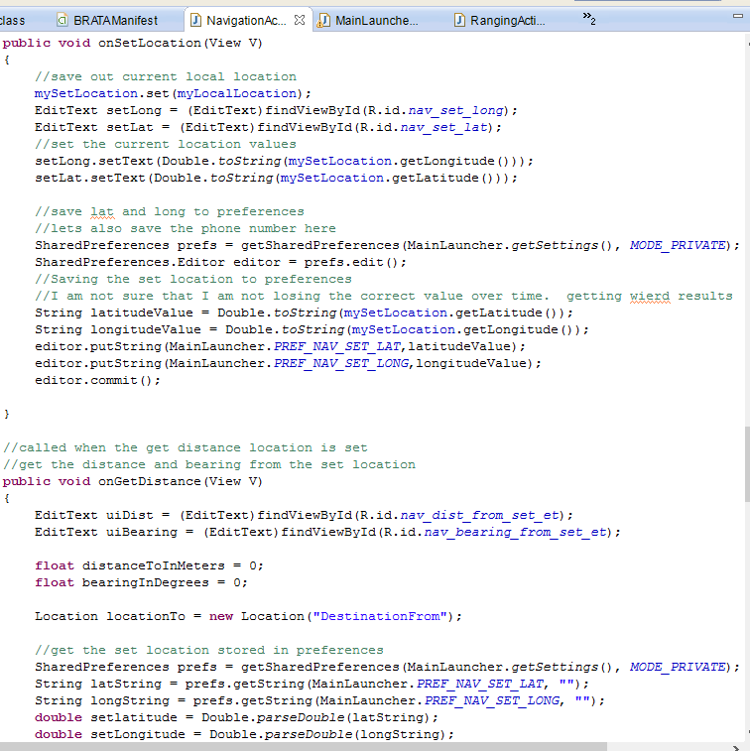
Saving Data in Preferences
Preference object accessed via common “name”.
Note that DOUBLE values are converted to strings to save
All data stored must also have a common “name”
Data stored as a STRING
Getting the data from preferences
Note that the strings are now converted back to doubles

Slide 28
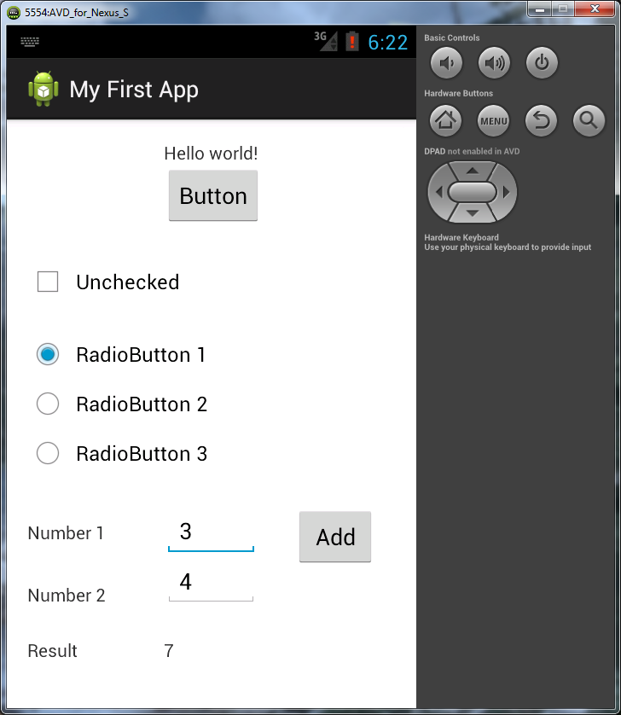
Lab - Calculator
Now we are going to create add a simple calculator to our Hello World app using
Edit Text
Text View
Button
Add a Text View (“Number 1”) and a Edit Text (numOneEditText)
Add a second Text View (“Number 2”) and a Edit Text (numTwoEditText)
Add a third Text View (“Results”) and a text view (resultsText)
Add a Button called (addButton)

Slide 29
Lab - Calculator
Now add a callback function for the button like before
Get LOCAL references for our widgets.
We don’t need global references
Convert the two edit text inputs to integers.
int inputOne = Integer.valueOf(numOne.getText().toString());
The Integer class is a default Java wrapper class that provides nice convenience functions for conversion
Add the numbers and output back to our resultsText Text View.
resultsText.setText(Integer.toString(result));
BONUS :: Save number 1 and number 2 in preferences.
Show that the numbers come back when you restart the application
Remember that once the IDE loads the application you can access it like a standard app in the emulator.

Slide 30
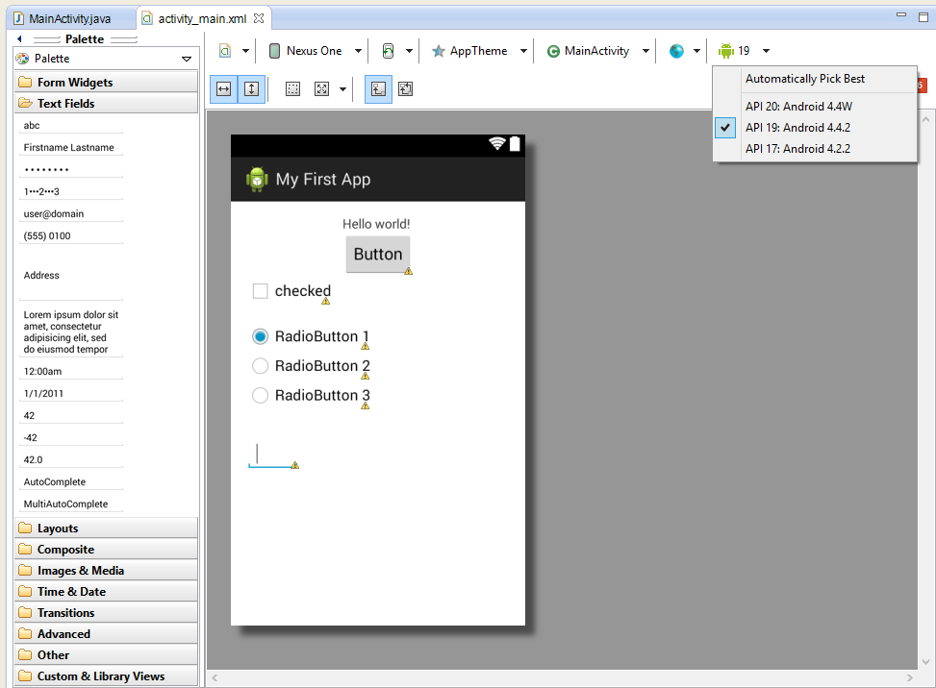
Another 4.4w (API20) gotcha
It does not support EditText. So in the Activity xml file, in the Edit window, drop the API for rendering to API19

Slide 31
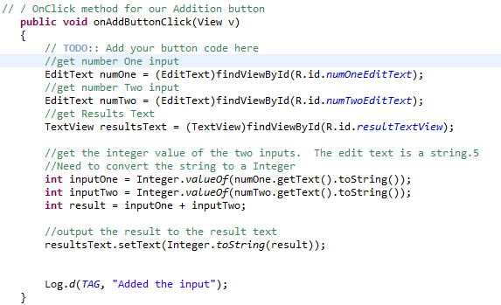
Lab Calculator
Now for fun try entering something other than a number into your Edit Text input and then add.
Looks like we should have done some error handling

Slide 32
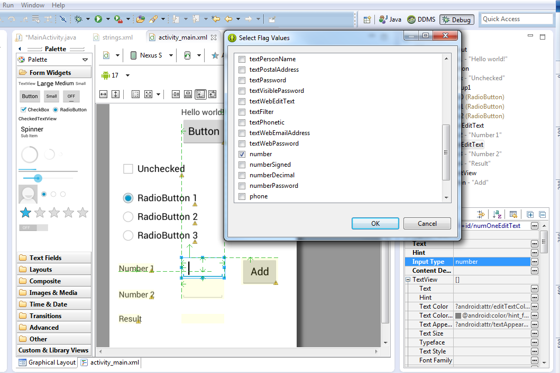
Lab Calculator
Limit the EditText fields to numbers only.
Now the Edit Text will only take numeric input.
Instructors can also demonstrate how to use the debugger with the AVD

Slide 33
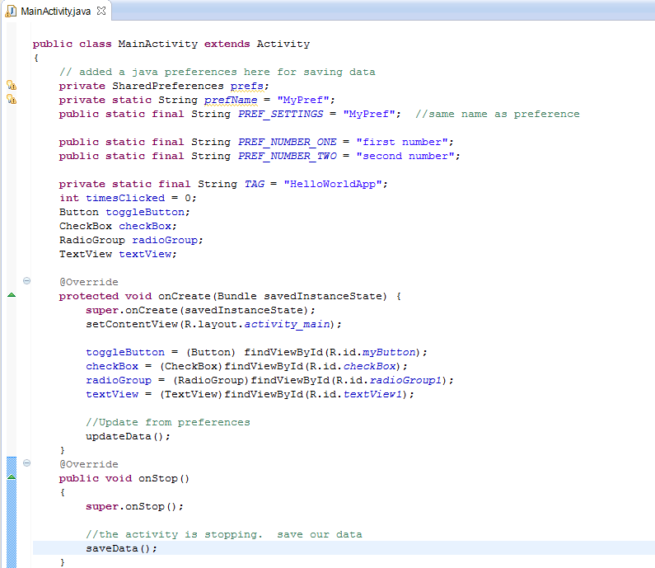
Bonus : Save Data in Calculator
All data stored must also have a common “name”
Data stored as a STRING
Preference object accessed via common “name”.
Function to save data. Called in the override function for onStop. (Remember the activity flow chart?)
Function to update this activities values. I call this in the onCreate() function .

Slide 34
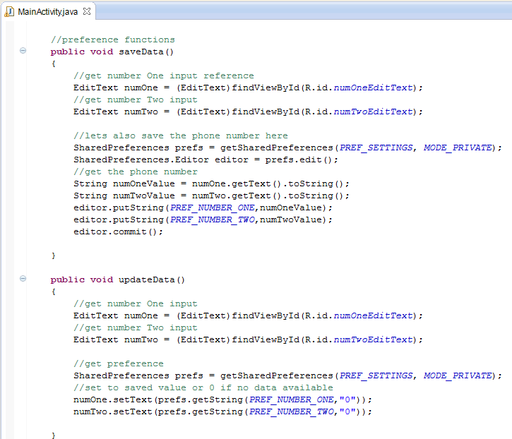
Bonus : Save Data in Calculator
Function to save data. Called in the override function for onStop. (Remember the activity flow chart?)
All data stored must also have a common “name”
Data stored as a STRING
Preference object accessed via common “name”.
Function to update this activities values. I call this in the onCreate() function .

Slide 35
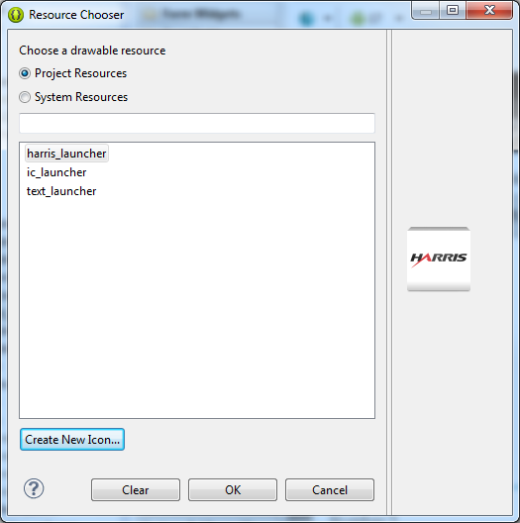
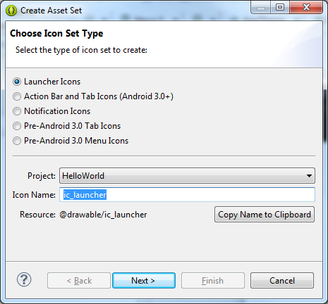
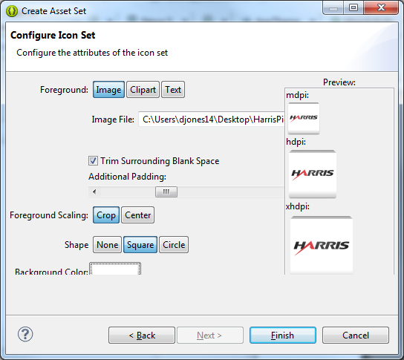
Lab – Add Image View
ImageView is located in Images & Media
When adding an ImageView a Resource Chooser dialog will be displayed Select ic_launcher and then OK
Add a default Icon or pick out a picture of your own.
Name the new Icon
Select the configuration
Now you have a new icon that can be selected for the Image View

Slide 36
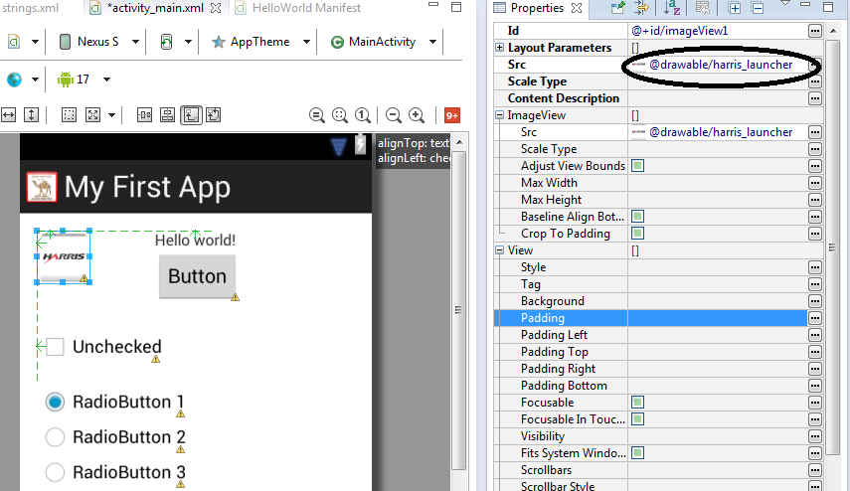
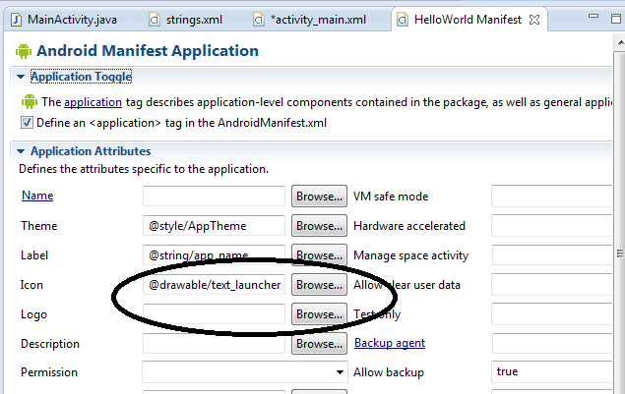
Lab – Update Icon
For the Image View – add the new icon in the SRC option of the properties tab
For the application Icon
Update from the HelloWorld Manifest

Slide 37
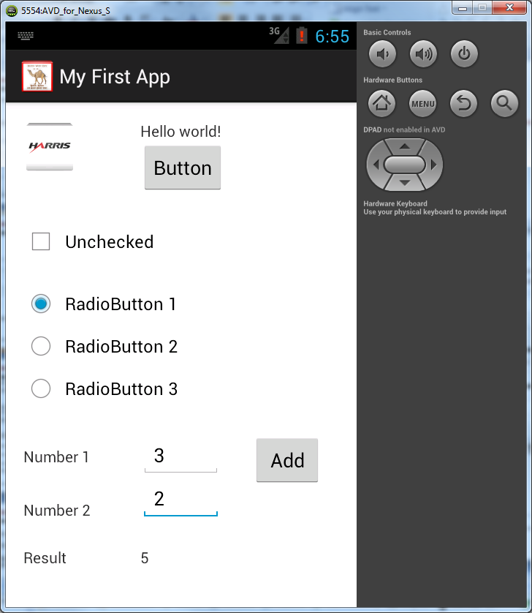
Hello World applicaton
The Final application should look something like this.
Congratulations !! You have created your first android App.

Slide 38
Most common layout types
LinearLayout, RelativeLayout, and TableLayout are three very commonly used ways to group Views (TextView, EditText, Button, Spinner, etc…) together.
Keep in mind that every view and every layout manager, added to the application comes at a cost: initialization, layout and drawing become slower
LinearLayout - This is the layout that has been used in the previous labs
Very easy to utilize, can be oriented horizontally (rows) or vertically (columns)
android:orientation property - set the value to be horizontal for a row or vertical for a column
Place Views within the LinearLayout container and it will handle aligning them
Very easy to misuse and create too many layers to the layout tree
Useful property settings
android:layout_weight – sets what proportion of the free space a widget gets. If there are two widgets and you set one’s weight to 1 and the other one’s to 2, the second will get twice as much of the free space.
android:layout_gravity – alignment - default for LinearLayout is align top left.
Column values are left, center_horizontal, and right
Row values – default to let the widgets align along their bottom, but use center_vertical to center along the row’s vertical midpoint
android:padding – use this to insert whitespace between widgets. Using this property will add padding around the widget equally.
If the padding needs to vary on each side, use android:padding<Left, Right, Top, Bottom>

Slide 39
Most common layout types
RelativeLayout
Contents are laid out based on their relationship to the other widgets and the parent container
Alignment is based on total size – includes padding if any
Set relationships to parent container using:
android:layout_alignParrent<Top, Bottom, Left, Right>
android:layout_center<Horizontal, Vertical, InParent>
These are set using true or false
Set Relationships to other widgets using:
Referenced widgets need to have an id tag and should be referenced using “@id”
android:layout_<above, below, toLeftOf, toRightOf>
android:layout_align<Top, Bottom, Left, Right, Baseline>
android:layout_toRightOf = "@id/widget_a"
Google has a tutorial about RelativeLayouts on the developer site

Slide 40
Most common layout types
TableLayout
Very similar to creating a table in HTML for a web page
Views are arranged in rows and columns
Google has a tutorial about TableLayouts on the developer site
Scrollview
Given that the Android device will have limited screen area, at some point you will have to use scrolling
Can only have one child element – but that child can have many elements
There is a HorizontalScrollView, but generally users mind scrolling up and down less than side to side

