Slide 1
Intro To the FAT Framework
Mark Ramasco

Slide 2
Course Outline
Getting started
Importing the FAT framework
Understanding the FAT project structure
Adding a new tool
Adding UI widgets to existing views
Using raw values and updating the screen

Slide 3
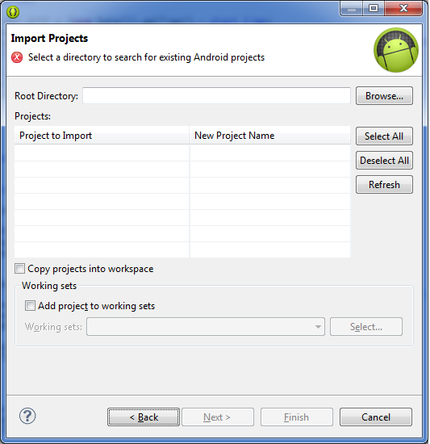
Importing
To import the FAT project into the ADT, navigate to File>Import then select Existing Android Code Into Workspace under the Android section. Browse to the projects location on disk and click ok.

Slide 4
FAT Project Structure
Like any Android Project, the FAT framework contains:
src: contains all the Java files
res: contains images and xml layouts
gen: autogenerated files
AndroidManifest: defines properties of the app

Slide 5
FAT Project Structure
Src
com.harris.challenge.brata package: contains classes to define main structure of the FAT framework
com.harris.challenge.framework package: contains classes that provide access to the phones sensors and messaging system.
com.harris.challenge.tools: contain the tools that you will be using to complete the challenge (hint: you will mostly be working in here.

Slide 6
FAT Project Structure
res
layout: provides all the layouts used in the tools sections described previously. Note that these are mostly empty layouts. You will need to customize these screens to suit your needs.
menu: defines the layout of the apps main screen. You can edit this to customize your app.

Slide 7
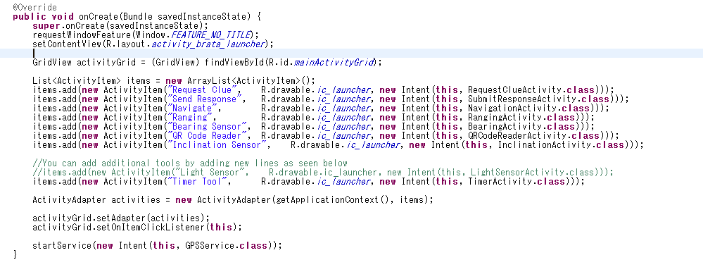
Adding a New Tool
In BrataLauncherActivity.java, we can add a new tool by adding an ActivityItem to the list used in the main app screen.

Slide 8

ActivityItem
An ActivityItem is just a fancy wrapper around an Android Intent. It is ok if you don’t fully understand the purpose of an intent, but understand that they are used to launch the tools we create.
When creating a new ActivtyItem, we need to specify a label, icon, and what to launch. Remember to change these values to customize your app.

Slide 9
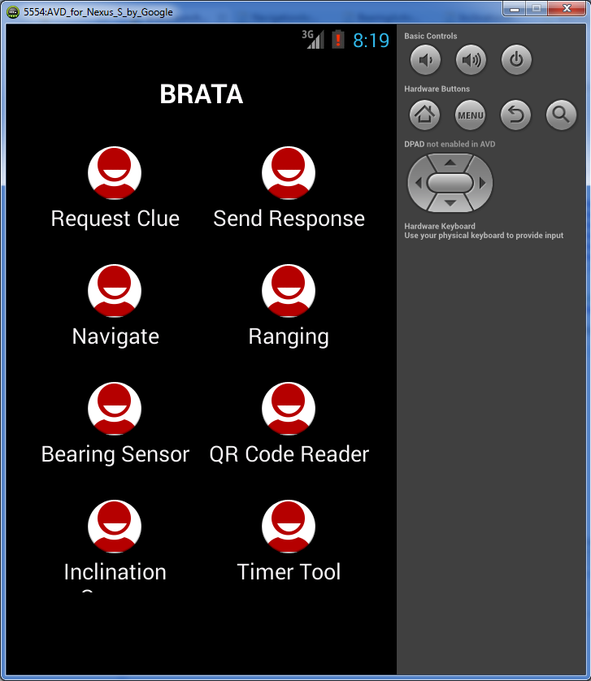
The Timer Tool
Now when we launch the app, we have a new tool available called the timer tool.

Slide 10
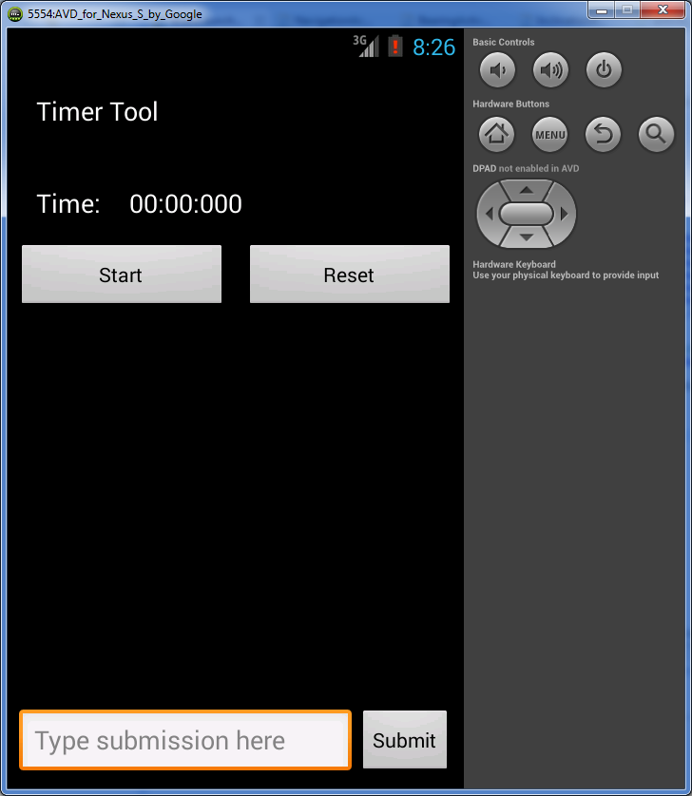
The Timer Tool
Clicking the timer tool, brings us to this screen. The timer tool is for training only, and most of your other tools won’t come with this much built in.

Slide 11
Your Task
The criminal encrypts his clues by taking the current timer’s minute value and multiplying by 42, taking the current second value multiplying by Pi, and taking the current millisecond value and multiplying by E (mathematical constant), then adds them all together.
Your task: To understand the crime scene better, use the timer tool to encrypt the timer value like the criminal, and display it to the screen.

Slide 12
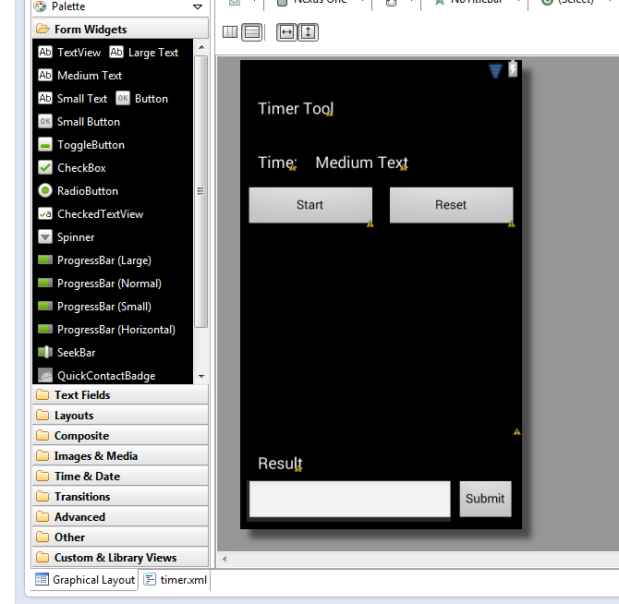
Timer Tool
First, we need to add a TextView in the timer layout for the “result” field. Add it anywhere you want, but give it an ID of “TextResult”. When done, your layout should look similar to this:

Slide 13
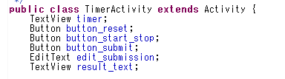

Timer Tool
Since we we will be changing the value of the new text field dynamically, we need to get a reference to it in our java code.
Declare the TextView object
Attach it to the TextView defined in the layout

Slide 14
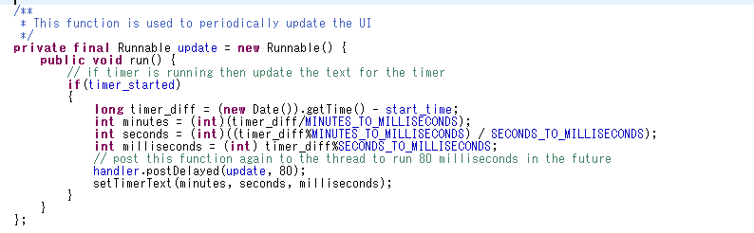
Timer Tool
Similar to the other tools, the FAT framework will often provide “raw” data from either the phones internal sensors, GPS, or the SMS messaging system. The Timer Tool provides the time difference from when you click start in minutes, seconds, and milliseconds.

Slide 15
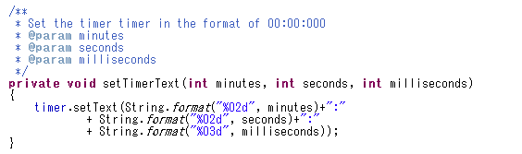
Timer Tool
We can see in the setTimerText method how to take raw values and assign them to a text field.
Note that timer was declared above similar to how we initialized the result view.

Slide 16
Try it out!
Translate the formula described previously into code and use it to output the clue result to the result text view on the screen.
The formula for reference: result = min*42 + sec*pi + ms*e
Hint 1: Use Math.PI and Math.E for math constants.
Hint 2: Ints and floats can be converted to strings with the Integer.toString(val) or Float.toString(val) methods.
Hint 3: If your calculation looks to big, break it apart into separate calculations. Remember to keep consistent data type.

Slide 17
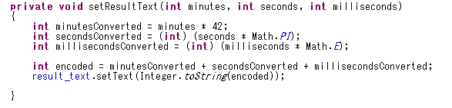
Solution
Here is one way to do it. It is ok if your solution is different, and in fact may be even better (note I convert to an int which loses some accuracy).

