Slide 1
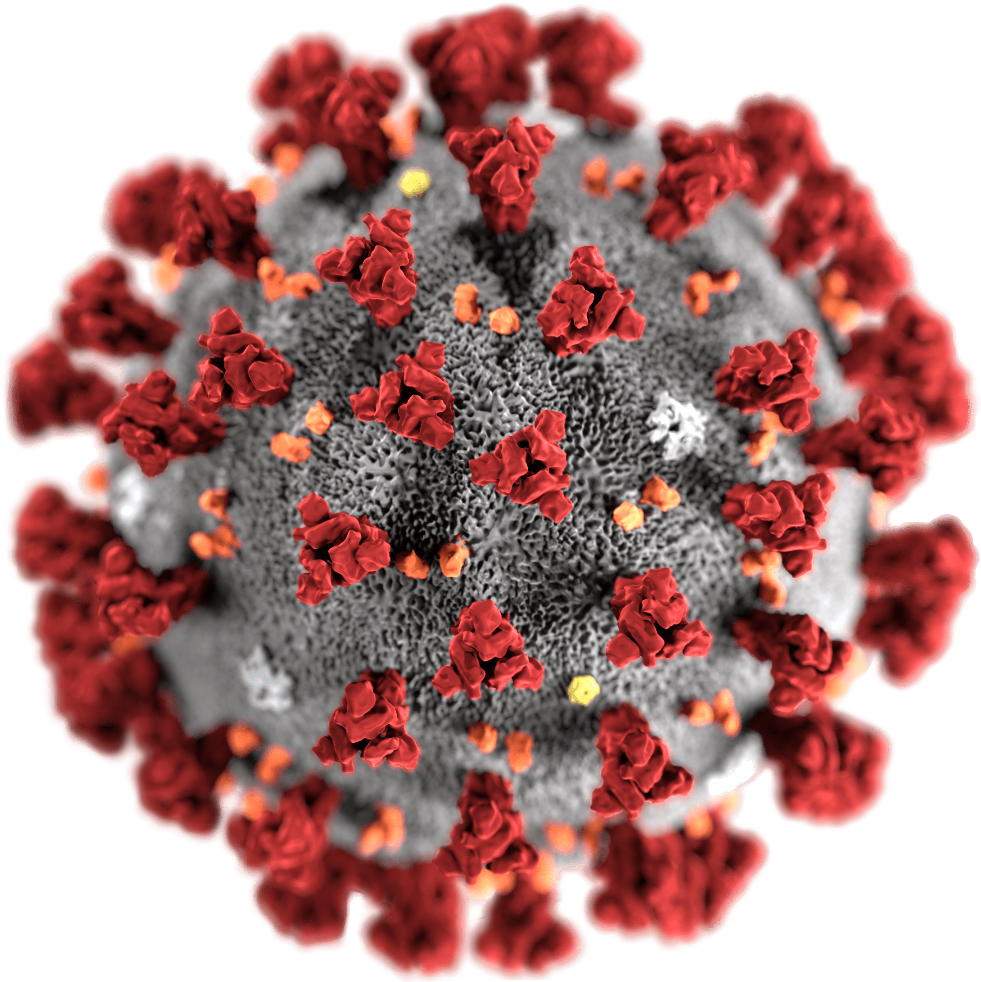

Analysis of Vaccination Rates and Test Cases
Analysis of Age Groups, Test Cases, Vaccination Comparisons and Recovery
( Time Frame 2020-2024)
Data Sources: WHO, John Hopkins University, and other relevant sources.[Sources
are given in Reference]

Slide 2

Objectives of the Analysis
The COVID-19 pandemic has required comprehensive data analysis to understand its impact and develop effective response strategies.
Assessing the spread and impact of COVID-19:
Geographic Distribution: Analyse the spread of COVID-19 across different countries and regions.[ Germany, USA, Italy,India,France,Spain,China,Algeria,Argentina]
Temporal Trends: Examine how the number of cases, deaths, and vaccinations have evolved over time from 2020 to 2024.
Demographic Analysis:
Age Groups: Investigate the distribution of COVID-19 cases, hospitalizations, and deaths across various age groups.
Vulnerable Populations: Identify populations at higher risk of severe outcomes and mortality.

Slide 3

3 . Evaluating vaccination efforts:
Vaccination coverage: Compare the vaccination rates across different countries and age groups.
Comparing Different Vaccines and Efficacy and Side Effects: Compare the efficacy and side effects of various vaccines (eg, Moderna, Pfizer-BioNTech, Covaxin) in preventing infections, hospitalizations, and deaths .
4 Visualizing Data for Insights:
Boxplots and Violin Plots: compare the distributions of cases
Heatmaps and Histplot: shows vaccination coverage across different regions.
Scatter , Line Plots and Pair plots : illustrate trends over time and correlations between variables.
5. Preparing for Future Pandemics:
Lessons Learned: Improve Future Pandemic Preparedness
Building Resilience: building more resilient healthcare systems
and ensure rapid response to future health crises.

Slide 4

Methodology, Tools, Analysis Framework
Time series data to capture trends from 2020 to 2024.
Data sources (eg, WHO, CDC, country health departments)
Key metrics: doses administered, infection rates, age group segmentation for vaccination rates and vaccination comparison
Data :{ vaccinations-by-age-group.csv, affected_country.csv, vaccinations-by-manufacturer.csv, aggregated_vaccine_data.csv } and tools Jupyter lab,anaconda,[Pandas,seaborn,plotly,cartopy,
Numpy],sqlite

Slide 5
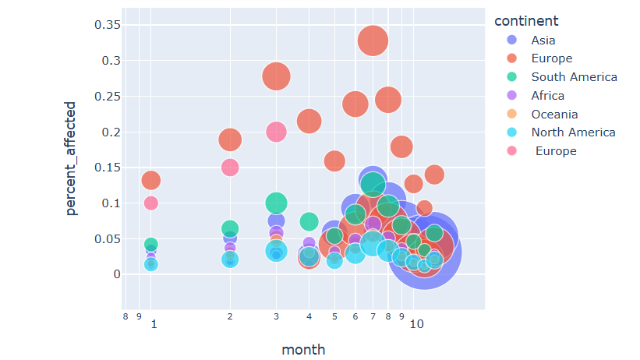
Positive case Visualization Affected Continent by Year
Analysis Insights
Using these visualizations, we can extract several insights:
Total Affected Persons : The scatter will show which countries had the highest total number of affected persons.
Temporal Spread : This will reveal how the pandemic spread over time in different countries, identifying periods of high transmission.
Testing and Case Detection : The scatter plot will help in understanding the relationship between the number of tests conducted and the reported cases, which can indicate the effectiveness of testing strategies.
Trends Over Time : The line plot will illustrate the temporal trends of the pandemic, showing peaks and declines in the number of cases.

Slide 6
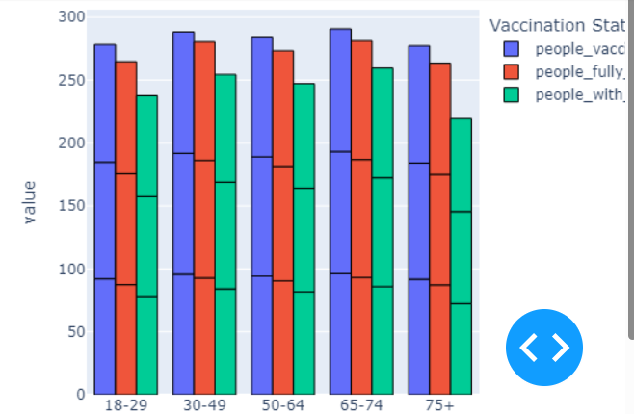
Interactive dashboard using (Bar chart) to visualize vaccination rates across different age groups for different country . ( Vaccination by Age Group [2020-2024 )
Vaccination Rates: Different age groups also showed varying levels of vaccination uptake. Older age groups were prioritized for vaccination in many countries, resulting in higher vaccination rates compared to younger populations.
Infection Rates: Younger people, especially those under 30, showed different infection patterns compared to older adults. Younger individuals often had higher rates of infection but lower severity.
Hospitalization and Death Rates: Older adults, particularly those over 60, had higher rates of severe outcomes, including hospitalizations and deaths.

Slide 7
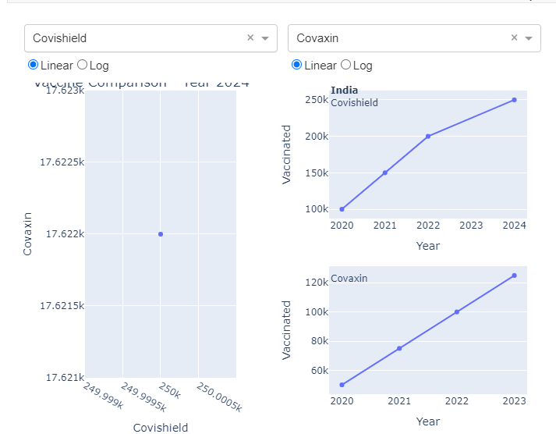
. Analysis of Vaccination Rates Across Different Countries
Distribution and uptake: A line plot showing the number of doses administered for each vaccine in various countries can highlight which countries are predominantly using which vaccines. This helps identify distribution patterns.
Vaccination Rates: Analyzing vaccination rates across different countries over time provides insights into the efficiency of vaccination and public health strategies.
Impact on Infection and Recovery Rates: Correlating vaccination data with infection and recovery rates helps assess the real-world effectiveness of vaccines, informing future vaccination strategies.

Slide 8
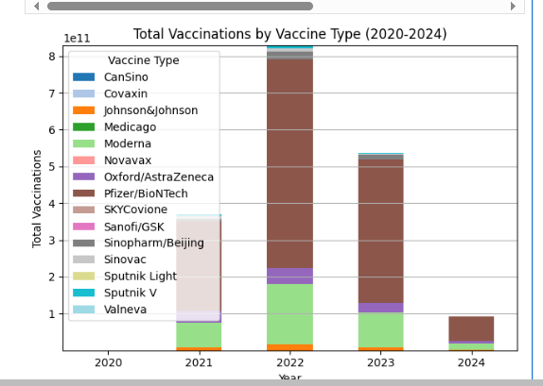
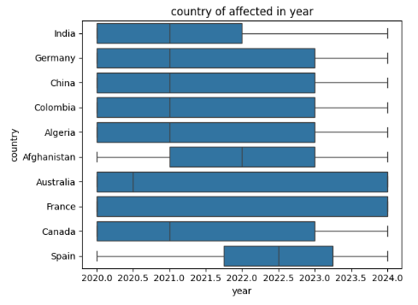
Analysis of Vaccination Rates Across Different Countries (bar plot and box plot)
Interpretation :
Assess whether higher vaccination rates correlate with lower infection rates and higher recovery rates.
Boxplots provide a summary of the distribution of a dataset. They display the median, quartiles, and potential outliers. (year and different country)

Slide 9
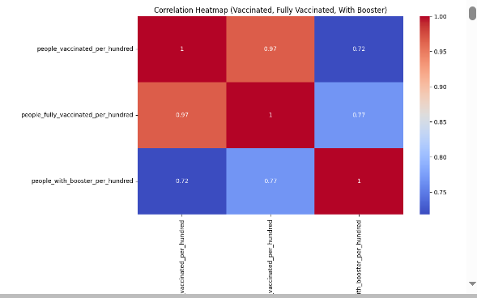
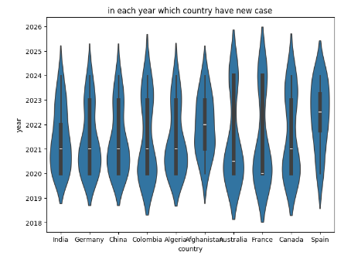
correlations between vaccination metrics for different age groups using a heatmap visualization and Violin Plot
Heat maps : Heat maps can illustrate the vaccinations doses
Violin plots show the distribution of data across different countries and provide a visual representation of data density.

Slide 10
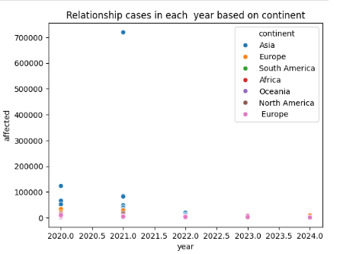
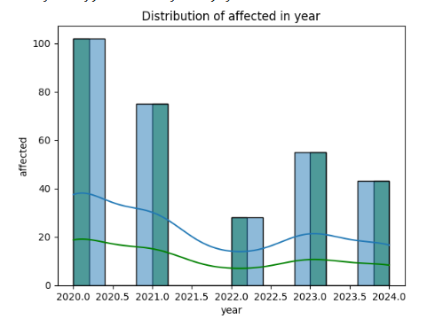
Analyzing Histplot and Scatter Plot
Scatter plots are used to show the relationship between year and test cases and help identify correlations and outliers .
Histograms help in visualizing how frequently certain infection rates occur within a given population or timeframe.
A histogram of cases might show a right-skewed distribution

Slide 11
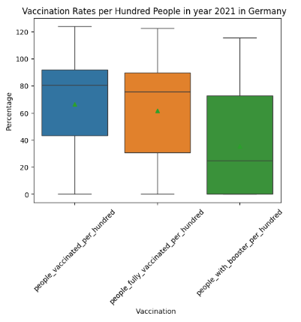
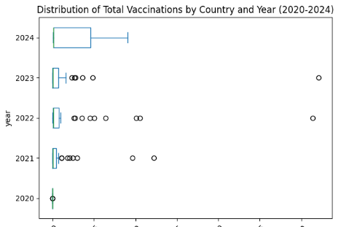
Box plot to visualize the distribution of total vaccinations across different years[2020-204]
Comparing Infection Rates Over Time : Box plots can show how the vaccination rates vary over different periods .
Compare the distribution of vaccination rates among different age groups.

Slide 12
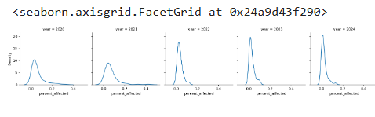
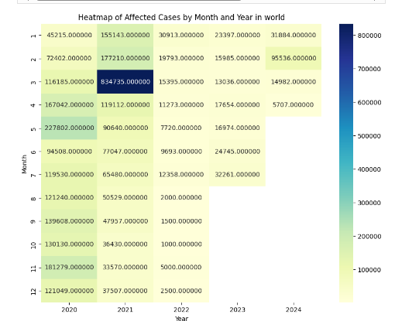
Analyzing by Facet Grid and Heatmap test case over year(2020-2024)
Facet grids can display infection rates across different regions over time, making it easier to compare trends and patterns.
Heatmap :Show the vaccination rates over time for different a year and month.

Slide 13
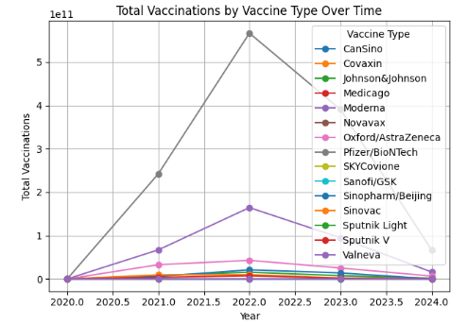
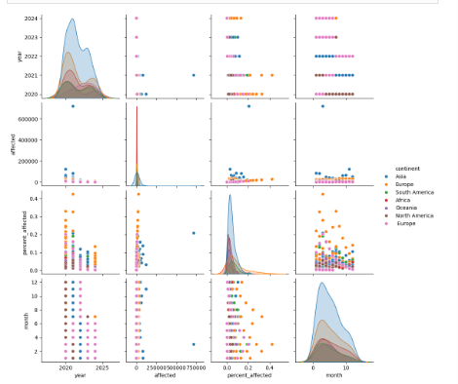
Analyzing by lineplot and pairplot
Line plots can illustrate the cumulative number of vaccinations administered over time, showing the pace and acceleration of vaccination .
Pair plots can reveal relationships between multiple factors such as age, test case, and vaccination status.
Multivariate Analysis : quick visual examination of the relationships between several variables, which can be crucial in understanding the factors influencing COVID-19 spread and outcomes.

Slide 14
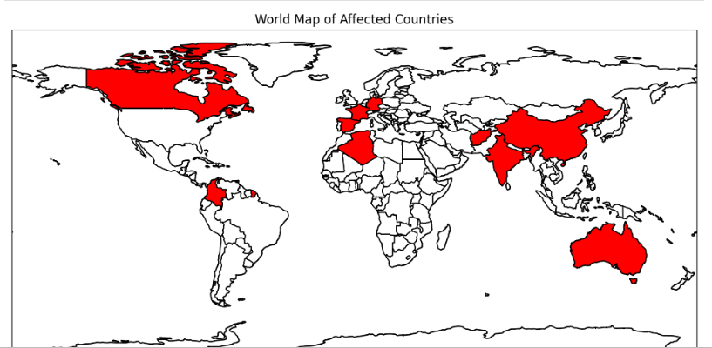
Geographical distribution of cases
Interactive geographical maps can display affected countries over time, allowing for a visual representation of the spread and control of the virus.
vaccinations reveals significant regional disparities and trends influenced by various factors such as healthcare infrastructure, government policies, public health measures, and socio-economic conditions

Slide 15
Sources:
1.(https://www.rki.de/EN/Content/infections/epidemiology/inf_dis_Germany/COVID-19/Situationsberichte_Tab.html).
2. https://www.moph.gov.af/en
3 https://health-infobase.canada.ca/covid-19/
4. For real data, you can refer to official sources from the Algerian Ministry of Health (https://ghdx.healthdata.org/organizations/ministry-health-population-and-hospital-reform-algeria) or the World Health Organization (https://www.who.int/emergencies/diseases/novel-coronavirus-2019/advice-for-public).
5. http://www.emro.who.int/images/stories/coronavirus/covid-sitrep-28.pdf
6. https://ourworldindata.org/coronavirus-testing
https://data.who.int/dashboards/covid19/

