Slide 1

NEXT

Slide 2
public static void main(String[] args)
class StaticMethod {
public static void main(String[] args)
{
System.out.println("I am a Static");
}
}

Slide 3
Static methods
Can be called without creating an object of class.
They are referenced by the class name itself or reference to the Object of that
Important Points:
Static method(s) are associated to the class in which they reside
i.e. they can be called even without creating an instance
of the class i.e ClassName.methodName(args).
They are designed with aim to be shared among all Objects created from
the same class.
Static methods can not be overridden. But can be overloaded
since they are resolved using static binding by compiler at compile time.
public static void geek(String name)
{
// code to be executed....
}
// Must have static modifier in their declaration.
// Return type can be int, float, String or user defined data type

Slide 4
Static Class
Why Java is not a Pure Object Oriented Language?
Primitive Data Type
The static keyword

Slide 5

Strings in Java
String vs StringBuilder vs StringBuffer
Integer to String Conversions
String to Integer– parseInt()
Swap two Strings without using third variable
Searching characters and substring in a String
Compare two Strings in Java
Reverse a string in Java (5 Different Ways)
Remove Leading Zeros From String in Java
Trim (Remove leading and trailing spaces) a string
Counting number of lines, words, characters and paragraphs in a text file using Java
Check if a string contains only alphabets in Java using Lambda expression
Remove elements from a List that satisfy given predicate in Java
Check if a string contains only alphabets in Java using ASCII values
Check if a string contains only alphabets in Java using Regex

Slide 6
Arrays in Java
Arrays in Java(Practice)
Default Array values
Util Arrays Class (Contains utility functions for Arrays)
Interesting facts about Array assignment in Java
Array IndexOutofbounds Exception
Array vs ArrayList in Java
Implementations:
Compare two arrays
ArrayList to Array Conversion
Merge arrays into a new object array in Java

Slide 7
Stream in Java
Java Stream
Implementations:
Features
10 Ways to Create a Stream in Java
How to get ArrayList from Stream in Java 8
Stream.of() vs. Arrays.stream()

Slide 8
Stream Features
A stream is not a data structure and does not store elements. Collections, Arrays or I/O Channels is where it takes the input from.
The source of the stream remains unmodified after operations are performed on it. For example, filtering a stream simply produces a new stream without the filtered elements, instead of modifying the original stream.
Aggregation operations such as filter, reduce, match, find, etc are supported by stream.

Slide 9
Methods in Java
Methods
Parameters passing
Returning Multiple values
Throwable printStackTrace() method in Java
Different ways of Method Overloading in Java
Overriding equals method
Overriding toString() method
Private and final methods
Clone() method
Default Methods
System.exit() method

Slide 10
Overloading Vs. Overriding
METHOD OVERLOADING | METHOD OVERRIDING
Method overloading is a compile time polymorphism. | Method overriding is a run time polymorphism.
It help to rise the readability of the program. | While it is used to grant the specific implementation of the method which is already provided by its parent class or super class.
It is occur within the class. | While it is performed in two classes with inheritance relationship.
Method overloading may or may not require inheritance. | While method overriding always needs inheritance.
In this, methods must have same name and different signature. | While in this, methods must have same name and same signature.
In method overloading, return type can or can not be be same, but we must have to change the parameter. | While in this, return type must be same or co-variant.

Slide 11
Exception Handling
Exceptions
OutOfMemoryError Exception
3 Different ways to print Exception messages in Java
Flow control in try-catch-finally
Types of Exceptions
Throw and Throws
User-defined Custom Exception
Multicatch
Chained Exceptions
Null Pointer Exception
Output of Java program | Set 12(Exception Handling)

Slide 12
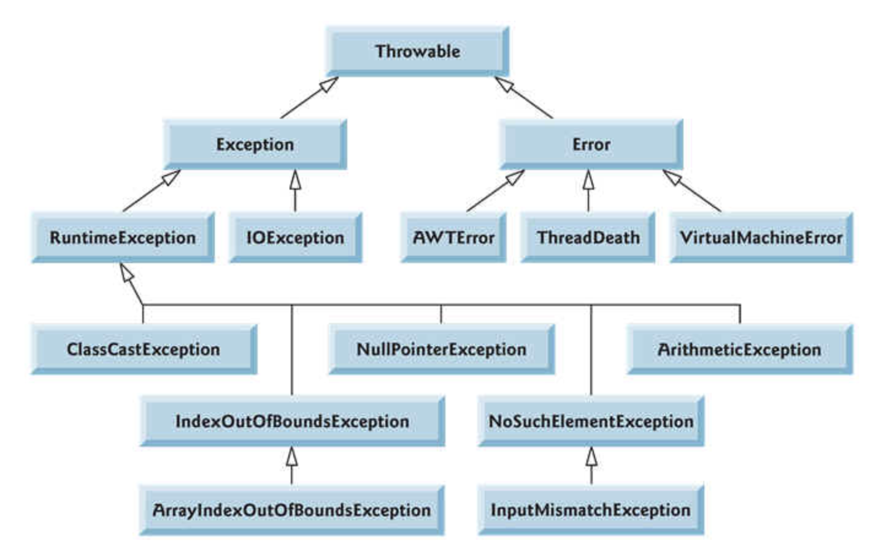
Exception Handling

Slide 13
Collection in Java
Collection:
Collections Class in Java
Enumeration, Iterators and ListIterators
Convert an Iterable to Collection in Java
Using Iterators
Iterator vs Foreach
Types of iterator
Creating Sequential Stream from an Iterator in Java
Implementations:
Output of Java Program | Set 13(Collections)
Immutable List in Java (Guava)
java.util.Concurrent

Slide 14
Collection Interview FAQ’s
Vector vs ArrayList
ArrayList vs LinkedList
Comparable vs Comparator
Differences between TreeMap, HashMap and LinkedHashMap
HashMap vs HashTable
Hashmap vs WeakHashMap in Java
How to Synchronize ArrayList in Java
ArrayList and LinkedList remove() methods
How to Remove an element from ArrayList

Slide 15
Garbage Collection
Garbage Collection
How to make object eligible for garbage collection in Java?
Automatic Resource Management
Output of Java programs | Set 10 (Garbage Collection)
Iterator vs Collection in Java

Slide 16
File Handling
File class
Ways of Reading a text file in Java
file permissions in java
Moving a file from one directory to another using Java
Copying file using FileStreams
Delete a file using Java
Java program to delete duplicate lines in text file
Java program to merge two files alternatively into third file
Java program to List all files in a directory and nested sub-directories | Recursive approach
Java program to delete certain text from a file
Check if a File is hidden in Java
Redirecting System.out.println() output to a file

