Slide 1
Computer Organization and Architecture
Module 5
Prof. Indranil Sengupta
Dr. Sarani Bhattacharya
Department of Computer Science and Engineering
IIT Kharagpur

Slide 2
Computer Arithmetic

Slide 3
Introduction
Computers are built using tiny electronic switches.
Typically made up of MOS transistors.
The state of the switches are typically expressed in binary (ON/OFF).
To design arithmetic circuits for use in computers, we need to work with binary numbers.
How to carry out various arithmetic operations in binary?
How to implement them efficiently in hardware?

Slide 4
Addition / Subtraction

Slide 5
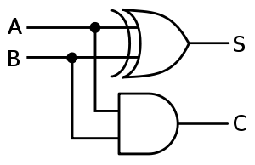
Addition of Two Binary Digits (Bits)
When two bits A and B are added, a sum (S) and carry (C) are generated as per the following truth table:
Inputs |  | Outputs
A | B | S | C
0 | 0 | 0 | 0
0 | 1 | 1 | 0
1 | 0 | 1 | 0
1 | 1 | 0 | 1
S = A’.B + A.B’ = A ⊕ B
C = A.B
0 + 0 = 00
0 + 1 = 01
1 + 0 = 01
1 + 1 = 10
A
HA
S
B
C
HALF ADDER

Slide 6
Addition of Multi-bit Binary Numbers
0 0 1 0 1 1 0
0 1 0 1 0 1 1
+ 0 0 0 1 0 0 1
0 1 1 0 1 0 0
Carry
1 1 1 1 1 1 0
0 1 1 1 1 1 1
+ 0 0 0 0 0 0 1
1 0 0 0 0 0 0
Carry
Number A
Number A
Number B
Number B
Sum S
Sum S
At every bit position (stage), we require to add 3 bits:
1 bit for number A
1 bit for number B
1 carry bit coming from the previous stage
WE NEED A FULL ADDER

Slide 7
Full Adder
Inputs |  |  | Outputs
A | B | C_{in} | S | C_{out}
0 | 0 | 0 | 0 | 0
0 | 0 | 1 | 1 | 0
0 | 1 | 0 | 1 | 0
0 | 1 | 1 | 0 | 1
1 | 0 | 0 | 1 | 0
1 | 0 | 1 | 0 | 1
1 | 1 | 0 | 0 | 1
1 | 1 | 1 | 1 | 1
A
FA
S
B
C_{in}
C_{out}
S = A’.B’.C_{in} + A’.B.C_{in}’ + A.B’C_{in}’ + A.B.C
= A ⊕ B ⊕ C_{in}
C_{out} = B.C_{in} + A.C_{in} + A.B + A.B.C_{in}
= A.B + B.C_{in} + A.C_{in}

Slide 8
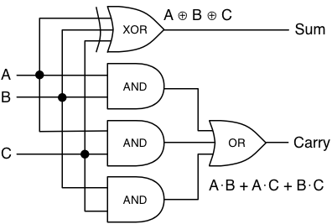
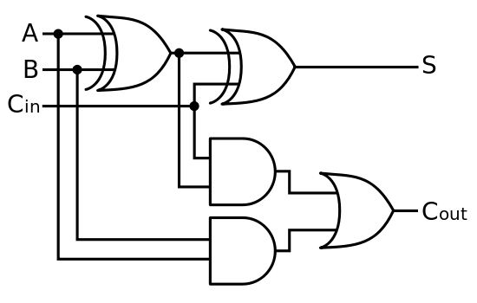
Various Implementations of Full Adder
A
HALF
ADDER
A
C
OR
C_{out}
B
B
S
HALF
ADDER
A
C
C_{in}
B
S
S

Slide 9
Delay of a full adder:
Assume that the delay of all basic gates (AND, OR, NAND, NOR, NOT) is δ.
Delay for Carry = 2δ
Delay for Sum = 3δ
(AND-OR delay plus one inverter delay)

Slide 10
Parallel Adder Design
We shall look at the various designs of n-bit parallel adder.
Ripple carry adder
Carry look-ahead adder
Carry save adder
Carry select adder

Slide 11
Ripple Carry Adder
Cascade n full adders to create a n-bit parallel adder.
Carry output from stage-i propagates as the carry input to stage-(i+1).
In the worst-case, carry ripples through all the stages.
1 1 1 1 1 1 0
0 1 1 1 1 1 1
+ 0 0 0 0 0 0 1
1 0 0 0 0 0 0
Carry
Number A
Number B
Sum S

Slide 12
A_{n-1}
B_{n-1}
A₂
B₂
A₁
B₁
A₀
B₀
C_{n-1}
……
C₃
C₂
C₁
C₀
FA_{n-1}
FA₂
FA₁
FA₀
Delay for C₁ = 2δ
Delay for C₂ = 4δ
Delay for C_{n-1} = 2(n-1)δ
Delay for C_{n} = 2nδ
C_{n}
S_{n-1}
S₂
S₁
S₀
Two numbers: A_{n-1}…A₂A₁A₀ and B_{n-1}…B₂B₁B₀
Input carry: C₀
Sum: S_{n-1}…S₂S₁S₀
Output carry: C_{n}
Delay for S₀ = 3δ
Delay for S₁ = 2δ + 3δ = 5δ
Delay for S₂ = 4δ + 3δ = 7δ
Delay for S_{n-1} = 2(n-1)δ + 3δ = (2n+1) δ
Delay is proportional to n

Slide 13
How to Design a Parallel Subtractor?
Observation:
Computing A-B is the same as adding the 2’s complement of B to A.
2’s complement is equal to 1’s complement plus 1.
Let X_{i} = B_{i}’.
A_{n-1}
X_{n-1}
A₂
X₂
A₁
X₁
A₀
X₀
C_{n-1}
……
C₃
C₂
C₁
C₀ = 1
FA_{n-1}
FA₂
FA₁
FA₀
C_{n}
S_{n-1}
S₂
S₁
S₀

Slide 14
A Parallel Adder/Subtractor
xor gate is a controlled inverter
A_{n-1}
A₁
A₀
B_{n-1}
B₁
B₀
ADD’ / SUB
…
…
xor
xor
xor
n-bit Parallel Adder
C_{n}
C₀
…
S_{n-1}
S₂
S₁
S₀

Slide 15
Carry Look-ahead Adder
The propagation delay of an n-bit ripple carry order has been seen to be proportional to n.
Due to the rippling effect of carry sequentially from one stage to the next.
One possible way to speedup the addition.
Generate the carry signals for the various stages in parallel.
Time complexity reduces from O(n) to O(1).
Hardware complexity increases rapidly with n.

Slide 16
Consider the i-th stage in the addition process.
We define the carry generate and carry propagate functions as:
G_{i} = A_{i}.B_{i}
P_{i} = A_{i} ⊕ B_{i}
G_{i} = 1 represents the condition when a carry is generated in stage-i independent of the other stages.
P_{i} = 1 represents the condition when an input carry C_{i} will be propagated to the output carry C_{i+1}.
A_{i}
FA
S_{i}
B_{i}
C_{i}
C_{i+1}
C_{i+1} = G_{i} + P_{i}.C_{i}

Slide 17
Unrolling the Recurrence
C_{i+1} = G_{i} + P_{i}C_{i} = G_{i} + P_{i} (G_{i-1} + P_{i-1}C_{i-1}) = G_{i} + P_{i}G_{i-1} + P_{i}P_{i-1}C_{i-1}
= G_{i} + P_{i}G_{i-1} + P_{i}P_{i-1} (G_{i-2} + P_{i-2}C_{i-2})
= G_{i} + P_{i}G_{i-1} + P_{i}P_{i-1} G_{i-2} + P_{i}P_{i-1}P_{i-2}C_{i-2} = …..
C_{i+1} = G_{i} + ∑ G_{k} ∏ P_{j} + C₀ ∏ P_{j}
i-1
i
i
k=0
j=k+1
j=0

Slide 18
Design of 4-bit CLA Adder
C₄ = G₃ + G₂P₃ + G₁P₂P₃ + G₀P₁P₂P₃ + C₀P₀P₁P₂P₃
C₃ = G₂ + G₁P₂ + G₀P₁P₂ + C₀P₀P₁P₂
C₂ = G₁ + G₀P₁ + C₀P₀P₁
C₁ = G₀ + C₀P₀
S₀ = A₀ ⊕ B₀ ⊕ C₀ = P₀ ⊕ C₀
S₁ = P₁ ⊕ C₁
S₂ = P₂ ⊕ C₂
S₃ = P₃ ⊕ C₃
4 AND2 gates
3 AND3 gates
2 AND4 gates
1 AND5 gate
1 OR2, 1 OR3, 1 OR4 and 1 OR5 gate
4 XOR2 gates

Slide 19
Design of 4-bit CLA Adder
C₄ = G₃ + G₂P₃ + G₁P₂P₃ + G₀P₁P₂P₃ + C₀P₀P₁P₂P₃
C₃ = G₂ + G₁P₂ + G₀P₁P₂ + C₀P₀P₁P₂
C₂ = G₁ + G₀P₁ + C₀P₀P₁
C₁ = G₀ + C₀P₀
S₀ = A₀ ⊕ B₀ ⊕ C₀ = P₀ ⊕ C₀
S₁ = P₁ ⊕ C₁
S₂ = P₂ ⊕ C₂
S₃ = P₃ ⊕ C₃
4 AND2 gates
3 AND3 gates
2 AND4 gates
1 AND5 gate
1 OR2, 1 OR3, 1 OR4 and 1 OR5 gate
4 XOR2 gates

Slide 20
Design of 4-bit CLA Adder
C₄ = G₃ + C₃P₃
C₃ = G₂ + G₁P₂ + G₀P₁P₂ + C₀P₀P₁P₂
C₂ = G₁ + G₀P₁ + C₀P₀P₁
C₁ = G₀ + C₀P₀
S₀ = A₀ ⊕ B₀ ⊕ C₀ = P₀ ⊕ C₀
S₁ = P₁ ⊕ C₁
S₂ = P₂ ⊕ C₂
S₃ = P₃ ⊕ C₃
4 AND2 gates
2 AND3 gates
1 AND4 gates
1 AND5 gate
1 OR2, 1 OR3, 1 OR4 and 1 OR2 gate
4 XOR2 gates

Slide 21
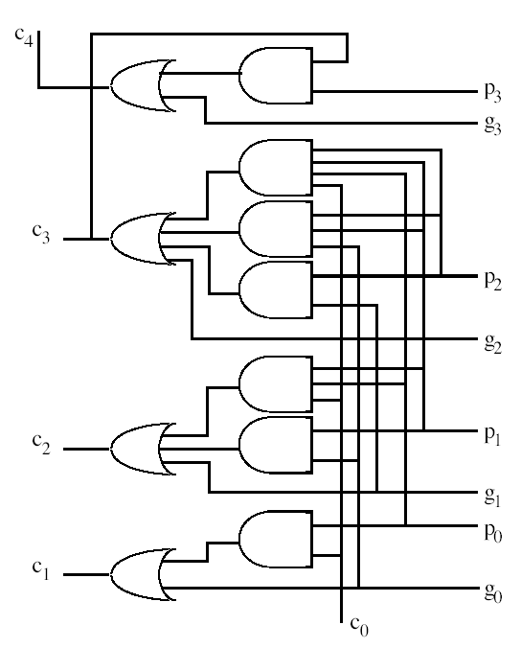
The 4-bit CLA Circuit
C₄
P₃
G₃
C₃
P₂
G₂
C₂
P₁
G₁
P₀
C₁
G₀
C₀

Slide 22
B₃
A₃
B₂
A₂
B₁
A₁
B₀
A₀
G_{i} and P_{i} Generator
3δ
G₃
P₃
G₂
P₂
G₁
P₁
G₀
P₀
4-bit Carry Look Ahead Circuit
2δ
C₃
C₂
C₁
C₀
xor
xor
xor
xor
3δ
C₄
S₃
S₂
S₁
S₀

Slide 23
16-bit Adder Using 4-bit CLA Modules
A₁₅-A₁₂
B₁₅-B₁₂
A₁₁-A₈
B₁₁-B₈
A₇-A₄
B₇-B₄
A₃-A₀
B₃-B₀
4-bit CLA Adder
4-bit CLA Adder
4-bit CLA Adder
4-bit CLA Adder
C₀
C₁₂
C₈
C₄
C₁₆
S₁₅-S₁₂
S₁₁-S₈
S₇-S₄
S₃-S₀
Problem: Carry propagation between modules still slows down the adder

Slide 24
Solution:
Use a second level of carry look-ahead mechanism to generate the input carries to the CLA blocks in parallel.
The second level of CLA generates C4, C8, C12 and C16 in parallel with two gate delays (2δ).
For larger values of n, more CLA levels can be added.
Delay calculation of a 16-bit adder:
For original single-level CLA: 14δ
For modified two-level CLA: 10δ

Slide 25
Delay of a k-bit Adder
n | T_{CLA} | T_{RCA}
4 | 8δ | 9δ
16 | 10δ | 33δ
32 | 12δ | 65δ
64 | 12δ | 129δ
128 | 14δ | 257δ
256 | 14δ | 513δ
T_{CLA} = (6 + 2 log₄ n ) δ
T_{RCA} = (2n + 1) δ

Slide 26
Carry Select Adder
Basically consists of two parallel adders (say, ripple-carry adder) and a multiplexer.
For two given numbers A and B, we carry out addition twice:
With carry-in as 0
With carry-in as 1
Once the correct carry-in is known, the correct sum is selected by a multiplexer.

Slide 27
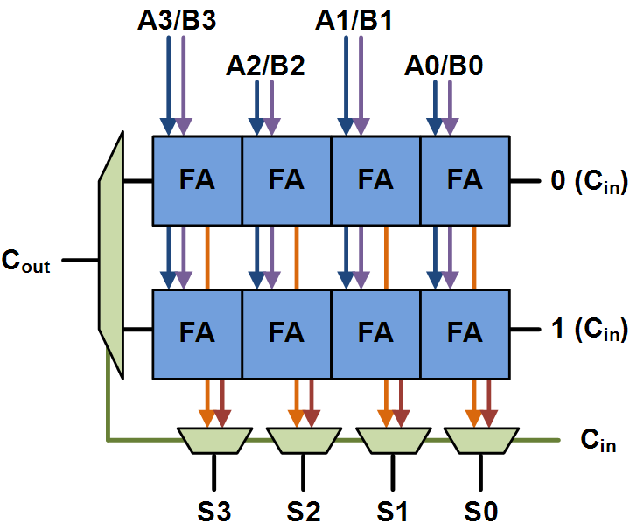
Basic building block of a carry-select adder, with block size of 4.
For a multi-bit adder, the number of bits in each carry select block can be either uniform or variable.

Slide 28
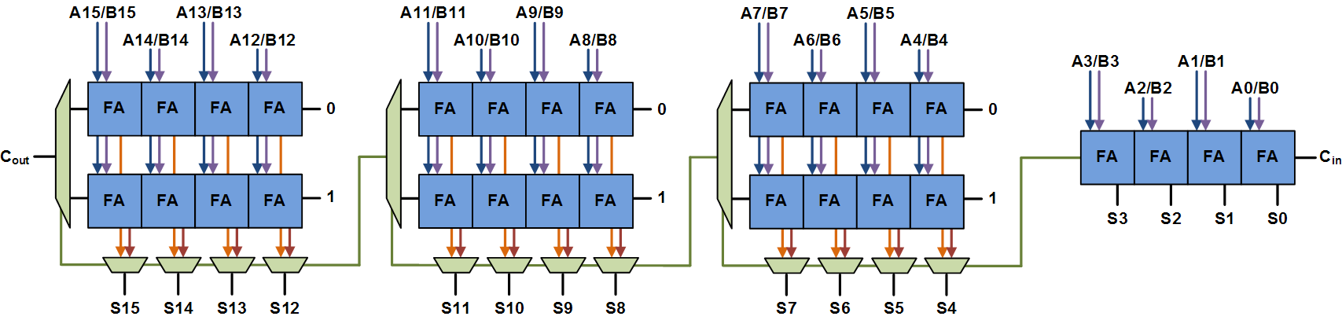
Uniform sized adder
A 16-bit carry select adder with a uniform block size of 4 is shown.
The least significant block needs a single adder (since the carry-in is known).
Total delay is 4 full adder delays, plus 3 MUX delays.

Slide 29
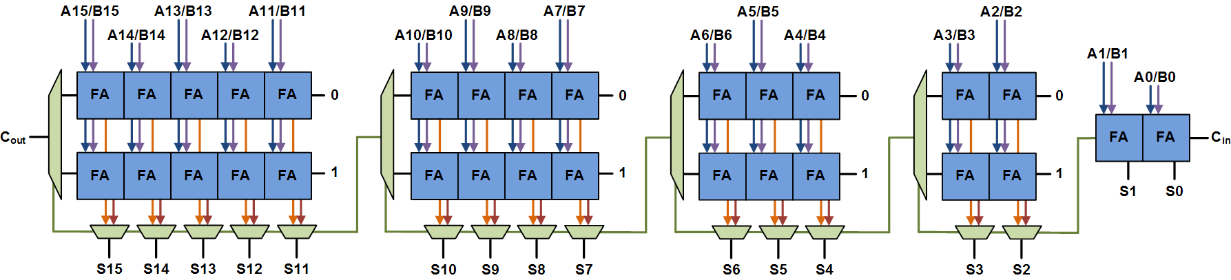
Variable-sized adder
A 16-bit carry select adder with variable block sizes of 2-2-3-4-5 is shown.
Total delay is 2 full adder delays, plus 4 MUX delays.

Slide 30
Carry Save Adder
Here we add three operands (say, X, Y and Z) together.
For adding multiple numbers, we have to construct a tree of carry save adders.
Used in combinational multiplier design.
Each carry save adder is simply an independent full adder without carry propagation.
A parallel adder is required only at the last stage.

Slide 31
An illustrative example:
A set of full adders generate carry and sum bits in parallel
The sum and carry vectors are added later (with proper shifting)

Slide 32
An n-bit Carry Save Adder
X_{n-1}
Y_{n-1}
Z_{n-1}
X₂
Y₂
Z₂
X₁
Y₁
Z₁
X₀
Y₀
Z₀
Full Adder
….
Full Adder
Full Adder
Full Adder
C_{n-1}
S_{n-1}
C₂
S₂
C₁
S₁
C₀
S₀
The carry input of the full adder is used as the third input

Slide 33
Adding m Numbers: Some Examples
CSA
CSA
CSA
CSA
CSA
CSA
CSA
Parallel Adder
Parallel Adder
Parallel Adder
m = 3
m = 4
m = 6

Slide 34
Generating the Status Flags
Many contemporary processors have a flag register that contains the status of the last arithmetic / logic operation.
Zero (Z): tells whether the result is zero.
Can be used for both arithmetic and logic operations.
Sign (S): tells whether the result is positive (=0) or negative (=1).
Can be used for both arithmetic and logic operations.
Carry (C): tells whether there has been a carry out of the most significant stage.
Used only for arithmetic operations.
Overflow (V): tells whether the result is too large to fit in the target register.
Used only for arithmetic operations (addition and subtraction).

Slide 35
A
B
F_{n-1}
F₁
F₀
F
…
Carry out
…
NOR
ALU
C Flag
Z Flag
Overflow can occur during addition when the sign of the two operands are the same.
Sign of the result becomes different from the sign of the operand(s).
V = A_{n-1}.B_{n-1}.F_{n-1}’ + A_{n-1}’.B_{n-1}’.F_{n-1}
V = F_{n-1} ⊕ Carry_out
F
F
…
Assume A, B and F are n-bit registers
F_{n-1}
S Flag

Slide 36
The MIPS architecture does not have any status flags.
Why?
MIPS ISA is designed for efficient pipeline implementation.
Several instructions can be in various stages of execution in the pipeline.
Flag registers result in side effects among instructions.
MIPS stores information about the flags temporarily in a GPR.
slt $t0, $s1, $s2
beq $t0, $zero, Label

