Slide 1
Disk and I/O Management

Slide 2
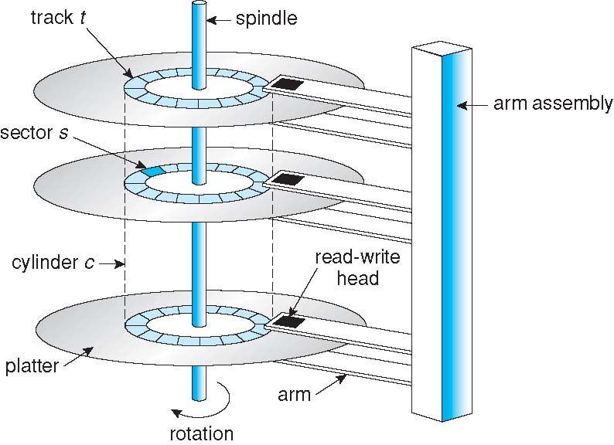
Moving-head Disk Mechanism

Slide 3
Magnetic Disk Performance
Average access time = average seek time + average latency+ transfer time
For example, to transfer a k bytes block on a 3600 RPM disk with a 10ms average seek time with a .1ms controller overhead
Track size=32kB
block size k
Rotation time=60/3600 sec=16.67 ms
Average rotational latency=(0+r)/2=r/2
Avg. access time=seek time+ rotational delay +transfer time
10ms + 8.3ms + (k / 32KB)×16.67 sec +0.1ms

Slide 4
Disk Scheduling
The operating system is responsible for using hardware efficiently
for the disk drives, this means having a fast access time
Minimize seek time
Seek time ≈ seek distance (depends on track numbers)

Slide 5
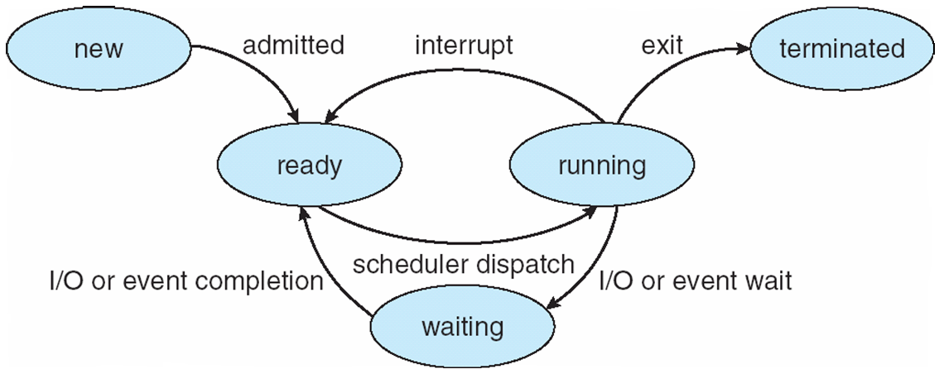
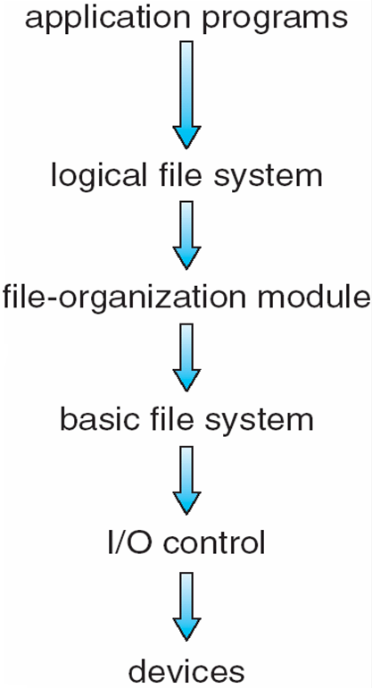
Disk Scheduling
There are many sources of disk I/O request
System processes
Users processes
OS maintains queue of requests, per disk or device
Idle disk can immediately work on I/O request
busy disk means work must queue
Note that drive controllers have small buffers and can manage a queue of I/O requests (of varying “depth”)
Several algorithms exist to schedule the servicing of disk I/O requests
We illustrate scheduling algorithms with a request queue (0-199)
98, 183, 37, 122, 14, 124, 65, 67 (track numbers)
Head pointer 53

Slide 6
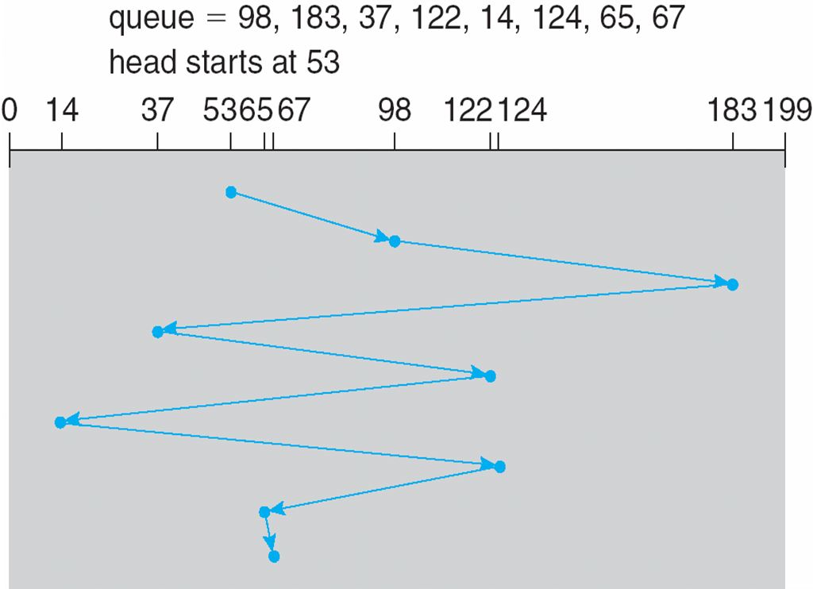
FCFS
Illustration shows total head movement of 640 cylinders

Slide 7
SSTF
Shortest Seek Time First selects the request with the minimum seek time from the current head position
Close to the current disk head

Slide 8
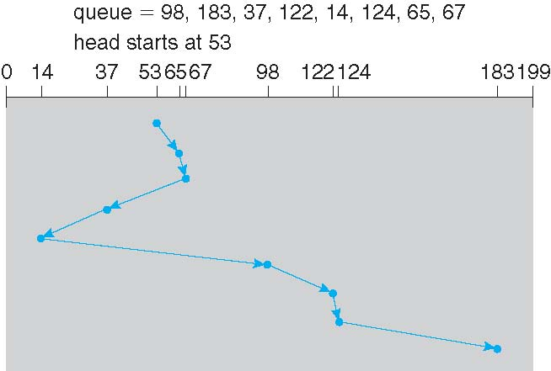
SSTF
Illustration shows total head movement of 236 cylinders

Slide 9
SSTF
Shortest Seek Time First selects the request with the minimum seek time from the current head position
Close to the current disk head
Greedy
Not necessarily optimal
SSTF scheduling may cause starvation of some requests

Slide 10
SCAN
The disk arm starts at one end of the disk, and moves toward the other end, servicing requests until it gets to the other end of the disk, where the head movement is reversed and servicing continues.
SCAN algorithm Sometimes called the elevator algorithm
But note that if requests are uniformly dense, largest density at other end of disk and those wait the longest

Slide 11
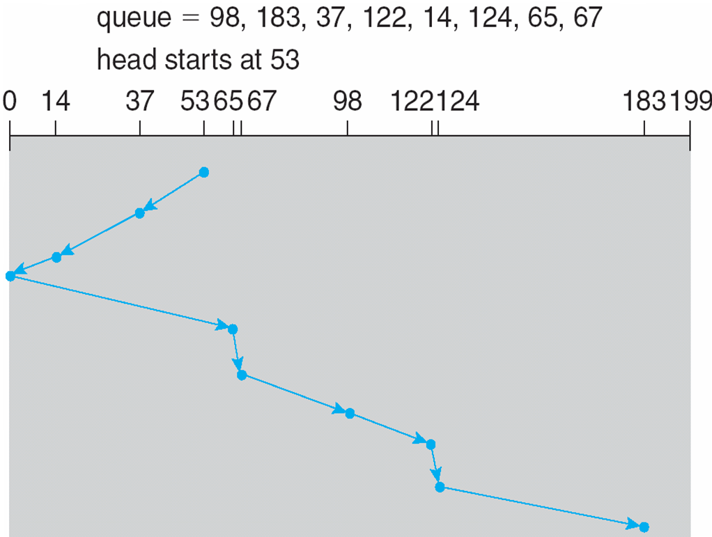
SCAN
Illustration shows total head movement of 208 cylinders

Slide 12
C-SCAN
Provides a more uniform wait time than SCAN
The head moves from one end of the disk to the other, servicing requests as it goes
When it reaches the other end, however, it immediately returns to the beginning of the disk, without servicing any requests on the return trip
Treats the cylinders as a circular list that wraps around from the last cylinder to the first one

Slide 13
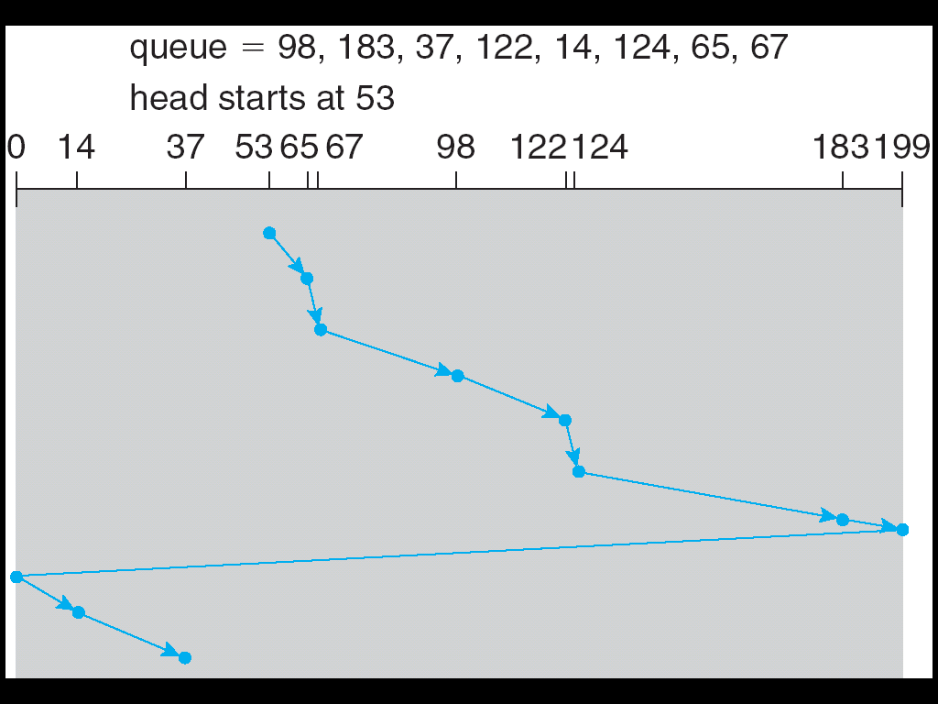
C-SCAN (Cont.)

Slide 14
LOOK
LOOK a version of SCAN, C-LOOK a version of C-SCAN
Arm only goes as far as the last request in each direction, then reverses direction immediately, without first going all the way to the end of the disk

Slide 15
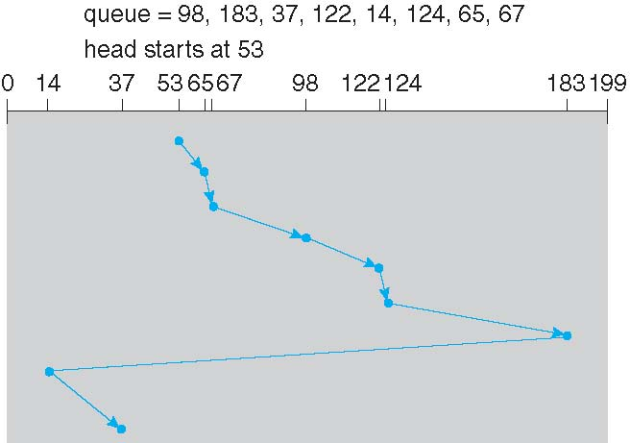
C-LOOK (Cont.)

Slide 16
Selecting a Disk-Scheduling Algorithm
Requests for disk service can be influenced by the file-allocation method
Contiguous, indexed etc
Location of Directory , i-node
The disk-scheduling algorithm should be written as a separate module of the operating system, allowing it to be replaced with a different algorithm if necessary
Either SSTF or LOOK is a reasonable choice for the default algorithm
But implemented inside disk controller
Physical block info is inside controller
How does disk-based queuing effect OS queue ordering?
OS has other constraints
Demand paging over normal I/O
Controller is unaware of that
File organization module ensures the order

Slide 17
Disk Layout

Slide 18
Disk Management
Low-level formatting, or physical formatting — Dividing a disk into sectors that the disk controller can read and write
Each sector can hold header information, plus data, plus error correction code (ECC)
Usually 512 bytes of data but can be selectable
Logical to physical address map
To use a disk to hold files, the operating system still needs to record its own data structures on the disk
Partition the disk into one or more groups of cylinders, each treated as a logical disk
Logical formatting or “making a file system”
Create the data structures (FAT, directory, inode, free space)

Slide 19
Application I/O Interface
OS structure enables the I/O devices to be treated in a standard/uniform way
Application can open a file on a disk without knowing the disk details
New devices can be added without disrupting the OS

Slide 20
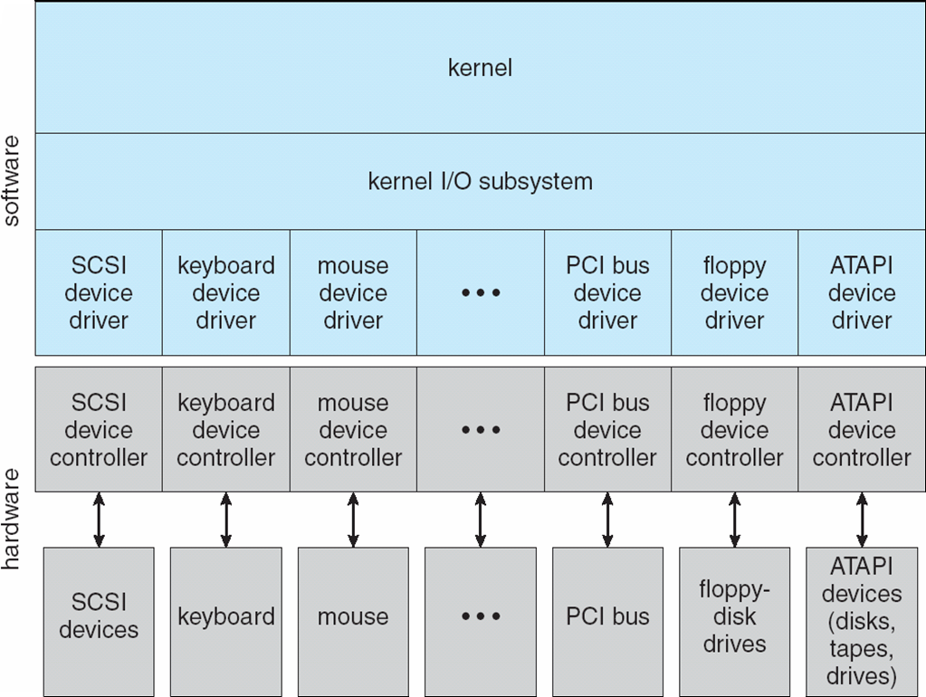
Application I/O Interface
Abstract away detailed differences in I/O devices identifying few general/standard syscall (read(), write())
Interface
I/O system calls encapsulate device behaviors in generic classes
Kernel program interacts with I/O system using standard system call
Device differences are encapsulated within device drivers (custom tailored for that device) => provides a generic interface to interact
Device-driver layer hides differences among I/O controllers from kernel
Want to add new device?
New devices talking already-implemented controller need no extra work
Otherwise write a driver for that device (specific to particular OS)

Slide 21
Thank you

