Slide 1
File Management

Slide 2
Objectives
File Systems : File system structure, allocation methods (contiguous, linked, indexed), free-space management (bit vector, linked list, grouping), directory implementation (linear list, hash table)
Disk Management : disk structure, disk scheduling (FCFS, SSTF, SCAN,C-SCAN) , disk reliability, disk formatting, boot block, bad blocks.

Slide 3
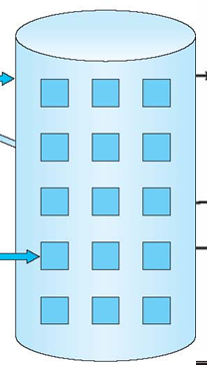
Disk blocks
Data stored within the block

Slide 4
File-System Structure
File system
Provide efficient and convenient access to disk
Easy access to the data (store, locate and retrieve)
Two aspects
User’s view
Define files/attributes, operations, directory
Implementing file system
Data structures and algorithms to map logical view to physical one

Slide 5
Disk Layout
Files stored on disks.
Disks broken up into one or more partitions, with separate file system on each partition

Slide 6
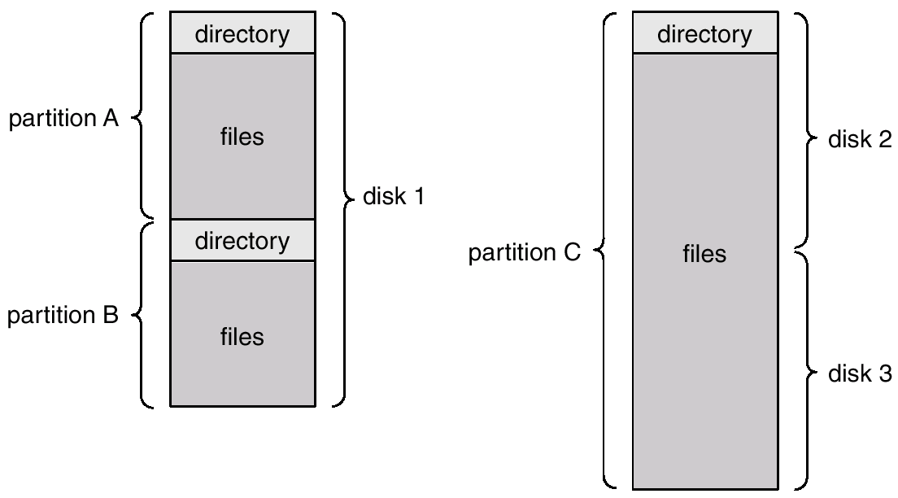
A Typical File-system Organization

Slide 7
Directory Structure
A collection of nodes containing information about all files
Directory
Files
F 1
F 2
F 3
F 4
F n

Slide 8
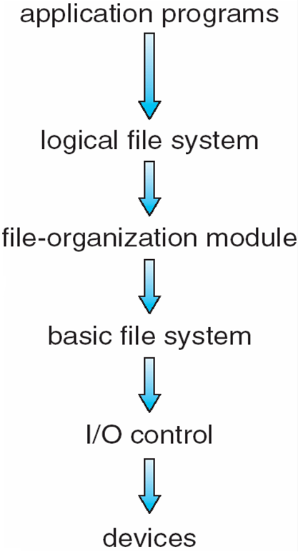
Layered File System
Manages FCB
Translates logical to physical blocks
Issue commands
Each level uses the feature of low level
Create new features for higher level
R/W Physical block (cylinder, track, sector)
Hardware specific instruction
Device driver, transfer information between memory/disk

Slide 9
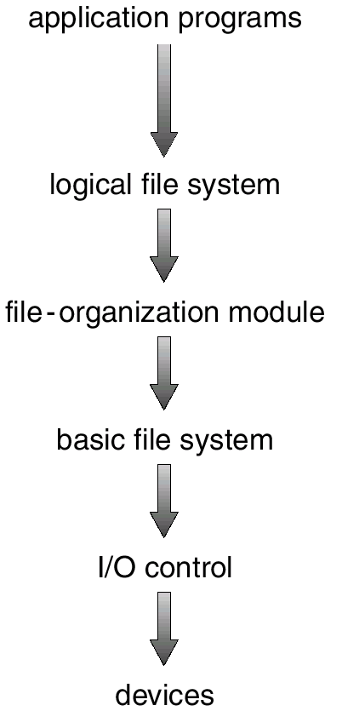
Manages meta date about files, file organization, directory structure, file control blocks, etc.
Mapping of logical block# (0..n) to physical block# (sector, track #, etc), free space mgmt
Issues generic commands to device drive to R/W physical blocks on disk
Device drivers, interrupt service routines, etc

Slide 10
File System Layers
I/O control layer consists of device drivers manage I/O devices at the I/O control layer
Given commands like “read drive1, cylinder 72, track 2, sector 10, into memory location 1060” outputs low-level hardware specific commands to hardware controller
Basic file system Issues commands with physical block address (sector, track)
File organization module understands files, logical address, and physical blocks
Translates logical block # to physical block #
Manages free space, disk allocation

Slide 11
File System Layers (Cont.)
Logical file system manages metadata information
Translates file name into file number, file handle, location by maintaining file control blocks (inodes in Unix)
Directory management
Layering useful for reducing complexity and redundancy, but adds overhead and can decrease performance
Shares the I/O control and basic FS
Many file systems, sometimes many within an operating system
Each with its own format (CD-ROM is ISO 9660; Unix has UFS, FFS; Windows has FAT, FAT32, NTFS as well as floppy, CD, DVD, Linux has more than 40 types, with extended file system ext2 and ext3 leading; plus distributed file systems, etc)

Slide 12
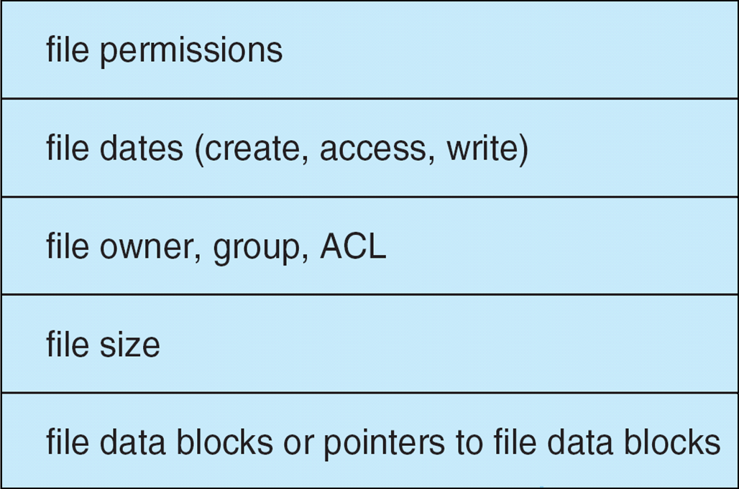
A Typical File Control Block

Slide 13
Disk Layout
Files stored on disks. Disks broken up into one or more partitions, with separate file system on each partition
Sector 0 of disk is the Master Boot Record
Used to boot the computer
End of MBR has partition table. Has starting and ending addresses of each partition.
One of the partitions is marked active in the master boot table

Slide 14
Disk Layout

Slide 15
File system data structures
On disk
In memory

Slide 16
Disk Layout
Boot control block contains info needed by system to boot OS from that partition
Needed if partition contains OS, usually first block of partition
Partition control block (superblock, master file table) contains partition details
Total # of blocks, # of free blocks, block size, free block pointers or array
Directory structure organizes the files
Names and inode numbers, master file table
Per-file File Control Block (FCB) contains many details about the file
Inode number, permissions, size, dates
NTFS stores into in master file table using relational DB structures

Slide 17
Disk Layout

Slide 18
A Typical File Control Block

Slide 19
In-Memory File System Structures
In memory directory structure holds the directory information of recently accessed directories
System-wide-open file contains a copy of FCB for each file
Per-process open file table: contains pointer to appropriate entry in the system wide open file table

Slide 20
File handling
Create a new file
Application program calls the logical file system
Logical file system
Allocates a new FCB
Reads the appropriate directory into memory
Updates directory with new filename and FCB
Write it back to disk
Using the file (I/O)
Open() [filename]
Directory is searched
FCB is copied into system wide open file table
Entry made to Per-process open file table
Pointer to the system table entry
File descriptor#

Slide 21
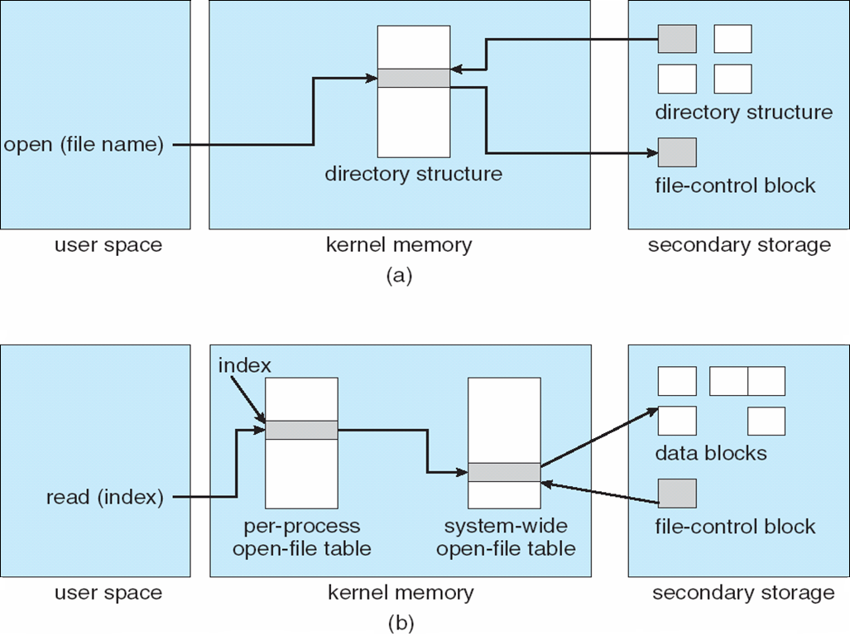
In-Memory File System Structures

Slide 22
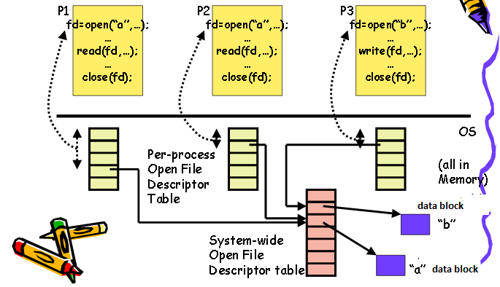

Slide 23
A process closes a file
Per process table entry removed
System table count decremented
All processes closed the file
Updated file info is copied back to disk
System wide open file table entry removed

Slide 24
Allocating Blocks to files
An allocation method refers to how disk blocks are allocated for files
Most important implementation issue
Methods
Contiguous allocation
Linked list allocation
Linked list using table
I-nodes

Slide 25
Allocation Methods - Contiguous
Contiguous allocation – each file occupies set of contiguous blocks
Blocks are allocated b, b+1, b+2,…….
Best performance in most cases
Simple – only starting location (block #) and length (number of blocks) are required (directory)
Easy to implement
Read performance is great. Only need one seek to locate the first block in the file. The rest is easy.
Accessing file is easy
Minimum disk head movement
Sequential and direct access

Slide 26
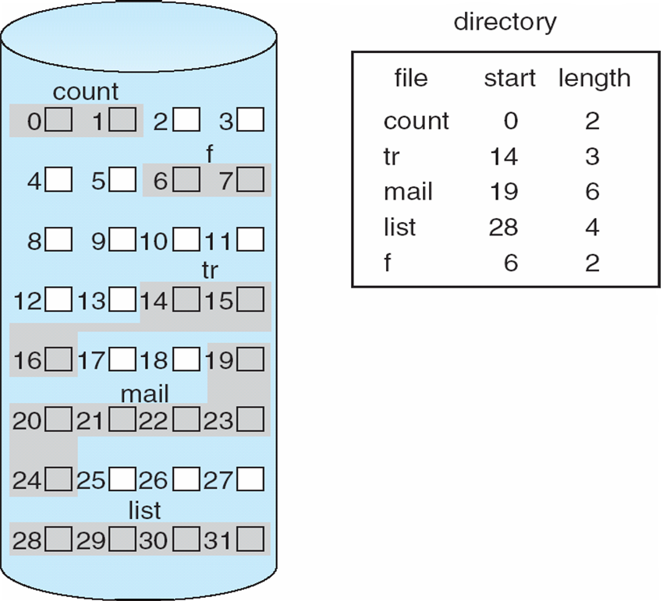
Contiguous Allocation of Disk Space

Slide 27
Problems
Finding space for file
Satisfy the request of size n from the list of holes
External fragmentation
Need for compaction routine
off-line (downtime) or on-line
Do not know the file size a priori
Terminate and restart
Overestimate
Copy it in a larger hole
Allocate new contiguous space (Extent)

Slide 28
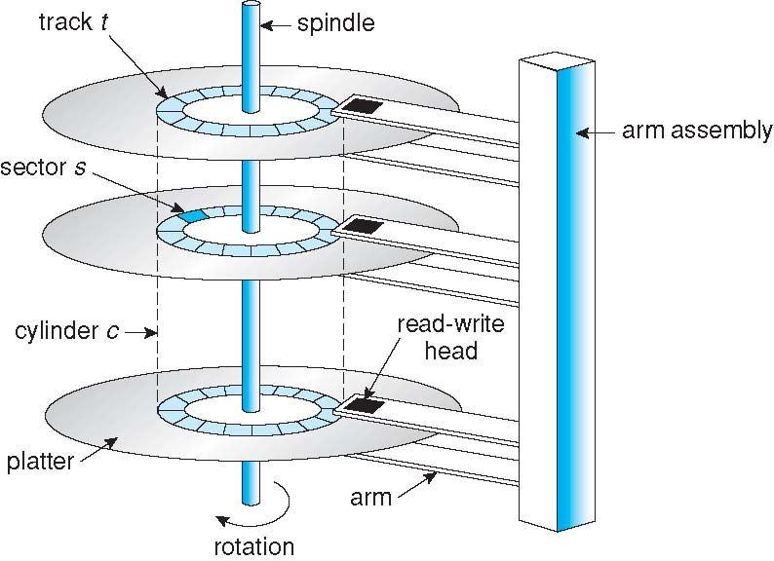
Moving-head Disk Mechanism

Slide 29
Extent-Based Systems
Many newer file systems (i.e., Veritas File System) use a modified contiguous allocation scheme
Extent-based file systems allocate disk blocks in extents
An extent is a contiguous block of disks
Extents are allocated for file allocation
A file consists of one or more extents

Slide 30
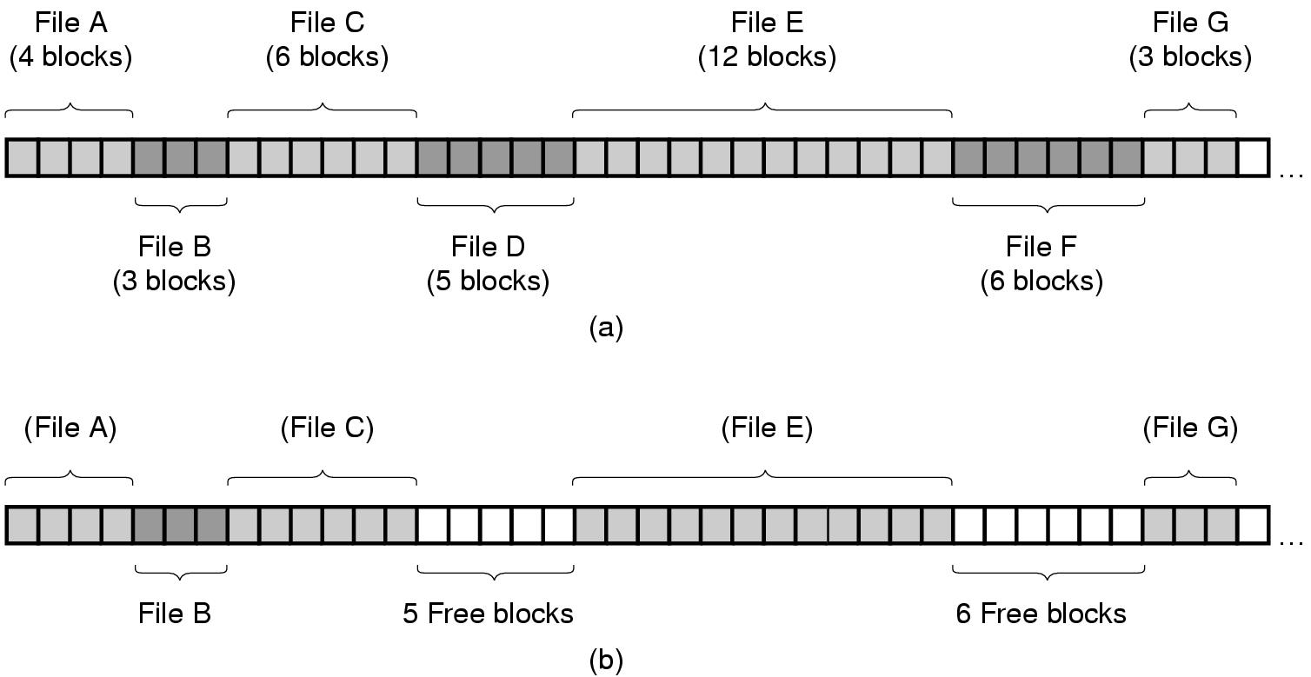
Contiguous Allocation
(a) Contiguous allocation of disk space for 7 files.
(b) The state of the disk after files D and F have been removed.

Slide 31
Linked Allocation
Each file is a linked list of disk blocks: blocks may be scattered anywhere on the disk
block =
pointer
Each block contains pointer to next block
File ends at nil pointer

Slide 32
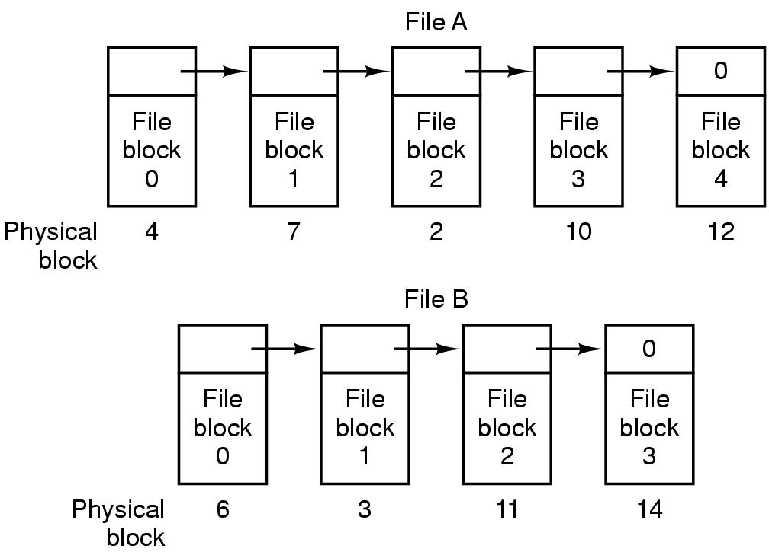
Linked List Allocation
Storing a file as a linked list of disk blocks.

Slide 33
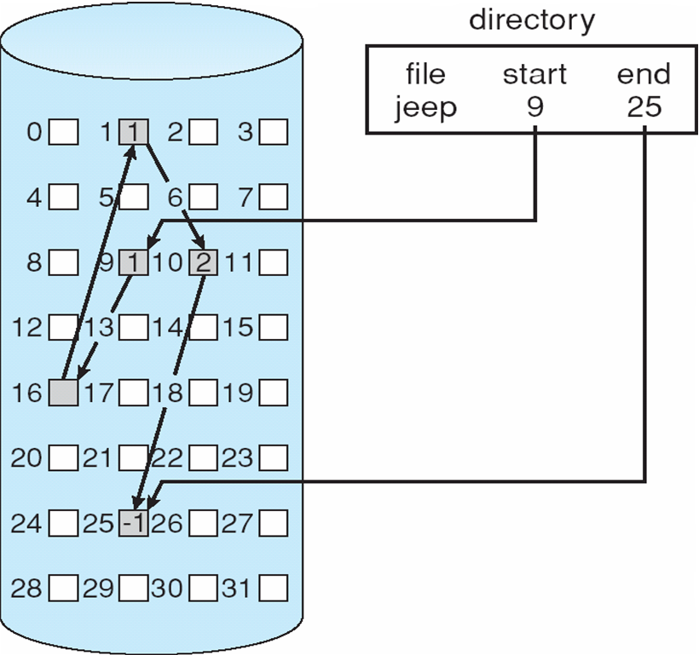
Linked Allocation

Slide 34
Linked Allocation
Free blocks are arranged from the free space management
No external fragmentation
Files can continue to grow
Disadvantage
Effective only for sequential access
Random/direct access (i-th block) is difficult
2. Space wastage
If block size 512 B
Disk address 4B
Effective size 508B
3. Reliability
Lost/damaged pointer
Bug in the OS software and disk hardware failure
4. Poor performance
Solution: Clusters
Improves disk access time (head movement)
Decreases the link space needed for block
Internal fragmentation

Slide 35
Moving-head Disk Mechanism

Slide 36
Linked Allocation
FAT (File Allocation Table) variation
Beginning of partition has table, indexed by block number
Much like a linked list, but faster on disk and cacheable
New block allocation simple
Section of the disk at the beginning of the partition contains FAT table
Unused blocks => 0

Slide 37
Allocation Methods - Linked
Linked allocation – each file a linked list of blocks
No compaction, external fragmentation
Free space management system called when new block needed
Reliability can be a problem
Locating a block can take many I/Os and disk seeks

Slide 38
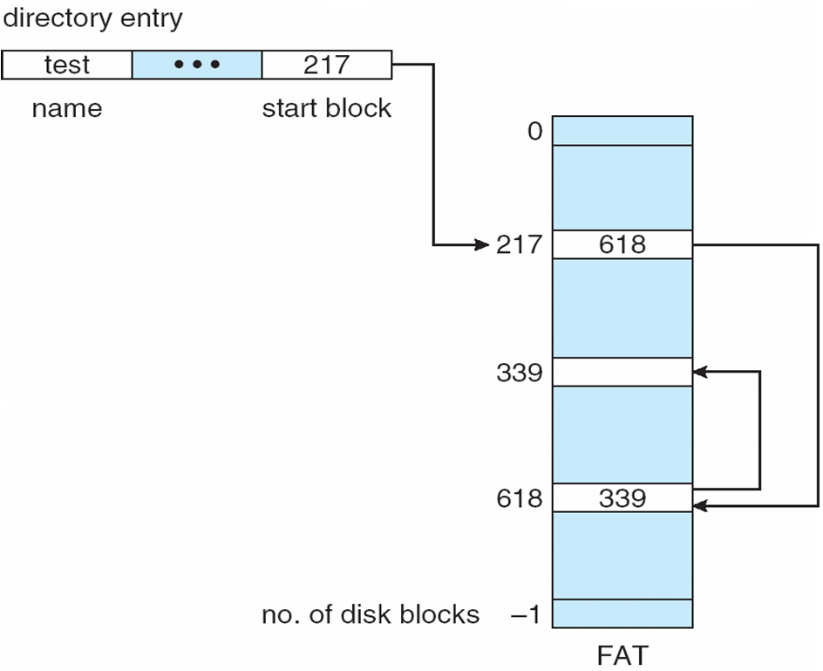
File-Allocation Table
MS DOS
Caching of FAT16

Slide 39
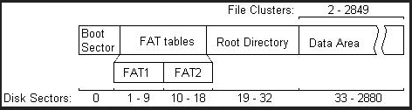
DOS

Slide 40
Allocation Methods - Indexed
Indexed allocation
Each file has its own index block(s) of pointers to its data blocks
Directory contains address of the index block
Logical view
index table

Slide 41
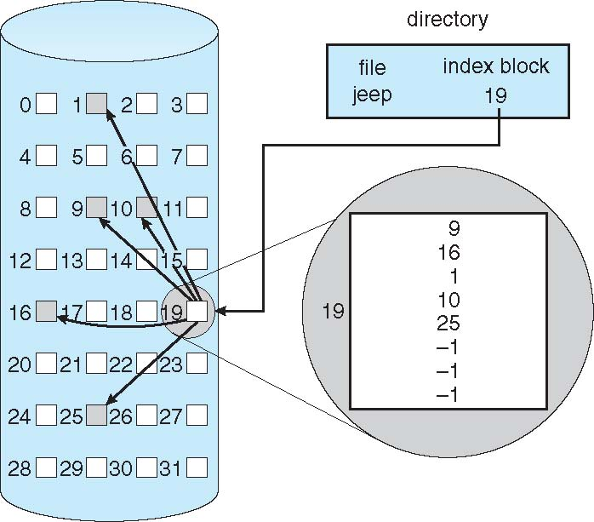
Example of Indexed Allocation

Slide 42
Indexed Allocation
Efficient random access without external fragmentation,
Size of index block
One data block
Overhead of index block
Wastage of space
Small sized files

Slide 43
Linked scheme
Linked scheme – Link blocks of index table (no limit on size)
Multilevel index

Slide 44
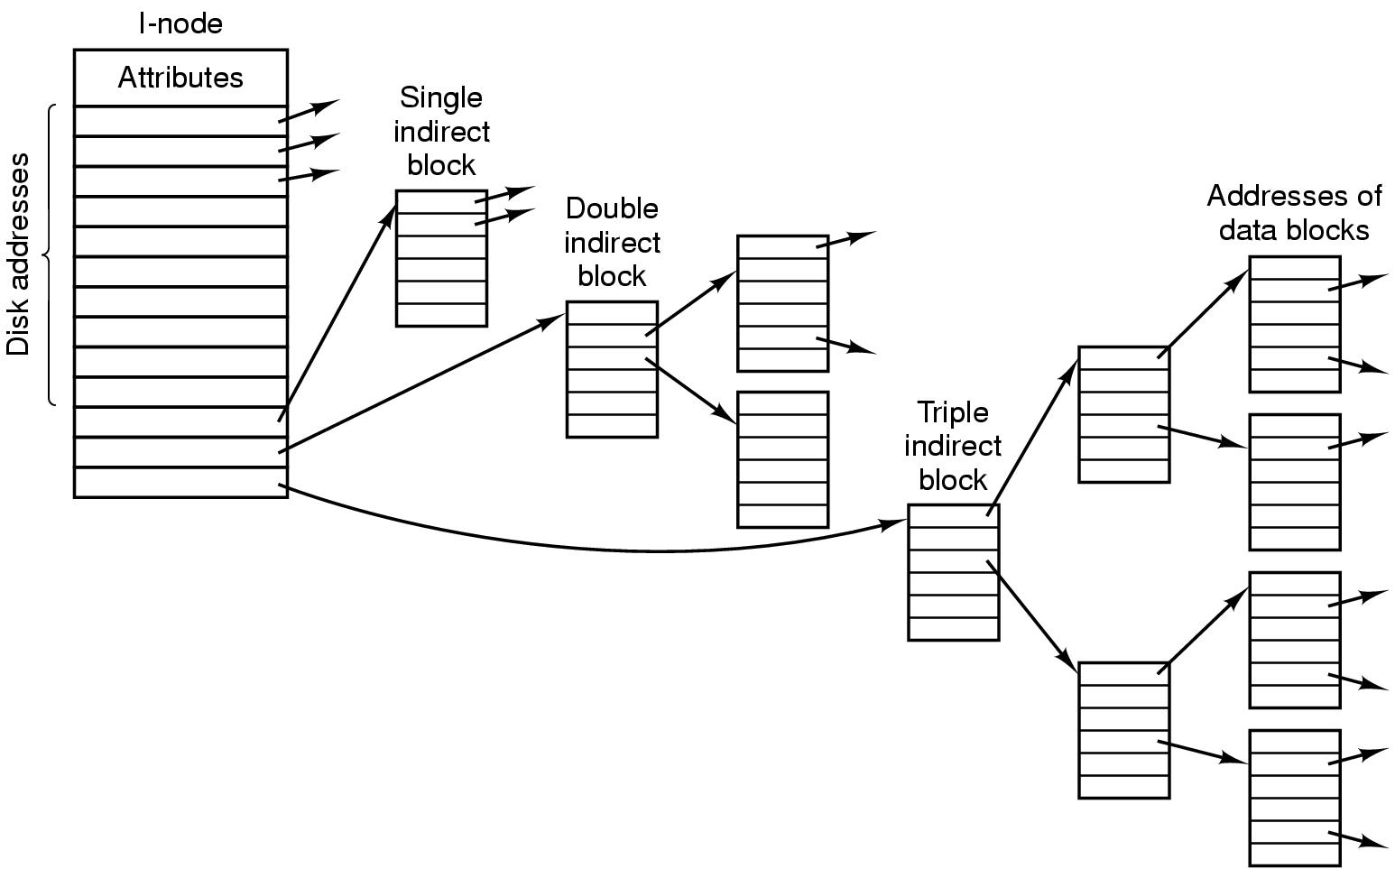
The UNIX File System
A UNIX i-node.

Slide 45
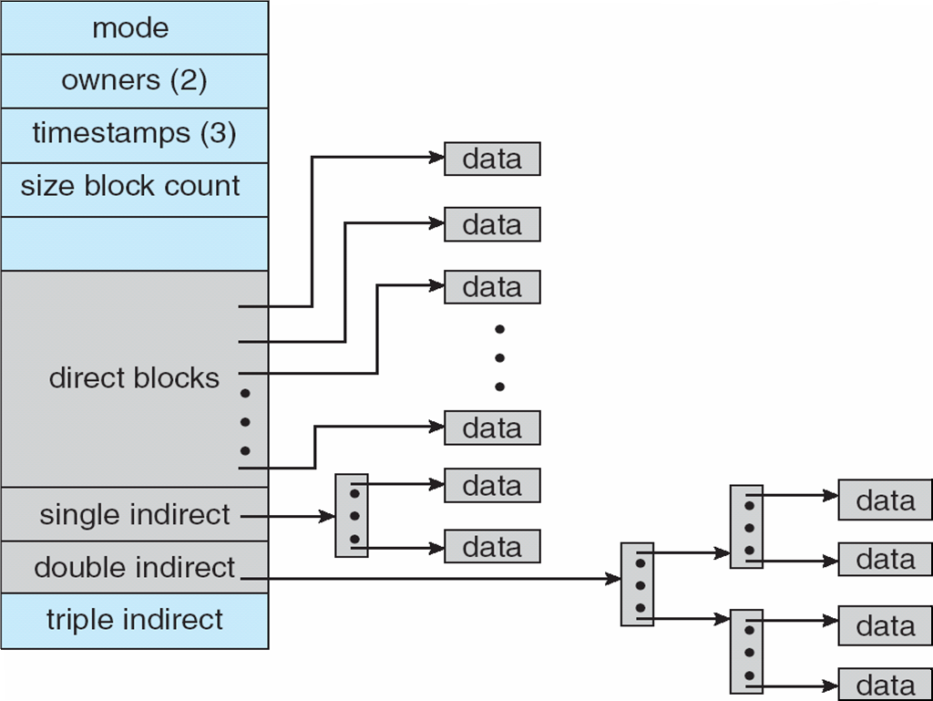
Combined Scheme: UNIX UFS (4K bytes per block, 32-bit addresses)

Slide 46
Implementing Directories
OS uses path name supplied by the user to locate the directory entry
Stores attributes
Directory entry specifies block addresses by providing
Number of first block (contiguous)
Number of first block (linked)
Number of i-node

Slide 47
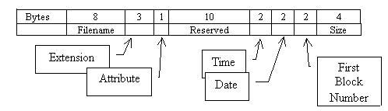
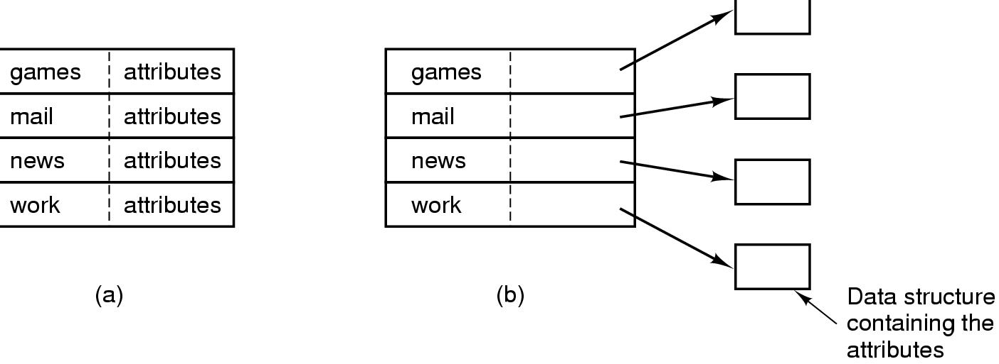
Implementing MS DOS Directories
Each entry 32 bytes long

Slide 48
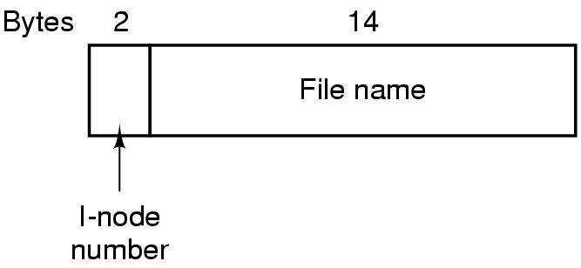
The UNIX File System

Slide 49
Disk Layout

Slide 50
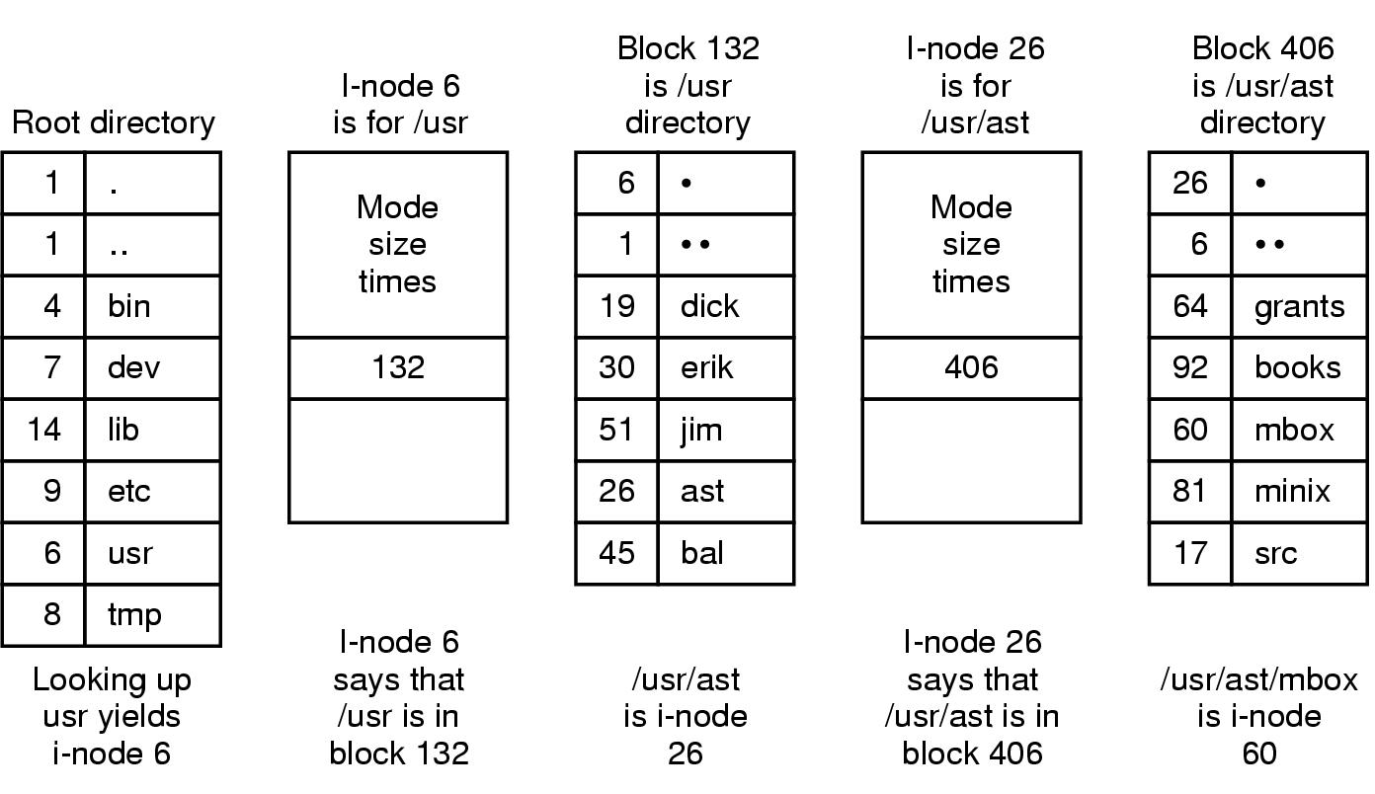
The UNIX File System
The steps in looking up /usr/ast/mbox.

Slide 51
Directory Implementation
Linear list of file names with pointer to the data blocks
Simple to program
Time-consuming to execute
Linear search time
New file creation / deletion
Cache the frequently accessed entry
Binary search to speedup directory search
Could keep ordered alphabetically via linked list
or use B+ tree

Slide 52
Hash Table – hash data structure
Hash value computed from filename
Decreases directory search time
Insertion and deletion simple
Collisions – situations where two file names hash to the same location
Chaining
Hash table of fixed size
Only good if entries are fixed size (CD-ROM)
Performance depends on hash function

Slide 53
Free-Space Management
File system maintains free-space list to track available blocks
Bit vector or bit map (n blocks)
Each block is represent by 1 bit
0
1
2
n-1
…
1 ⇒ block[i] free
0 ⇒ block[i] occupied
bit[i] =

Mac
Simple and Efficient to find first free blocks or n consecutive free blocks
CPUs have instructions to return offset within word of first “1” bit
0 | 0 | 0 | 0 | 0 | 0 | 1 | 0
Bit map
word
(number of bits per word) *
(number of 0-value words) +
offset of first 1 bit
Block number calculation=

Slide 54
Free-Space Management
Bit map requires extra space
Example:
block size = 4KB = 2¹² bytes
disk size = 2⁴⁰ bytes (1 terabyte)
Number of blocks n = 2⁴⁰/2¹² = 2²⁸ bits (or 256 MB)
if clusters of 4 blocks -> 64MB of memory
Keep the vector in main memory

Slide 55
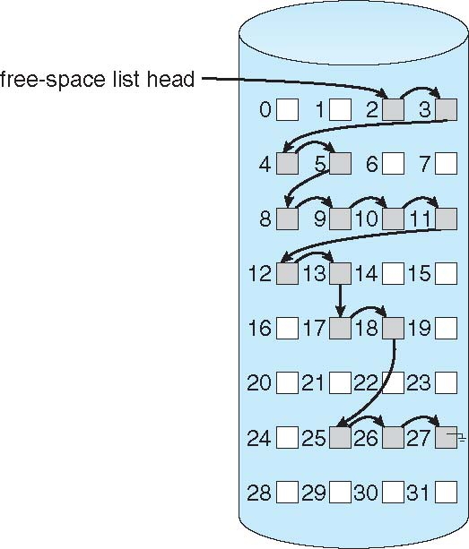
Linked Free Space List on Disk
Link together all the free disk blocks
Keep a pointer to the first free block
Cannot get contiguous space easily
Traverse the list
Generally require first free block

Slide 56
Free-Space Management
Grouping
Reserve few disk blocks for management
Modify linked list to store address of next n-1 free blocks in first free block, plus a pointer to next block that contains free-block-pointers
Counting

Slide 57
Keeping Track of Free Blocks (1)
Storing the free list using (a) Grouping (b) Bitmap.

Slide 58
1KB block
16 bits block number
Each block holds 511 free blocks
20M disk needs 40 blocks for free list
How many for bit map?

Slide 59
Free Space for FAT
MS DOS

Slide 60
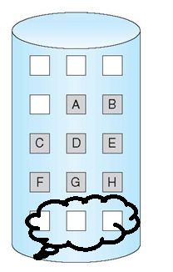
Demand Paging Example
Memory access time = 200 nanoseconds
Average page-fault service time = 8 milliseconds
EAT = (1 – p) x 200 + p (8 milliseconds)
= (1 – p ) x 200 + p x 8,000,000
= 200 + p x 7,999,800
If one access out of 1,000 causes a page fault, then
EAT = 8.2 microseconds.
This is a slowdown by a factor of 40!!
If want performance degradation < 10 percent
220 > 200 + 7,999,800 x p 20 > 7,999,800 x p
p < .0000025
< one page fault in every 400,000 memory accesses
Better utilization of swap space
Swap space

Slide 61
Layered File System
Manages FCB
Translates logical to physical blocks
Issue commands
Each level uses the feature of low level
Create new features for higher level
R/W Physical block (cylinder, track, sector)
Hardware specific instruction
Device driver, transfer information between memory/disk

