Slide 1
General Information
Class time (NC 141)
Mon (8.00-10.00)
Tue (12.00-13.00)
Lab Tutorial (Mon, 2.00pm-4.00pm) Room 119

Slide 2
General Information
Grading Policy
Midsem – 30%
Endsem – 50%
Internal – 20% (Tutorial, Class tests, Scribe and Attendance)
http://cse.iitkgp.ac.in/~bivasm/OS2016.html
Text Books / References :
1. Silbersehatz A. and Galvin P., “Operating System Concepts”, Wiley.
2. Tanenbaum A.S., “Operating System Design & Implementation”, Practice Hall NJ.
3. Stalling, William, “Operating Systems”, Maxwell McMillan International Editions, 1992.
4. Dietel H. N., “An Introduction to Operating Systems”, Addison Wesley.

Slide 3
What is an Operating System?

Slide 4
Why do we need an Operating System?
Write a program to sort n elements
Hardware (resource)
Disk
Input/ Output
CPU
Memory

Slide 5
What is an Operating System? (User’s view)
A program that acts as an intermediary between a user of a computer and the computer hardware
Defines an interface for the user to use services provided by the system
Creates an environment for the user

Slide 6
What is an Operating System? (User’s view)
Abstract Machine
Hides complex details of the underlying hardware
Provides common API to applications and services
Simplifies application writing
Command Interpreter
Part of a OS that understands and executes commands that are entered interactively by a human being or from a program
Shell

Slide 7

What is an Operating System? (User’s view)
Application
Shell
Operating System
CPU
Memory
Video Card
Network
Monitor
Disk
Printer

Slide 8
Why is abstraction important?
Without OSs and abstract interfaces, application writers must program all device access directly
load device command codes into device registers
understand physical characteristics of the devices
Applications suffer!
very complicated maintenance and upgrading
no portability

Slide 9

What Operating Systems Do (User’s view)
Depends on the point of view
Single user system
Users want convenience, ease of use
Don’t care about resource utilization
Optimized for single user experience

Slide 10
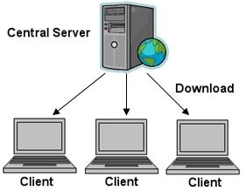
What Operating Systems Do (User’s view)
Depends on the point of view
Shared computer such as mainframe must keep all users happy
Response time minimum
Keep all the users happy
Shared CPU, memory

Slide 11
What Operating Systems Do
(Systems view)
OS is a resource allocator
Manages all resources
Decides between conflicting requests for efficient and fair resource use
OS is a control program
Controls execution of programs to prevent errors and improper use of the computer

Slide 12
Concept of Process
Process
Program loaded in memory and in execution
Program is a passive entity
Process is an active entity

Slide 13
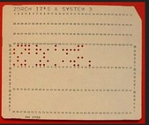
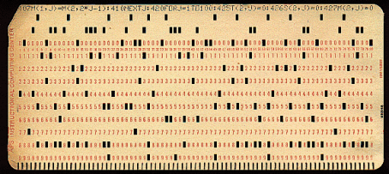
Types of Systems
Batch Systems
Multiple jobs, but only one job in memory at one time and executed (till completion) before the next one starts
Operating system
User program
Jobs waiting

Slide 14
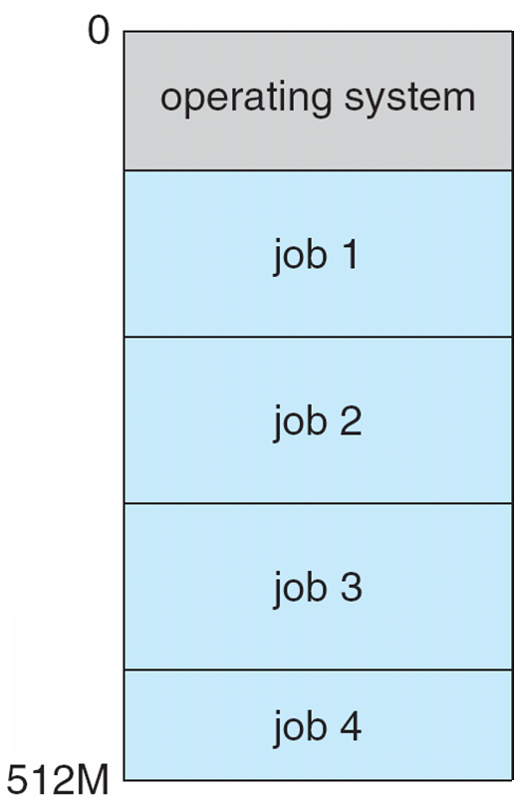
Types of Systems
Multiprogrammed Systems
Multiple jobs in memory, CPU is multiplexed between them
Single user cannot keep CPU and I/O devices busy at all times
When it has to wait (for I/O for example), OS switches to another job
Multiprogramming organizes jobs (code and data) so CPU always has one to execute
A subset of total jobs in system is kept in memory
One job selected and run via job scheduling
Effective resource utilization
Poor user experience

Slide 15


Types of Systems
Time-sharing Systems (multitasking)
logical extension of multiprogramming in which CPU switches jobs so frequently that users can interact with each job while it is running, creating interactive computing
Response time should be < 1 second
Each user has at least one program executing in memory
If several jobs ready to run at the same time  CPU scheduling
Low Response time
Low Response time

Slide 16
What Operating Systems Do
(Systems view)
OS is a resource allocator
Manages all resources
Decides between conflicting requests for efficient and fair resource use
OS is a control program
Controls execution of programs to prevent errors and improper use of the computer

Slide 17
Manage resources
Job 1
Share the CPU with several users
Decide when to allocate CPU to which user (CPU scheduling)
Ensure fair user experience
CPU
Job 2
Job 3
Share memory with several different users
Should not overlap
Ensure protection
Memory

Slide 18
What Operating Systems Do
(Systems view)
OS is a resource allocator
Manages all resources
Decides between conflicting requests for efficient and fair resource use
OS is a control program
Controls execution of programs to prevent errors and improper use of the computer

Slide 19
Control program (Protection)
Multiple jobs are sharing the common resource
With sharing, many processes could be adversely affected by a bug in one program
Make sure that error in one program could cause problems only for that program
A job gets stuck in an infinite loop
Prevent correct operations of other jobs
One erroneous program might modify another program, even operating system
J2, J3 waiting
CPU
(J1)
Incorrect program cannot cause other programs to execute incorrectly

Slide 20
Role of Operating system
Computer system can be divided into four components:
Hardware – provides basic computing resources
CPU, memory, I/O devices
Application programs – define the ways in which the system resources are used to solve the computing problems of the users
Word processors, compilers, web browsers, database systems, video games
Users
People, machines, other computers
Operating system
Controls and coordinates use of hardware among various applications and users

Slide 21
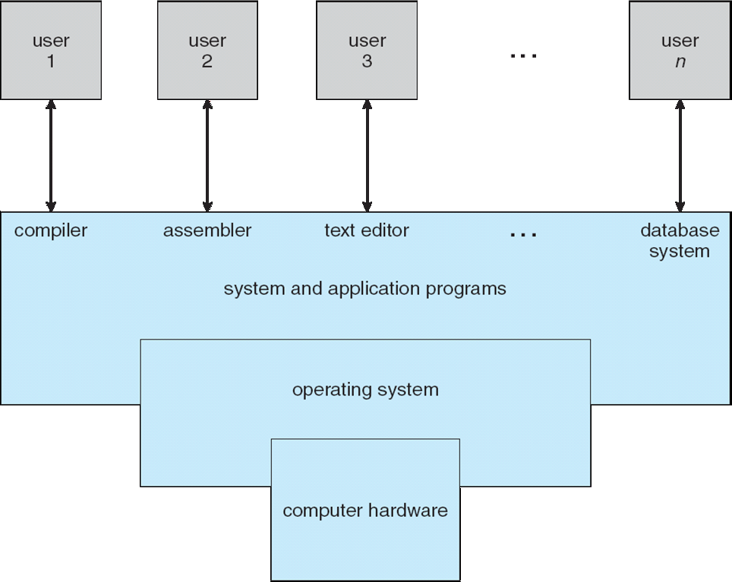
Four Components of a Computer System

Slide 22
Execution of OS
Interrupt driven
Until an interrupt comes, OS remains Idle
Interrupt/trap
Possibility 1---- error
Possibility 2
User program invokes OS code by generating Interrupt, system call
To perform some task reserved for OS
Accessing I/O devices (read, write files)
ISR

Slide 23
Providing abstraction via system calls
Application
System Calls: fork(), wait(), read(), open(), write(), mkdir(), kill() ...
Operating System
Process Mgmt
Device Mgmt
File System
Network Comm.
Protection
Kernel
Security
CPU
Memory
Video Card
Network
Monitor
Disk
Printer

Slide 24
Execution of OS
Interrupt driven
Until an interrupt comes, OS remains Idle
User program invokes OS code by generating Interrupt, system call
To perform some task reserved for OS
Accessing I/O devices (read, write files)
Any difference in execution between user and OS program?

Slide 25
Operating-System Operations
Must distinguish between the use level code and OS code
User mode and kernel mode
Mode bit provided by hardware
Provides ability to distinguish when system is running user code or kernel code
System call changes mode to kernel, return from call resets it to user

Slide 26
System boot
Hardware starts kernel mode
Load Operating system
Start user application
Switch to User mode
Whenever Trap or interrupt occurs, hardware switches to user to kernel mode

Slide 27
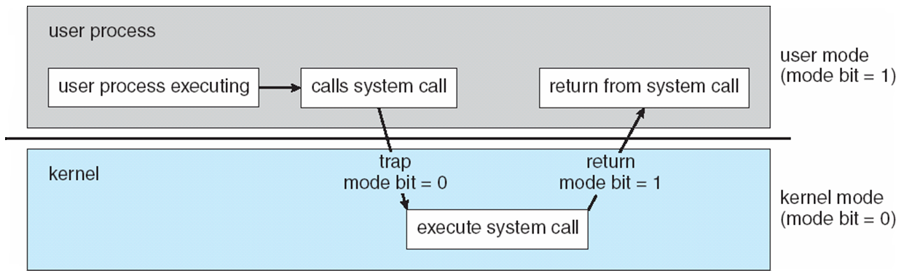
Some instructions designated as privileged, only executable in kernel mode

Slide 28
Providing abstraction via system calls
Application
System Calls: fork(), wait(), read(), open(), write(), mkdir(), kill() ...
Operating System
Process Mgmt
Device Mgmt
File System
Network Comm.
Protection
Security
CPU
Memory
Video Card
Network
Monitor
Disk
Printer

Slide 29
What Operating Systems Do
(Systems view)
OS is a resource allocator
Manages all resources
Decides between conflicting requests for efficient and fair resource use
OS is a control program
Controls execution of programs to prevent errors and improper use of the computer

Slide 30
Control program (Protection)
Multiple jobs are sharing the common resource
With sharing, many processes could be adversely affected by a bug in one program
Make sure that error in one program could cause problems only for that program
A job gets stuck in an infinite loop
Prevent correct operations of other jobs
One erroneous program might modify another program, even operating system
J2, J3 waiting
CPU
(J1)
Incorrect program cannot cause other programs to execute incorrectly

Slide 31
Dual-mode operation allows OS to protect itself and other system components
Privilege instructions
Software error creates exception or trap
Division by zero, request for operating system service, setting timer
Restricts user process from executing privilege instruction
E.g. Segmentation fault!

Slide 32
Mode change
computation
I/O
computation
A1
A2
computation
Initiates I/O
Mode
U (A1)
K
K
U (A2)
K
U (A1)
Time
Schedules A1
Schedules A2

Slide 33
What is the difference between
Privileged Instruction and System call?

Slide 34
System calls
Win 32
POSIX
JVM
Application
System Calls: fork(), wait(), read(), open(), write(), mkdir(), kill() ...
Operating System
Process Mgmt
Device Mgmt
File System
Network Comm.
Protection
Security
CPU
Memory
Video Card
Network
Monitor
Disk
Printer

Slide 35
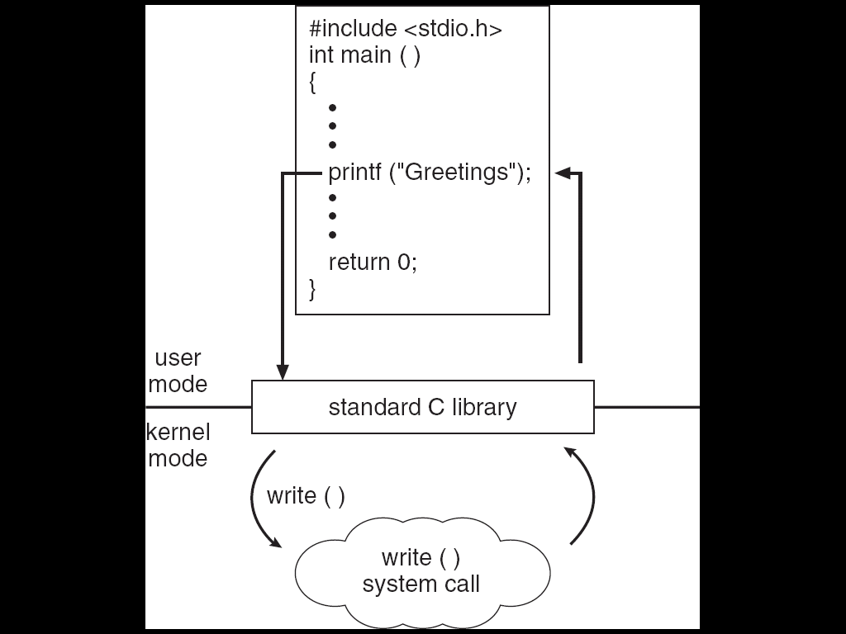
Standard C Library Example
C program invoking printf() library call, which calls write() system call

Slide 36
Resources Managed by OS
Physical
CPU, Memory, Disk, I/O Devices like keyboard, monitor, printer
Logical
Process, File, …
Hence we have
Process management
Memory management
File management
I/O management

Slide 37
Process Management
A process is a program in execution. Program is a passive entity, process is an active entity.
Process needs resources to accomplish its task
CPU time
Representation of process
Process has one program counter specifying location of next instruction to execute
Data structure (stores information of a process)
Many processes may be associated with the same program
Typically system has many processes
some user processes,
some operating system processes
Life cycle of a process
States
Arrival, Computation, I/O, I/O completion, termination

Slide 38
Process Management Activities
The operating system is responsible for the following activities in connection with process management:
Creating and deleting both user and system processes
Suspending and resuming processes
Process scheduling
Providing mechanisms for process synchronization
Providing mechanisms for process communication
Providing mechanisms for deadlock handling
R1
P1
R1
P1
R2
P2
R2
P2

Slide 39

Memory Management
All instructions and data in memory in order to execute
Translate the logical address to physical address
Process terminates => MMU declares that the memory space is available
Multiprogramming: Memory management manages several processes in memory
Optimizing CPU utilization and computer response to users
Ensure memory protection
Track illegal address
Memory management activities
Keeping track of which parts of memory are currently being used and by which process
Allocating and deallocating memory space as needed
Introduces Virtual memory
If the process size is bigger than the RAM size
Hardware support
Process
Memory Management Unit
CPU
Logical address
Physical address

Slide 40
File Management
OS provides uniform, logical view of information storage
Abstracts physical properties to logical storage unit - File
File => Collection of related information defined by the creator
Each medium is controlled by device (i.e., disk drive, tape drive)
Varying properties include access speed, capacity, data-transfer rate, access method (sequential or random)
User
Files (user’s view)
Device Driver
Mapping
Disk (sector, track)
Physical media

Slide 41
File Management
OS provides uniform, logical view of information storage
Abstracts physical properties to logical storage unit - file
Each medium is controlled by device (i.e., disk drive, tape drive)
Varying properties include access speed, capacity, data-transfer rate, access method (sequential or random)
OS implements the abstract concept of file by managing mass storage media (disk etc) and devices that control them
Files usually organized into directories
Access control on most systems to determine who can access what
File-System management
Creating and deleting files and directories
Primitives to manipulate files and dirs
Mapping files onto secondary storage

Slide 42
Disk Management
Usually disks used to store data that does not fit in main memory or data that must be kept for a “long” period of time
Most of the programs are stored on disk
Proper management is of central importance
Entire speed of computer operation depends on disk subsystem and its algorithms
OS activities
Storage allocation (logical blocks)
Free-space management
Disk scheduling

Slide 43
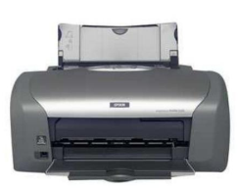
I/O Subsystem
One purpose of OS is to hide peculiarities of hardware devices from the user
I/O subsystem responsible for
Memory management of I/O including buffering (storing data temporarily while it is being transferred), caching (storing parts of data in faster storage for performance)
General device-driver interface
Drivers for specific hardware devices
I/O subsystem (general interface)
Device Drivers
I/O devices

Slide 44
OS design and structure
Large complex system
Designed carefully
if it is to function properly
Modified easily
Common approach
Partition the tasks into small components/modules
Each module must accomplish some specified task

Slide 45
UNIX
UNIX – consists of two separable parts
Systems programs
The kernel
Consists of everything below the system-call interface and above the physical hardware
Provides the file system, CPU scheduling, memory management, and other operating-system functions; a large number of functions for one level

Slide 46
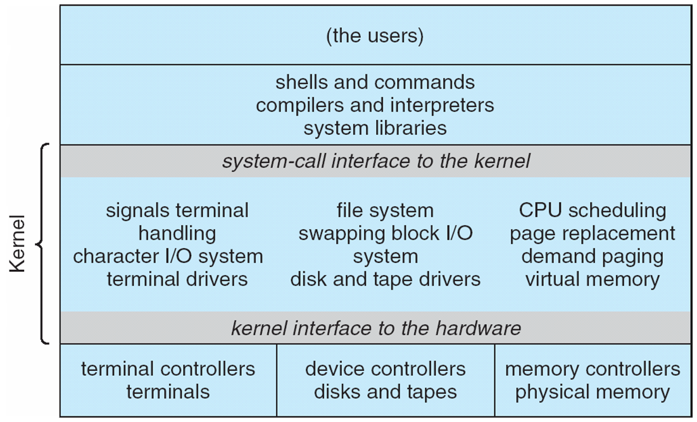
Traditional UNIX System Structure
Evolves over time

Slide 47
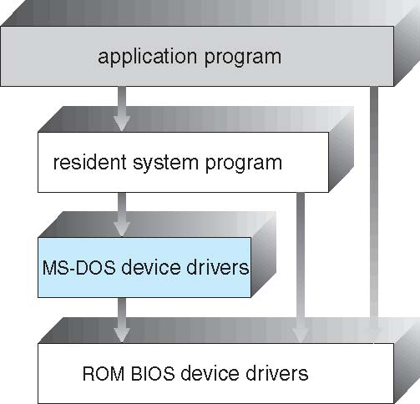
MS-DOS
Application programs can directly access I/O routines
Makes the system vulnerable
No mode bit
Limitations in hardware
Intel 8088

