Slide 1
Reducing Prediction Churn –Proofpoint, Inc.
Dauren Bizhanov
Himangshu Bhantana
Satvik Kishore
Tigran Harutyunyan
Notes:
Introduce ourselves and proofpoint

Slide 2
Agenda
What is Prediction Churn?
Types of Churn
Example of good churn and bad churn
Motivation
Methods
Knowledge Distillation
Experiments

Slide 3

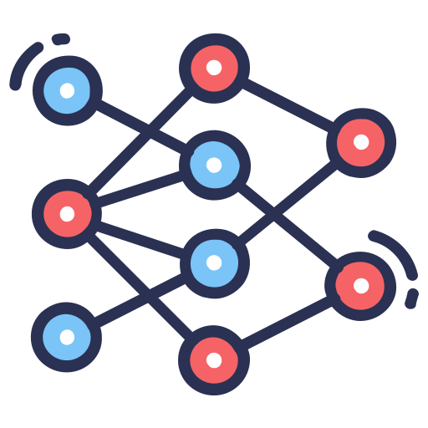


Model Consistency is important
Proofpoint Model
Email from Boss
Phishing Bank Email
Fake Job Offer
Inbox
Model works well

Slide 4
Model Consistency is important
Proofpoint Model
Email from Boss
Phishing Bank Email
Fake Job Offer
Inbox
Model behavior has changed

Slide 5
What is Prediction Churn?
“Churn is a measure of discrepancy between the predictions made by two models. It can be defined as a proportion of mismatched predictions to the number of overall predictions.”
Types of Churn
Good Churn:
Case when an updated version of the model makes correct predictions on cases where the old model made incorrect predictions.
Bad Churn:
This churn is the most problematic since an updated model makes mistakes in cases where the old model’s predictions were incorrect causing needless inconsistency in behavior.
Notes:
Define churn

Slide 6




Last Week’s Model
This Week’s Model
True Label
Predicted Labels
True Label
Predicted Labels
Cat
Cat
Churn, but good
Dog
Monkey
Snake
Lizard
Churn
Monkey
Elephant
Churn
Notes:
What is Prediction Churn?
Why is it bad?
Types?

Slide 7
Motivation
Experiment to determine the best method
Implement a model agnostic open-source tool that can help users reduce their prediction churn.
Develop a novel methodology that can uniquely address our client’s problems (we do not know this yet).
Notes:
Successively trained models not behaving consistently cause downstream issues.
Research is surprisingly lacking, only 3 papers that directly deal with prediction churn.

Slide 8
Experiments
Methods
Anchor
Label Smoothing
Knowledge Distillation
Model Architecture:
ResNet for image classification data.
Bidirectional LSTM for text classification (sentiment analysis).
TabNet for classification of tabular data
Notes:
Successively trained models not behaving consistently cause downstream issues.
Research is surprisingly lacking, only 3 papers that directly deal with prediction churn.
“A unit of experiment will be a unique combination of label modification methodology, model size, dataset, and methodology hyperparameters”.

Slide 9
Knowledge Distillation
Older model’s predictions are combined with the true label in a weighted manner.
Distillation has been typically used to train a smaller network to mimic a larger network
In our context, a newer model learns to partially mimic the older model in addition to learning from newer data
Training is done by optimizing on the loss while constraining on the churn.

Slide 10
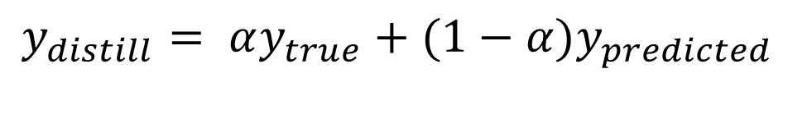

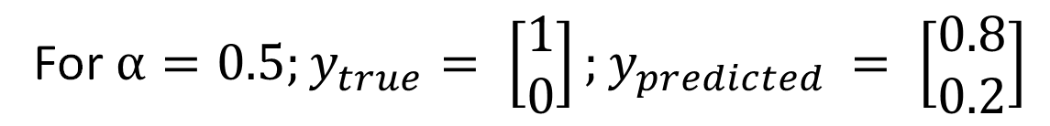
$$y_{distill}= αy_{true}+(1−α)y_{predicted}$$
Distillation
Example
For $α=0.5;y_{true}= \left[\begin{aligned}1 \\ 0\end{aligned}\right];y_{predicted }= \left[\begin{aligned}0.8 \\ 0.2\end{aligned}\right]$
$$y_{distill}=0.5 ∗\left[\begin{aligned}1 \\ 0\end{aligned}\right]+0.5∗\left[\begin{aligned}0.8 \\ 0.2\end{aligned}\right]=\left[\begin{aligned}0.9 \\ 0.1\end{aligned}\right]$$

Slide 11
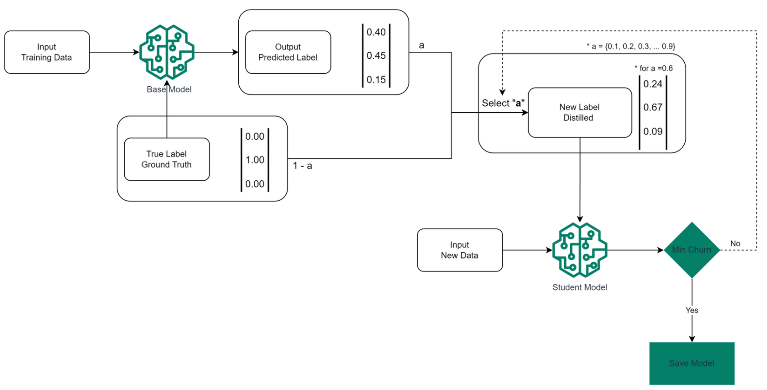
α
α

Slide 12
Notes:
Evaluation Metrics
Accuracy
Churn
Churn Ratio (Ratio of churn wrt baseline)
Win/Loss Ratio (Ratio of new predictions corrected vs made wrong)
Good Churn, Bad Churn

Slide 13
Thank You
Questions

Slide 14

Next Steps
Packaging
Packaging : The final product will be a general, model-agnostic Python package that can help users reduce churn.
Develop
Novel Algorithm : After identifying areas where existing approaches may be made better, our major objective is to develop new churn reduction algorithm.

