Slide 1
A Git/GitHub Workflow
Grant Braught
Dickinson College
COMP491
Fall 2016
Licensed under a Creative Commons Attribution-NonCommercial-ShareAlike 4.0 International License.

Slide 2
Fork / Clone
Origin
Upstream
Fork repo on GitHub
cd Documents
git clone <URL>
git remote –v
cd github-issues-activity
ls
fork
clone
Remotes
On GitHub
Local
On Your Machine
Master Branch
Files
Stage

Slide 3
Branch / Checkout
Origin
Upstream
cd github-issues-activity
git branch –a
git branch feature
git checkout feature
Remotes
On GitHub
Local
On Your Machine
Master Branch
Feature Branch
Files
checkout
Stage

Slide 4
Status / Add / Commit
Origin
Upstream
Make changes to files
git status
git add filename
git commit –m “message”
Remotes
On GitHub
Local
On Your Machine
Master Branch
Feature Branch
Files
Commit
add
Stage

Slide 5
Push / Pull Request
Origin
pull request
Upstream
git push origin feature
Check feature on GitHub
Pull Request to Upstream
Upstream does merge(s)
push
Remotes
On GitHub
Local
On Your Machine
Master Branch
Feature Branch
Files
Stage

Slide 6
Remote Add / Fetch
Origin
Upstream
git checkout master
git remote add upstream <URL>
git remote –v
git fetch upstream
fetch
Remotes
On GitHub
Local
On Your Machine
Master Branch
Feature Branch
Files
upstream/master
Stage

Slide 7
Merge / Push
Origin
Upstream
git merge upstream/master
git push origin master
push
Remotes
On GitHub
Local
On Your Machine
Master Branch
Feature Branch
Files
upstream/master
merge
Stage

Slide 8
Delete
Origin
Upstream
git branch –d feature
git push origin :feature
push
Remotes
On GitHub
Local
On Your Machine
Master Branch
Feature Branch
Files
upstream/master
Stage

Slide 9
Concurrent Changes
Origin
Pull Request
Upstream
Synch with upstream
git branch feature
git checkout feature
Modify feature
Upstream modified too
git push origin feature
Issue Pull Request
Push
Remotes
On GitHub
Local
On Your Machine
Master Branch
Feature Branch
Files
upstream/master
merge
Stage

Slide 10
Synch Upstream Changes
Origin
Upstream
git checkout master
git fetch upstream
git merge upstream/master
git push origin master
Push
fetch
Remotes
On GitHub
Local
On Your Machine
Master Branch
Feature Branch
Files
upstream/master
merge
Stage

Slide 11
Rebase
Origin
Upstream
git checkout feature
git rebase master
Remotes
On GitHub
Local
On Your Machine
Master Branch
Feature Branch
Files
upstream/master
rebase
Stage

Slide 12
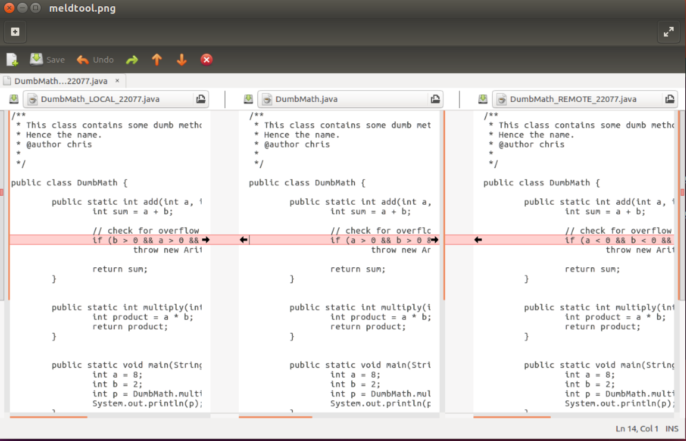
Merge Tool (Meld)
git mergetool
Master Branch
Merged Result
Feature Branch

Slide 13
Rebase Continue
Origin
Update
Pull Request
Upstream
git rebase --continue
git push --force origin feature
Push --force
Remotes
On GitHub
Local
On Your Machine
Master Branch
Feature Branch
Files
upstream/master
Stage

Slide 14
Credits
http://foss2serve.org/index.php/Git:_GitHub_Issues_and_Pull_Request
A similar activity produced by Chris Murphy.
http://foss2serve.org/index.php/Git:_GitHub_Workflow_Activity
A similar activity produced by Darci Burdge and Stoney Jackson.
https://github.com/StoneyJackson/github-workflow-activity/blob/master/presentation.pptx
Slides used by Darci Burdge and Stony Jackson with the above activity.
Basic GitHub elements (cloud/arrows/filesystems) were copied from this slide set.
http://foss2serve.org/index.php/Git:_Working_Locally_from_the_Command_Line
Activity introducing some of the basic git commands produced by Stoney Jackson, Nick Yeates.

