Slide 1
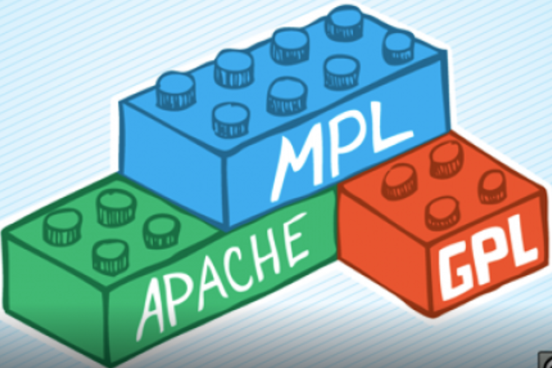



06 – Software Licensing and FOSS
COMP 190 – Dickinson College
Prof. Braught
Fall 2020
Images from: https://opensource.org/, https://www.fsf.org/
https://fossbytes.com/open-sources-license-type/

Slide 2
Software and Licensing
Software licenses are legal documents that grant or restrict rights on the way software may be used, copied, modified and distributed.
Proprietary Software Licenses
Restrictive
Commercial development
Free and Open Source Software (FOSS) Licenses
Permissive
Community development
Notes:
Proprietary licenses
often restrictive – prohibiting you from copying or sharing or modifying the software in any way.
Usually developed by companies who earn money from the sale of he software
FOSS licenses
always permissive – granting others the right of copy, modify and share the software.
Usually developed by communities of individuals and businesses for the common benefit of everyone.

Slide 3
Intellectual Property Protections
Software, like other inventions and creative works, is the intellectual property of those that created it, or the companies they work for (work for hire).
Four categories of protection for Intellectual Property
Trademarks
Copyrights
Patents
Design Rights
Notes:
If you create intellectual property you own it.
Or if you create it for an employer they will often own it
known as a work for hire.
There are four categories of protection for intellectual property.
Which applies depends upon what you are protecting.
Rather than go over these in details here – you’ll watch a video in the activities that covers them.
But these categories exist around the world but are largely controlled by individual countries.
Thus the specific legal mechanisms corresponding to these differs from country to country.
Which can also complicate the enforcement.
- Trademarks
protect a brand
slogans, logos, distinctive sounds, or colors
nike, coke-a-cola
- Copyrights
protect creative works embodied in a fixed tangible form
books, music, plays, movies and software programs.
Automatic upon completion.
- Patents
protect inventions or processes with commercial value
the idea rather than a specific physical form
Light bulb – the patent protected not just the specific form but any device performing the same function in fundamentally the same way.
- Design Rights’
novel new forms or designs for products and packaging
confer commercial value by improving appeal or functionality
The shape of the coke-a-cola bottle, iPhone design, computer font

Slide 4
Software as Intellectual Property
Software is unique with respect to intellectual property and two protections apply:
It is a creative work in a fixed tangible form.
Copyright
It expresses a process
Patentable
Notes:
All software, like every creative work, is immediately and automatically copyrighted.
Including the shell script you wrote last week.
Software that expresses a novel process with commercial value is patentable.
E.g. Googles page rank algorithm for ranking search results

Slide 5
FOSS Licenses
A license makes software Free or Open Source Software by granting others specific permissions on how they may use the copyrighted work.
Permissive Licenses
“Do Anything” / “Anything Goes”
Copyleft Licenses
“Share-a-like” / “Viral”

Slide 6

This Can Get Complicated…
Even program fragments are copyrighted.
https://meta.stackexchange.com/questions/12527/do-i-have-to-worry-about-copyright-issues-for-code-posted-on-stack-overflow
Consider what happens if…
a copyrighted line appears in a program that you open source…
a copylefted line appears in a commercial program...
Notes:
CC by-sa requires attribution and “share alike” which is copyleft.
So code from stack exchange if integrated into a product, requires that it be sa also…
Commercial software houses go to great length to ensure that no copyleft code appears in their products.

Slide 7
What’s Next?
Q05 – Friday
A06 – One week
Revise and resubmits
Quiz scores
Be active on Teams

Slide 8

Acknowledgments:
Slide Template From:
https://creativecommons.org/licenses/by/4.0/
Slide Content Licensed as:
https://creativecommons.org/licenses/by-nc/4.0/

