Slide 1
09 – Building a FOSS Project with the GNU autotools
COMP 190 – Dickinson College
Prof. Braught
Fall 2020

Slide 2
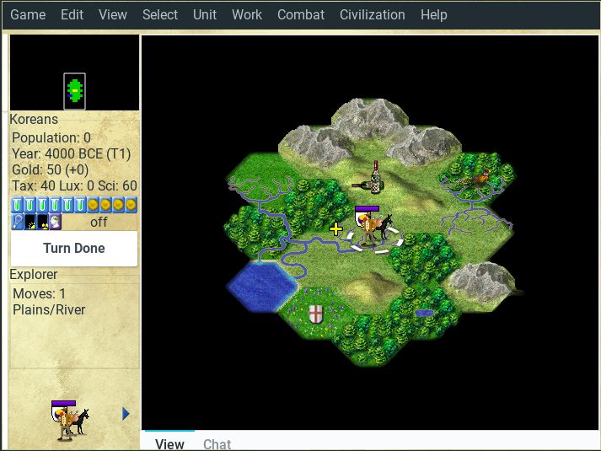
Freeciv
Freeciv is a Free and Open Source empire-building strategy game inspired by the history of human civilization.
Apply what we’ve learned using a real project.

Slide 3
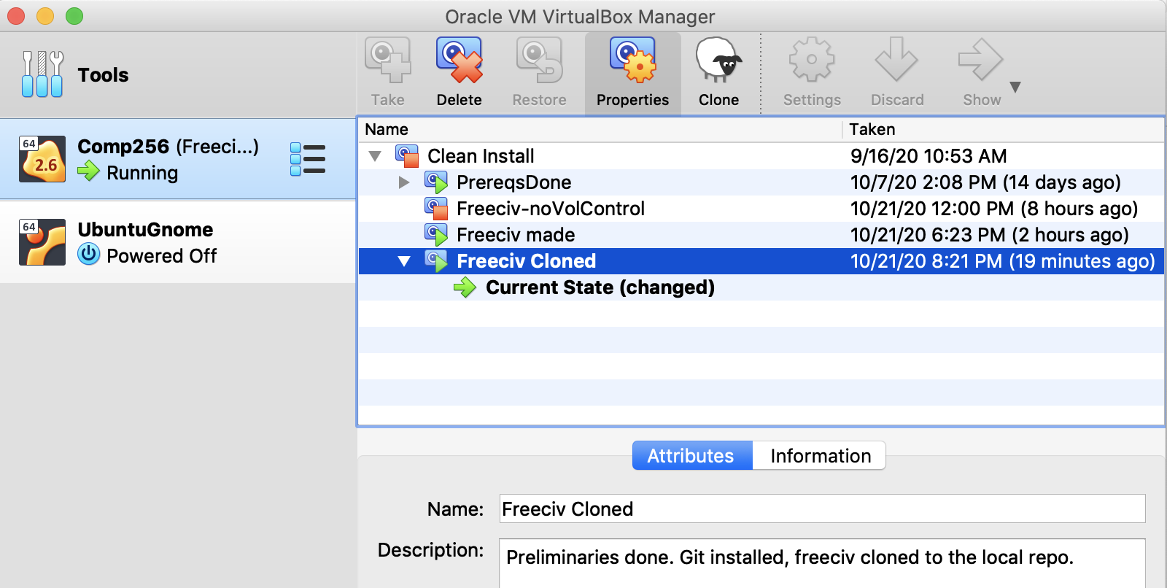
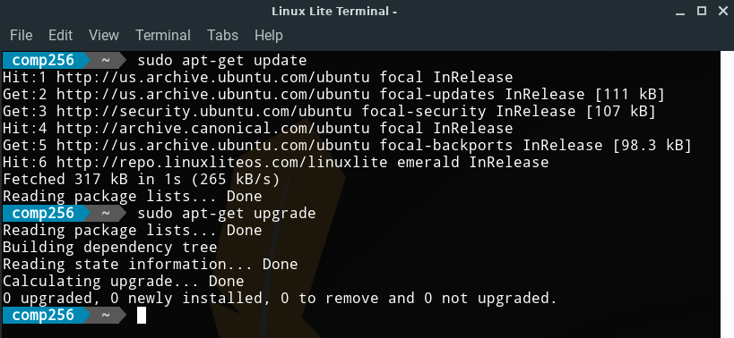
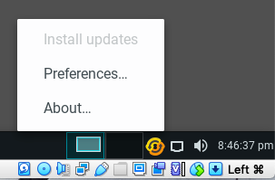
Updates & Snapshots

Slide 4
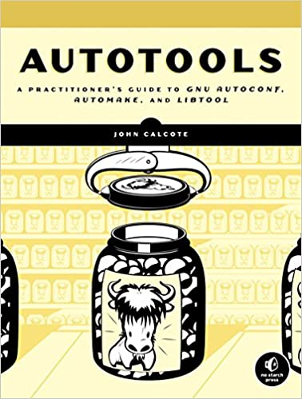
GNU Build Tools
The autotools were created as part of the GNU project to simplify the process of writing build scripts for projects.
Three step process:
autogen.sh
configure
make
Image from: https://www.amazon.com/Autotools-Practitioners-
Autoconf-Automake-Libtool-ebook/dp/B003WUYEL6
Notes:
People were using shell scripts to build projects.
Those scripts got very long and most of it was the same with just some small differences that were project specific.
So extracted the stuff that changed from project to project into data files which were much smaller and easier to create.
Then wrote programs that generated the actual build scripts from those files
Much less for the programmers to write – much less wasted time.
That is the autotools.
Possibly a little old school, but if you are going to be around unix systems, still essential knowledge.
Maybe not writing them… but knowing about them and being able to use them.
Autogen
- makes the configure script
Cconfigure
- checks that everything that is needed is installed
- makes the makefile
Make
- uses the makefile to build the program.

Slide 5
Autogen.sh / autoconf / automake
The autogen.sh shell script:
Uses autoconf with configure.ac to produce the configure script as output.
Uses automake with Makefile.am produces the Makefile.in file
configure.ac
configure
autogen.sh
Makefile.am
Makefile.in
Notes:
It is just a shell script.
A big nasty complicated one… but one none the less.
So configure.ac and makefile.am contain the project specific information.
They are converted into
- configure – a full executable script with all of the code that is the same from project to project.
- makeffile.in – not quite the final product but a bit closer
- the info in Makefile.am augmented with the specific configuration information from configure.ac.

Slide 6
Configure & dependencies
The configure script checks:
checks for all dependencies
Reads Makefile.in and produces the Makefile
Adding machine specifics.
configure
if dependencies satisfied
Makefile.in
Makefile

Slide 7
Make
The make program uses the information in the Makefile to build the executable files from the source files.
Makefile
make
Executable
Program(s)
Project
Source Code
& Data

Slide 8
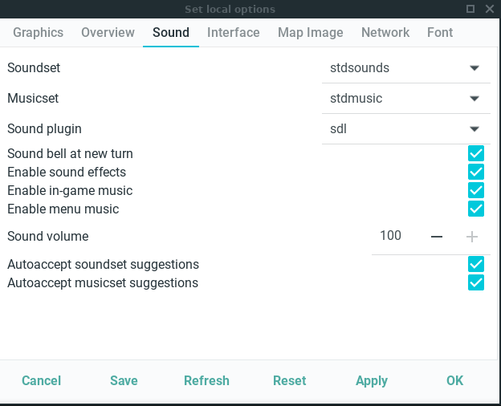
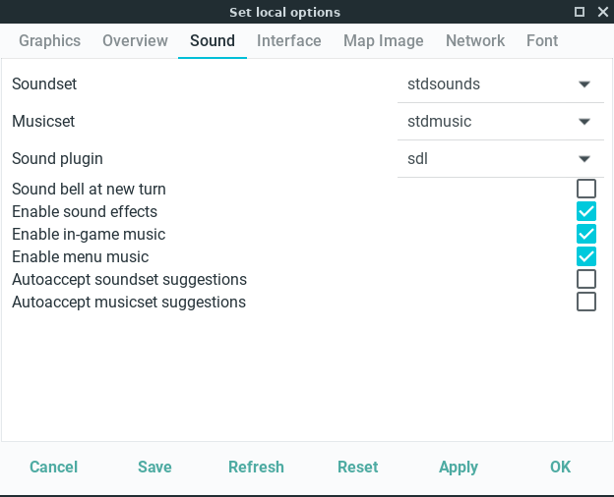
The Volume Control

Slide 9

Acknowledgments:
Slide Template From:
https://creativecommons.org/licenses/by/4.0/
Slide Content Licensed as:
https://creativecommons.org/licenses/by-nc/4.0/

