Slide 1
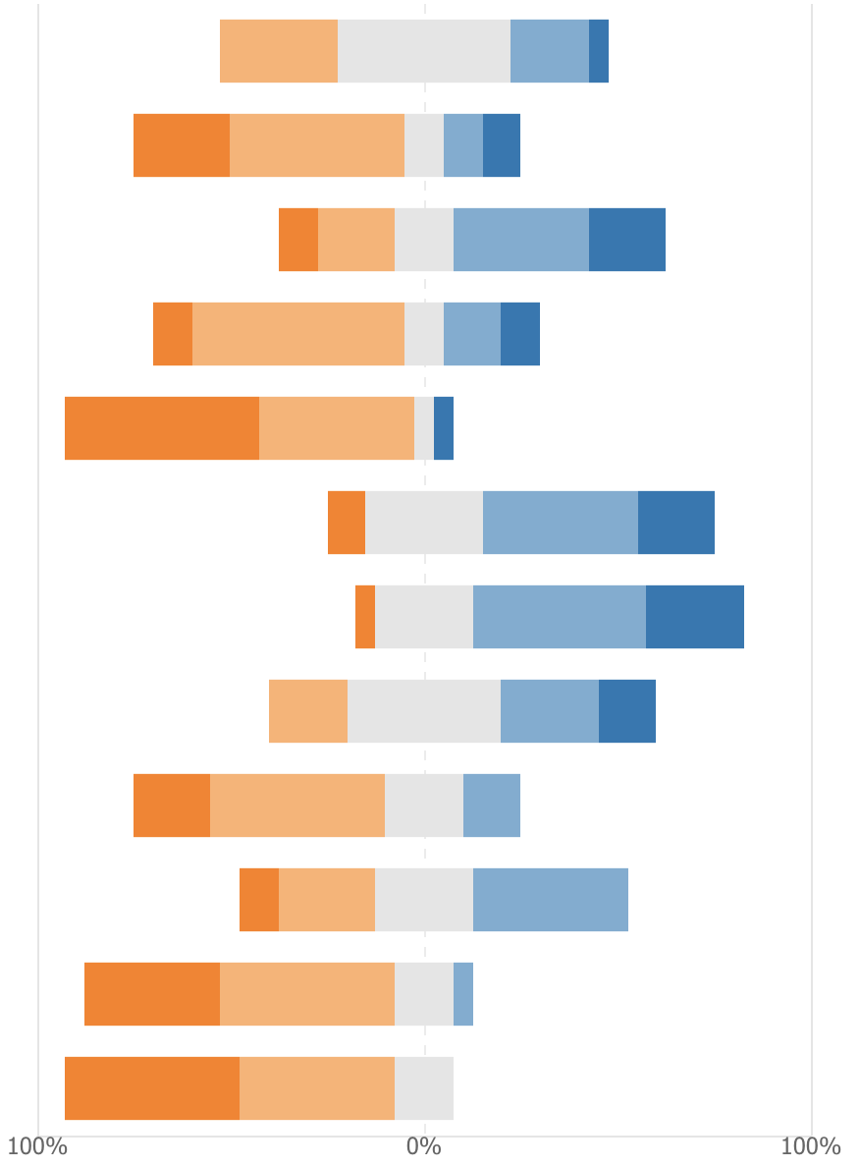
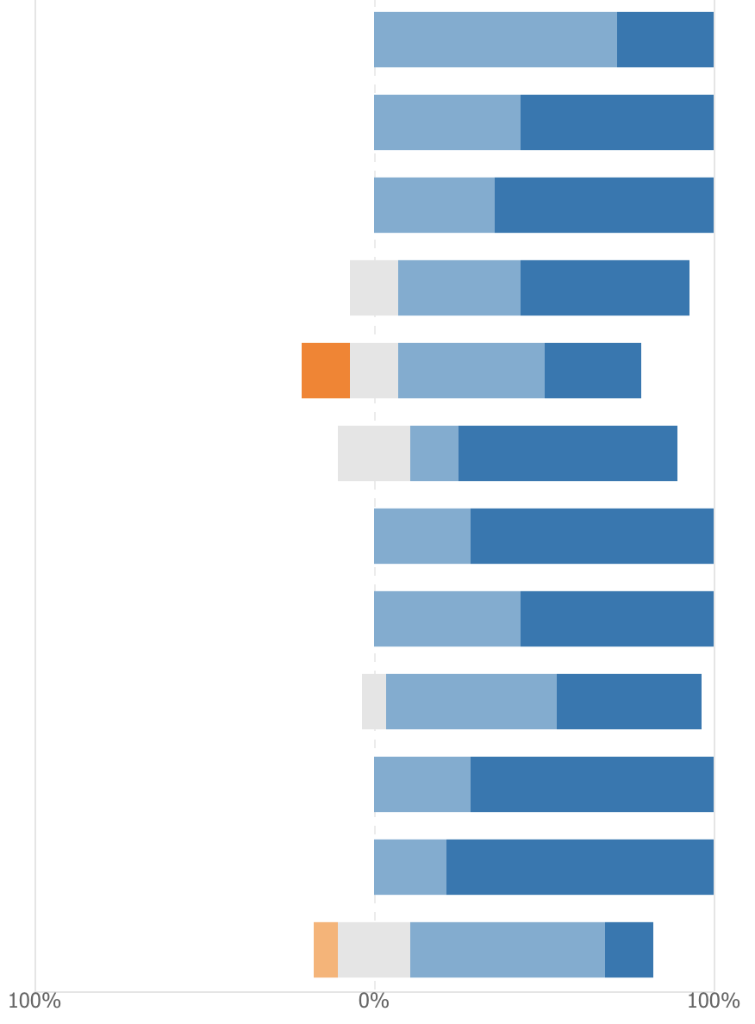
Pre-Course Survey
Post-Course Survey
I am confident using a command line (Terminal) interface
I am able to perform basic system administration in Unix / Linux (e.g. use a package manager, manage permissions).
I know what it means for software to be Free and Open Source Software (FOSS).
I understand the role that licensing plays in FOSS.
I have contributed to a FOSS project in the past.
I plan to contribute to a FOSS project in the future.
FOSS provides a way for computer scientists to contribute to the greater good.
I understand how to use version control software (e.g. git).
I understand how to resolve code conflicts (e.g. merge changes) using version control software.
I understand the purpose of pull/merge requests in team software projects.
I understand how to use an issue tracker in a team software project.
I know how to write a good bug report.

