Slide 1
Neural Network Project
Machine Learning
Braum Russell and Griffin Williams

Slide 2
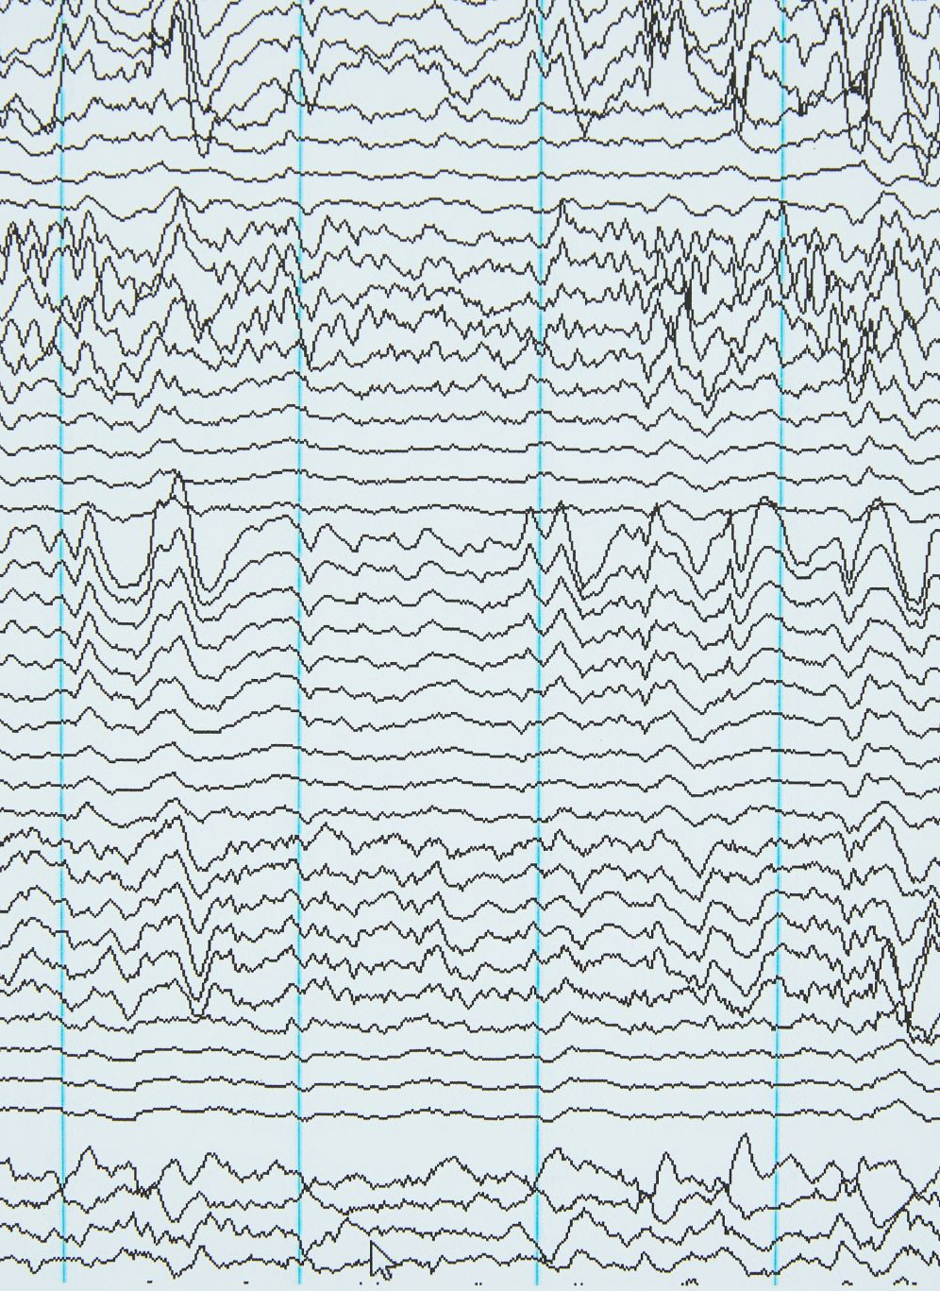
Project Task Recap
In our project, we wanted to analyze the domain of text-to-audio systems.
Text-to-audio models involves the conversion of a textual prompt into an audio representation, basically allowing the model to speak out the description of the text you give it.
TANGO (Text to Audio using iNstruction-Guided diffusiOn) model
Prompt text encoding using an LLM (FLAN-T5)
The LDM creates a latent representation of the audio from the encoded text by using forward and reverse processes
The VAE creates a mel-spectrogram of the final latent representation
A vocoder uses the mel-spectrogram to generate the audio

Slide 3
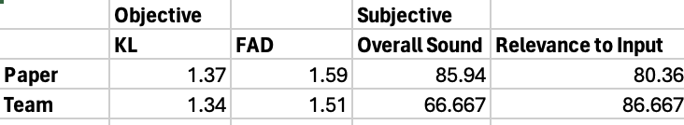
Model Performance
Objective Evaluation
KL Divergence- computes divergence of differences between audio distributions of original and generated audio samples based on labels from the pretrained prompts
FAD (Frechet Audio Distance)- measures the distance between generated audio distribution and real audio distribution without using any reference samples
Subjective Evaluation (on a scale 1-100 averaged)
Overall Sound Quality
Relevance of Audio to the Input Text
A dog barking
Rolling thunder with lightning strikes
An older man speaking the word “hello”
*Objective testing was based on a checkpoint from their inference file instead of our own trained model

Slide 4

Interesting Experience
AudioCaps Dataset
It was interesting to see how in depth and large the dataset that the Tango model was trained on.
The dataset is open-sourced and is primarily comprised of audio descriptions from public YouTube videos.
Descriptive Audio Generation
The generated audio from this model can handle many descriptive words to make it more realistic.
Because the dataset this model is trained on is so vast, the audio we were able to generate could be very helpful in certain industries to save money.
However, there are some ethical concerns with how realistic generated audio could be used maliciously.

Slide 5

Suggestions
YouTube is a great resource to assist on some models/papers, especially when getting started.
If there is little to no documentation or helpful information in the model's README, consult online forums like StackOverflow.
Print out the research paper.
Get started working with model as early as possible because some models require a lot of processing power.

Slide 6
Thank you!

