Slide 1

CASCADE:
Parker Williams, Braum Russell, Ashley Meza, Alex Ball, Skarlett Espinoza-Melgar, Tré Gonzales
Comprehensive Analysis of Stroke Contributing Factors and Demographics

Slide 2

Agenda
Problem
Description of Data
Procedure
Results
Conclusions
Q&A

Slide 3



Facts Surrounding Strokes
Occurs every 40 seconds
1/3 U.S. Adults have high blood pressure
1/6 of Cardiovascular Disease-related Deaths
Notes:
Every 40 seconds, someone in the United States experiences a stroke, underscoring the urgent need to address this pressing public health issue. Therefore, according to this average, by the conclusion of this 20 minute presentation, 30 strokes will have occurred.
Nearly one in three U.S. adults has high blood pressure, with many unaware due to the lack of symptoms. High blood pressure is the number one modifiable risk factor for stroke, contributing to various cardiovascular complications (American Stroke Association).
Strokes accounted for one out of every six deaths related to cardiovascular disease

Slide 4



Addressing the Challenges in Stroke Research
Strokes impact individuals, families, and healthcare systems
Gaps remain in understanding stroke risk
Complexity in stroke assessment
Bridge the gap through analysis
Notes:
Strokes remain a significant challenge for individuals, families, and healthcare systems worldwide, necessitating a comprehensive understanding of the multifaceted factors contributing to their occurrences.
Despite considerable research efforts, gaps persist in understanding the intricate interplay between demographic, lifestyle, and clinical variables in determining stroke risk. The problem at hand lies in the complexity of stroke risk assessment, intensified by the heterogeneous nature of risk factors and the limited generalizability of existing studies across diverse populations. Moreover, while large-scale datasets such as the Stroke Prediction Dataset offer a wealth of information, extracting meaningful insights requires overcoming methodological challenges related to data processing and predictive modeling
This study aims to bridge these gaps by comprehensively analyzing the Stroke Prediction Dataset, uncovering hidden patterns, and developing predictive models for stroke occurrence
The research seeks to filter stroke risk assessment methods and develop targeted prevention strategies to empower healthcare practitioners and individuals, ultimately improving health outcomes

Slide 5
Description of Data
Original Dataset – 5110 Rows of patient data, cleaned for visualization for the 249 people who have had a stroke for observation
The dataset consists of twelve columns containing both quantitative ratios, numerical values, and categorical data.
Gender, age, BMI, heart disease, smoking status, etc.,
Weka

Slide 6
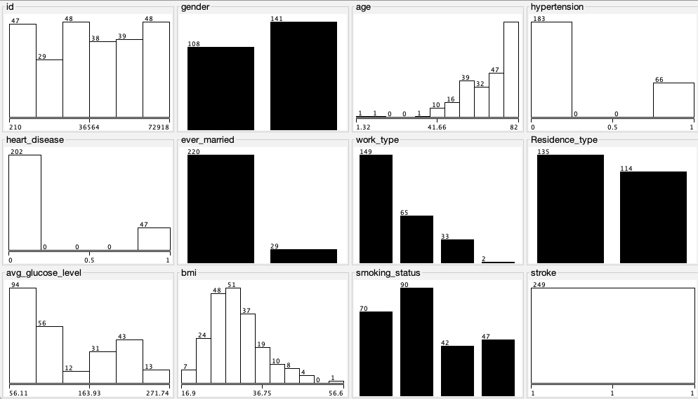
Visualizing the Data
249 patients suffered from stroke
108 Males, 141 Females
Average age of 43.23 for all patients, Average age of 67.72 for those who suffered from stroke
Average BMI of 28.89, 30.47 for those who suffered from stroke
66 Patients suffered from hypertension
47 patients suffered from heart disease

Slide 7
Procedure
Observing our data to see what our dataset contains and how analyses can be performed
Data cleaning depending on the analyses being performed
Conduct a cluster analysis, 0's and 1's
Perform an analysis on association rules
Determine conclusions

Slide 8
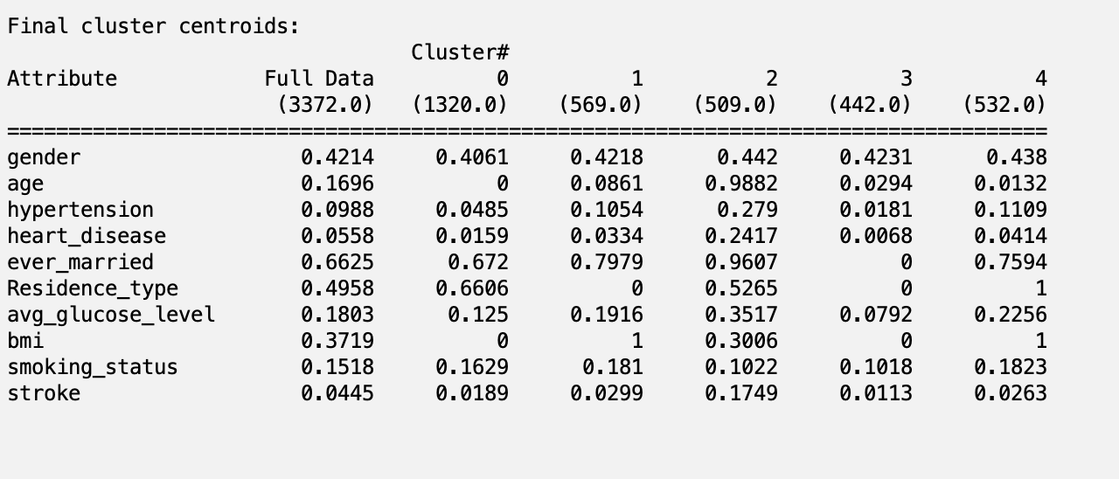
Results – Cluster Analysis
Cluster 2 appears to have the strongest association with strokes as it contains individuals who are older, have higher prevalence of hypertension, marriage, elevated glucose levels, and BMI

Slide 9
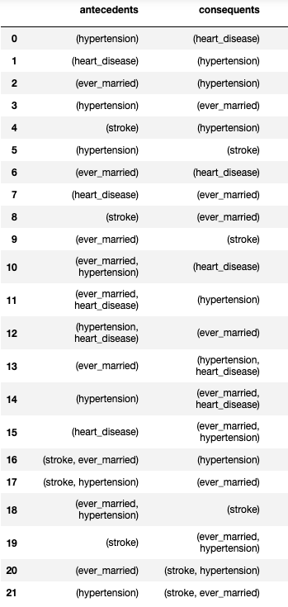
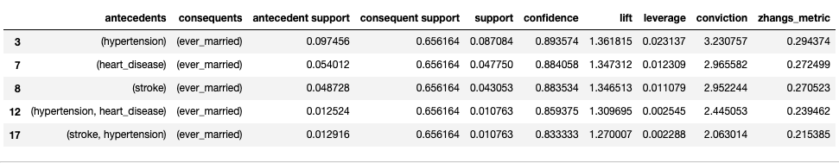
Results – Association Rules
8.7% of the people in the collected data have had both hypertension and have been married at some point in time, 89% confidence level, 1.36 lift
1% of people have been married and have also had both hypertension and stroke, 83% confidence level, 1.27 lift

Slide 10
Conclusions
Valuable insights gained
Factors associated with strokes
Emphasis on early detection and lifestyle modifications
Importance of datasets
Limitations of our dataset
Bias
Missing variables
Further research

Slide 11
Q&A

