Slide 1

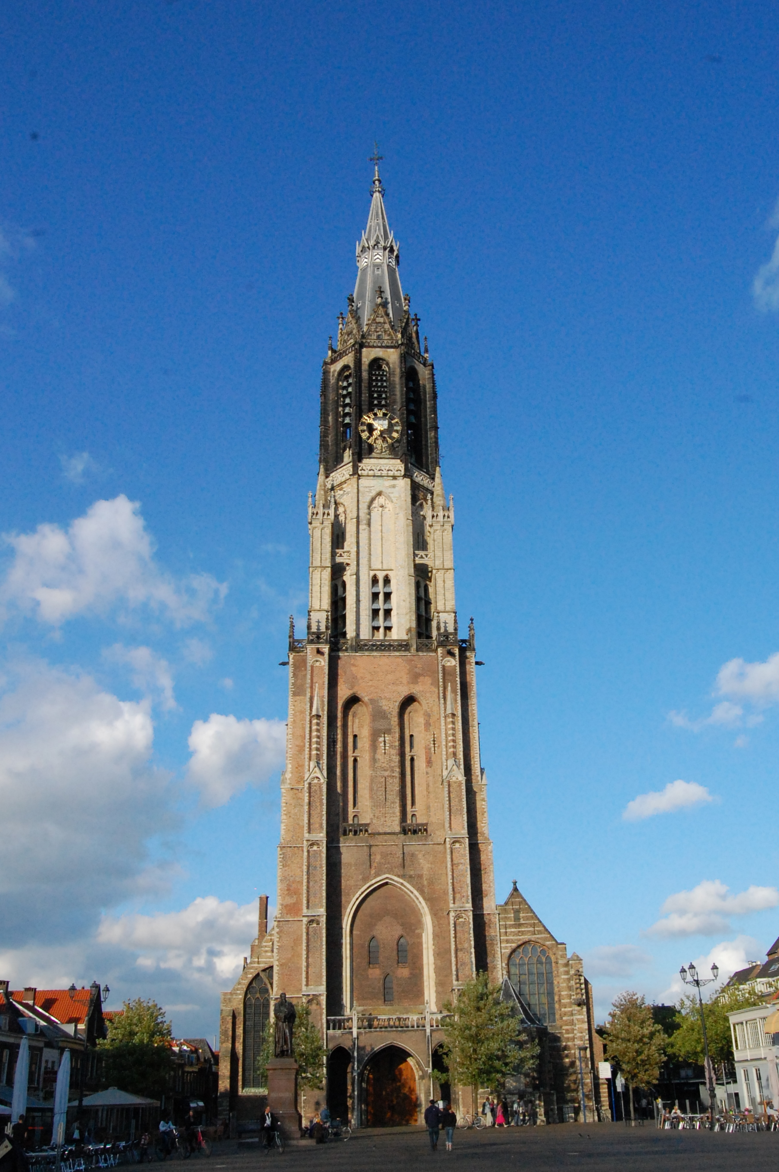


Delft Students
on
Software Architecture
DESOSA 2018

