Slide 1
Merging Scopus Author Profiles
Steven Braun
Informatics/Data Services Specialist
University of Minnesota
Health Sciences Libraries
sbraun@umn.edu
Last updated 12/16/2014

Slide 2
Merging profiles
Why might I need to do this?
Scopus is excellent at disambiguating common author names. For instance, if you have the last name “Johnson,” there are many other researchers in the world you could get confused with. However, Scopus is very good at ensuring it has attributed the correct publications to the correct “Johnson” based on affiliation algorithms.
Even so, occasionally publications will appear under multiple and/or erroneous author profiles in Scopus. While the publications may be correctly attributed to a given author, the author may be split into multiple profiles based on multiple differing affiliations.
Scopus provides a mechanism for merging author profiles when this happens. This document will guide you through the process of merging your publications under a single author profile.
Merging Scopus Author Profiles

Slide 3
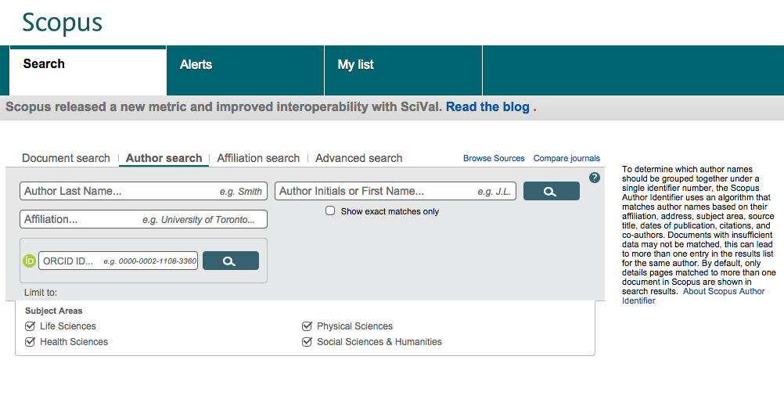
Locate your author profile(s)
STEP 1
Every author listed in Scopus is automatically assigned a profile. In most instances, a faculty member will have a “primary” Scopus author profile that lists most, but not necessarily all, of their publications.
A
Go to http://www.scopus.com through access provided by University Libraries licensing (using a VPN, if necessary). Click Author Search from the provided search tab options.
B
Enter your last name and first initial (or name). You can also add a search term for affiliation, as indicated. Click the search button.
Merging Scopus Author Profiles

Slide 4
Locate your author profile(s)
STEP 1
In this example, we will search for Eric Newman using the full last name and first initial. The search produces a list of results with varying affiliations.
Newman
E
Search
Merging Scopus Author Profiles

Slide 5
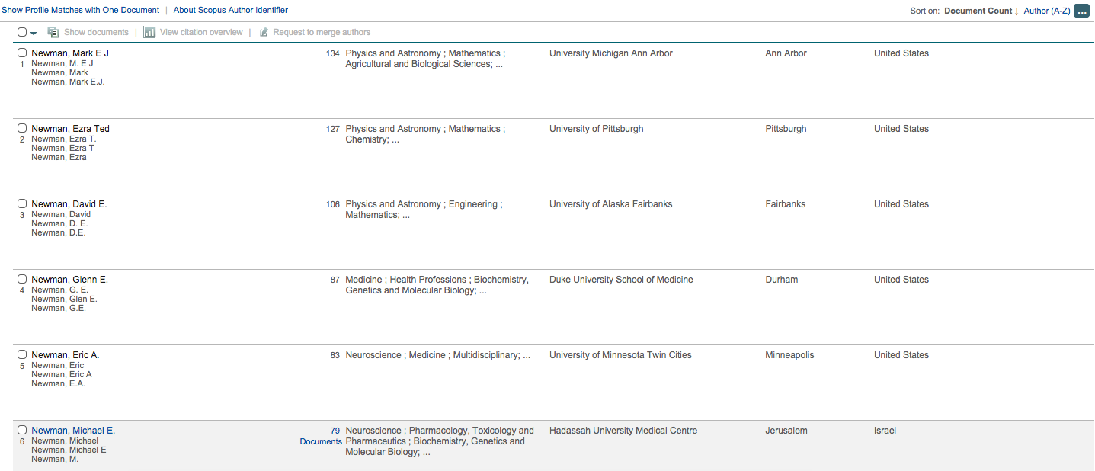
Locate your author profile(s)
STEP 1
In this example, we will search for Eric Newman using the full last name and first initial. The search produces a list of results with varying affiliations.
Search Results
Newman
E
Search
Merging Scopus Author Profiles

Slide 6
Locate your author profile(s)
STEP 1
In this example, we will search for Eric Newman using the full last name and first initial. The search produces a list of results with varying affiliations.
Search Results
Newman
E
Search
C
Locate and click on your primary profile; this will likely be the result with the correct name and correct “University of Minnesota” affiliation listed.
Merging Scopus Author Profiles

Slide 7
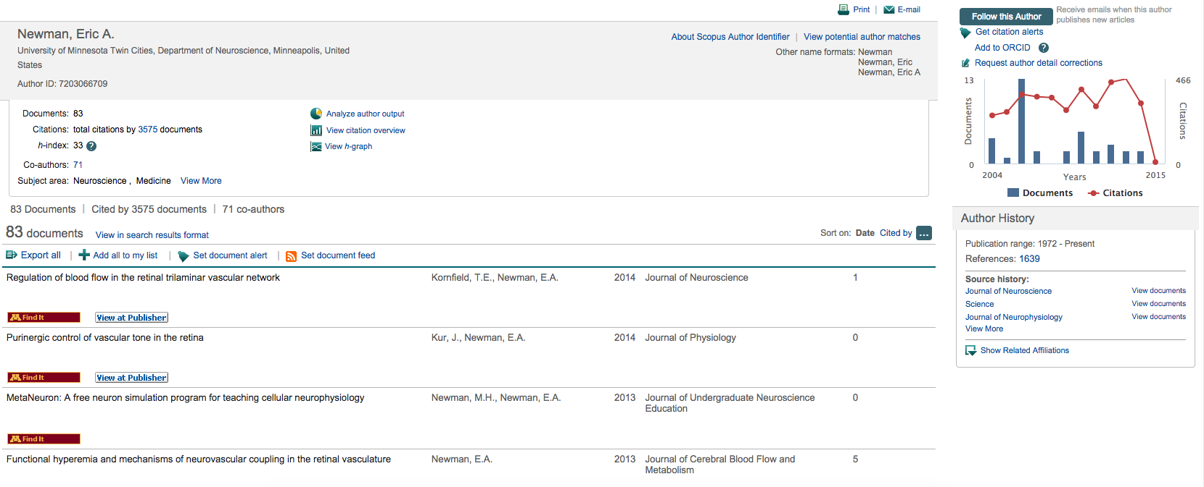
Request author detail corrections
STEP 2
When you load your profile, Scopus provides a link that allows you to request corrections to your author profile.
A
Click the Request author detail corrections link on the right side of the page.
Merging Scopus Author Profiles

Slide 8
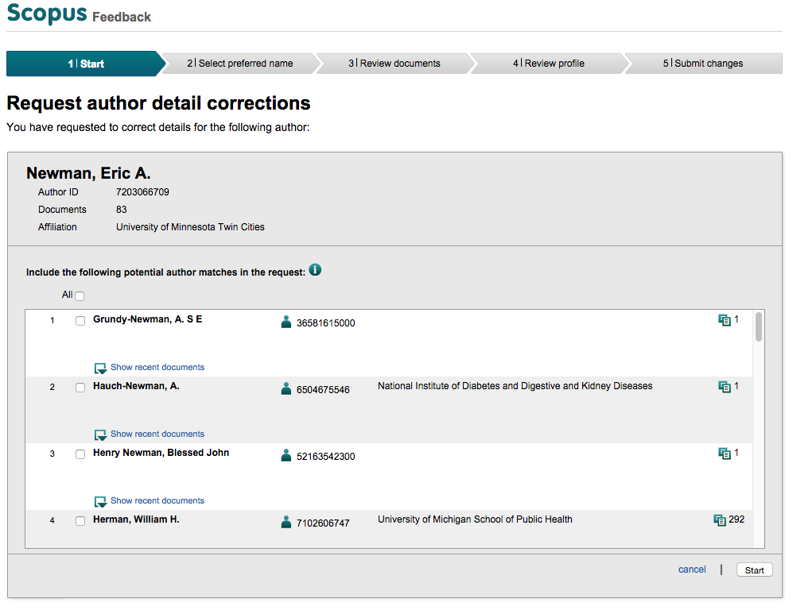
Request author detail corrections
STEP 2
B
In the new window that opens, select other author profiles provided that correctly match your name/publication history (if any listed) and click Start.
Merging Scopus Author Profiles

Slide 9
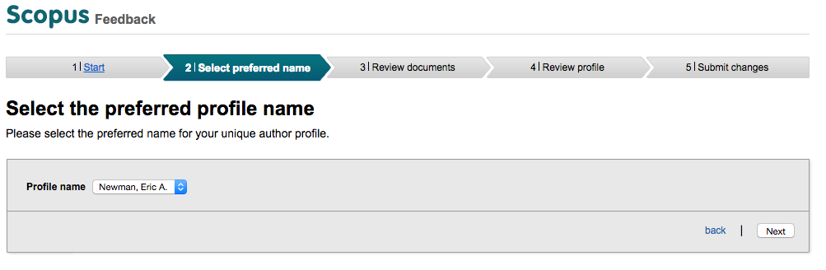
Request author detail corrections
STEP 2
C
From the dropdown list provided, select your preferred display name for your profile. Options are generated from how author names are printed in Scopus publication records. Click Next.
Merging Scopus Author Profiles

Slide 10
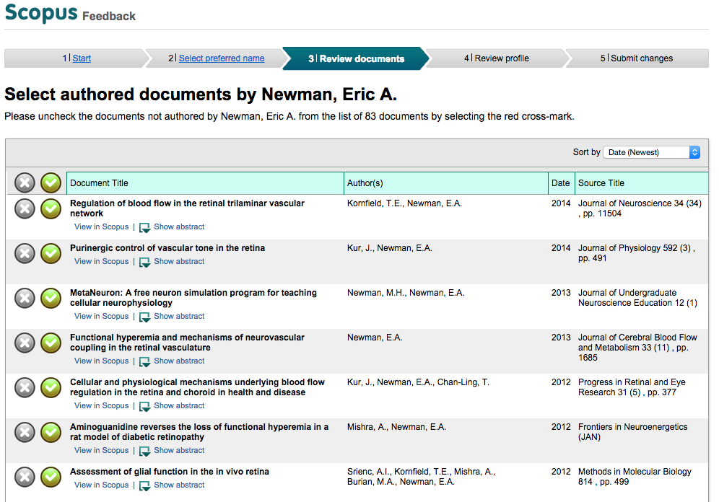
Request author detail corrections
STEP 2
D
Review your list of publications. If there are any publications listed that are incorrectly attributed to you, you may specify those by clicking the X button next to them.
Merging Scopus Author Profiles

Slide 11
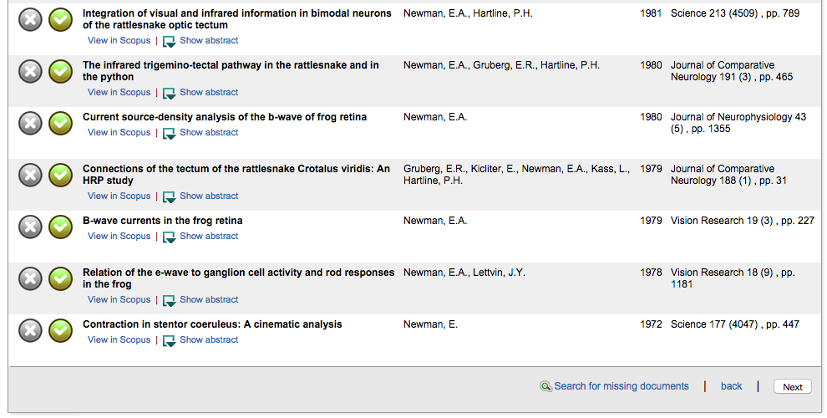
Request author detail corrections
STEP 2
Here, you can also add missing publications by searching for them. Scroll to the bottom of the publications list and click Search for missing documents.
Merging Scopus Author Profiles

Slide 12
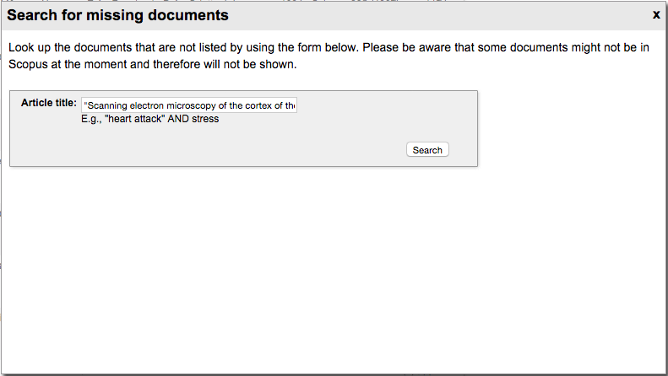
Request author detail corrections
STEP 2
In the dialogue box that opens, enter part of the title of an article you want added to your primary Scopus profile and click Search.
Merging Scopus Author Profiles

Slide 13
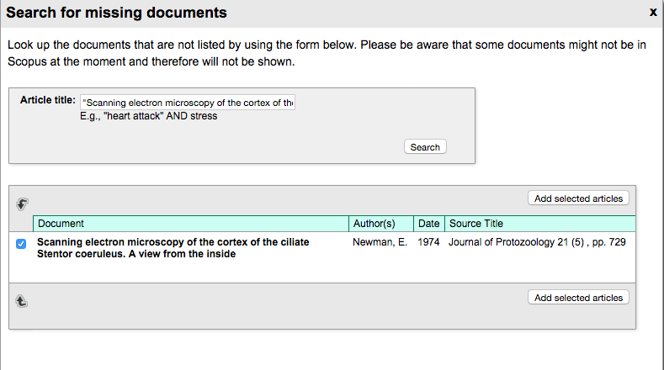
Request author detail corrections
STEP 2
Select any matching documents and click Add selected articles.
Merging Scopus Author Profiles

Slide 14
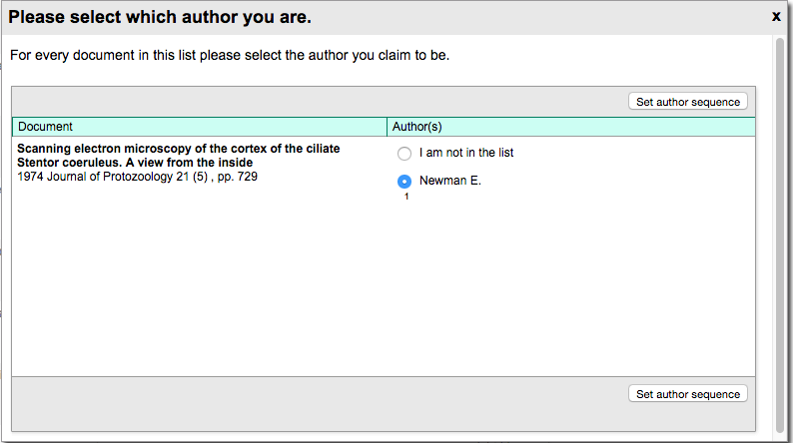
Request author detail corrections
STEP 2
Follow the instructions to select which author you are on the publication(s). Click Set author sequence.
Merging Scopus Author Profiles

Slide 15
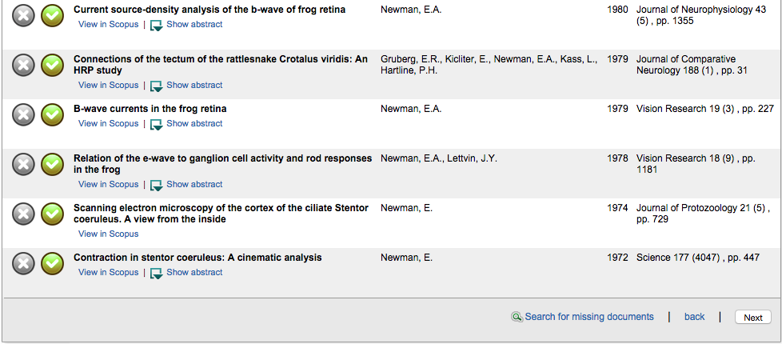
Request author detail corrections
STEP 2
Repeat this process for any other missing publications and verify your finalized publication list for accuracy. When you are done, click Next.
Merging Scopus Author Profiles

Slide 16
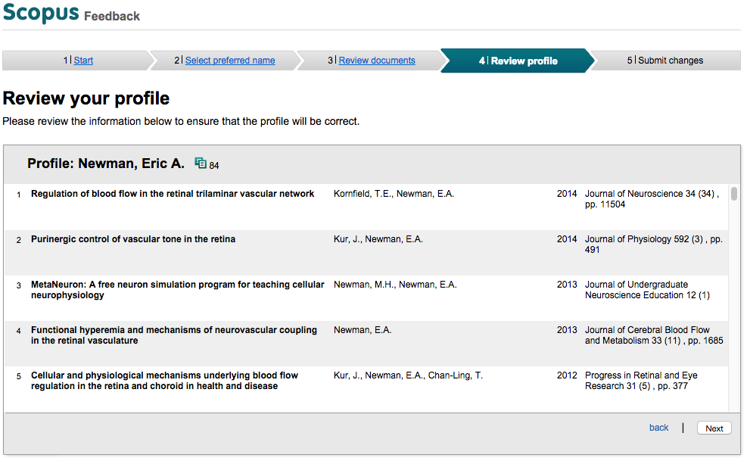
Verify profile corrections
STEP 3
Review your profile along with any changes you made. When you are satisfied, click Next.
Merging Scopus Author Profiles

Slide 17
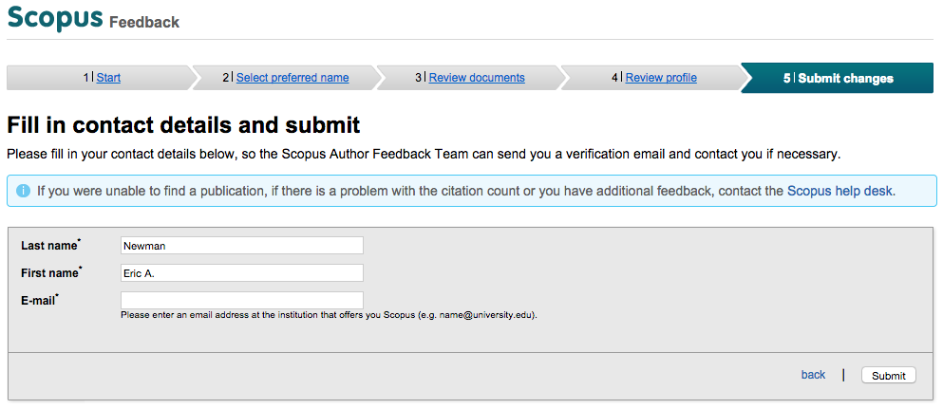
Submit profile corrections
STEP 4
When prompted, enter your first name, last name, and institutional (UMN) e-mail address and click Submit. This completes the profile correction process.
Merging Scopus Author Profiles

Slide 18
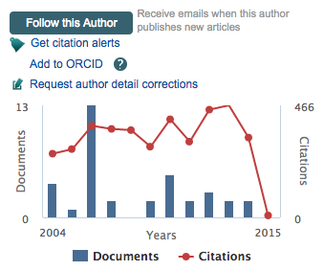
Tips
Sometimes, your author profile may be listed under an unexpected affiliation. If you are unable to locate a primary profile for your name, this may be due to your profile being listed under a previous affiliation or an erroneously attributed affiliation.
If you have registered for an ORCID, Scopus gives you the ability to add your Scopus author ID to your ORCID registration. This makes it easier for publications to be correctly attributed to you instead of others.
Merging Scopus Author Profiles

Slide 19
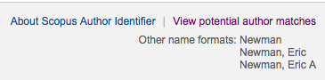
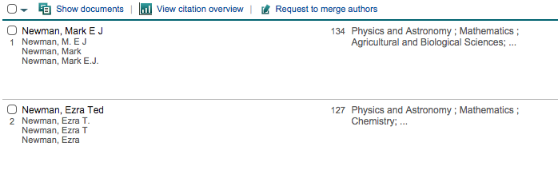
Tips
There are two alternative ways to merge author profiles. One is by clicking View potential author matches near the top of your author profile and following the prompted instructions. Another is by selecting authors you wish to merge from the author search results and clicking Request to merge authors.
Merging Scopus Author Profiles

Slide 20
Questions
If there are specific problems with individual documents or your profile that cannot be addressed through the self-service correction process, you can contact the Scopus help desk for personalized assistance:
http://help.elsevier.com/app/ask_scopus/p/8150
Examples include
Add/remove citations
Request corrections to document details
Request corrections to affiliations
Report missing documents
Merging Scopus Author Profiles

Slide 21
Contact
Steven Braun
Informatics/Data Services Specialist
sbraun@umn.edu
(612) 624-1654
301 Diehl Hall

