Slide 1
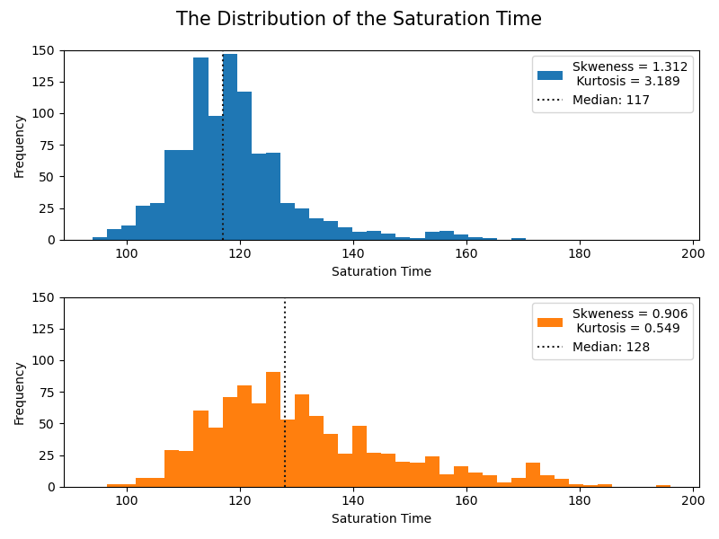
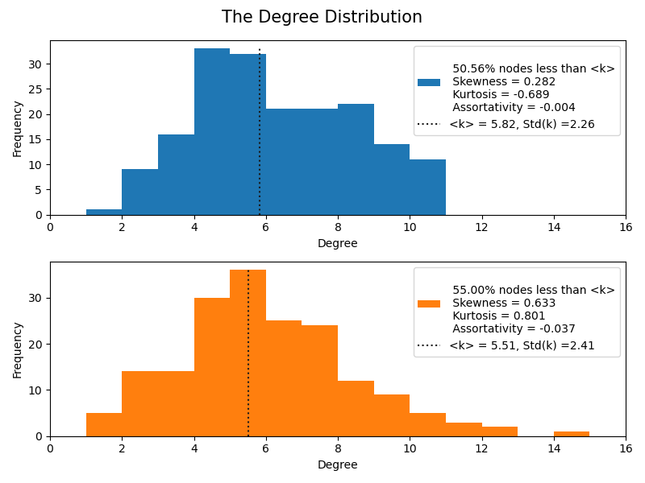
A
Distribution of Saturation Time
Frequency
Saturation Time
B
Degree Distribution
Frequency
C
Degree
Distribution of Saturation Time
Frequency
Saturation Time
D
Degree Distribution
Frequency
Degree

