Slide 1
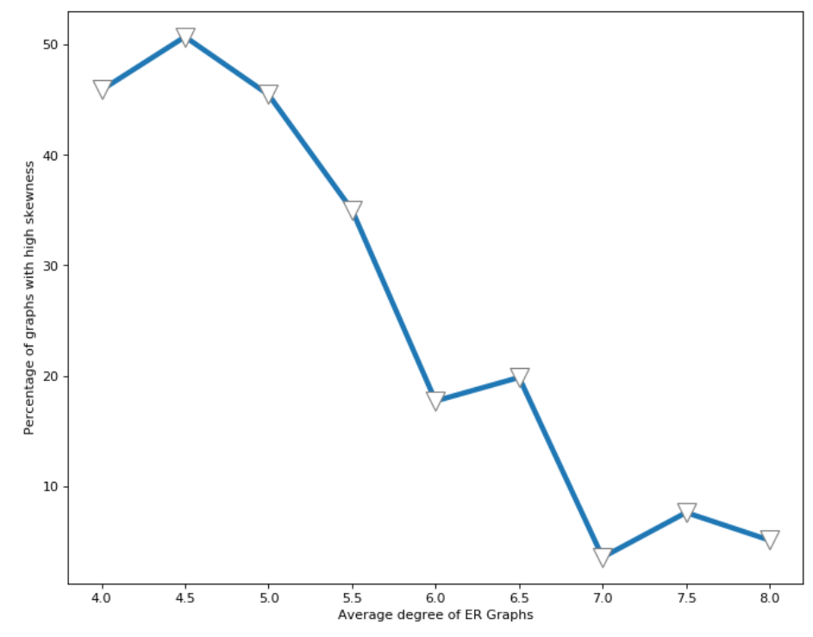
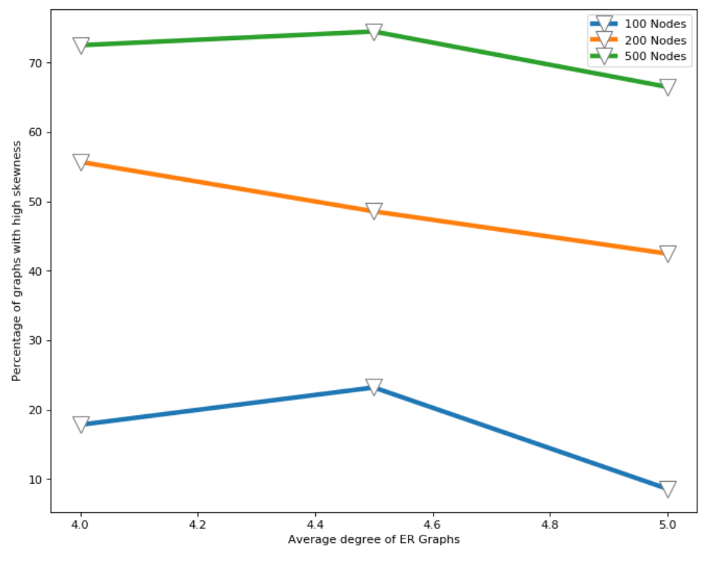
A
Percentage of graphs with high skewness
B
Average degree of ER Graphs
Percentage of graphs with high skewness
Average degree of ER Graphs

