Slide 1
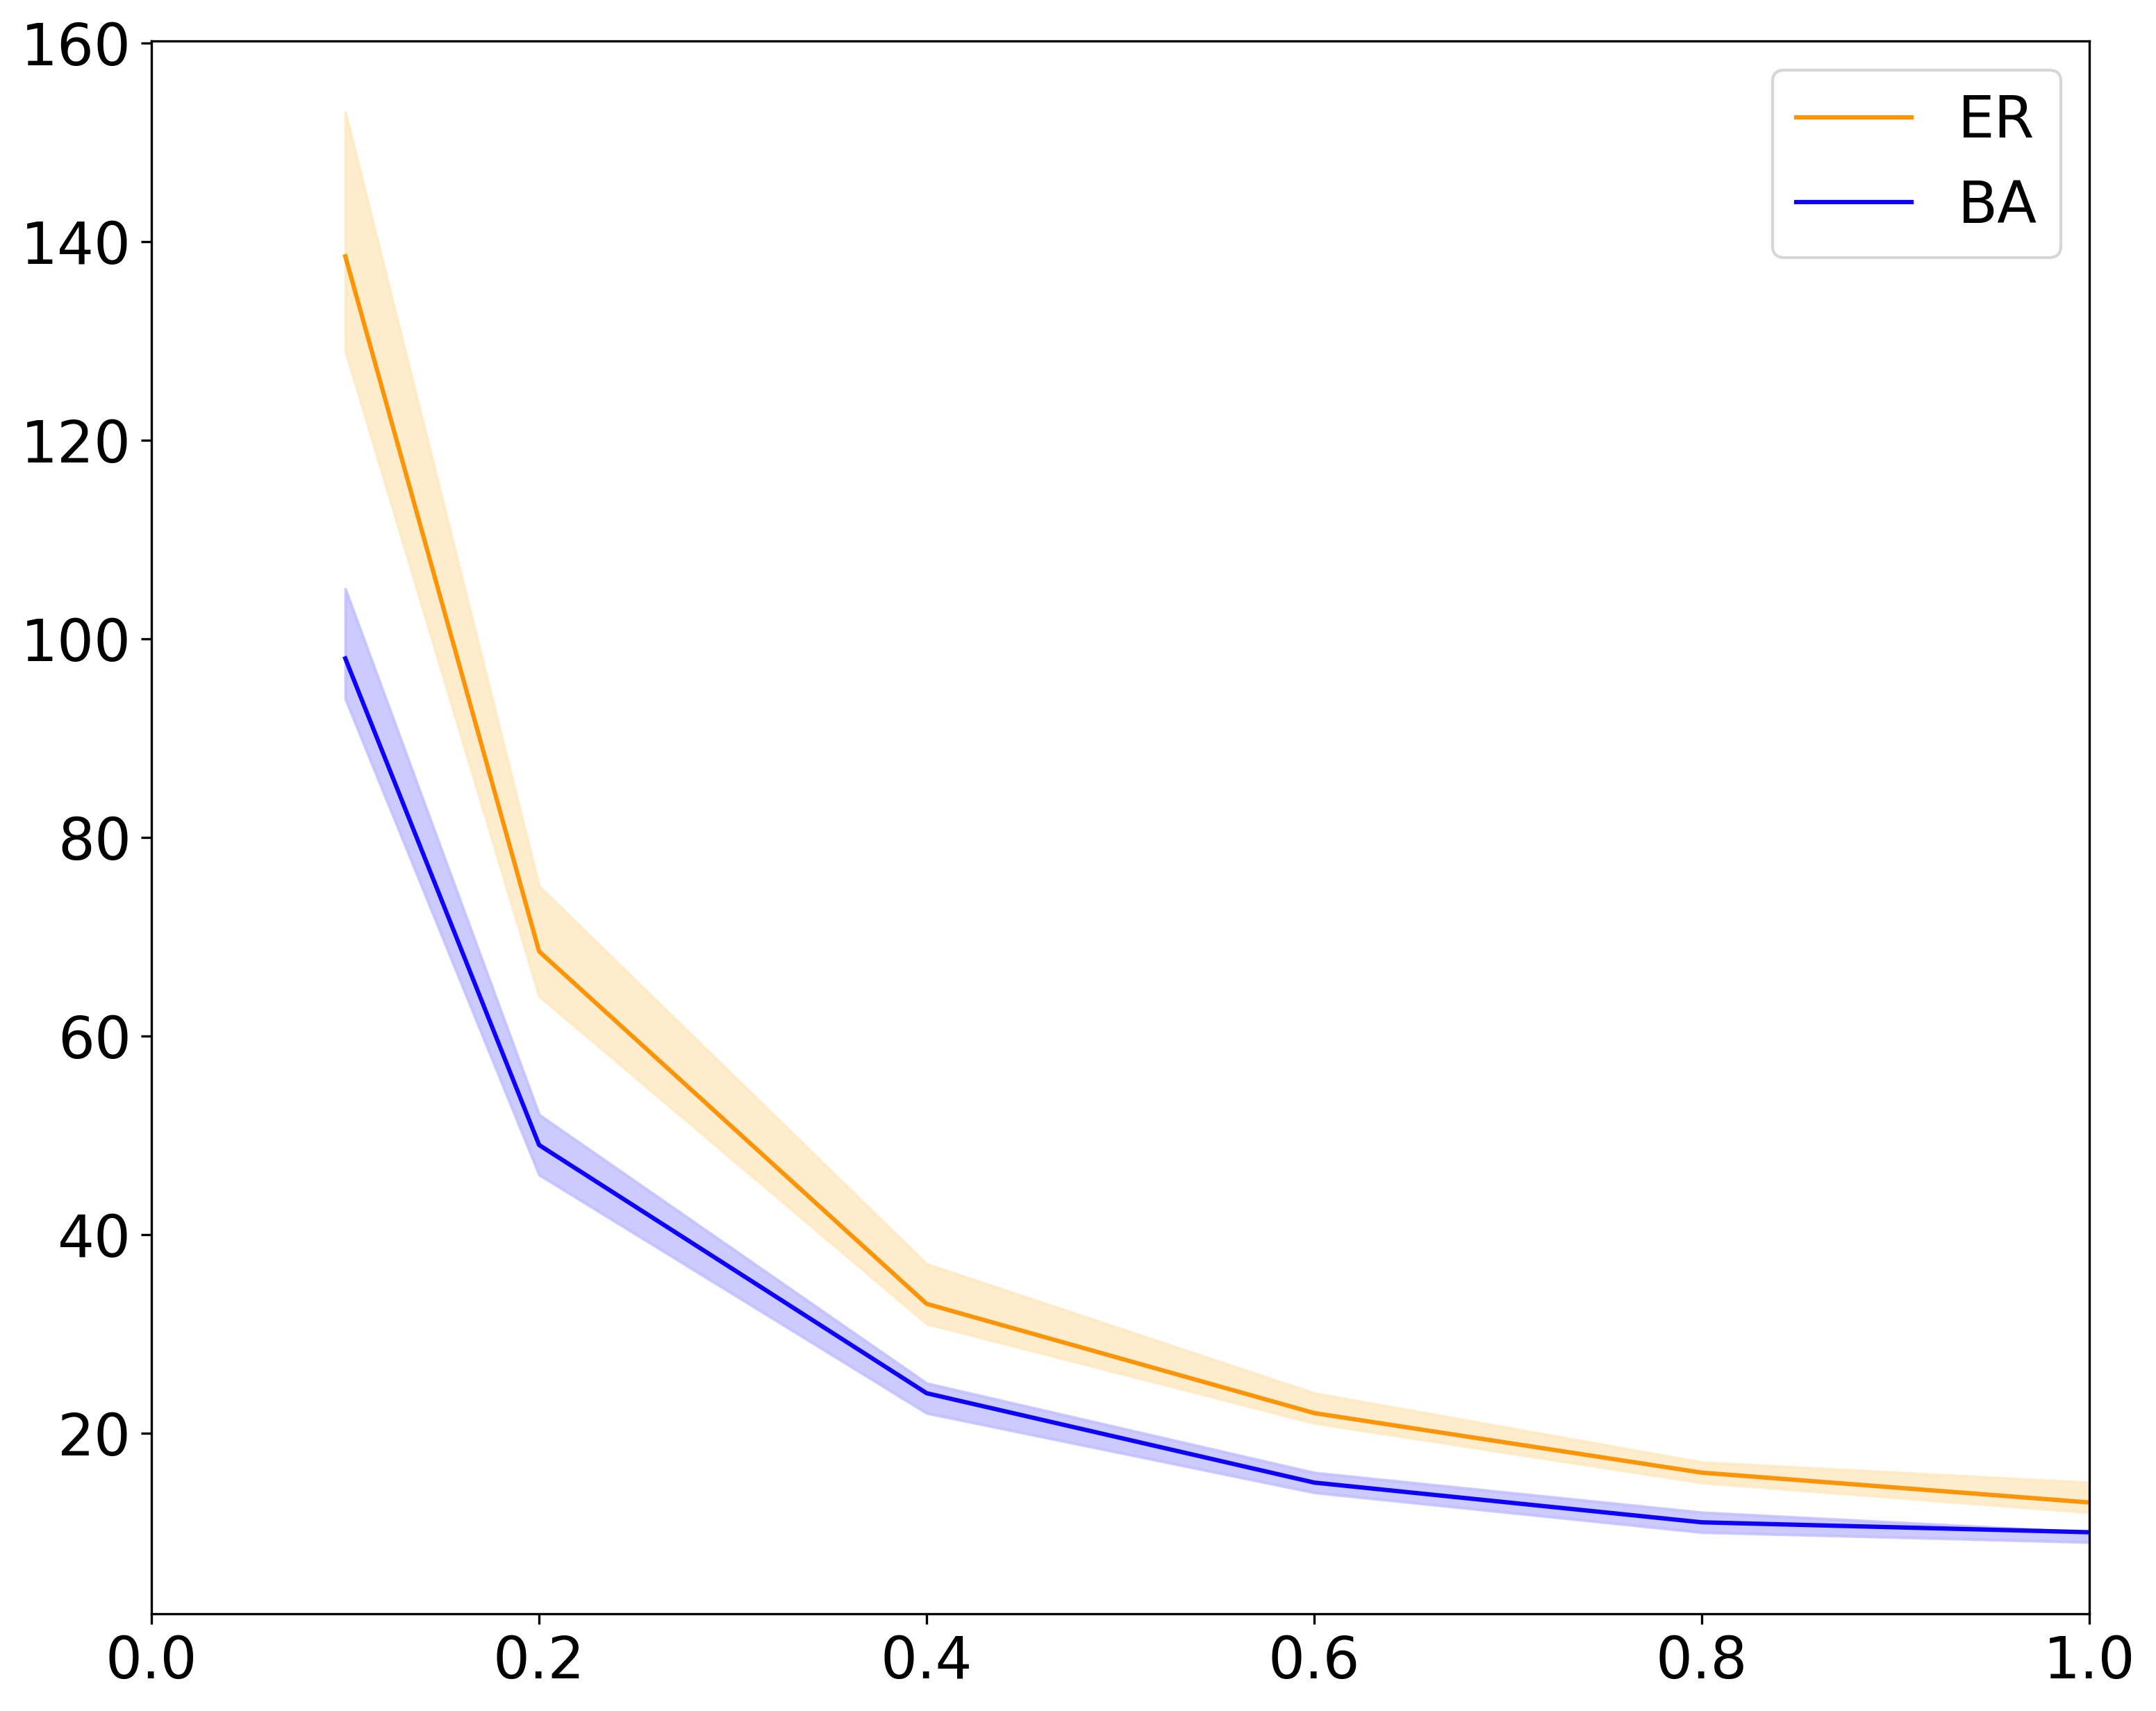
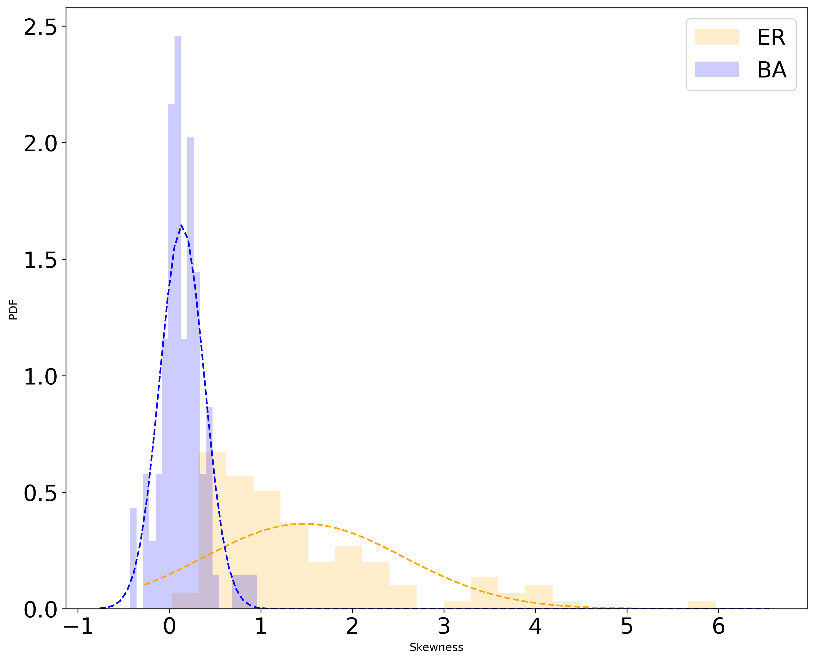
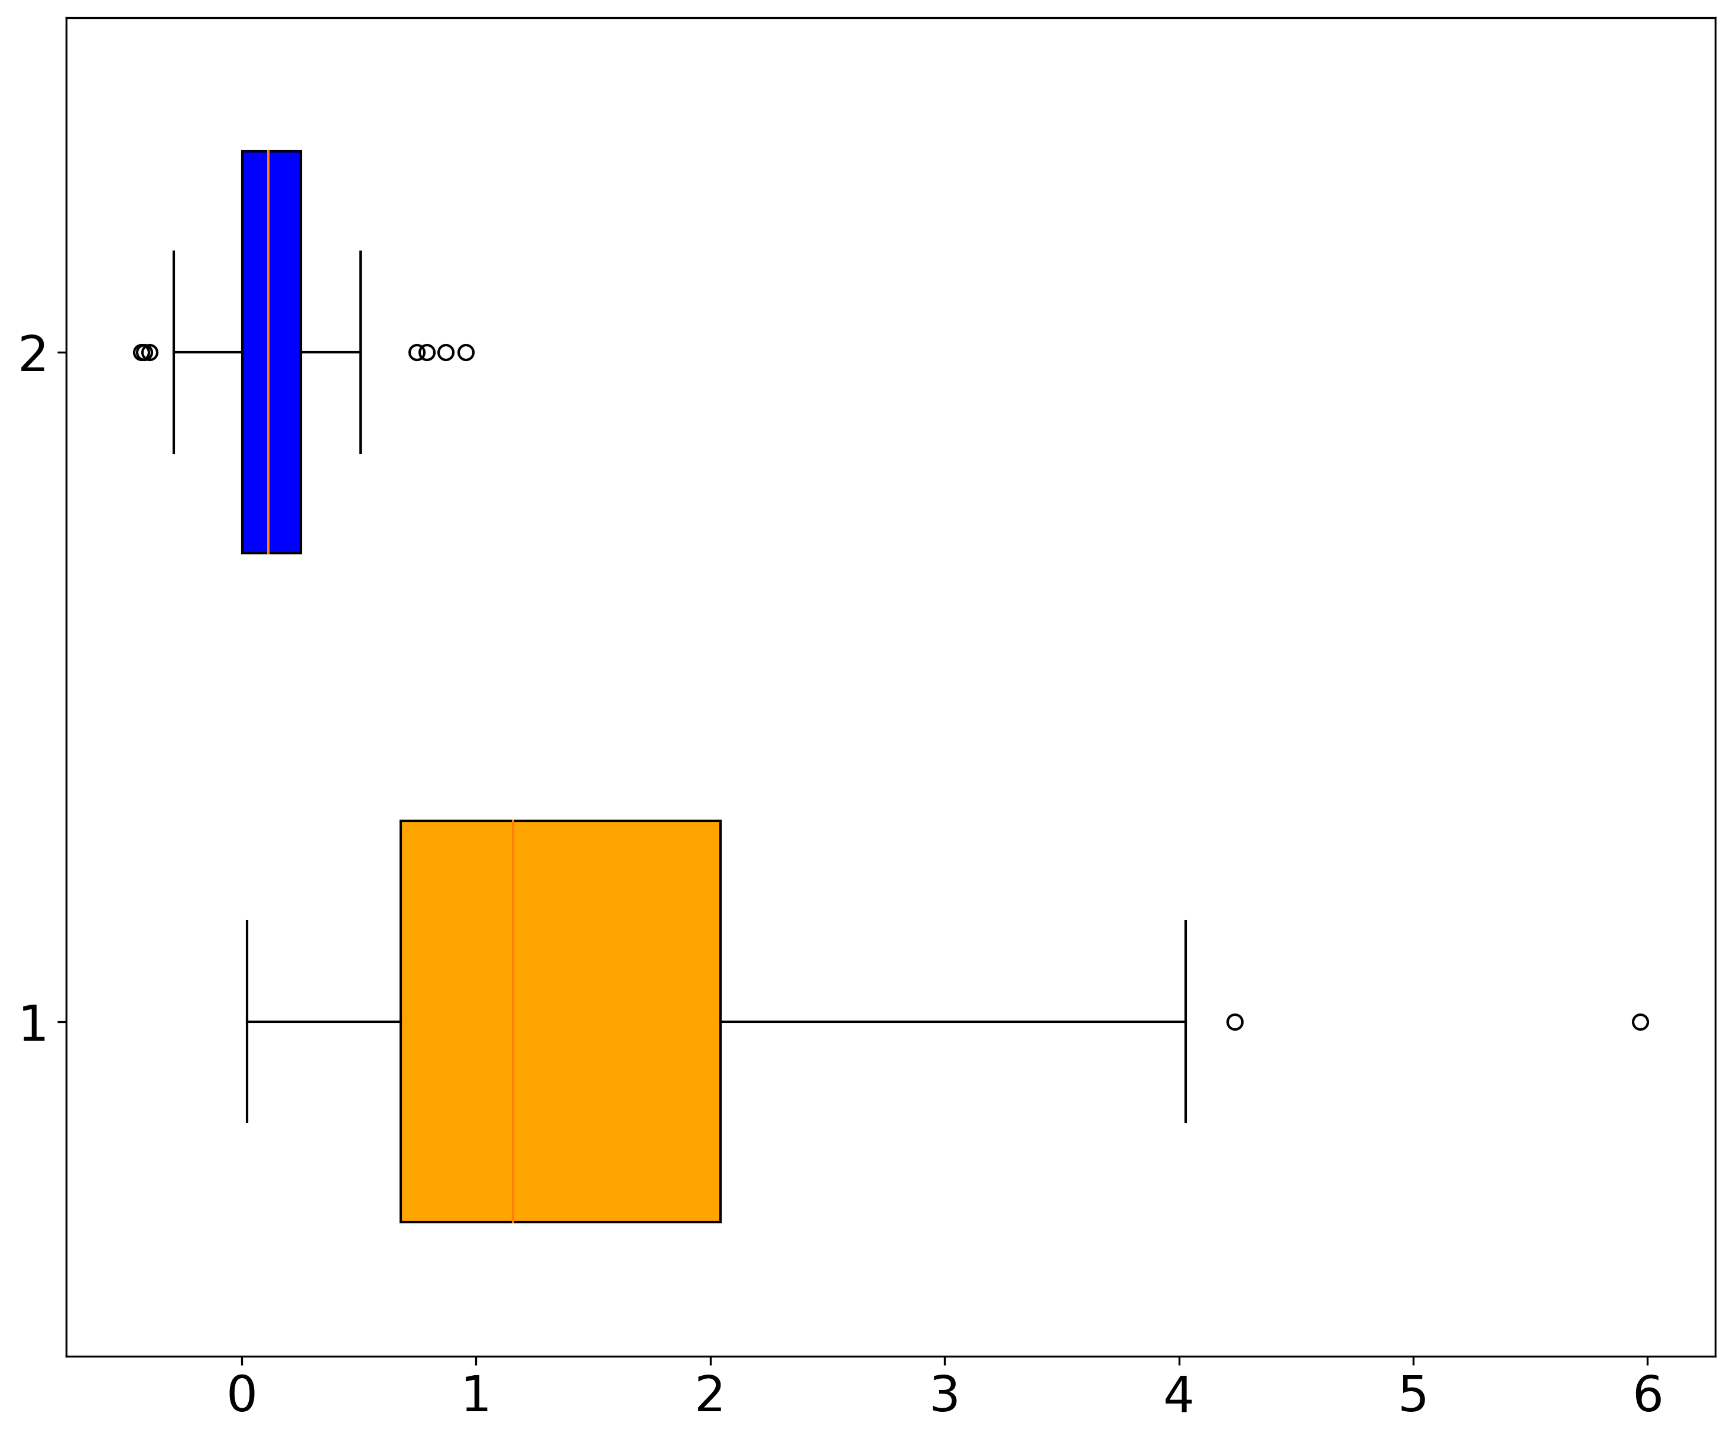
A
B
58% ER graph instances (with N=1,000 and <k>=6) show asymmetric saturation time
Median Saturation Time
(Simulation Ticks)
PDF
Diffusion probability p
Skewness

