Slide 1
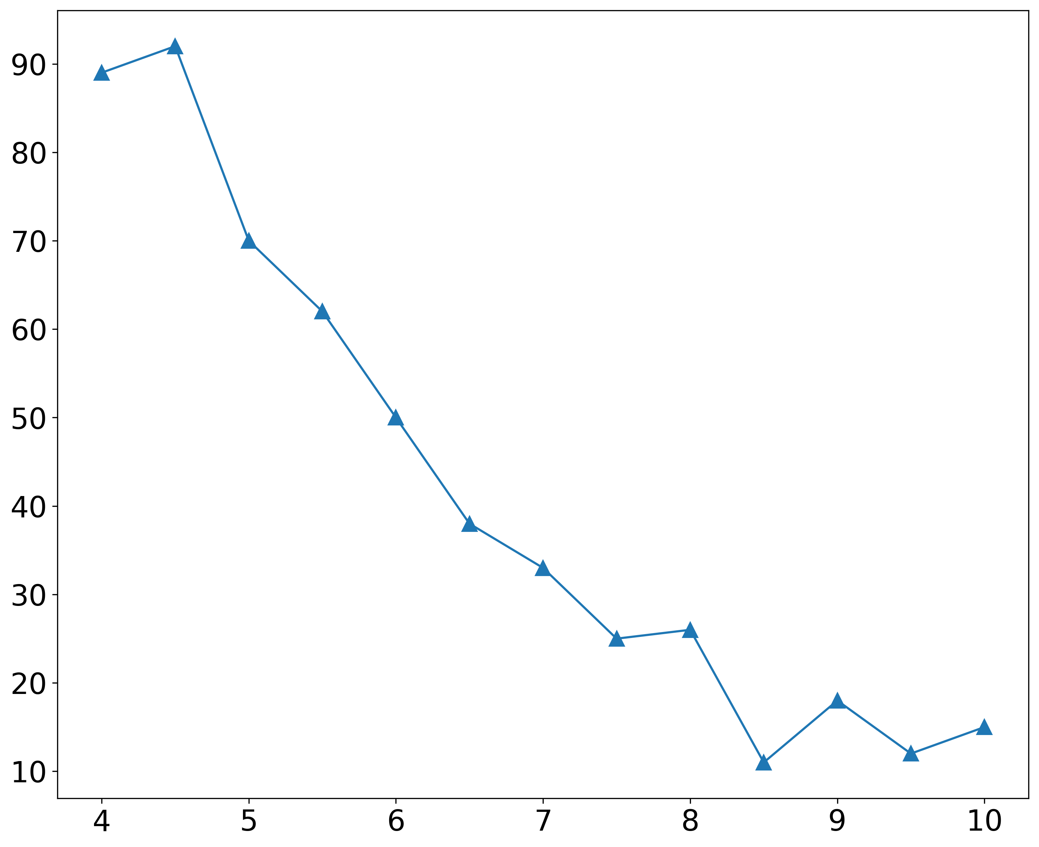
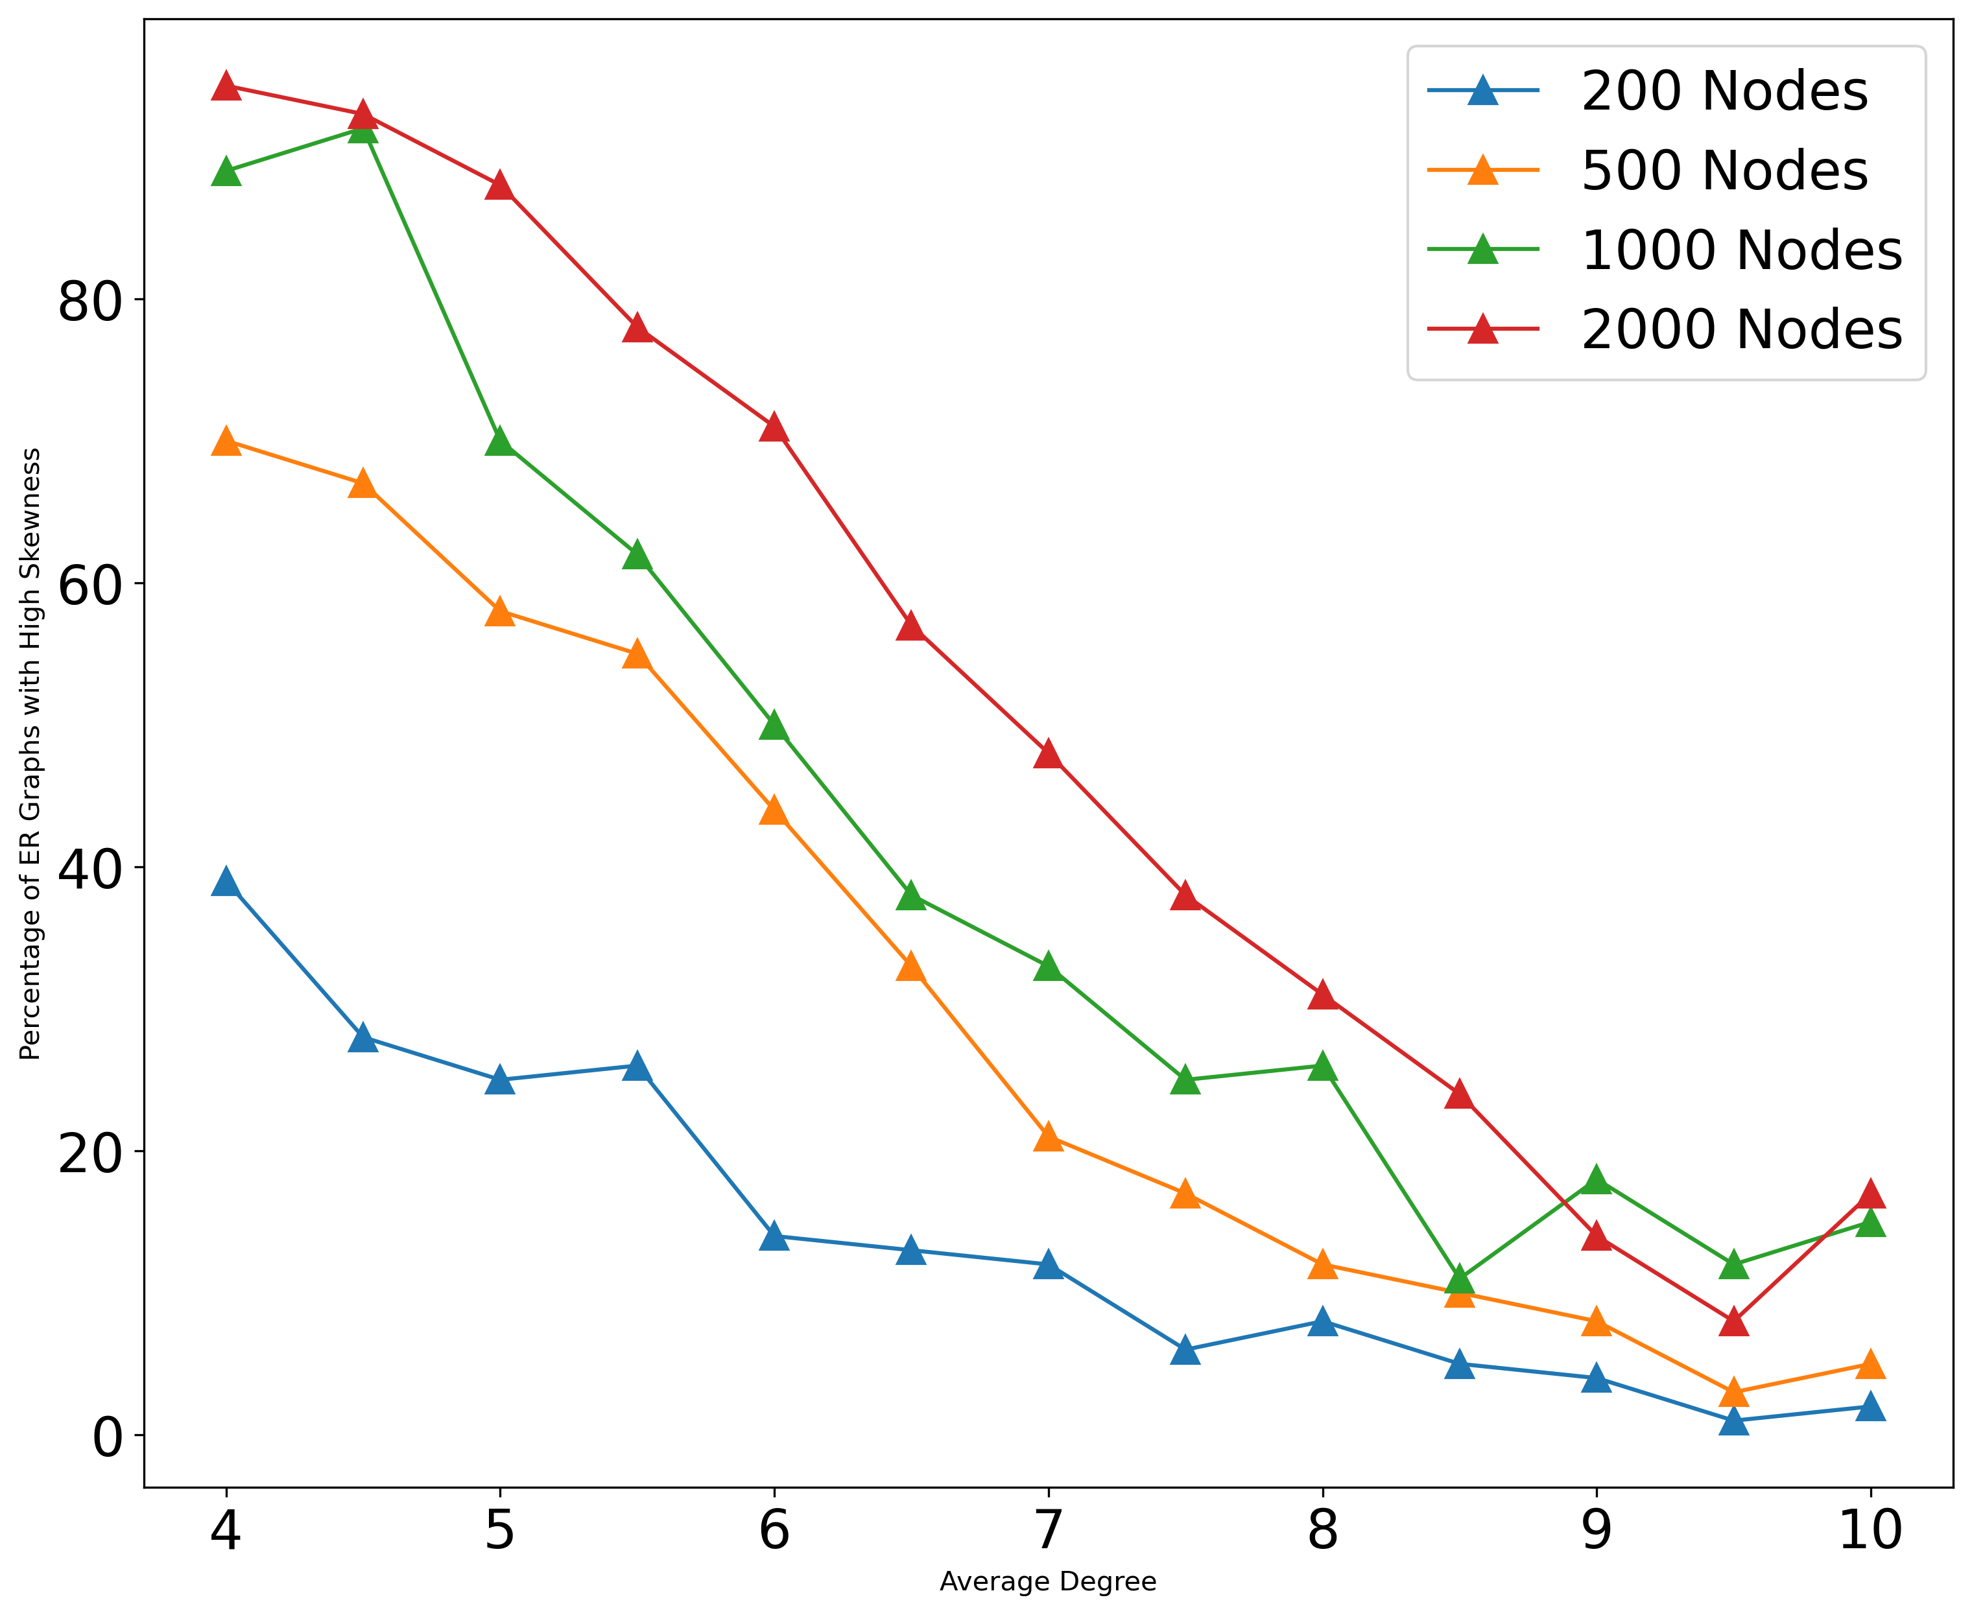
A
B
Percentage of graphs with high skewness
Percentage of graphs with high skewness
Average degree <k>
Average degree <k>

