Slide 1
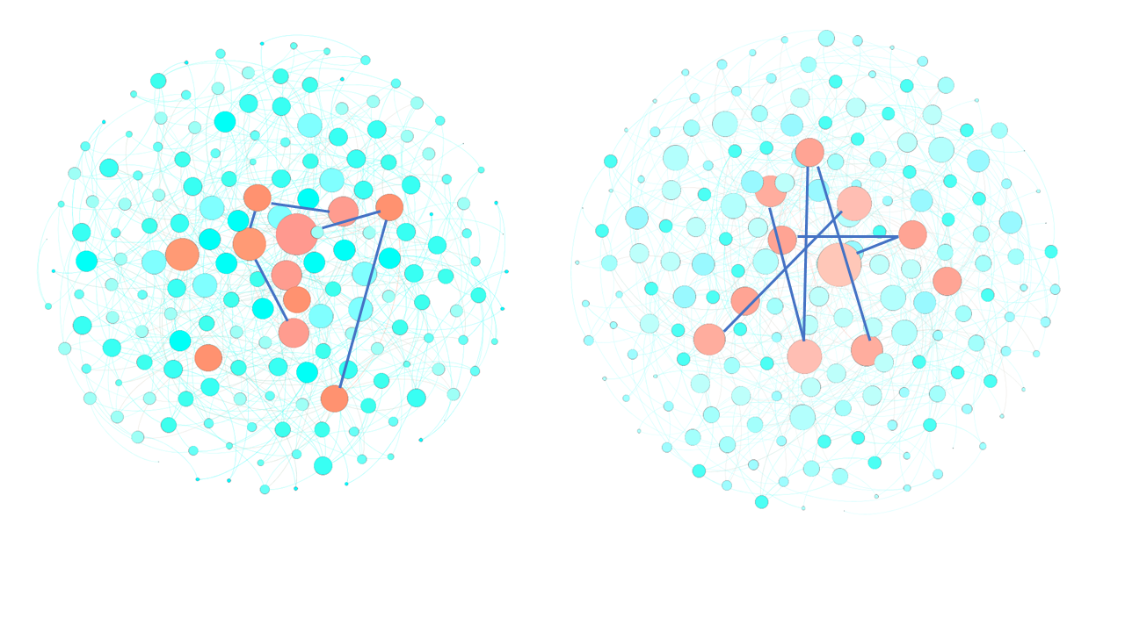
A
B
ER Graphs
Scale-free Graphs
Pseudo-Hubs = High degree
Hubs = High degree + Inter-hub links
C
D
Correlation Coefficient (ER Graphs)
Correlation Coefficient (BA Graphs)
 | Saturation Time | Skewness
Number of Hubs | 0.037 | 0.081
 | Saturation Time | Skewness
Number of Hubs | 0.630 | 0.025

