Slide 1
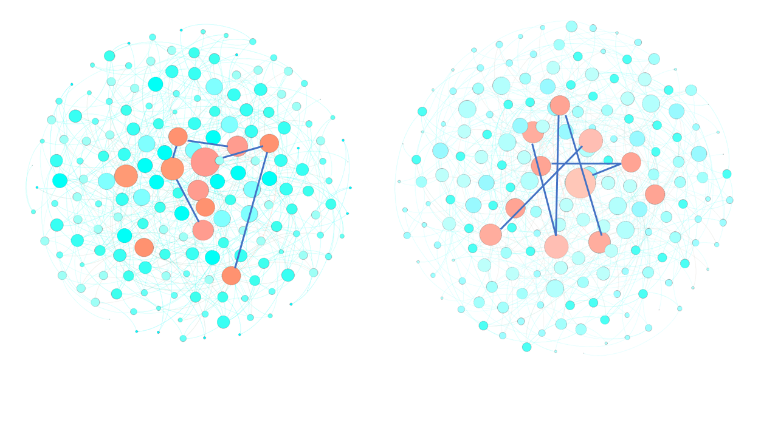
a
b
ER Graphs
Scale-free Graphs
Pseudo-Hubs = High degree
Hubs = High degree + Inter-hub links

