Slide 1
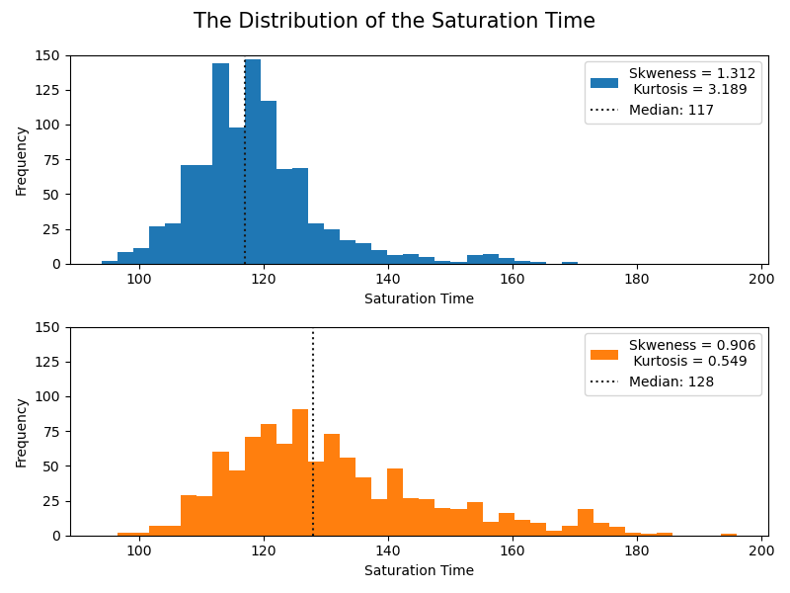
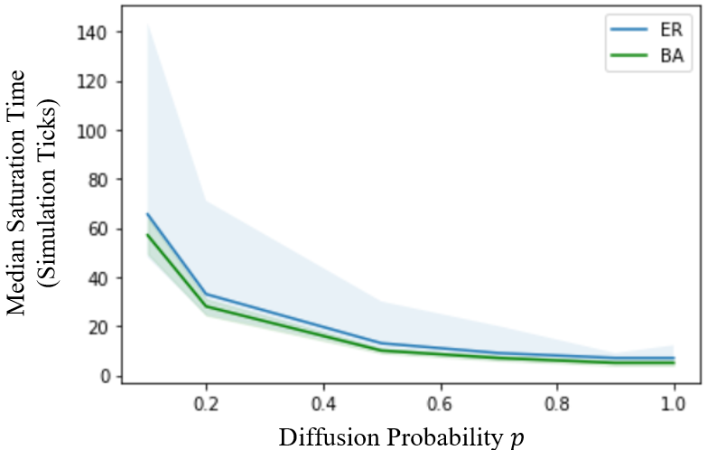
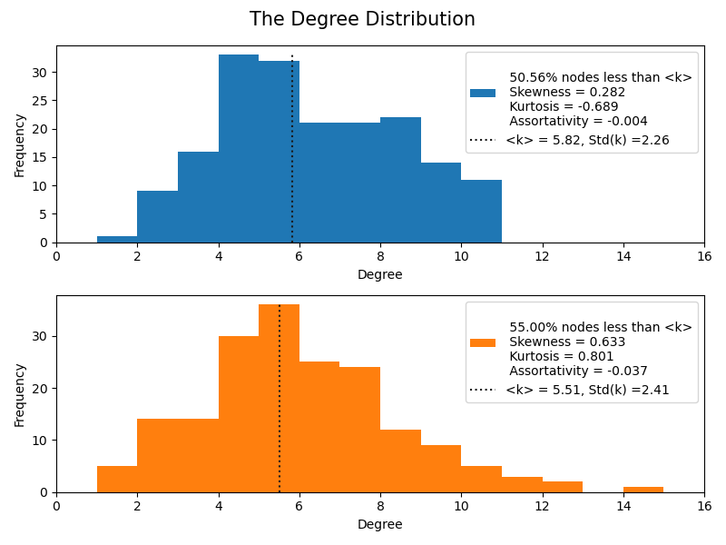
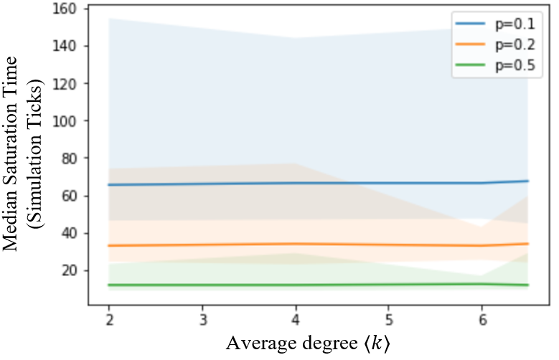
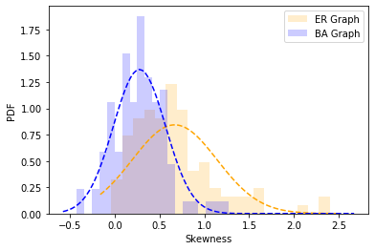
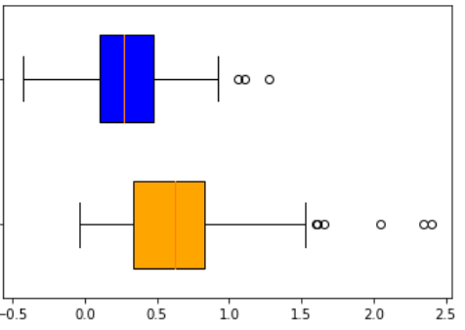
A
D
Distribution of Saturation Time
Frequency
Saturation Time
E
Degree Distribution
B
Frequency
F
Degree
Distribution of Saturation Time
Frequency
C
ER
Scale-free
Saturation Time
G
Degree Distribution
PDF
Frequency
Skewness
Degree

