Slide 1

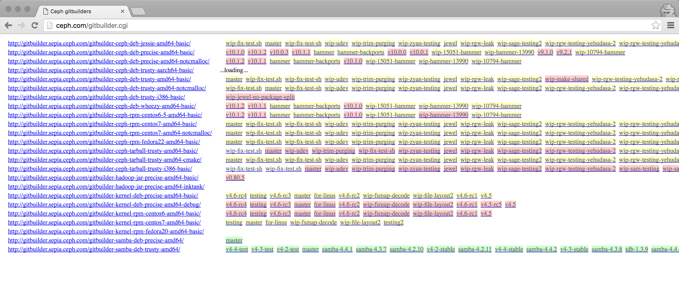

Ceph development-build-test cycle
/myhome/ceph
├── admin
├── AUTHORS
├── autogen.sh
└── ...
/myhome/ceph
├── admin
├── AUTHORS
├── autogen.sh
├── ...
└── build/
├── bin
├── etc
├── lib
└── ...
make
M
vstart.sh
OSD
OSD
OSD
git push
Problems:
* local and git-builder environments differ
* testing end-to-end deploy pipeline
* building, packaging, deployment
* slow
Goal:
* separate concerns (ceph vs. packaging)
* make it fast
sync
Ceph’s git-builder
ceph-deploy
M
OSD
OSD
OSD
Notes:
Local vs. git-builder. When we test using vstart.sh, we have a specific environment that might differ from the curate/sanitized one from upstream (git-builder)
Testing the entire end-to-end build pipeline: when we build using a builder, we are testing the entire end-to-end development pipeline. A build in git-builder might break because of a problem with packaging, i.e. distro-specific. But when we develop we don’t care about those issues, we care about the stuff we’re hacking on. We can defer those issues to later, when we’re done with out stuff
It might take more than an hour from the time we finish running make, to the time we can test (on bare-metal) in remote nodes. Testing locally using vstart.sh is fast, but unrealistic.

Slide 2
builder image
ceph-daemon
rootfs
/myhome/ceph
├── admin
├── AUTHORS
├── autogen.sh
└── ...
/myhome/ceph
├── admin
├── AUTHORS
├── autogen.sh
├── ...
└── install/
├── bin
├── etc
├── lib
└── ...
ubuntu
official ceph binaries
build_daemon_image.sh
my bin files
subsequent builds
only new bin files
ceph-ansible
(containerized)
docker run
M
localhost
192.168.0.1
M
OSD
OSD
OSD
OSD
OSD
OSD
192.168.0.2
192.168.0.3
192.168.0.4
Notes:
Using containers we can solve all the issues mentioned before:
We all share the same dev environment since we use a docker image to build (we all are using the same 3rd party lib dependencies)
We don’t need to wait for distro-specific packaging to finish since we’re directly copying binaries.
We get rid off vstart.sh by running all daemons in a single container. To reproduce an issue, we share git’s sha1 and the docker run args for the ceph/demo image.
We deploy using upstream ceph-ansible, so we don’t need to worry about
Iterations are fast since we copy only the binaries that got recompiled.

