Slide 1

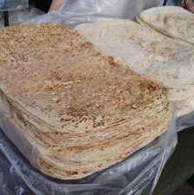



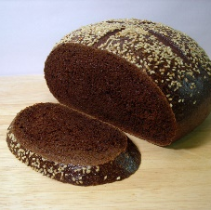
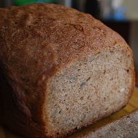


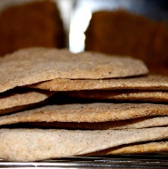


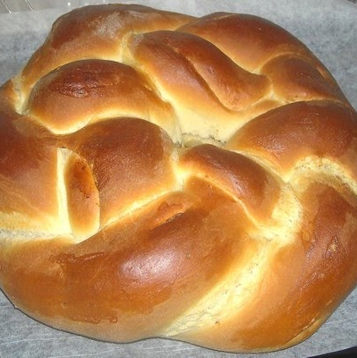


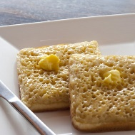
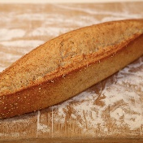


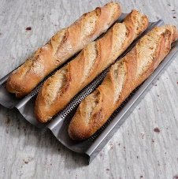
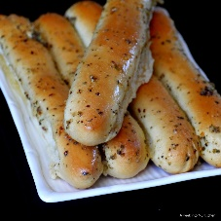
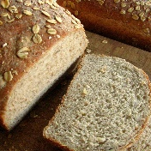

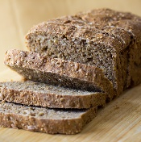
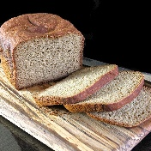
Brave Breadership Team
Lavash
Logistics
Sourdough Internal Affairs
Pita
Supply
Ciabatta
Finance & Infra Dir.
Pumpernickel
People Director
Rye
Recruitment
Naan
Moons
Whole Grain
Corp. Recruitment
Tortilla
Industry
Biscuit 2iC
Pretzel
Diplo Director
Brioche Alliance CEO
Hardtack
Military Director
English Muffin
Chief of Staff
Crumpet
Recon
Bastone
Head Coordinator
Scone
2iC
Muffin
IT Director
Baguette & Breadstick
Dojo Co-Directors
Emeritus
Multigrain
White Bread
Whole Wheat
Gluten-Free
Notes:
Teophanu Tivianne

