Slide 1



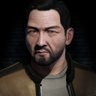
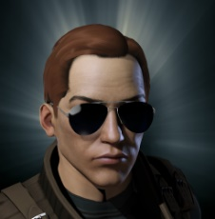
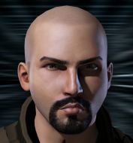
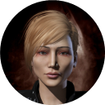
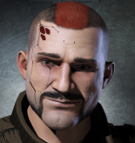
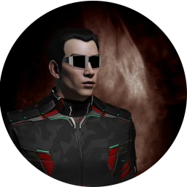

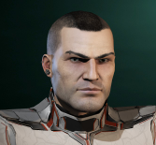
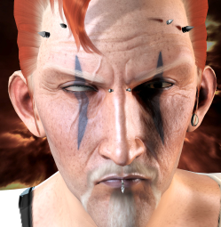


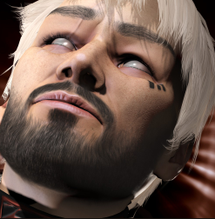
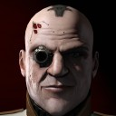

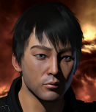

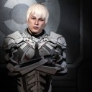

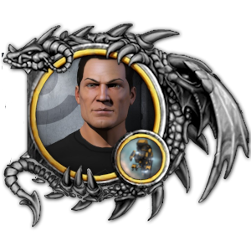
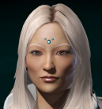


Brave Leadership Team
Alonso Calip
Logistics
Naverin
Internal Affairs
Bokobo Shahni
Supply
Avend Avalhar
Finance & Infra Dir.
Algorthan Gaterau
People Director
Gepa Bow
Recruitment
Cond0mBurst
Moons
HaChu Wildly
Corp. Recruitment
Rael Armansky
Industry
Sadism Evolved
2iC
Professor Push
Diplo Director
Jinx De’Caire
Alliance CEO
Shattered Armer
Military Director
BeardyCheese
Chief of Staff
Reynauld Lachapelle
Recon
Rangvaldr
2iC
Tian Khamez
IT Director
Jana Halley
Dojo Director
Wolfy Alexstrasza
Head Coordinator
Emeritus
Cagali Cagali
Yukiko Kami
Dunk Dinkle
Nancy Crow
n0rman
Notes:
Teophanu Tivianne

