Slide 1
Introduction to Machine Learning/Deep Learning
Bozhao Tan

Slide 2
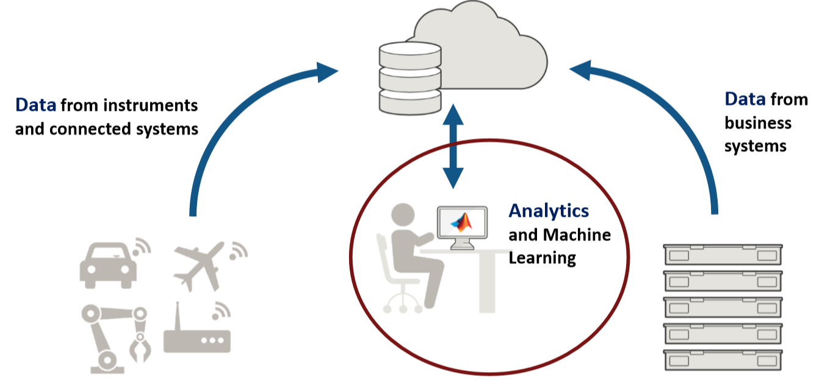
Data, Data in the world we are living

Slide 3
Why we Need Machine Learning
A computer program is said to ‘learn’ from experience E with respect to some tasks T and performance measure P, if its performance at tasks in T, as measured by performance P, improves with experience E.
Handcrafted rules will result in a large number of rules and exceptions
We need ML in cases where we cannot directly to write a program to handle every case, so it is better to have a machine that learns from the Training set or past Experience.
  Task (T) : recognizing sensitive human data
  Performance P: percent of dataset correctly classified
  Training Experience E: a dataset of sensitive column names we already know

Slide 4
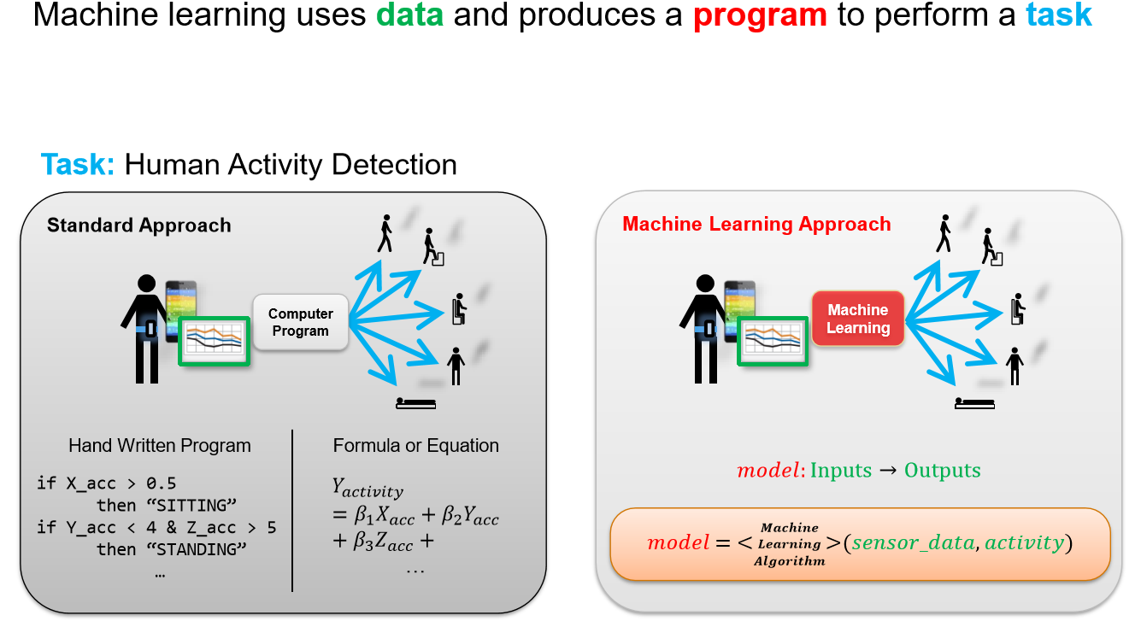
What is Machine Learning

Slide 5
ML Applications
Image Classification, Object Detection, Self-Driven Car
Speech Recognition, Speaker Recognition, Deep Fake Generation
Natural Language Processing (Chatbot, Search, Topic detection, etc)
Fraud/Spam Detection
Gaming industry
Advertising, Marketing, Finance, Business Decision
  Medical – predict patient’s illness, diagnose, operation
Robots, Industry 4.0, etc.
…

Slide 6
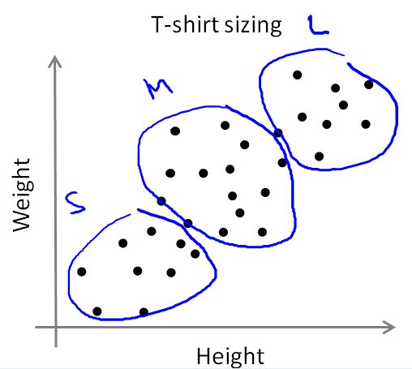
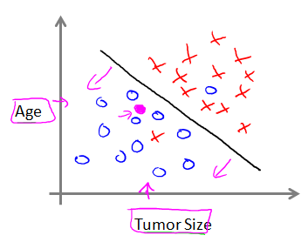
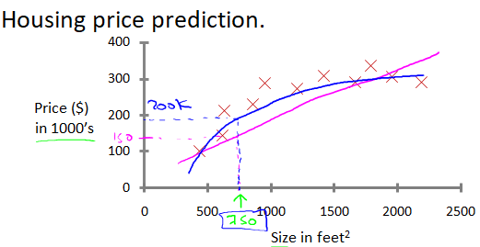
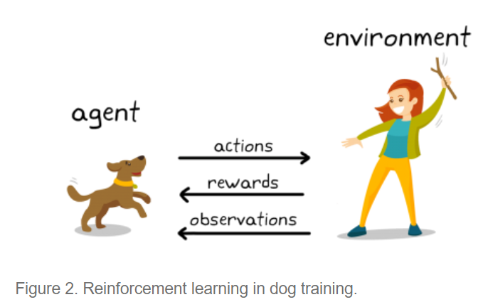
ML Algorithms
Supervised Learning
  Classification
  Regression
Unsupervised Learning
Others: Reinforcement Learning, Recommendation System

Slide 7
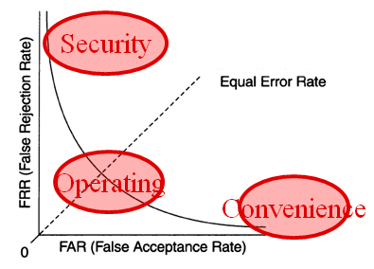
Performance Evaluation Metrics
Target & Non-Target
False rejection rate (FRR)
  Frequency that a system will inaccurately reject an genuine command
  Convenience measure (1-FRR)
False acceptance rate (FAR)
  Frequency that a system will inaccurately accept an imposter
  Security measure (1-FAR)
Equal error rate (EER)
  The rate at which FAR and FRR are equal

Slide 8
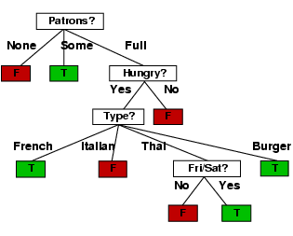
Decision Trees
A sequence of Yes/No rules (Nodes and Leaves)
Learning methods: C4.5 (J48), Random Forest, Bagging, Alternative):
Notes:
8

Slide 9
Hidden Markov Models
A Hidden Markov Model (HMM) allows the modeling of uncertain events as a stochastic process, especially for temporal pattern recognition
HMMs are used for training the Speech Recognition models, for example
States, possible observations, state transition prob., output prob.
Notes:
9

Slide 10
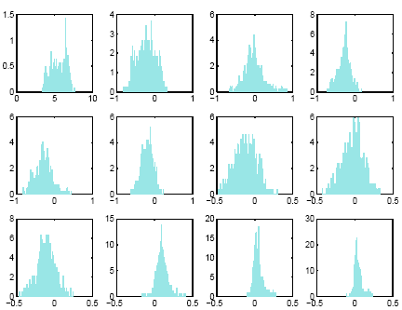

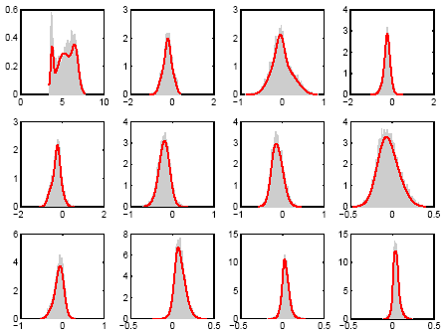
Gaussian Mixture Models
Statistical GMM modeling variations of features
Weighted sum of component densities
Building client model
  Maximum likelihood estimation
  Expectation maximization (EM)
  Diagonal covariance matrix
Notes:
10

Slide 11
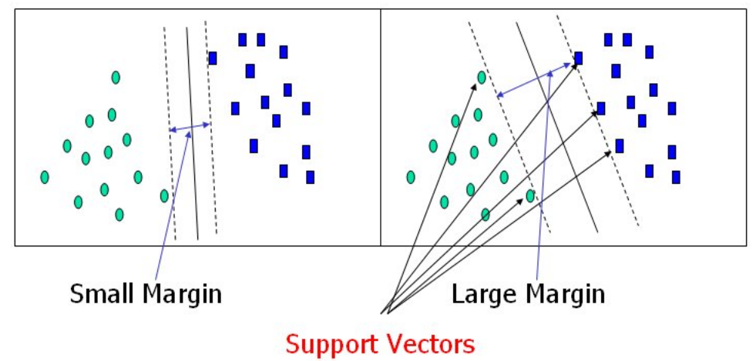
Support Vector Machines
Constructing an N-dimensional hyperplane that optimally separates the data with large margin.
Notes:
11

Slide 12
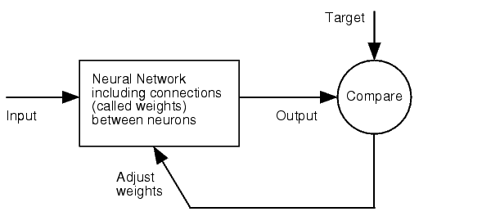
Artificial Neural Network
A neuron is made of inputs, weights, some sort of summing functions and a transfer function
For neural networks to work they first must be trained and from this training retain some knowledge (Back propagation)
Layer 1
Layer 2
Layer 3
Layer 4
Notes:
12

Slide 13
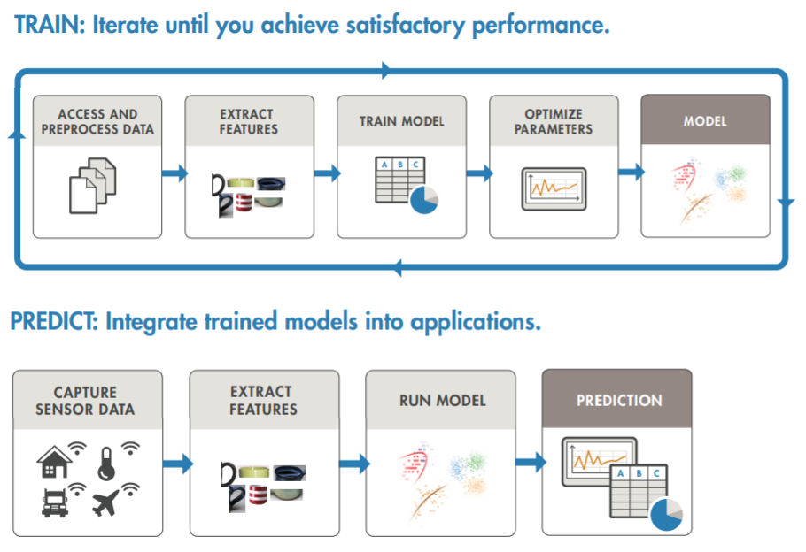
Typical ML Model Development and Deployment Flow

Slide 14
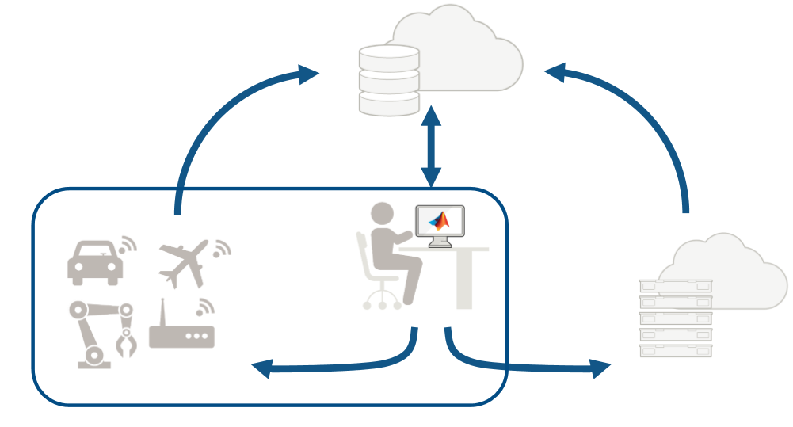
Share & Integrate ML Models

Slide 15
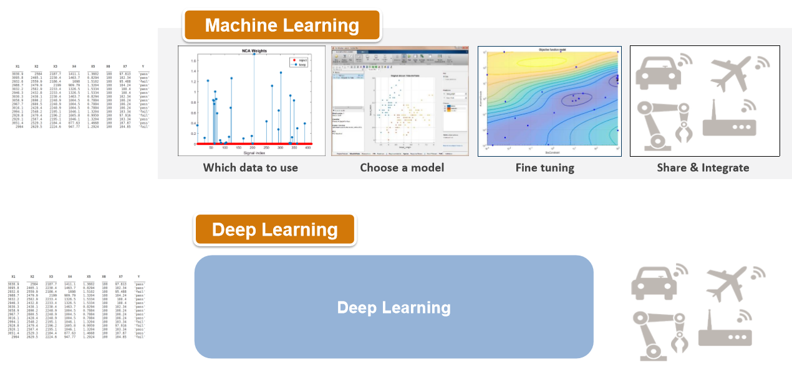
Difference of Machine Learning/Deep Learning

Slide 16
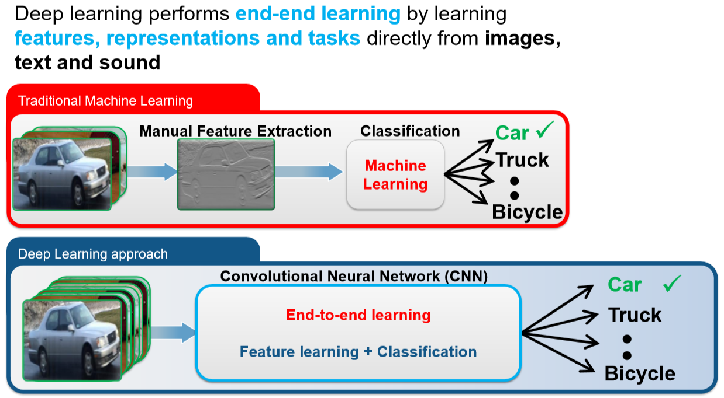
Deep Learning

Slide 17
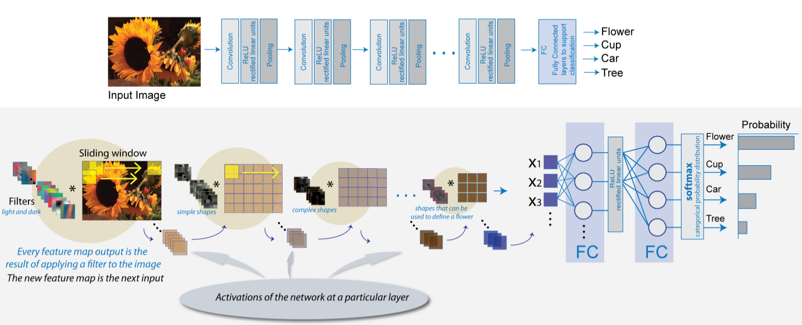
What is Deep Learning

Slide 18
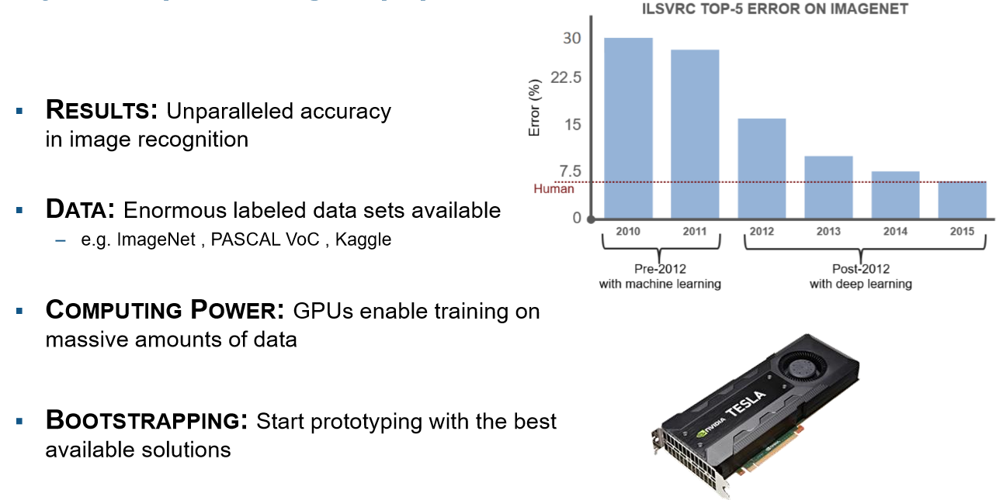
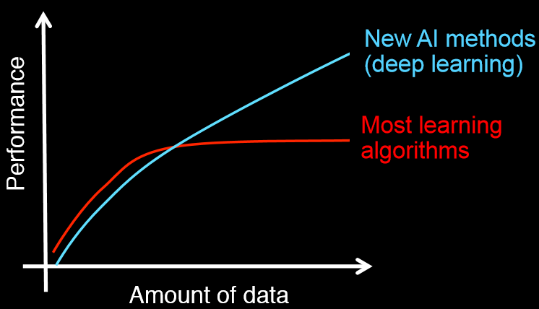
Why is Deep Learning so Popular?

Slide 19
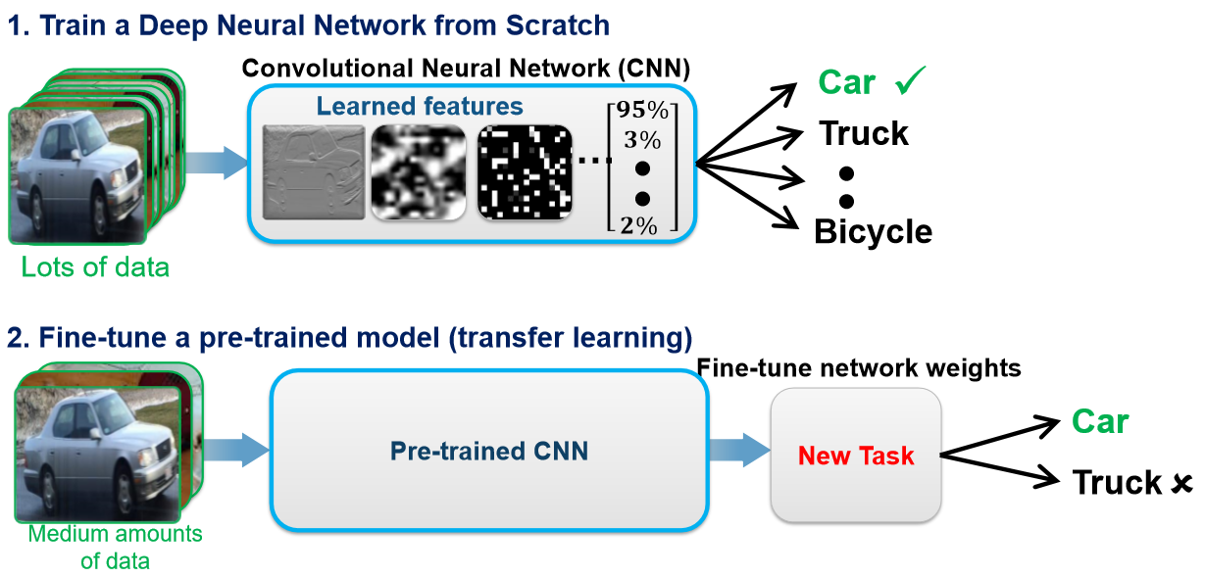
Two Approaches for Deep Learning

Slide 20
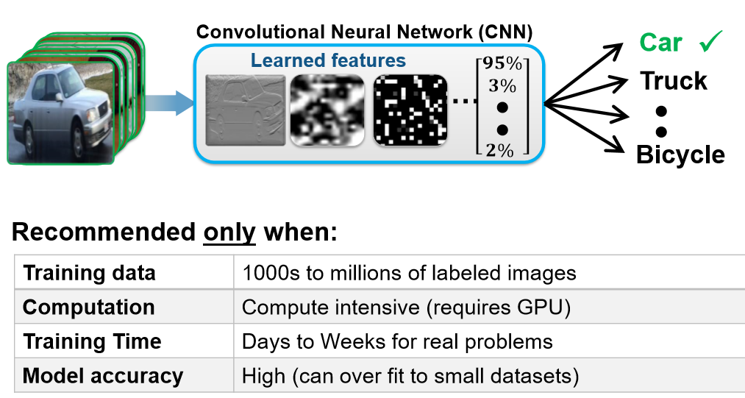
Two Approaches for Deep Learning
Approach 1: Train a Deep NN from Scratch

Slide 21
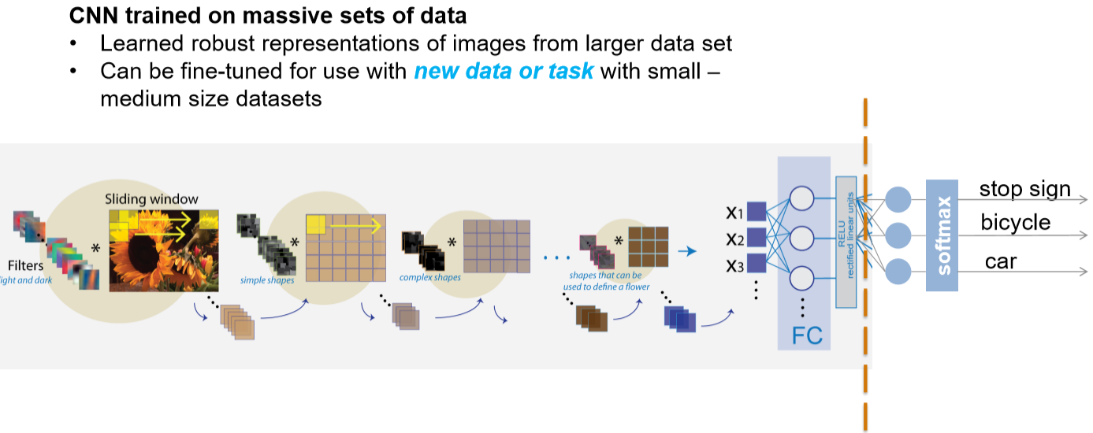
Two Approaches for Deep Learning
Approach 2: Fine-tune a pre-trained model (Transfer Learning)

Slide 22
ML Algorithm Tests
1. Objective Test
2. Subjective test
3. Comparison test

