Slide 1
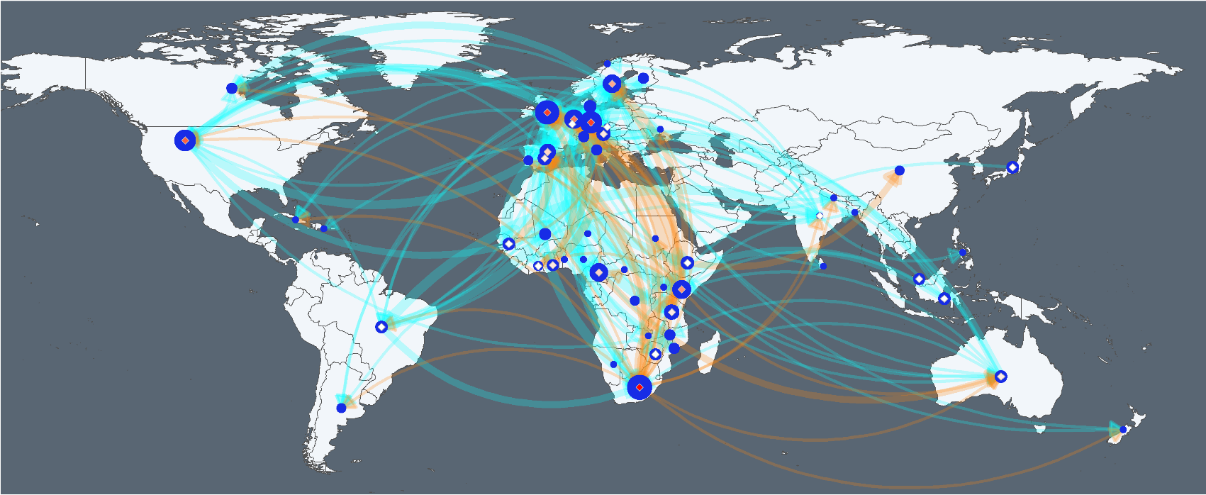
Authorship
1
5
10
First author
1
18
37
Co-author
First author to Co-author
African first author
Overseas first author

Slide 2
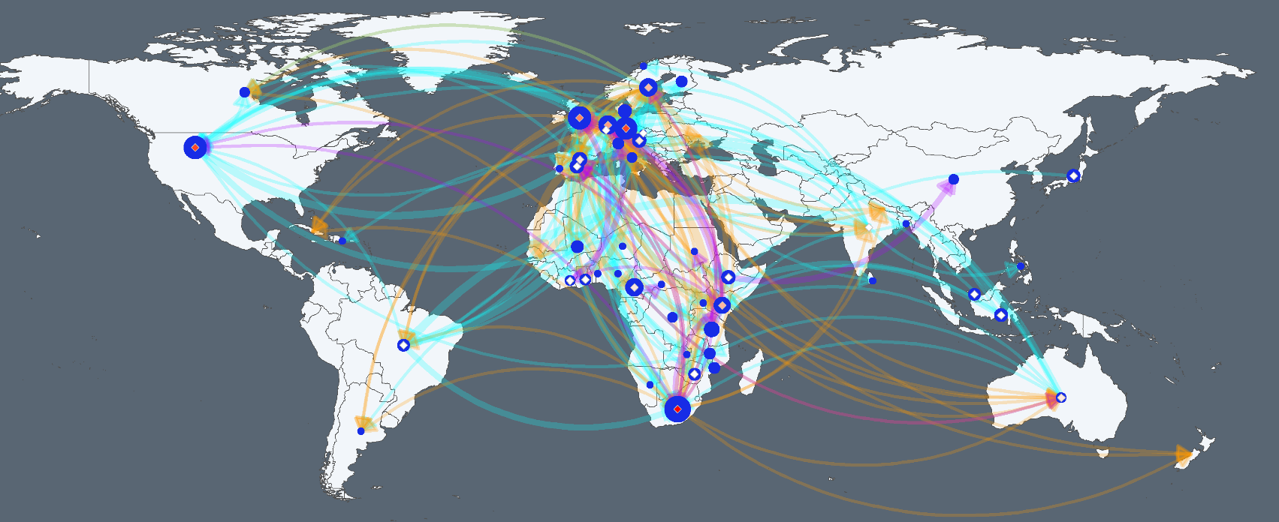
Authorship
1
5
10
First author
1
18
37
Co-author
First author to Co-author
African 1st author
Overseas 1st author
Overseas /Africa 1st author

Slide 3
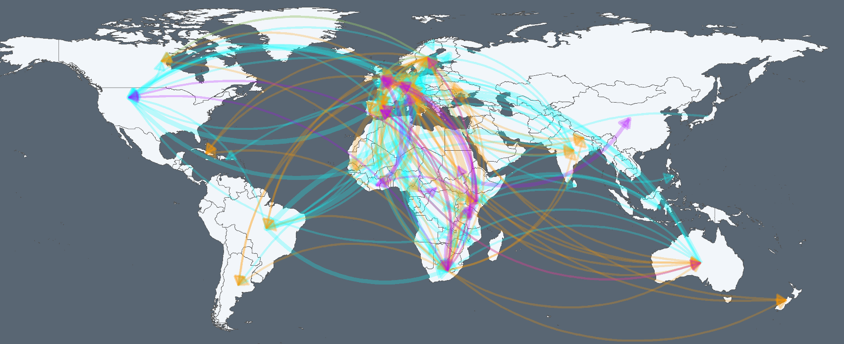
First author to Co-author
African 1st author
Overseas 1st author
Overseas /Africa 1st author

Slide 4



