Slide 1
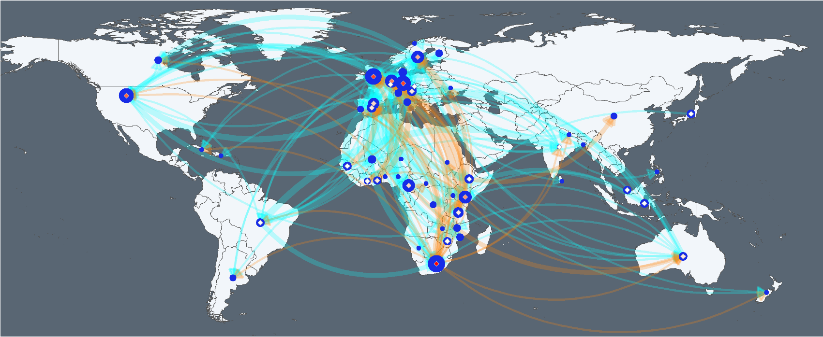
Authorship
1
5
10
First author
1
18
37
Co-author
First author to Co-author
African first author
Overseas first author

Slide 2



