Slide 1
Type checking in modern languages
By Yannick Vaillancourt - 300226628

Slide 2

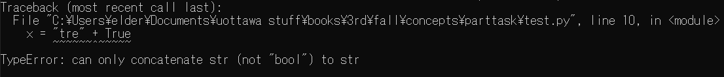
Intro to Type Checking
Statement A using Argument A & Argument B = Valid or Invalid?
Compilation Error
Runtime Error
Result = Double + Int
Result = Double + Double(Int)
Result = Double + Double

Slide 3

Static type checking: Java
Statically Typed language
Variables cannot change type during runtime
Variables need to be given an explicit data type
function’s return type function argument type

Slide 4
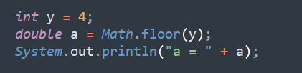
Java type coercion
4.0 is deemed a suitable replacement for 4.
Same for ‘4.0’

Slide 5
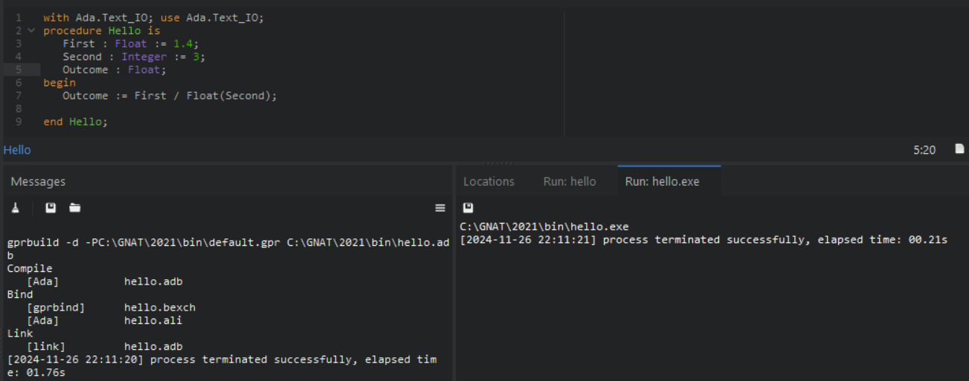
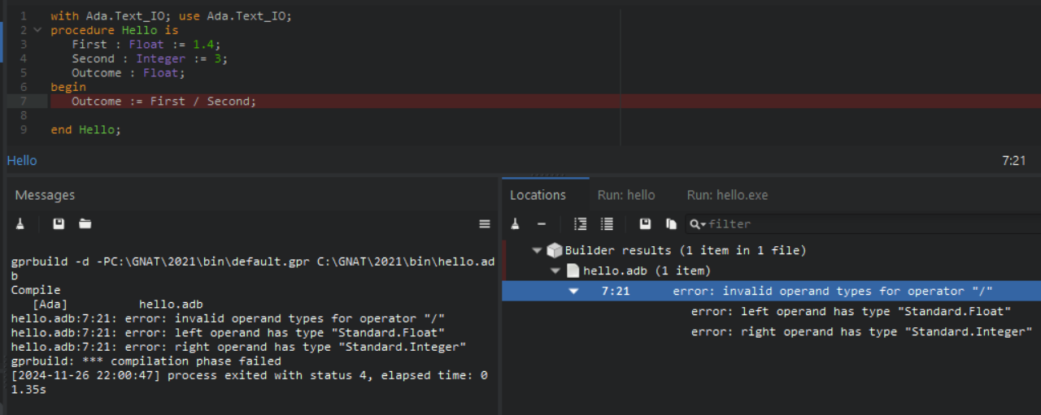
Java vs a more strict language: Ada

Slide 6

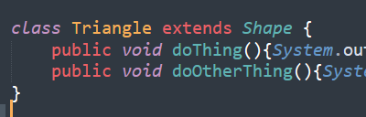

Java OOP and type checking
“Triangle” is a “Shape”
Perfectly fine
Compilation error

Slide 7
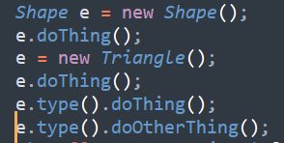


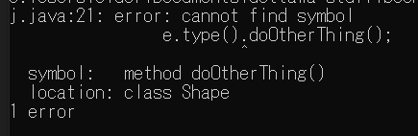
More OOP

Slide 8
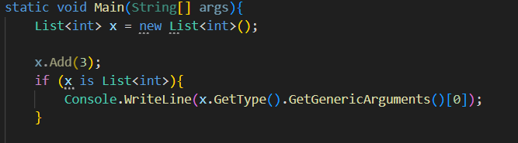

Similar, but different: C#

Slide 9
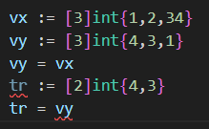
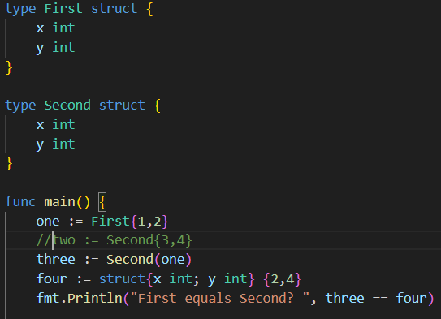
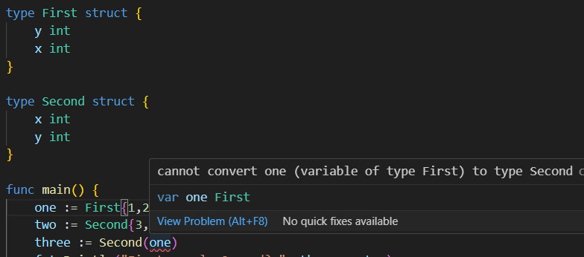
Structural Equivalence: Go
vx & vy are comparable and even assignable, but tr & vy are not, this would cause a compile error
Both values can’t have distinct names, so a comparison using an unnamed struct is valid.
Attribute ordering still matters here

Slide 10
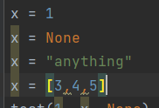
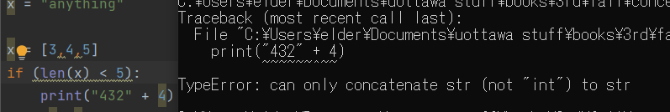
Dynamic type checking: Python
Same variable, different types
Error only appears if the program encounters it during runtime

Slide 11
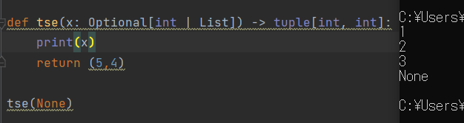
Python type hints
‘Optional’ means None is also accepted

Slide 12
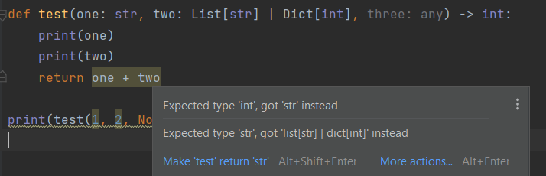


Python type hints more
Actual output:

Slide 13
References
https://ozanagma.medium.com/type-checking-in-java-b84d6f38ba8f
https://visionx.io/blog/c-sharp-vs-java/#:~:text=Generics%20Implementation%3A%20Generics%20in%20Java,robust%20type%20checking%20and%20reflection.
https://learn.adacore.com/courses/Ada_For_The_CPP_Java_Developer/chapters/05_Type_System.html
https://learn.microsoft.com/en-us/dotnet/fundamentals/reflection/how-to-examine-and-instantiate-generic-types-with-reflection
https://stackoverflow.com/questions/46679484/golang-why-named-and-non-named-struct-comparison-with-equal-result

