Slide 1
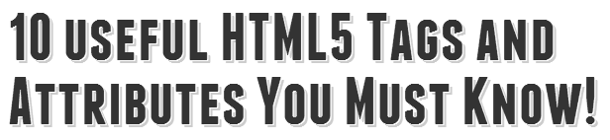
Prepared by
Vira Lytvyn

Slide 2
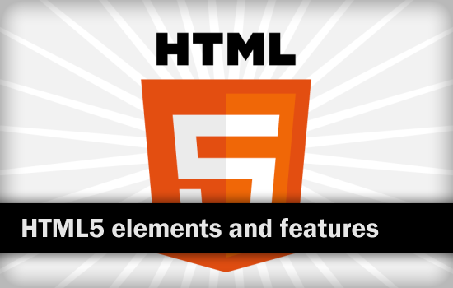

Slide 3
introduction
As we know, HTML5 is now becoming a hot topic among web designers and developers as well as bloggers. So, how about you? Interest in HTML5 also? Then you’re come to the right place.
We all know that HTML5 has introduced many brand new tags and elements as well as attributes and features. Some of these are really useful and helpful for our sites. Hence, in this presentation, I have summarized 10 useful and important HTML5 tags and attributes that you must know and can’t miss out!
Perhaps, you can use these as HTML5 essential before start your own HTML5 website.

Slide 4
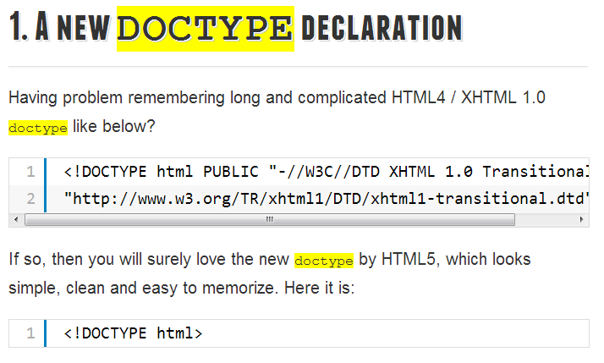

Slide 5
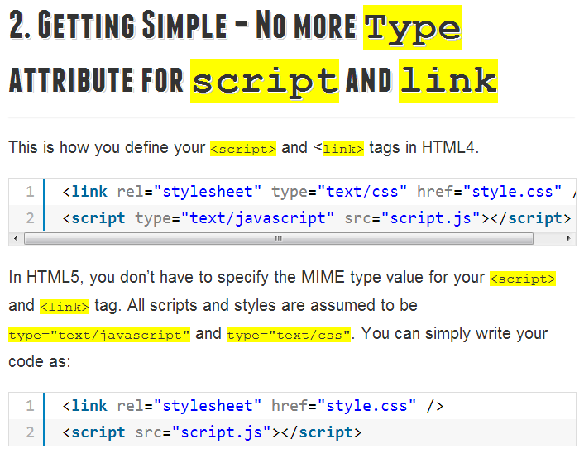

Slide 6
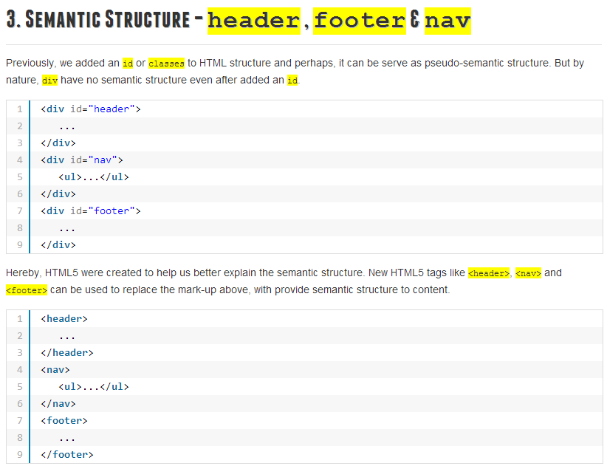

Slide 7
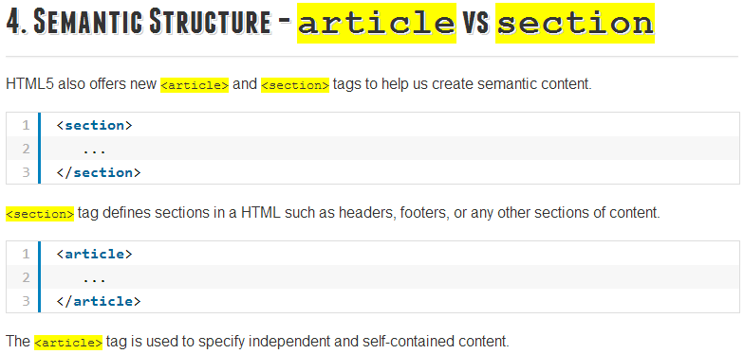

Slide 8
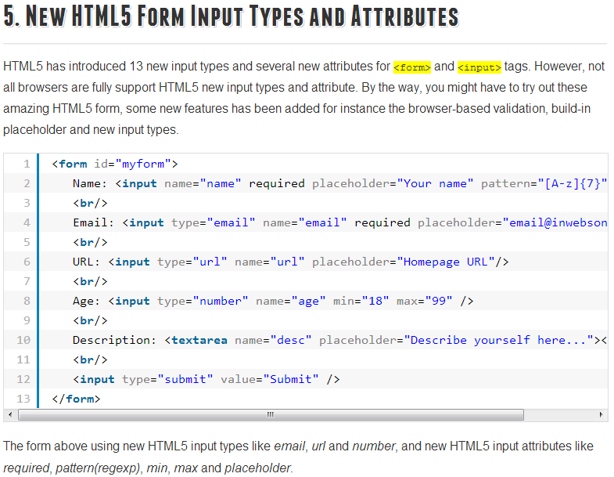

Slide 9
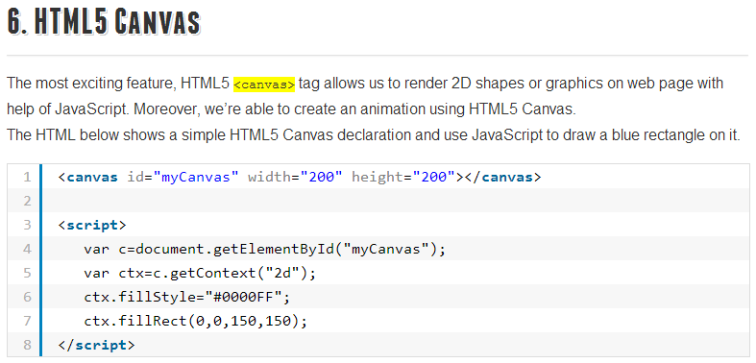

Slide 10
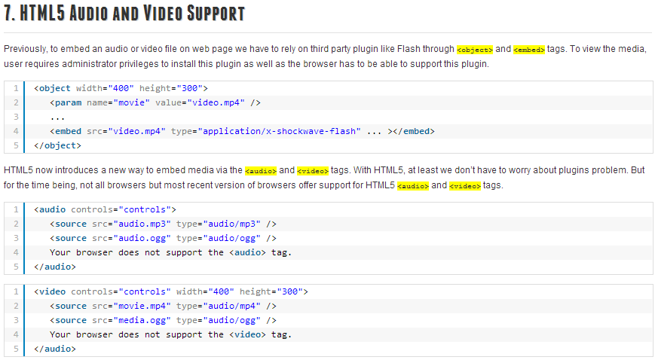

Slide 11
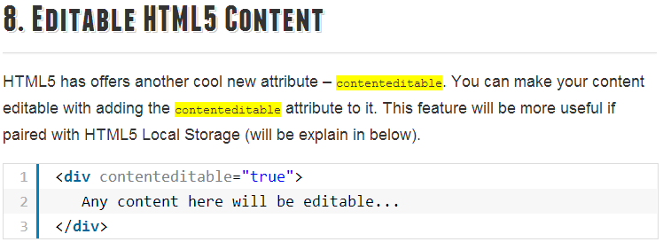

Slide 12
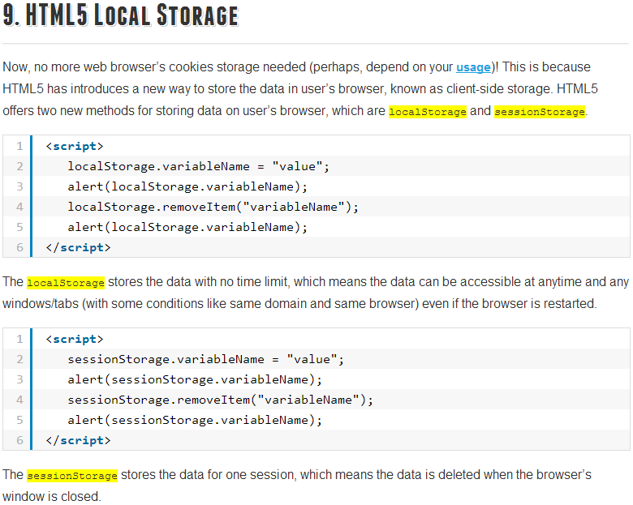

Slide 13
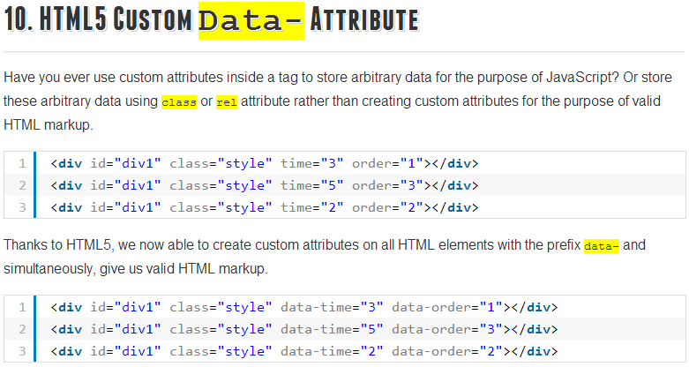

Slide 14
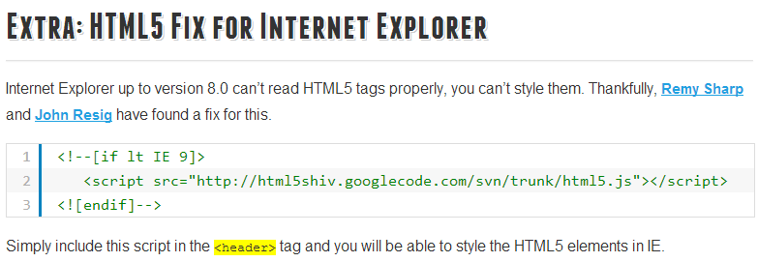

Slide 15
Conclusion
That’s all for today’s tips and tricks.
However, this doesn’t mean all for HTML5, there are still a lot of new tags and attributes by HTML5, I will cover some other useful HTML5 tips in future.
Hope you join!

Slide 16
Thank you for attention!
☺☺☺

