Slide 1
Ministry of Education and Science of Ukraine Lviv Ivan Franko National University The Department of Foreign Languages for Sciences The concept of hypertext
This work is done by
Student of FEI – 41
Vira Lytvyn
Lviv – 2013

Slide 2
Content
1. The hypertext
1.1. The concept of hypertext
1.2. Types and uses of hypertext
1.3. Examples of implementation
2. HTML as an implementation of hypertext
2.1. The concept of Html
2.2. Html development history
2.3. HTML draft versions timeline
2.4. HTML5: Features and APIs

Slide 3
1.1. The concept of hypertext
Hypertext is text displayed on a computer screen or other electronic device with references (hyperlinks) to other text which the reader can immediately access, or where text can be revealed progressively at multiple levels of detail.
The hypertext pages are interconnected by hyperlinks, typically activated by a mouse click, key press sequence or by touching the screen.

Slide 4
1.2. Types and uses of hypertext
Hypertext document
static
(prepared and stored in advance)
dynamic
(continually changing in response to user input, such as dynamic web pages)

Slide 5
1.3. Examples of implementation
World Wide Web
Xanadu
Hypertext Editing System
Information Presentation Facility
Electronic Document System
HyperCard
Inter media
Wikis
Adobe's Portable Document Format
Windows Help
PaperKiller

Slide 6
2.1. The concept of Html
HTML is the main markup language for creating web pages and other information that can be displayed in a web browser.
HTML is written in the form of HTML elements consisting of tags enclosed in angle brackets , within the web page content.
HTML allows images and objects to be embedded and can be used to create interactive forms.
The browser does not display the HTML tags, but uses the tags to interpret the content of the page.

Slide 7
2.2. Html development history
Nov, 1995
HTML 2.0 was published (form-based file upload; tables; client-side image maps; internationalization)
Jan, 1997
HTML 3.2 was published as a W3C Recommendation. It was the first version developed and standardized exclusively by the W3C
Dec, 1997
HTML 4.0 was published as a W3C Recommendation . It offers three variations.
Apr, 1998
Dec, 1999
HTML 4.0 was reissued with minor edits without incrementing the version number.
HTML 4.01 was published as a W3C Recommendation. It offers the same three variations as HTML 4.0.
May, 2000
ISO/IEC 15445:2000 was published as an ISO/IEC international standard.

Slide 8
2.3. HTML draft versions timeline
HTML DTD
HTML5
January 2008
Hypertext Markup Language
HTML Tags
HTML 3.0
April 1995
June 1993
June 1992
October 1991

Slide 9
2.4. HTML5: Features and APIs
In September 2012, the W3C proposed a plan to release a stable HTML5 Recommendation
 | 2012 | 2013 | 2014 | 2015 | 2016
HTML 5.0 | Candidate Rec | Call for Review | Recommendation
HTML 5.1 | 1st Working Draft |  | Last Call | Candidate Rec | Recommendation
HTML 5.2 |  |  |  | 1st Working Draft

Slide 10
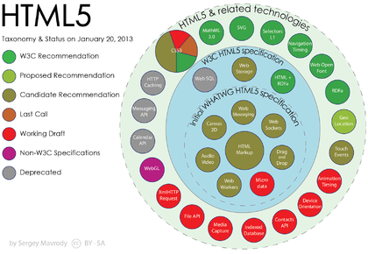
2.4. HTML5: Features and APIs
Some technologies that were originally defined in HTML5 itself are now defined in separate specifications:

Slide 11
2.4. HTML5: Features and APIs
HTML Working Group
Microdata,
Web Apps WG
IETF HyBi WG
WebRTC WG
WebVTT
HTML Canvas 2D Context
Web Messaging,
Web Workers,
Web Storage,
WebSocket API,
Server-Sent Events
WebSocket Protocol
WebRTC
W3C Web Media Text Tracks CG

Slide 12
Thank you for attention
Questions???

