Slide 1
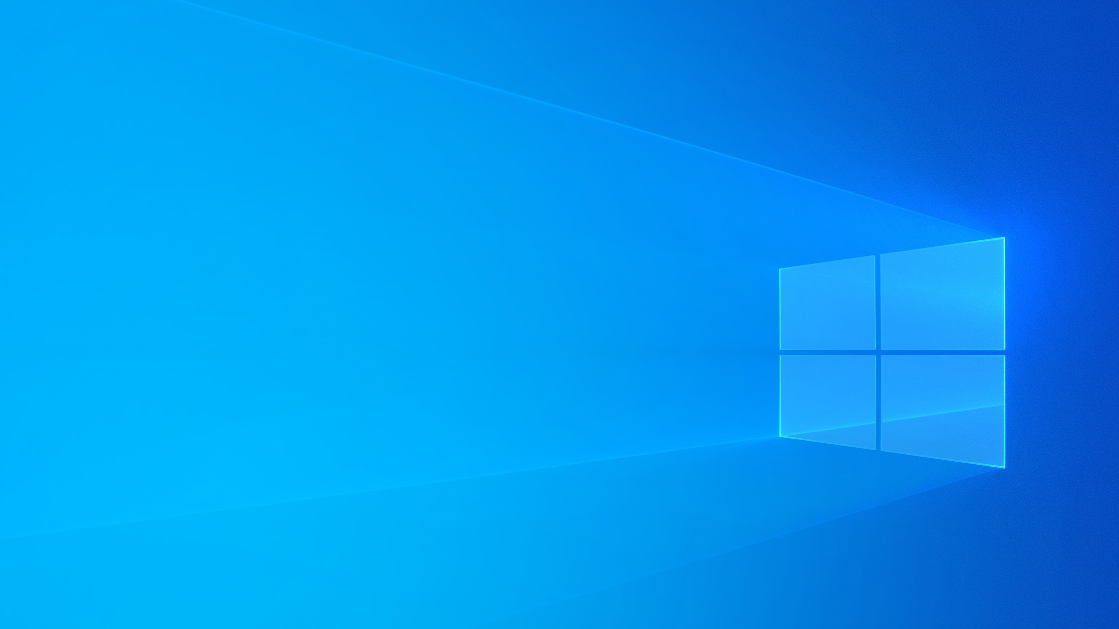


Slide 2



Tue, Aug 27, 2019 / 11:00 a.m.-12:00 p.m. CDT
Windows 10 and New Key UX Principles (for RAD Studio Developers)
Sarina DuPont, Director of Product Management, Embarcadero
Wed, Aug 28, 2019 / 11:00 a.m,-12:00 p.m. CDT
Enterprise Connectors Spotlight: MailChimp and Cassandra
Jim McKeeth, Embarcadero Chief Developer Advocate & Engineer
Thu, Aug 29, 2019 / 11:00 a.m.-12:00 p.m. CDT
Fast migration to Windows 10 High DPI with FastReports
Den Zubov, Lead Developer, Fast Reports

Slide 3


Tue, Sep 3, 2019 / 11:00 a.m.-12:00 p.m. CDT
Building native apps for Windows: why it matters?
Serge Pilko, Embarcadero MVP
Wed, Sep 4, 2019 / 11:00 a.m.-12:00 p.m. CDT
A tale of 3 APIs: VCL integration with WinAPI, COM & ShellAPI, WinRT
Marco Cantu, Embarcadero Product Manager
Thu, Sep 5, 2019 / 11:00 a.m.-12:00 p.m. CDT
Top Windows 10 features you can add to your VCL applications
Ian Barker, Embarcadero MVP

Slide 4



Tue, Sep 10, 2019 / 11:00 a.m.-12:00 p.m. CDT
Windows 10 - Modernization with RAD Studio and TMS Software
Holger Flick, TMS Software
Wednesday, Sep 18, 2019 / 11:00 a.m.-12:00 p.m. CDT
FireDAC for Windows 10 Database Access
Jens Fudge, Delphi Enthusiast, MVP, speaker, and trainer
Wed, Sep 25, 2019 / 11:00 a.m.-12:00 p.m. CDT
Enterprise Connectors Spotlight: Gmail and Bing Search
Olaf Monien, CEO Developer Experts, Embarcadero MVP

Slide 5
Top Windows 10 features you can add to your VCL applications
Check out the full series for replays and more
https://embt.co/Windows10ModernizeWebinarSeries
Ian Barker, Embarcadero MVP ian.barker@gmail.com about.me/IanBarker

Slide 6



Webinar Agenda
We’re going to take a look at some RAD Studio and Delphi features you can take advantage of today to make your existing (and new) apps look, feel and behave like modern Windows 10 applications
Check out the full series for replays and more
https://embt.co/Windows10ModernizeWebinarSeries
Notes:
Use these features - don’t fall into the “Visual Basic 6” or “it looks like it was designed for Windows 95” trap

Slide 7
RAD Studio 10.3 Rio and the community edition
Has everything the Professional SKU of Delphi has including mobile/cross platform development to iOS and Android
Suitable for learners, experimenters and open source - totally free
Trial versions available for full-time professional developers looking to move on from legacy versions of RAD Studio and Delphi
Notes:
Brief discussion about Delphi 7, Delphi 2009 and Delphi XE versions. Discuss Rio community edition free, plus trials. Plus Mida convertor http://midaconverter.com etc
We’re going to be concentrating on VCL apps today but Firemonkey adds a whole new dimension to things

Slide 8
GORGEOUS new themes and templates both for VCL and Firemonkey - all of them free via GetIt plus many built-in too
A deluge of new Windows 10 APIs
Specific VCL components targeting Windows 10 features and capabilities
APPx packaging and deployment - for local “ad-hoc”
APPx with Windows Store support
64bit Windows support - especially important now for Windows Server 2019
High-res DPI support and “per-monitor V2”
Top features include...
Notes:
APPx comes with Windows 10 Anniversary Update. It has to be the latest version of Windows 10. Look in "Update History" for Windows Build 1607. That's the one you need.
RAD Studio 10.1 Berlin Update 2 Anniversary Edition. It has to be "Update 2". If you are not sure, you can check the version of RAD Studio in "Help - About"
Windows 10 SDK (installed with RAD Studio)

Slide 9
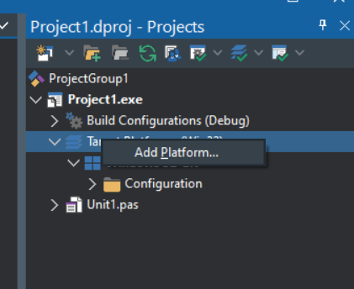
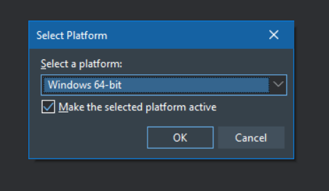
Windows 64bit
Notes:
This is especially important now with Windows 2019 server as I’m seeing more customers who insist on apps being “64 bit only” which is a growing trend for hardware manufacturers such as Apple both on mobile and, in time, desktop

Slide 10
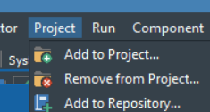
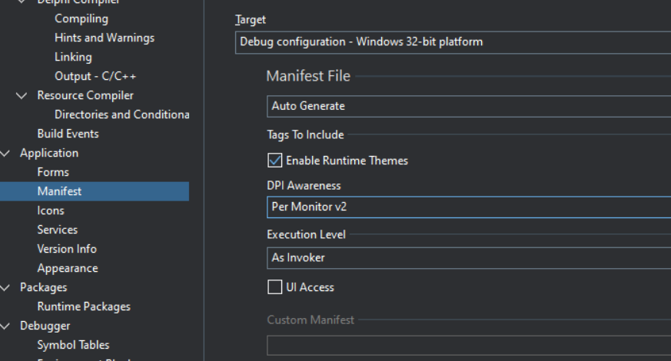
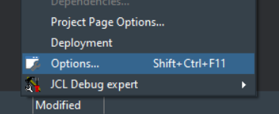
High-res DPI and Per Monitor v2
Notes:
It is very common now that users have more than one monitor; even laptop users often dock a screen which gives them two screens. People even sometimes use tablets as second screens. All of these can use different resolutions. Prior to 10.3 this made our apps look bad. Not so now. Also note that the “Enable runtime themes” needs to be checked for the themes to work (it’s checked by default). Execution level is actually pretty important and is a recent feature too. It controls the user permission level at which the app runs - default is “as invoker” but you might not want that. “Highest available” and “Administrator” are also options.

Slide 11
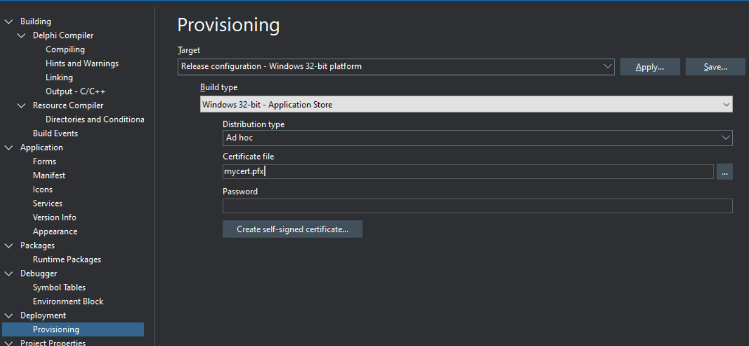
Package as an AppX
Notes:
Certs available from various sources - I personally use https://ksoftware.net (the certs are validate and supplied by Commodo)

Slide 12
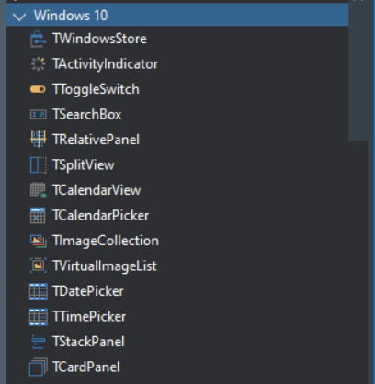
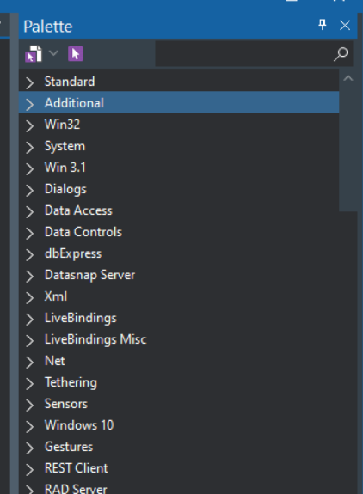
New VCL components
Notes:
Marco showed a way to do notifications in his webinar - there is a component which makes this a lot easier for mere mortals!

Slide 13
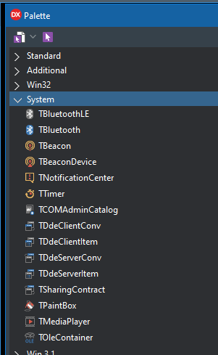
More VCL components
Bluetooth - both low energy and regular Bluetooth
Notification center - also called “toast” because it pops up 😃
It’s cross platform but works great for Windows 8 and Windows 10
Sharing Contract component allows you to easily share content among apps such as email, webbrowser etc.
See: https://docs.microsoft.com/en-us/previous-versions/windows/hh465251(v=win.10)
Notes:
Marco showed a way to do notifications in his webinar - there is a component which makes this a lot easier for mere mortals! The Bluetooth LE devices are becoming much more common now - for example several large motor insurers here in the USA use beacons which you put in your car and is used to identify the vehicle and driver and links to a mobile app to report back driving using sensors such as the accelerometer.

Slide 14
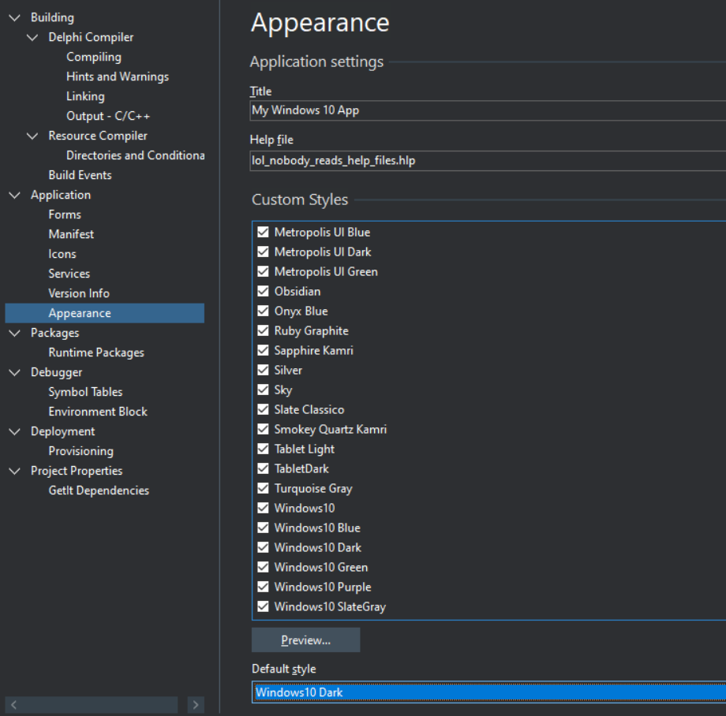
Themes
the smart way to look good!
Notes:
The themes can be a quick way to make your apps look “Windows 10” even if they’re on older versions of Windows. The themes do not need Windows 10; they’re graphical enhancements which do not reply on specific APIs. They even work on Windows XP (I tested this!) Use GetIt to find a load more too.

Slide 15
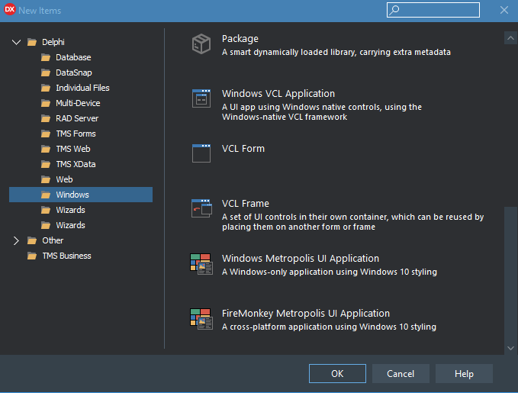
Selecting “New application” - options
Blank VCL application - you do all the hard work; but everything is still available to you
Ready-made Windows 10 style application framework
Notes:
Note that these are VCL apps - Firemonkey is also great for Windows 10 but the two technologies are very different.

Slide 16
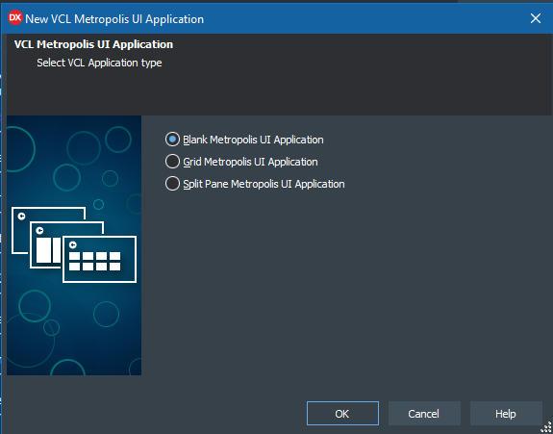
New Windows Metropolis UI Application
Blank application
has a gesture manager
has an appbar - with only a close button
has an actionlist
very basic
Grid application
also has gesture manager, app bar and action list
has panels, flow panels
uses master/detail UI idiom
more complete
Split pane
Similar to grid application
Master/detail with extra navigation
Notes:
There’s a caveat to this. You might not be looking to have the ‘Metropolis UI’ in your apps - it’s quite a specific look.

Slide 17
Windows 10 Api integration
It’s more subtle and more powerful than you might think. As of early this year all Windows APIs were mapped into the RTL - but it’s a moving target
See Marco’s presentation “A tale of three APIs” which is a part of this series of webinars

Slide 18
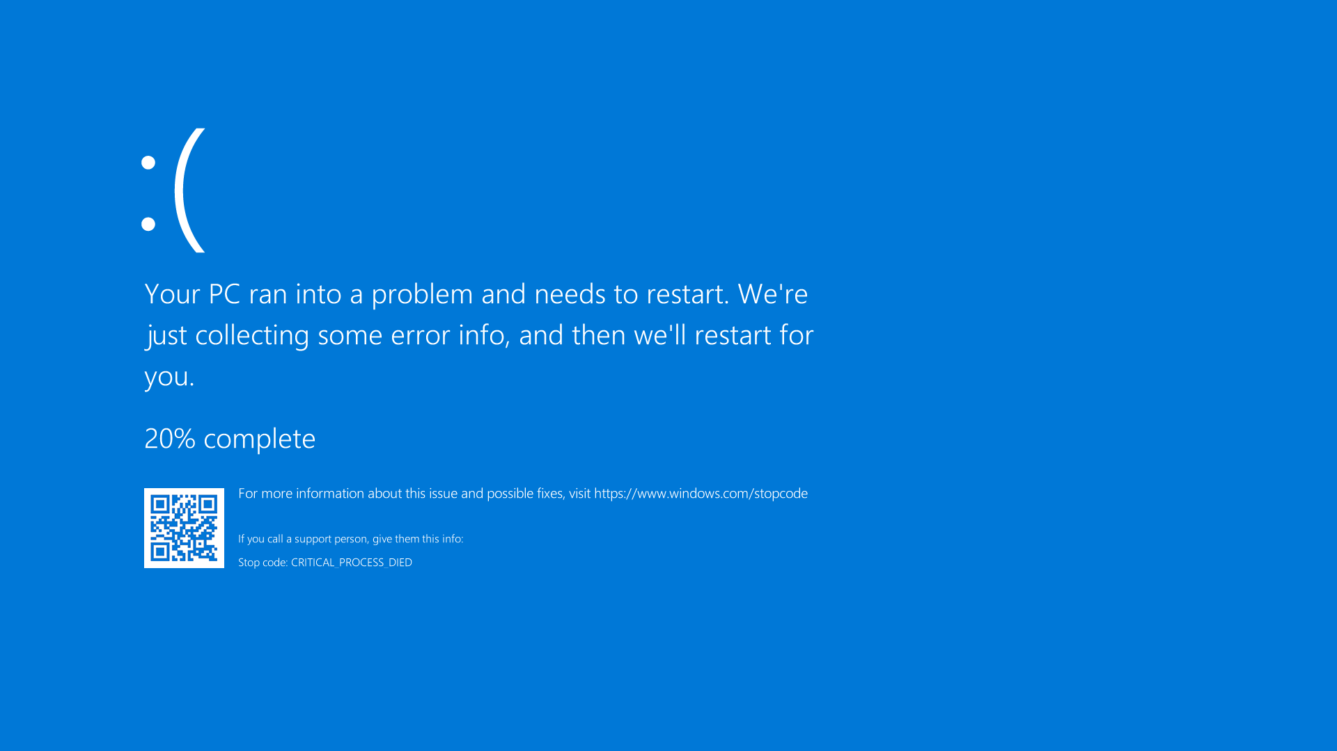
Hands on with the IDE
😃
Notes:
Based on https://francescocirillo.com/pages/pomodoro-technique and https://tomato-timer.com

Slide 19
The slides & other resources are available here https://github.com/checkdigits/w10Sep5th2019IanBCode
Easiest to follow me on GitHub
https://github.com/checkdigits
Updates and Delphi/developer chat on Twitter
https://twitter.com/punctuation
Email me
ian.barker@gmail.com

Slide 20


Check out the full series for replays and more
https://embt.co/Windows10ModernizeWebinarSeries

