Slide 1
Social Media Scraping
Keep track of your brand in real-time

Slide 2

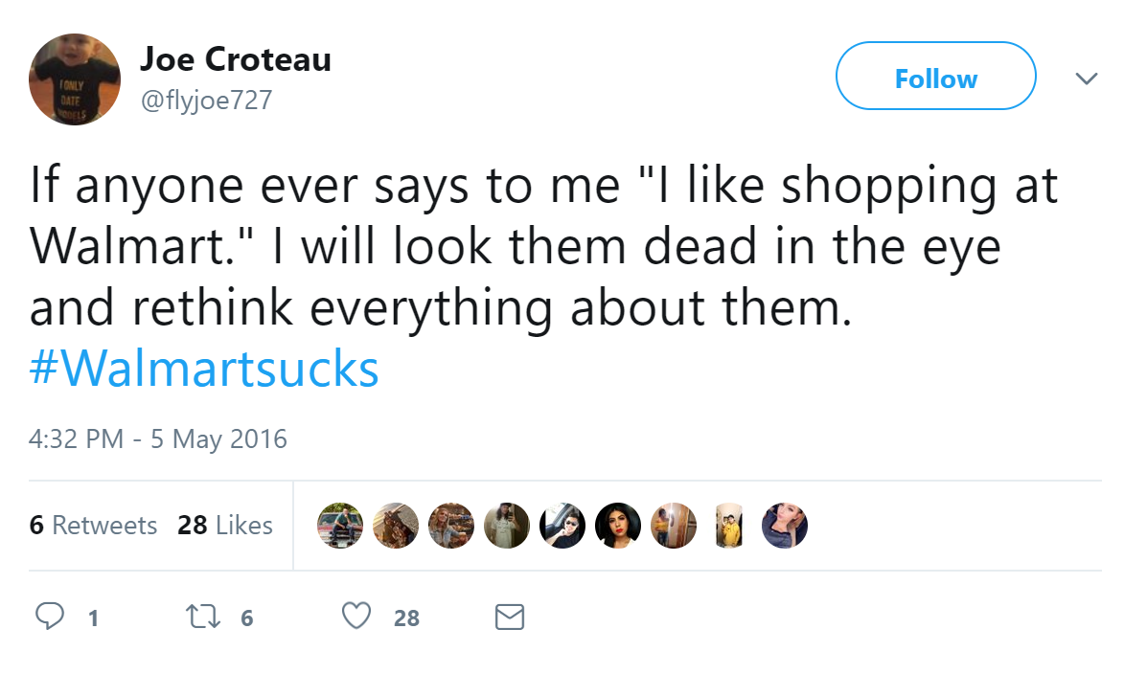
Situation
OPPORTUNITY:
Sentiments expressed through Social Media
CHALLENGE:
Posts not directly sent to entity
Manual parsing not practical
Dynamic entites

Slide 3
Solution
Social Media Scraper and Sentiment Analysis
Extract relevant content
Analyze text and filter posts
Forward to CSR and PR departments
User-friendly interface and reusable API

Slide 4
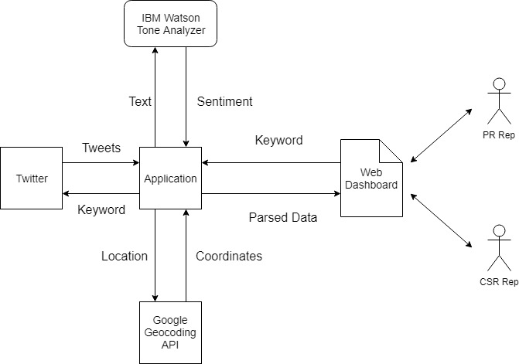
Data Flow

Slide 5
Future Improvements
Broaden Content:
OCR and Location Recognition for Media Objects
Utilize Reddit, Facebook, and Instagram
Improve Analysis:
Use NLP to further specify sentiment
Expand Use Cases:
Integrate with marketing/advertising and provide A/B response data
Real-time monitoring of active events around brand

