Slide 1
Android App Development

Slide 2

Android: A Brief Overview
It is based on the open source operating system Linux.
It controls 88% of the world smartphone market, over 1.4 billion people are now using Android.
System Requirements for Android Development:
Minimum of 8GB RAM.
A 64bit environment for versions higher than 2.3x.
2 GB of available hard-disk space for installation; extra free space is required during installation.

Slide 3
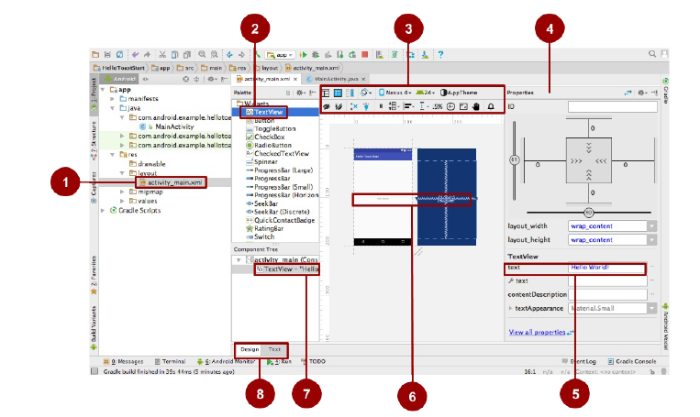
Components of
Android Window:
1. Activity Main.xml file
2. Pallets of UI Elements
3. Selectors
4. Properties Pane
5. Text View
6. Design Pane
7. Component Tree
8. Design & Text Tabs

Slide 4
1.
Project One: Brain Trainer
A Simple mathematical Game App

Slide 5
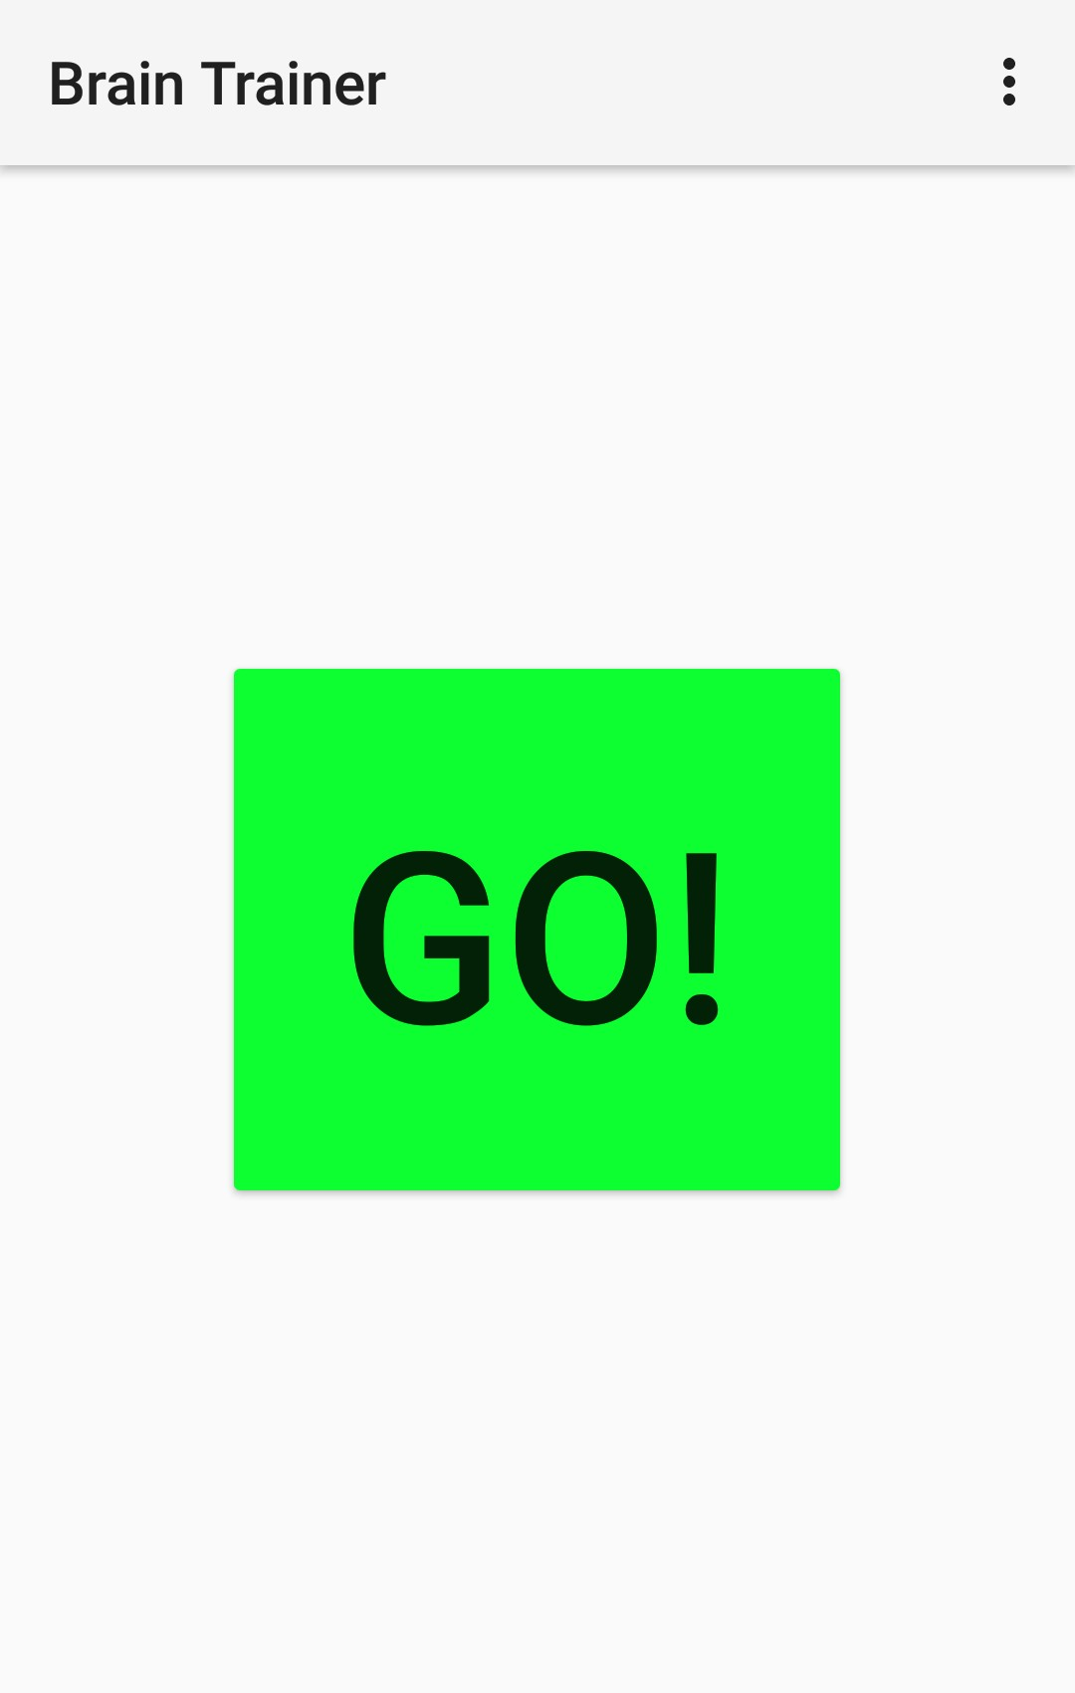
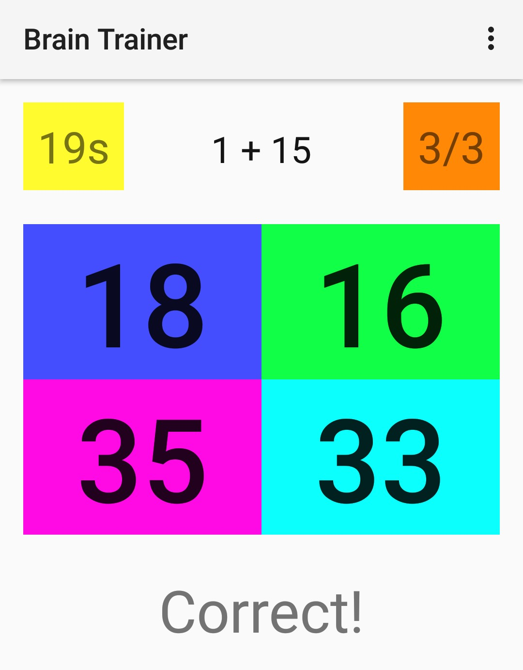
Screenshots:

Slide 6
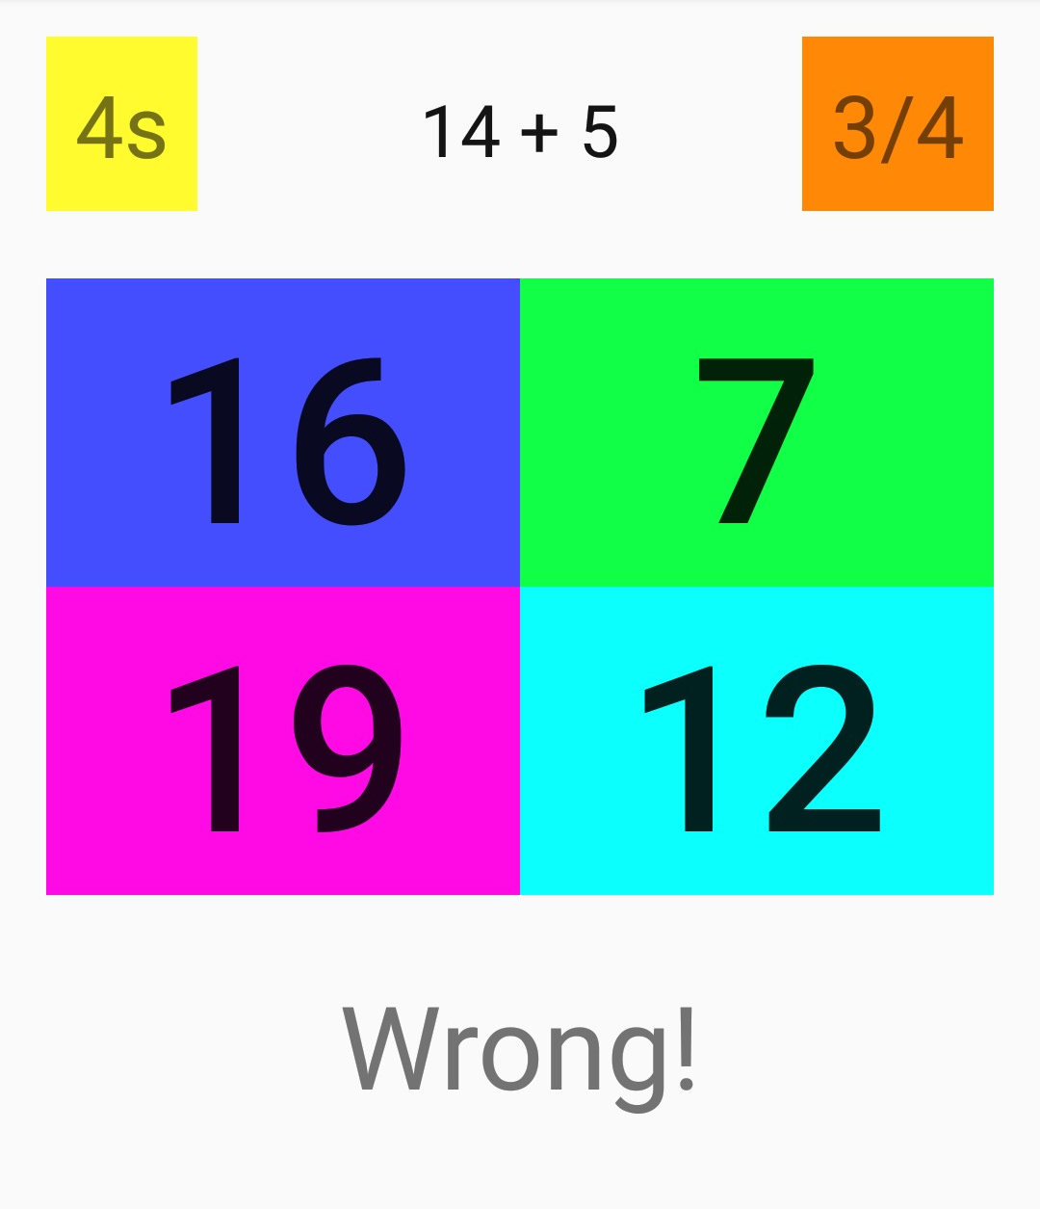
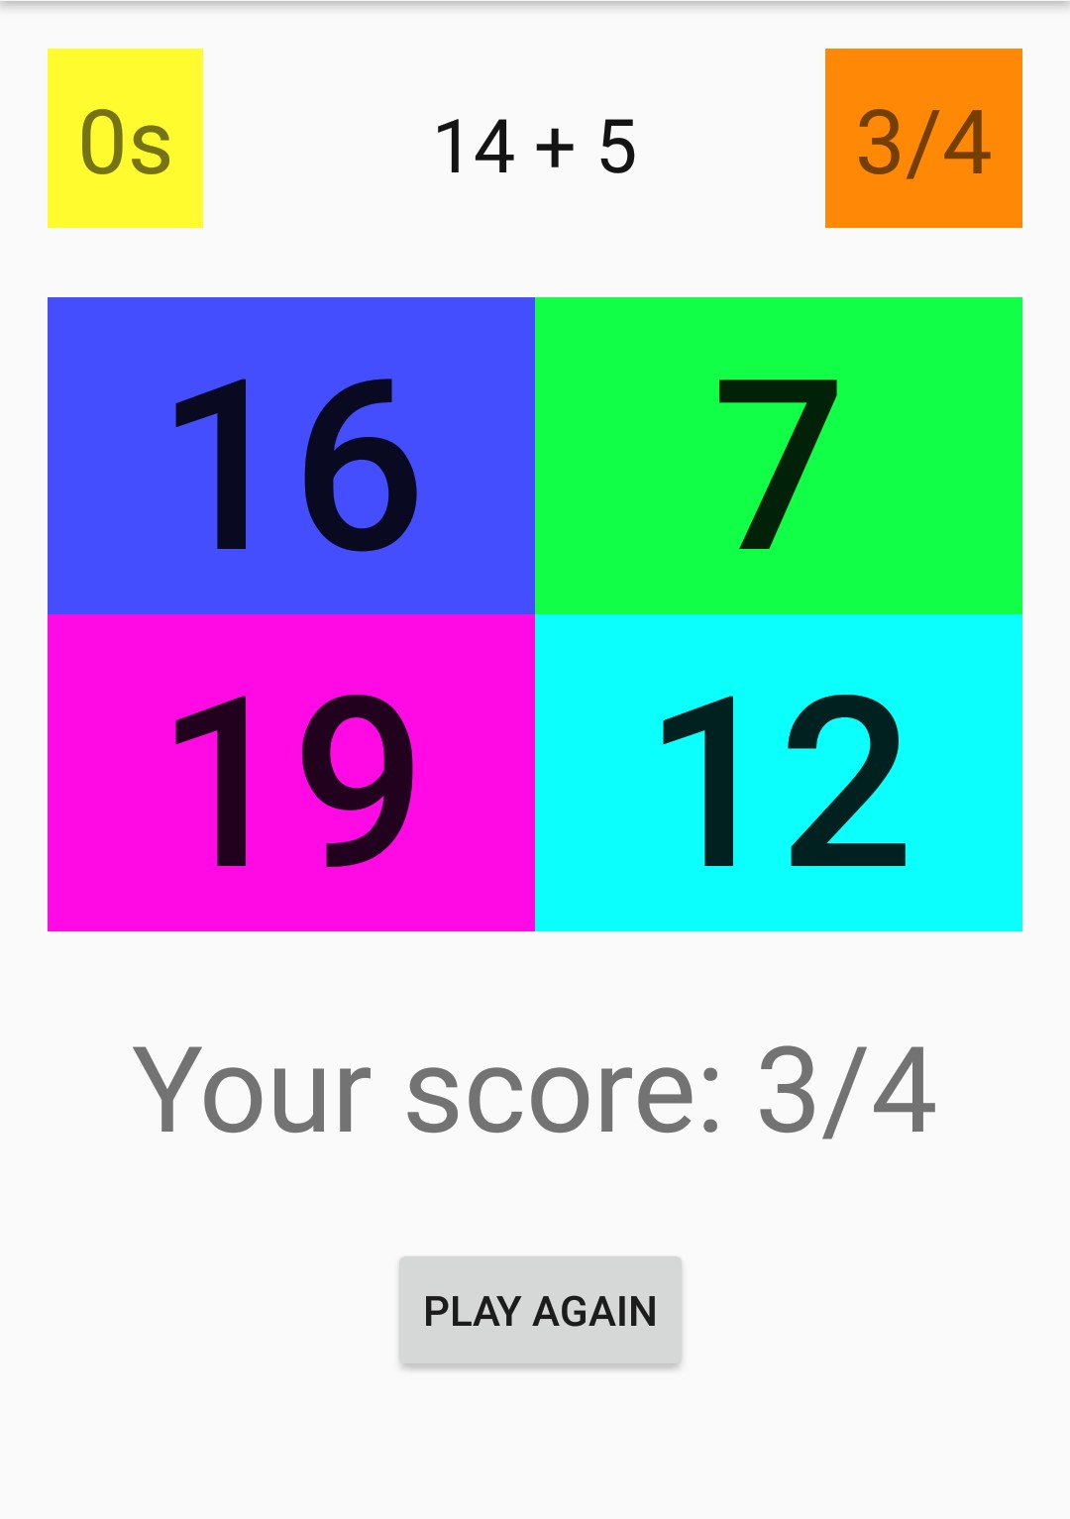
Screenshots:

Slide 7
Code: Activity-Main.xml:
<?xml version="1.0" encoding="utf-8"?>
<RelativeLayout xmlns:android="http://schemas.android.com/apk/res/android"
xmlns:app="http://schemas.android.com/apk/res-auto"
xmlns:tools="http://schemas.android.com/tools"
android:id="@+id/timer"
android:layout_width="match_parent"
android:layout_height="match_parent"
tools:context="com.example.vaibhav.braintrainer.MainActivity">
<Button
android:layout_width="wrap_content"
android:layout_height="wrap_content"
android:text="Go!"
android:id="@+id/startButton"
android:layout_centerVertical="true"
android:layout_centerHorizontal="true"
android:textSize="80sp"
android:padding="40dp"
android:onClick="start"
android:visibility="visible" />
<RelativeLayout
android:layout_width="match_parent"
android:layout_height="match_parent"
android:visibility="invisible"
android:id="@+id/gameRelativeLayout">
<TextView
android:layout_width="wrap_content"
android:layout_height="wrap_content"
android:text="30s"
android:id="@+id/timerTextView"
android:layout_alignParentTop="true"
android:layout_alignParentStart="true"
android:textSize="30sp"
android:background="#fffffb2e"
android:padding="10dp" />
<TextView
android:layout_width="wrap_content"
android:layout_height="wrap_content"
android:text="0/0"
android:id="@+id/pointsTextView"
android:layout_alignParentTop="true"
android:layout_alignParentEnd="true"
android:textSize="30sp"
android:padding="10dp"
android:background="#ffff8807" />
<TextView
android:layout_width="wrap_content"
android:layout_height="wrap_content"
android:text="31 + 12"
android:id="@+id/sumTextView"
android:layout_alignParentTop="true"
android:layout_centerHorizontal="true"
android:textSize="25sp"
android:padding="15dp"
android:textColor="#ff141414" />
<TextView
android:layout_width="wrap_content"
android:layout_height="wrap_content"
android:text="31 + 12"
android:id="@+id/sumTextView"
android:layout_alignParentTop="true"
android:layout_centerHorizontal="true"
android:textSize="25sp"
android:padding="15dp"
android:textColor="#ff141414" />
<GridLayout
android:layout_width="match_parent"
android:layout_height="wrap_content"
android:layout_below="@+id/sumTextView"
android:layout_alignParentStart="true"
android:layout_alignParentEnd="true"
android:layout_marginTop="20dp"
android:id="@+id/gridLayout">

Slide 8
Code: MainActivity.java:
package com.example.vaibhav.braintrainer;
import android.os.CountDownTimer;
import android.support.v7.app.AppCompatActivity;
import android.os.Bundle;
import android.util.Log;
import android.view.View;
import android.widget.Button;
import android.widget.RelativeLayout;
import android.widget.TextView;
import java.util.ArrayList;
import java.util.Random;
public class MainActivity extends AppCompatActivity {
Button startButton;
TextView resultTextView;
TextView pointsTextView;
Button button0;
Button button1;
Button button2;
Button button3;
TextView sumTextView;
TextView timerTextView;
Button playAgainButton;
RelativeLayout gameRelativeLayout;
ArrayList<Integer> answers = new ArrayList<Integer>();
int locationOfCorrectAnswer;
int score = 0;
int numberOfQuestions = 0;
public void playAgain(View view) {
score = 0;
numberOfQuestions = 0;
timerTextView.setText("30s");
pointsTextView.setText("0/0");
resultTextView.setText("");
playAgainButton.setVisibility(View.INVISIBLE);
generateQuestion();
new CountDownTimer(30100, 1000) {
@Override
public void onTick(long millisUntilFinished) {
timerTextView.setText(String.valueOf(millisUntilFinished / 1000) + "s");
}
@Override
public void onFinish() {
playAgainButton.setVisibility(View.VISIBLE);
timerTextView.setText("0s");
resultTextView.setText("Your score: " + Integer.toString(score) + "/" + Integer.toString(numberOfQuestions));
}
}.start();
}
public void generateQuestion() {
Random rand = new Random();
int a = rand.nextInt(21);
int b = rand.nextInt(21);
sumTextView.setText(Integer.toString(a) + " + " + Integer.toString(b));
locationOfCorrectAnswer = rand.nextInt(4);
answers.clear();
int incorrectAnswer;
for (int i=0; i<4; i++) {
if (i == locationOfCorrectAnswer) {
answers.add(a + b);
} else {
incorrectAnswer = rand.nextInt(41);
while (incorrectAnswer == a + b) {
incorrectAnswer = rand.nextInt(41);
}
answers.add(incorrectAnswer);
}
}
button0.setText(Integer.toString(answers.get(0)));
button1.setText(Integer.toString(answers.get(1)));
button2.setText(Integer.toString(answers.get(2)));
button3.setText(Integer.toString(answers.get(3)));
}
public void chooseAnswer(View view) {
if (view.getTag().toString().equals(Integer.toString(locationOfCorrectAnswer))) {
score++;
resultTextView.setText("Correct!");
} else {
resultTextView.setText("Wrong!");
}
numberOfQuestions++;
pointsTextView.setText(Integer.toString(score) + "/" + Integer.toString(numberOfQuestions));
generateQuestion();
}
public void start(View view) {
startButton.setVisibility(View.INVISIBLE);
gameRelativeLayout.setVisibility(RelativeLayout.VISIBLE);
playAgain(findViewById(R.id.playAgainButton));
}
@Override
protected void onCreate(Bundle savedInstanceState) {
super.onCreate(savedInstanceState);
setContentView(R.layout.activity_main);
startButton = (Button)findViewById(R.id.startButton);
sumTextView = (TextView)findViewById(R.id.sumTextView);
button0 = (Button)findViewById(R.id.button0);
button1 = (Button)findViewById(R.id.button1);
button2 = (Button)findViewById(R.id.button2);
button3 = (Button)findViewById(R.id.button3);
resultTextView = (TextView)findViewById(R.id.resultTextView);
pointsTextView = (TextView)findViewById(R.id.pointsTextView);
timerTextView = (TextView)findViewById(R.id.timerTextView);
playAgainButton = (Button)findViewById(R.id.playAgainButton);
gameRelativeLayout = (RelativeLayout)findViewById(R.id.gameRelativeLayout);
}
}

Slide 9
Project two: Weather App
An app based on web-api

Slide 10
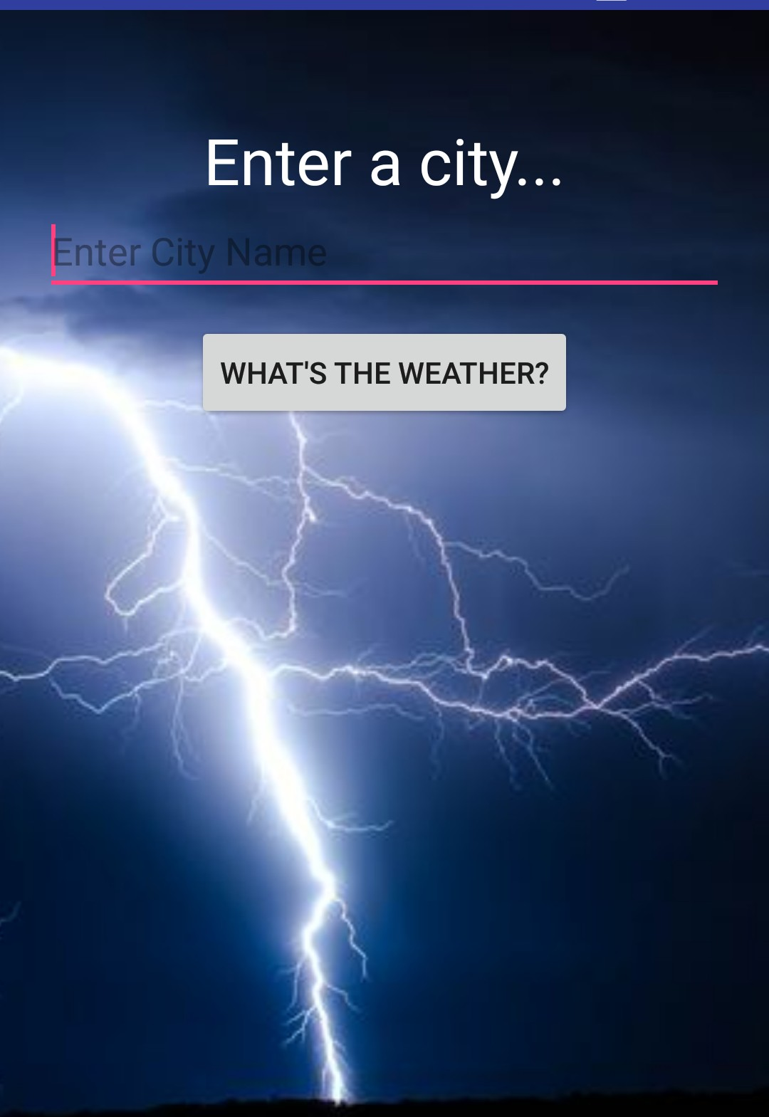
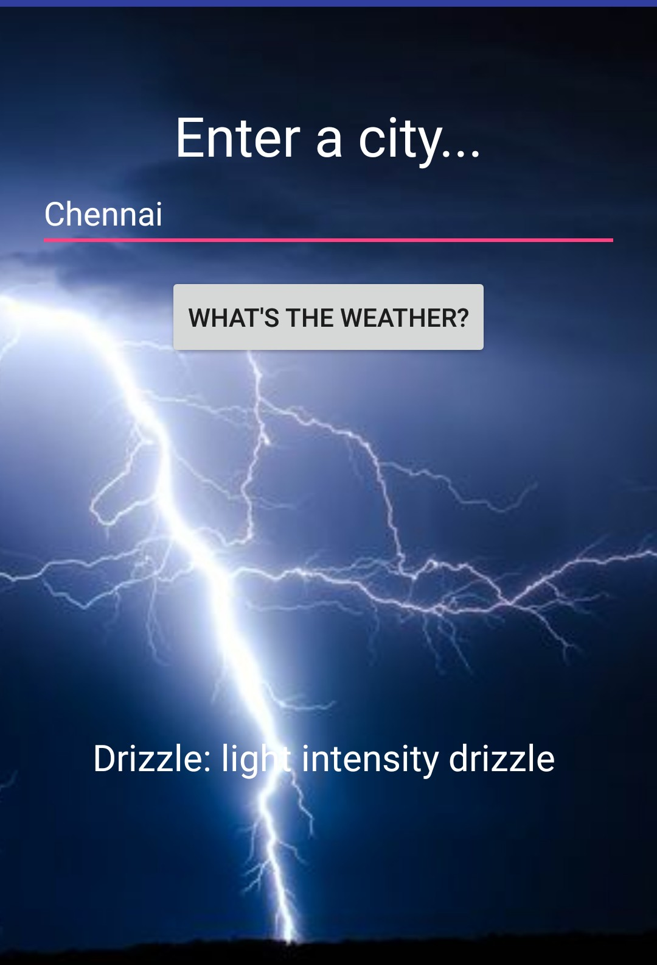
Screenshots:

Slide 11
Code: Activity-Main.xml:
<?xml version="1.0" encoding="utf-8"?>
<RelativeLayout xmlns:android="http://schemas.android.com/apk/res/android"
xmlns:app="http://schemas.android.com/apk/res-auto"
xmlns:tools="http://schemas.android.com/tools"
android:layout_width="match_parent"
android:layout_height="match_parent"
tools:context=".MainActivity">
<ImageView
android:id="@+id/imageView"
android:layout_width="fill_parent"
android:layout_height="fill_parent"
android:layout_alignParentStart="true"
android:layout_alignParentTop="true"
android:adjustViewBounds="false"
android:longClickable="false"
android:scaleType="centerCrop"
android:src="@drawable/weather" />
<TextView
android:layout_width="wrap_content"
android:layout_height="wrap_content"
android:text="Enter a city..."
android:id="@+id/textView"
android:layout_alignTop="@+id/imageView"
android:layout_centerHorizontal="true"
android:layout_marginTop="50dp"
android:textSize="30sp"
android:textColor="#ffffffff" />
<EditText
android:id="@+id/cityName"
android:layout_width="fill_parent"
android:layout_height="wrap_content"
android:layout_below="@+id/textView"
android:layout_centerHorizontal="true"
android:layout_marginLeft="40dp"
android:hint="Enter City Name"
android:textColor="#ffffff" />
<Button
android:layout_width="wrap_content"
android:layout_height="wrap_content"
android:text="What&apos;s The Weather?"
android:id="@+id/button"
android:layout_below="@+id/cityName"
android:layout_centerHorizontal="true"
android:onClick="findWeather"
android:layout_marginTop="10dp" />
<TextView
android:layout_width="wrap_content"
android:layout_height="wrap_content"
android:id="@+id/resultTextView"
android:layout_alignBottom="@+id/imageView"
android:layout_centerHorizontal="true"
android:layout_marginBottom="120dp"
android:textSize="20sp"
android:textColor="#ffffffff" />
</RelativeLayout>

Slide 12
Code: MainActivity.java:
package com.example.vaibhav.weatherapp;
import android.app.Activity;
import android.content.Context;
import android.os.AsyncTask;
import android.os.Bundle;
import android.util.Log;
import android.view.View;
import android.view.inputmethod.InputMethodManager;
import android.widget.EditText;
import android.widget.TextView;
import android.widget.Toast;
import org.json.JSONArray;
import org.json.JSONObject;
import java.io.InputStream;
import java.io.InputStreamReader;
import java.io.UnsupportedEncodingException;
import java.net.HttpURLConnection;
import java.net.URL;
import java.net.URLEncoder;
public class MainActivity extends Activity {
EditText cityName;
TextView resultTextView;
public void findWeather(View view) {
Log.i("cityName", cityName.getText().toString());
InputMethodManager mgr = (InputMethodManager) getSystemService(Context.INPUT_METHOD_SERVICE);
mgr.hideSoftInputFromWindow(cityName.getWindowToken(), 0);
try {
String encodedCityName = URLEncoder.encode(cityName.getText().toString(), "UTF-8");
DownloadTask task = new DownloadTask();
task.execute("http://api.openweathermap.org/data/2.5/weather?q="+encodedCityName+"&APPID=5340c24a4b443a7d4cdade75bf30af31");
} catch (UnsupportedEncodingException e) {
e.printStackTrace();
Toast.makeText(getApplicationContext(), "Could not find weather", Toast.LENGTH_LONG);
}
}
@Override
protected void onCreate(Bundle savedInstanceState) {
super.onCreate(savedInstanceState);
setContentView(R.layout.activity_main);
cityName = findViewById(R.id.cityName);
resultTextView = findViewById(R.id.resultTextView);
}
public class DownloadTask extends AsyncTask<String, Void, String> {
@Override
protected String doInBackground(String... urls) {
String result = "";
URL url;
HttpURLConnection urlConnection = null;
try {
url = new URL(urls[0]);
urlConnection = (HttpURLConnection) url.openConnection();
InputStream in = urlConnection.getInputStream();
InputStreamReader reader = new InputStreamReader(in);
int data = reader.read();
while (data != -1) {
char current = (char) data;
result += current;
data = reader.read();
}
return result;
} catch (Exception e) {
Toast.makeText(getApplicationContext(), "Could not find weather", Toast.LENGTH_LONG);
}
return null;
}
@Override
protected void onPostExecute(String result) {
super.onPostExecute(result);
try {
String message = "";
JSONObject jsonObject = new JSONObject(result);
String weatherInfo = jsonObject.getString("weather");
Log.i("Weather content", weatherInfo);
JSONArray arr = new JSONArray(weatherInfo);
for (int i = 0; i < arr.length(); i++) {
JSONObject jsonPart = arr.getJSONObject(i);
String main = "";
String description = "";
main = jsonPart.getString("main");
description = jsonPart.getString("description");
if (main != "" && description != "") {
message += main + ": " + description + "\r\n";
}
}
if (message != "") {
resultTextView.setText(message);
} else {
Toast.makeText(getApplicationContext(), "Could not find weather", Toast.LENGTH_LONG);
}
} catch (Exception e) {
Toast.makeText(getApplicationContext(), "Could not find weather", Toast.LENGTH_LONG);
}
}
}
}

Slide 13
Working of the App:
Server
Sending request through web-api
Receiving data form the server
The App sends request and receives data in JSON format.
App
App

Slide 14

Thanks!
For patiently hearing and bearing with me!

Slide 15
Credits
Special thanks to Rob Percival, for making such a nice course on Android App Development.

