Slide 1
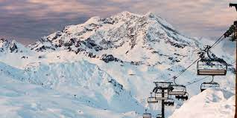
Big Mountain Ski Resort

Slide 2
Background
Big Mountain Ski resort is located in the mountains of Montana with views of Glacier National Park and Flathead National Forest
Each season an average of 350,000 people ski or snowboard
There are 11 lifts, 2 T-bars and 1 magic carpet for beginners
The longest run is 3.3 miles. The base elevation is 4,464 ft. The summit is 6,817 ft

Slide 3
Problem Summary
Additional chair lift has been added to increase visitor distribution across the resort
Operating costs have increased by $1,540,00 this season
Pricing strategy is to charge a premium above market average
How to select a better value for ticket prices ?
Consider options to either cut costs or support a higher ticket price

Slide 4
Recommendations
Increase the vertical drop by adding a run 150 feet lower down
Requires install of additional chair
Ticket prices will rise by $8.61
Expected income generated: $15,065,471

Slide 5
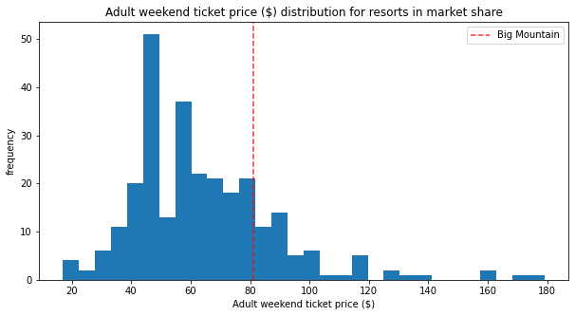
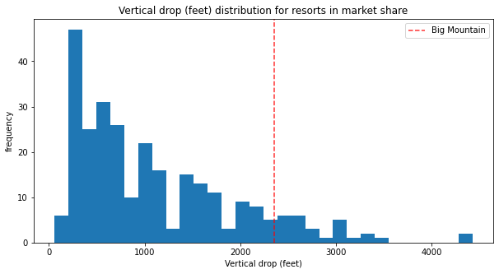
Big Mountain vs Resorts in Market

Slide 6
Conclusion
Big Mountain Resort can increase revenue and visitors by adding a new drop point and adding a chair. By placing the chairs in high visited areas, that can increase revenue without increasing costs. It would be done by moving lifts and chairs from low visited areas to highly trafficked areas.

