Slide 1


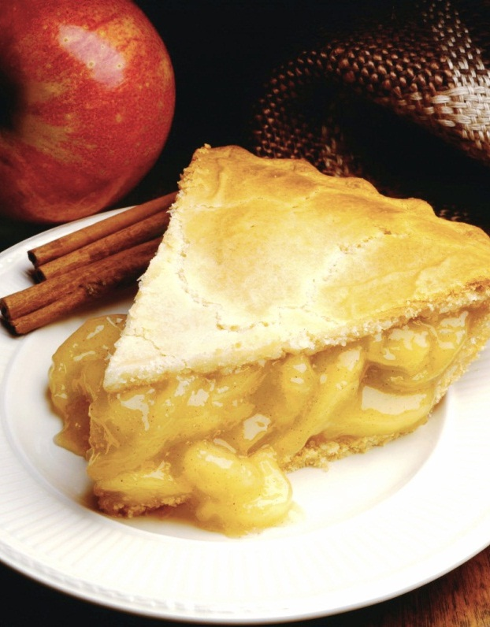
RECIPLEASE
By
THE ‘A’ TEAM
Isaak Galle, Kaitlin Cordell, Omonigho Odairi and Brandon Wernke.
Notes:
NOTE: To replace a picture, just select and delete it. Then use the Insert Picture icon to replace it with one of your own!

Slide 2
Introduction
Life as we know it today is on a fast track, many people have resorted to fast food for three main reasons; time, cost and convenience; however, some still prefer to cook but in a more convenient, fast and interactive way.
Reciplease is an online web recipe app created towards the resolution of these requirements and much more.

Slide 3
Abstract
Reciplease is flexible, reliable and user friendly, implemented using ASP.net, Visual studio and SQL Server. Our ability to connect to the Recipe API for a robust database of recipes, and to the Kroger API to allow users transfer personalized shopping list to a Kroger cart makes this project exceptional.

Slide 4
Contents
Application need
CPDM Project
Requirement process
Recommendations
Finished Application
Successes & Challenges

Slide 5
Overall Need
Reciplease has been carefully designed following extensive users requirements, created to meet the needs of different categories of users.
Easy pick up of ingredients for a great meal.
Help people try new recipes.
Stress free meal preparations.
Ability to share favorites recipes with friends and family.
Having a digital recipe book.

Slide 6
Our research process
After the decision on our project topic, we realized that we had chosen a path for the masses and everyone in the ‘A’ team went on to gather information via different methods which include one-on-one interviews, group interviews, online research, and focus group expectations and feedback sessions with several participants of all ages; cooks and non-cooks, professionals and non professionals of different fields including the young.

Slide 7
Research feedback
An app that has all the cookbooks in one location.
Ability to pick recipes related to diets and health needs.
Easy and advanced search engine for recipes.
Clear instructions on meal preparation including images.
Recipe Information at a glance for example, difficulty level, time etc.
Complete nutritional information of most meals.

Slide 8
Research feedback
A platform to develop or organize a self cookbook.
Ability to favorite or save recipes.
Ability to create, edit, and delete recipes.
The convenience of making and transferring a shopping list to a grocery store that has the option for home delivery.

Slide 9
Our Final Product
A review of our initial idea and the requirements obtained, has delivered to us a product which we believe incorporates the solution to the cooking needs of people of all ages and different classes. Reciplease can be accessed through different devices and operating systems, for an interactive and seamless cooking experience.
Our feedback can be expressed in two words “fast and convenient”.

Slide 10
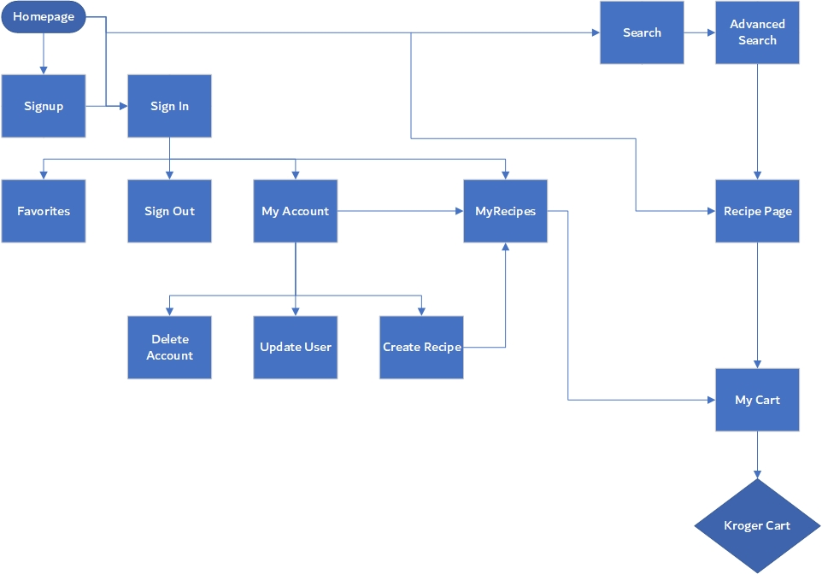
Reciplease Flowchart
Homepage
Search
Advanced search
Sign up
Myrecipe page
Sign-In
Favorites
MyCart
Shopping Cart
MyAccount
Create
View
Sign-Out
Update
Delete

Slide 11
Successes & Challenges
‘Reciplease’ 1.0 is functional and ready for use with a few fixes required; however, there were challenges on this path to success.
Some of these challenges include:
API’s complexities were more difficult than anticipated.
Learning how to use ‘Github’ was a challenge at the beginning.
As the application progressed, more database procedures were required than anticipated.
Update change required a database redesign.
More models were required than expected.
Limitation of Kroger API.

Slide 12
Recommendations
For future advancement and an outstanding performance of ‘Reciplease App’, we would like to make the following recommendations:
Ability to share recipes with friends on social media.
Ability to save and transfer multiple recipes to Kroger cart at once.
Adding other groceries stores instead of just Kroger.
Ability to remove ingredients from shopping list before sending it to Kroger.
Ability to change serving size.
A more efficient way of choosing ingredients.
Recording your location on our app before sending to Kroger.

Slide 13
Conclusion
Reciplease app is a quick response to users requirements for a cooking app. Its search engine is detailed enough to enable users find the exact recipe they desire. Users are able to create, update, and manage their accounts as well as their own recipes in a form of an organized cookbook.
An interactive platform that also allows for rating, feedback and more uniquely provide users the ability to transfer shopping list to a Kroger cart for an onward Kroger pickup or doorstep delivery if required.
Reciplease is indeed a fast and convenient way to enjoy cooking!

Slide 14

Reciplease
……fast & convenient.
Any questions?

