Slide 1


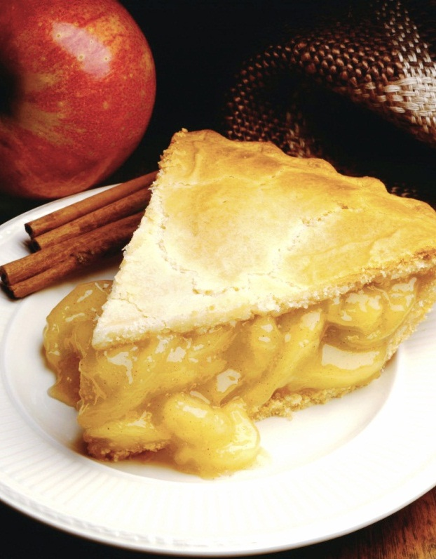
RECIPLEASE
By
THE ‘A’ TEAM
Issak Galle, Kaitlin Cordell, Omonigho Odairi and Brandon Wernke
Notes:
NOTE: To replace a picture, just select and delete it. Then use the Insert Picture icon to replace it with one of your own!

Slide 2
Introduction
Life as we know it today is on a fast track, many people have resorted to fast food for three main reasons; time, cost and convenience; however, some still prefer to cook but in a more convenient, fast and interactive way.
Reciplease is an online web recipe app created towards the resolution of these requirements and much more.

Slide 3
Abstract
Reciplease is flexible, reliable and user friendly, implemented using ASP.net, Visual studio and SQL Server. Our ability to connect to the Recipe API for a robust database of recipes, and to the Kroger API to allow users transfer personalized shopping list to a Kroger cart makes this project exceptional.

Slide 4
Contents
Application need
Requirement process
Finished Application
Successes & Challenges
Recommendations
CPDM Project

Slide 5
Overall Need
Reciplease has been carefully designed following extensive users requirements, created to meet the needs of different categories of users.
Eating is vital, therefore this app is geared towards meeting the needs of those who like to cook, help others learn how to cook, provide nutritional information on all recipes for health concerns, encourage personalized cookbooks, all in an interactive platform.
It is our utmost desire that ‘reciplease’ will be used widely to its full capacity.

Slide 6
Our research process
After the decision on our project topic, we realized that we had chosen a path for the masses and everyone in the ‘A’ team went on to gather information via different methods which include one-on-one interviews, group interviews, online research, and focus group expectations and feedback sessions with several participants of all ages; cooks and non-cooks, professionals and non professionals of different fields including the young.

Slide 7
Research feedback
Basic question:

Slide 8
Research feedback
Our research proved to us that majority of people would like to cook if our application would meet the following :
An app that has all the cookbooks in one location.
Easy search engine for any meal recipe, for example using abbreviated names.
Clear instructions on meal preparation including images.
Recipe Information at a glance for example, difficulty level, time etc.
Complete health/nutritional information of each meal.

Slide 9
Research feedback
A platform to develop or organize a self cookbook.
Ability to save or remove a particular recipe.
Ability to create, edit, and delete ingredients, especially for already existing ingredients.
The convenience of making and transferring a shopping list to a grocery store that has the option for home delivery.

Slide 10
Our Final Product
A review of our initial idea and the requirements obtained, has delivered to us a product which we believe incorporates the solution to the cooking needs of people of all ages and different classes. Reciplease can be accessed though different devices and operating systems, for an interactive and seamless cooking spree.
our feedback can be expressed in two words “fast and convenient”.

Slide 11
Reciplease Flowchart Screens
Homepage
Homepage
Search
Search for recipe
Advanced search
Sign up
Myrecipe page
Sign-In
Favorites
MyCart
Shopping Cart
MyAccount
create
view
Sign-Out
update
Delete

Slide 12
Reciplease App User Interface
Reciplease can be accessed with or without login details, a new user can
Sign-up, sign in and sign out of account.
Search and advanced search engine using names, cuisines, ingredients etc.
Instant information on timing, servings, difficulty etc.

Slide 13
Reciplease App User Interface
A logged in user can access more features.
Access to a reciplease account.
Privilege to update and delete user account.
User can rate a recipe.
Ability to save favorite recipes .

Slide 14
Reciplease App User Interface
User can create multiple Recipe.
Add and remove ingredients.
View recipes created.
Access to users own cookbook location in ‘myRecipe’.

Slide 15
Reciplease App User Interface
Ability to create a shopping list for ingredients.
Information on ingredients in shopping list
Seamless transfer of list to Kroger cart.
Ability to provide feedback on recipe.

Slide 16
Reciplease App User Interface
User
User
User
User

Slide 17
Reciplease App User Interface
User
User
User
User

Slide 18
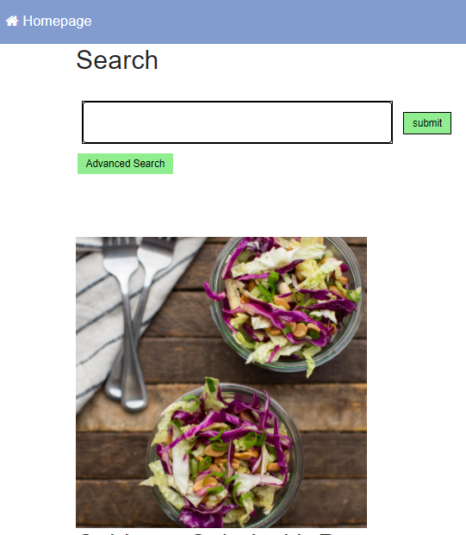
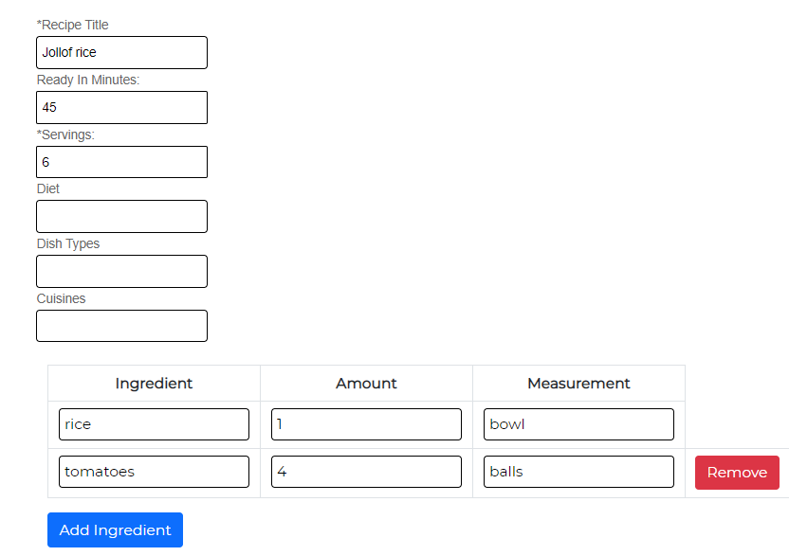
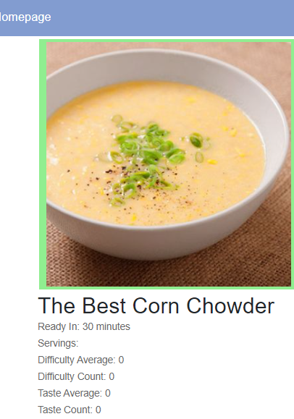
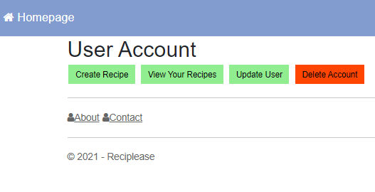
Screenshots of some features
Reciplease 2021

Slide 19
Successes & Challenges
‘Reciplease’ 1.0 is functional and ready for use with a few fixes required; however, there were challenges on this path to success.
Some of these challenges include:
…
….
….
….

Slide 20
Recommendations
For future advancement and an outstanding performance of ‘Reciplease App’, we would like to make the following recommendations:
Ability to share recipes with friends on Facebook, twitter etc.
Ability to save and transfer multiple recipes to Kroger cart at once.
Application can be extended to other API’s for an even more robust recipe database.
…
…
….

Slide 21
Conclusions
Reciplease app is a quick response to users requirements for a cooking app. Its search engine is detailed enough to enable users find the exact recipe they desire. Users are able to create, update, and manage their accounts as well as their own recipes in a form of an organized cookbook.
An interactive platform that also allows for rating, feedback and more uniquely provide users the ability to view the lowest prices of ingredients before the transfer of shopping list to a Kroger cart for an onward Kroger doorstep delivery if required.
Reciplease is indeed a fast and convenient way to enjoy cooking!

Slide 22
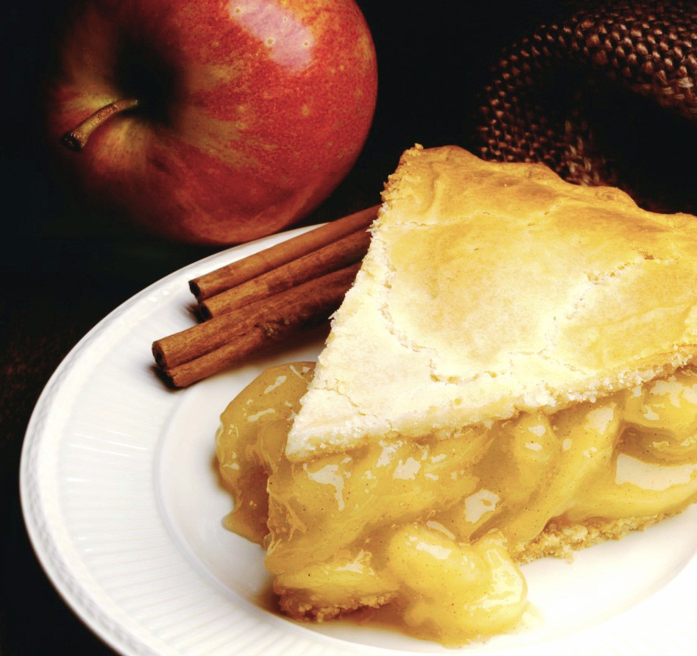
Reciplease
……fast & convenient.
Any questions?

