Slide 1

3D Virtual Reality Painting

Slide 2
Project idea: Create art through movement
VR based motion controls
Create, destroy, modify geometry
Save/Load a scene
Explore the technology

Slide 3
Project Challenges
Developing an as-of-yet unexplored technology
Creating an interface in 3D space
Developing

Slide 4
Challenges of VR
Unexplored field
Requires significant experimentation

Slide 5
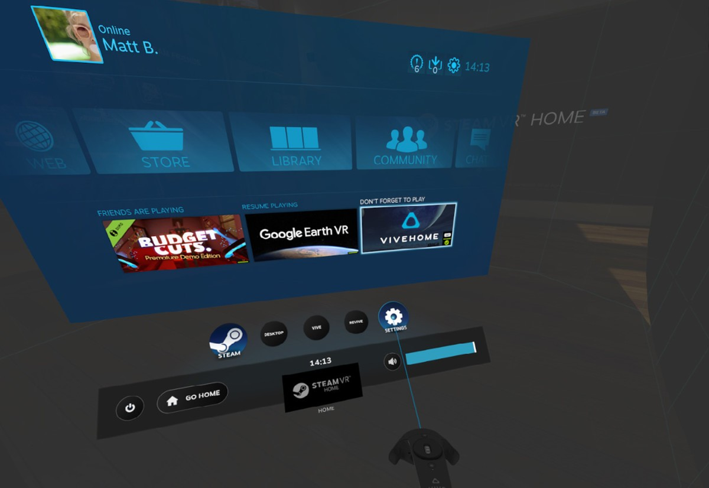
Developing a 3D interface
New Design paradigm
Also requires experimentation

Slide 6
Manipulating Geometry
Dependent on multiple systems
Requires coordination of different components
Has a much more accessible body of reference

Slide 7
Working in uncharted waters
Few points of reference
Exploratory in nature
Will require fast, discrete development cycles

Slide 8
Needs of the project
Run efficiently
Measure movement precisely
Maintain low latency
Freedom to express

Slide 9
VR Hardware Comparison
Oculus
Efficient
Supports native API
Vive
Powerful
Compatibility with Steam VR
Gear VR
Cheap
Compact setup

Slide 10
Tracking Solution
Motion Capture:
Accurate, flexible, scaleable
Large overhead, can cause conflicts in development
Integrated VR System:
Easy for development, supported by existing systems, reliable, reproducible
Not scalable, harder for multiple objects
DodecaPen:
Accurate, low hardware overhead, scalable
No supported system, harder to develop and integrate

Slide 11
User Interface Tools
Unreal:
Large expansive Library, UMG
Only experimental in world space UIs
Unity:
Dedicated VR UI structures, large community
Lots of models to choose from
CryEngine
Game object inheritance
Limited supported VR integration

Slide 12
Geometric Representations
NURBS
Triangles
Voxels

Slide 13
NURBS
NURBS
Spline

Slide 14
Triangles

Slide 15
Voxels

Slide 16
Data Organization
3D Array
Binary Space Partition Tree
Sparse Voxel Octree

Slide 17
3D Array

Slide 18
Binary Space Partition Tree
1
2
2
1
2
2
0

Slide 19
Sparse Voxel Octree

Slide 20
Rendering Method
Ray Tracing
Higher fidelity
More computationally expensive
Voxel Cone Tracing
More efficient
Still allows for dynamic and inter reflection

Slide 21
Scripting Language
C#
Has selective architecture optimization
Most common language for game engine scripting
Large library of code assets
C++
Compiled
Available for Unreal

Slide 22
Graphics API
Khronos
Large, open library
Extensive shader resources
Low level development in Vulkan
DirectX
Efficient device driver support
Has compute shader capability
Powerful rendering

Slide 23
Loading Tool Code
Statically Defined
Dynamic Loading
Code Injection into a Template

Slide 24
Game Engine
Unity
Large library of free assets
Lower learning curve
Lower hardware requirements
Uses C#
Unreal
Powerful renderer
Visual scripting
Uses C++

Slide 25
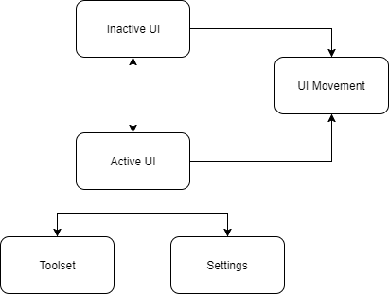
User interface
Movement Options
Inactive State
Active State
Nodes - Page traversal
Elements - Tool access

Slide 26
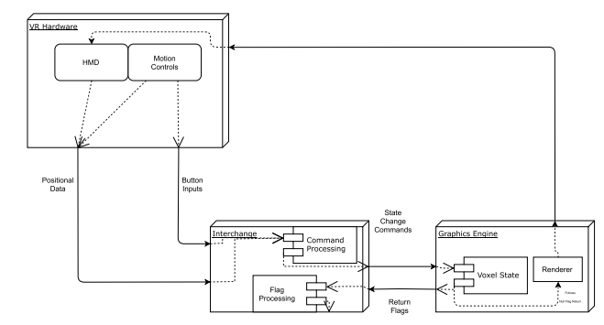
The Interchange

Slide 27
The Voxel State
Holds all of the data representing the virtual environment
Holds additional information to manage this data in memory
Consists of:
Nodes
The Data Buffer
The Head Buffer
The Heap Buffer

Slide 28
Nodes
Byte
? 0
? 1
? 2
? 3
? 4
? 5
? 6
? 7
struct node {
int8 Meta;
int24 Surface;
int32 Attributes[3];
int32 Children[8];
};
0 ?
Meta
Surface
Attribute 0
1 ?
Attribute 1
Attribute 2
2 ?
Child 0
Child 1
3 ?
Child 2
Child 3
4 ?
Child 4
Child 5
5 ?
Child 6
Child 7

Slide 29
The Data Buffer
Initial State
Heap 0
Heap 1
...
Heap N
Head 0
Head 1
...
Head N
Node
Node
Node
Node
Node
Node
Node
Node
...
...
…
...
Node
Node
Node
Node
Mid-use State
Heap 0
Heap 1
...
Heap N
Head 0
Head 1
...
Head N
Node
Node
Node
Node
Node
Node
Node
Node
...
...
…
...
Node
Node
Node
Node

Slide 30
The Head Buffer
Head 0
Head 1
...
Head N

Slide 31
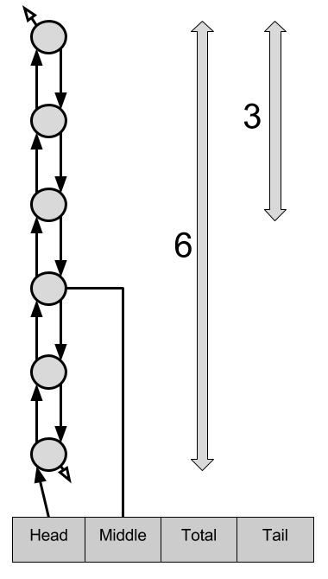
The Heap Buffer
Heap 0
Heap 1
Heap 2
Heap 3
...

Slide 32
Yggdrasil
Voxel State Rendering and Manipulation Engine
Composed of a suite of GPU-native programs:
The Memory Manager
The Tool Executer
The Renderer

Slide 33
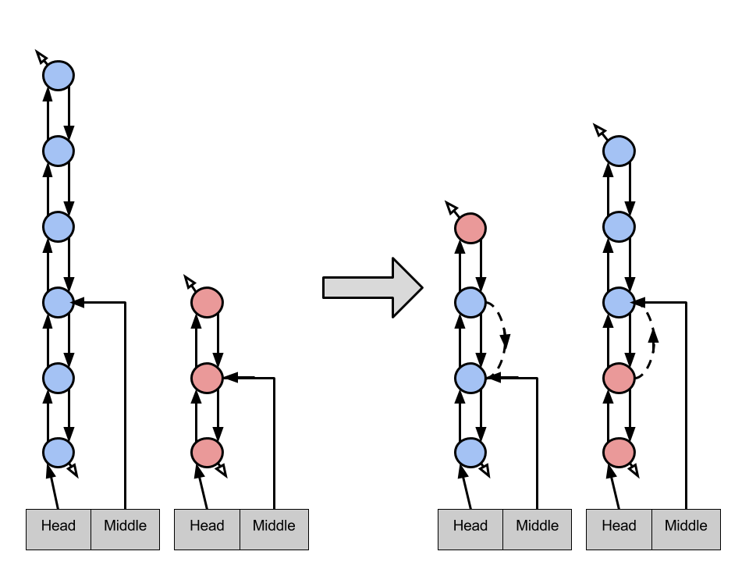
The Memory Manager
110
111
100
101
Swap 0
Swap 1
Swap 2
010
011
000
001

Slide 34
The Tool Executer
Exit
Find the Smallest Voxel Bounding the Stroke
Requires further depth?
Determine New Voxel Data
Nodes Need to Be Freed?
At maximum depth?
Traverse Deeper
Free Nodes
At Root Node?
Yes
No
Injected Code
Node Allocation Required?
Traverse Higher
Allocate Node

Slide 35
The Renderer
Sample 0
Sample 1
Sample 2
Sample 3

Slide 36
HMD Research
Oculus:
Lower hardware demand, API support, good resolution and speed
Small volume tracking space
HTC Vive:
Great resolution, API support, large tracking space and good speed
More performance demand
Gear VR:
Accessible to users
Harder for development

Slide 37
User interface
Movement Options
Inactive State
Active State
Nodes - Page traversal
Elements - Tool access

Slide 38
Future Plans

Slide 39
References
[1] M. Brown. (2017) How to apply skins to your htc vive controllers. [Online]. Available: http://web.archive.org/web/20080207010024/http: //www.808multimedia.com/winnt/kernel.htm
[2] M. Botsch, M. Pauly, C. Rossl, S. Bischoff, and L. Kobbelt, “Geometric modeling based on triangle meshes,” in ACM SIGGRAPH 2006 Courses, ser. SIGGRAPH ’06. New York, NY, USA: ACM, 2006. [Online]. Available: http://doi.acm.org/10.1145/1185657.1185839
[3] D. Santa-Cruz and T. Ebrahimi, “Coding of 3d virtual objects with nurbs,” Signal Processing, vol. 82, no. 11, pp. 1581 – 1593, 2002. [Online]. Available: http://www.sciencedirect.com/science/article/pii/S0165168402003031
[4] B. Naylor, “Binary space partitioning trees as an alternative representation of polytopes,” Computer-Aided Design, vol. 22, no. 4, pp. 250–252, 1990.
[5] C. L. Jackins and S. L. Tanimoto, “Oct-trees and their use in representing three-dimensional objects,” Computer Graphics and Image Processing, vol. 14, no. 3, pp. 249–270, 1980.
[6] T. K. G. Inc. (2017) Shader compilation. [Online]. Available: https://www.khronos.org/opengl/wiki/Shader Compilation
[7] “Cryengine,” http://docs.cryengine.com/display/CEMANUAL/VR+Support, accessed: 2017-11-21.
[8] “Unity,” https://docs.unity3d.com/Manual/index.html, accessed: 2017-11-21.
[9] “Unreal,” https://docs.unrealengine.com/latest/INT/l, accessed: 2017-11-21.

Slide 40
References
[10] B. Cuneo, C. Bakkom, R. Cunard: CS Capstone Problem Statement, VR Painting Application. Oregon State University, 20 Oct, 2017.
[11] B. Cuneo, C. Bakkom, R. Cunard: CS Capstone Requirements Document, VR Painting Application. Oregon State University, 3 Nov, 2017.
[12] R. Cunard. CS Capstone Technology Review, VR Painting Application. Oregon State University, 21 Nov, 2017.
[13] C. Bakkom: CS Capstone Technology Review, VR Painting Application. Oregon State University, 21 Nov, 2017.
[14] B. Cuneo: CS Capstone Technology Review, VR Painting Application. Oregon State University, 21 Nov, 2017.
[15] B. Cuneo, C. Bakkom, R. Cunard: CS Capstone Design Document, VR Painting Application. Oregon State University, 1 Dec, 2017.

