Slide 1

End-of-Term Winter Progress Report

Slide 2
Where we are at
Generates geometry
Saves and loads data
Navigate the virtual scene

Slide 3
Next Steps
Increase efficiency
Improve visuals
Build a better UI
Hit our stretch goals

Slide 4
Managing disparate systems
My main challenge has been to connect my group mates’ systems together
Eventually it became clear we would have a front end long before we had a back end
I had to improvise

Slide 5
What ended up happening with the shader
Braxton saw continuous technical setbacks
In order to move forward, his ray tracer had to become much less complex
This made my job easier

Slide 6
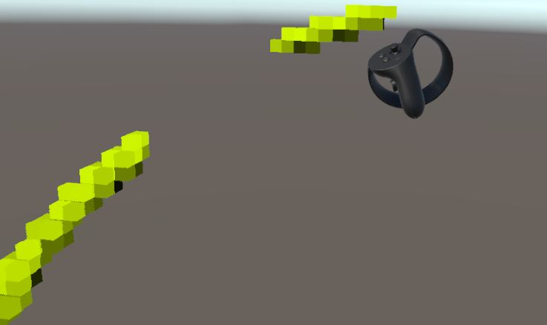
VR Controls
With Chris’ event handler, nearly any functionality could be controlled by a user

Slide 7
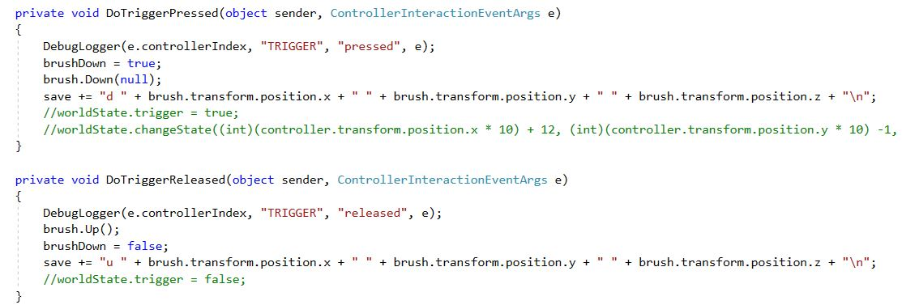
Handling brush strokes

Slide 8
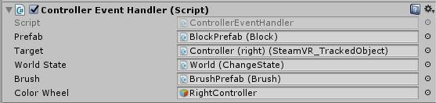
Additional Features
Due to time constraints, I put together the save/load in a very simple manner
We plan to have a better implementation following our beta
The RightController object itself contains the Controller event handler

Slide 9
Front End
Modular UI Cubes
VR Event handler
Simplified color picker

Slide 10
Modular UI cubes
UI cube manager to slot all accessible UI panes
Each cube running its own script
Panes are independent expressing their own functionality

Slide 11
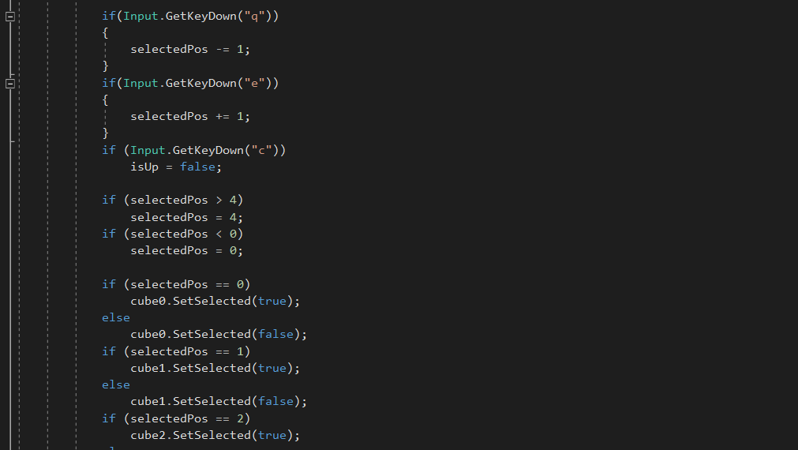

Slide 12
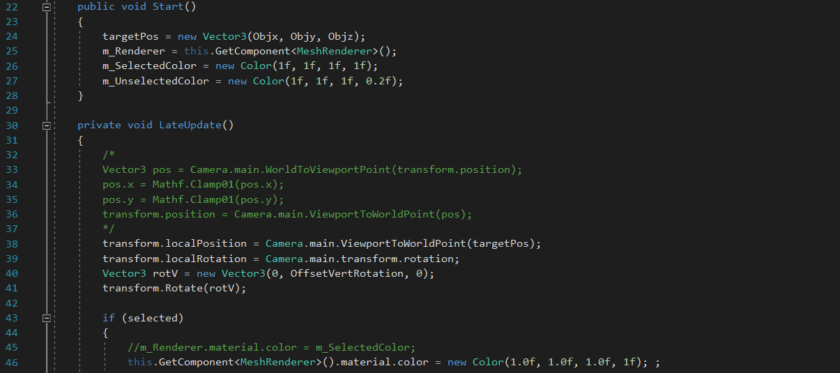

Slide 13
VR Event Handler
Tracking all the event broadcasted by the VR system
Custom code executed upon event

Slide 14
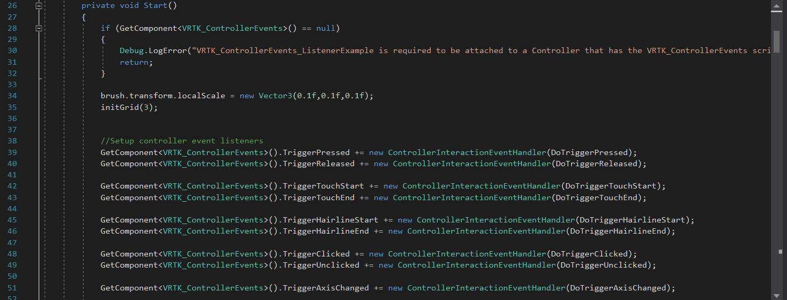

Slide 15
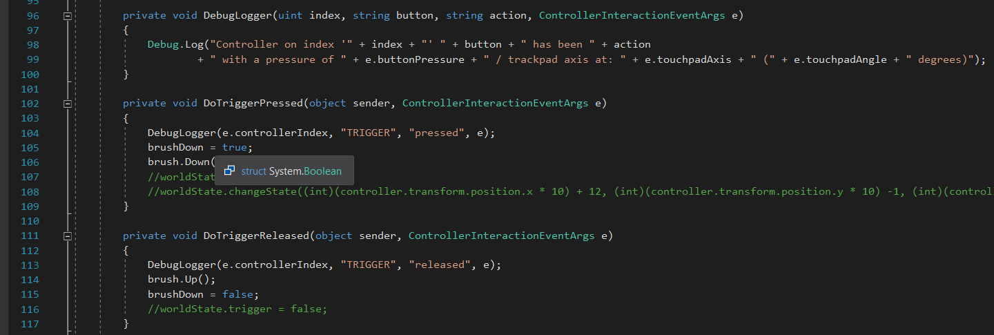

Slide 16
Simplified Color Picker
Started with all color features
Then condensed down to two controls

Slide 17
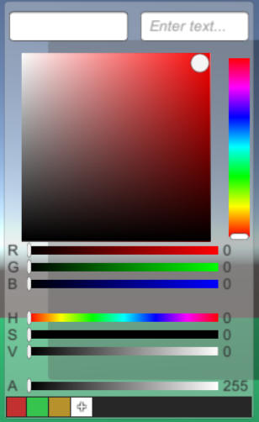
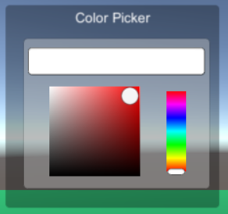

Slide 18
Where the front end is now
All required buttons are accessible
Hook up color picker to controllers
Polish and position elements for VR headset
Add in additional features.

Slide 19
The Back End

Slide 20
Problems - GLSL Support in Unity
Unity documentation states there is GLSL support for compute shaders
Unity does not have support for GLSL in compute shaders

Slide 21
Solution - Translation to HLSL
HLSL is the default shading language in Unity
HLSL is somewhat similar to GLSL

Slide 22
Problem - Data Buffer Typing
RWBuffer is the simplest Read-Write buffer in HLSL
Unity makes RWStructuredBuffer its default
Soft fails made debugging difficult

Slide 23
Solution - Changing Buffer Types
Simply change buffer types

Slide 24
Problem - Discrepancies in Resource Management
Occurred when verifying correctness of resource management code
The same memory was accessed by multiple processes
Other threads had no memory
Simplifying the code did not reveal the error

Slide 25
The Atomic Sanity Test
[numthreads(GROUP_SIZE, 1, 1)]
void main(uint3 _id : SV_DispatchThreadID) {
// Get thread ID
id = _id.x;
uint X = id;
uint div = 4;
uint lim = THREAD_COUNT / div;
uint A;
uint B;
uint count;
// Give single-element buffer a dummy value
if (id == 0) {
//storeHeap(0, NOT_THERE);
atomicSwapHeap(0, NOT_THERE, B);
}
// Memory sync
DeviceMemoryBarrierWithGroupSync();
// Perform atomic swap across all threads
A = X;
atomicSwapHeap(0, A, B);
X = B;
// Another memory sync
DeviceMemoryBarrierWithGroupSync();
// Store last value remaining in the buffer into the output buffer
if (id == THREAD_COUNT-1) {
B = loadHeap(0);
storeExchange(THREAD_COUNT, B);
}
// Store all swapped values into the swap buffer
storeExchange(id, X);
// One last memory sync to ensure writes are flushed
DeviceMemoryBarrierWithGroupSync();
}
Checks for basic preservation of information
Performs one atomic swap per thread
Values duplicated or destroyed
Atomic operations don’t work

Slide 26
Problem - Yggdrasil is Infeasible
Without atomic operations, resource management is too slow to use
Without resource management, Yggdrasil cannot perform basic actions
Too many more potential bugs to deal with
Too little time

Slide 27
Solution - A New Back End
Applying simplest practical methods
Storage : 3D read-write textures
Brush execution : Compute shaders on a per-texture basis
Rendering : Ray-tracing with periodic samples
Display : Rendered onto blocks
Brush interface : Object-based positioning

Slide 28
Brush API
PerformBrush : Takes all non-block parameters of brush shader and applies to all applicable blocks
BrushDown : Starts recording brush state, stores current shader
BrushUp : Clears current shader and stops recording state
Stroke : Uses current and previous brush state for operation

Slide 29
Beta Demo

Slide 30
Conclusion

Slide 31
Current State
Meets all basic requirements
Create, destroy, and modify geometry
Save and load functionality
Far from perfect
Can reach 90 FPS
Frame rate bogs at large canvas sizes
Maximum canvas size:
2x2x2 m
1.5 cm voxels
Strong aliasing

Slide 32
Future Plans
Optimize systems
Refine the ray tracer using a raster-line approach
Multiple levels of detail in voxel data
Stretch Goals
Improve User Interface
More realistic lighting effects

Slide 33
Works Cited

